Slide 1
ERCOT Frequency Control Report
June 2019
ERCOT
Operations Planning
PDCWG | July 18th, 2019

Slide 2
Summary of June 2019
CPS1: 174.62%
Current CPS1 12-Month Rolling Average: 174.28%
0 BAAL Exceedances
2 hourly CPS1 scores below 100%
BAAL-003 Events have updated through 2018
2018 BAAL-003 FRM Performance: -843.17
2019 RMS1 Statistics
  Mean: 15.07 mHz
  Min: 13.38 mHz
  Max: 17.94 mHz
Energy Statistics
  Total Energy: 35,157,820 MWh
  Wind Energy: 5,771,138 MWh
  Percent Energy from Wind Generation: 16.41%
Minimum System Inertia
  Mean: 255,097
  Max: 281,561 on Jun 19th
  Min: 195,835 on Jun 14th

Slide 3
Frequency Control
CPS1, BAAL, & RMS1

Slide 4
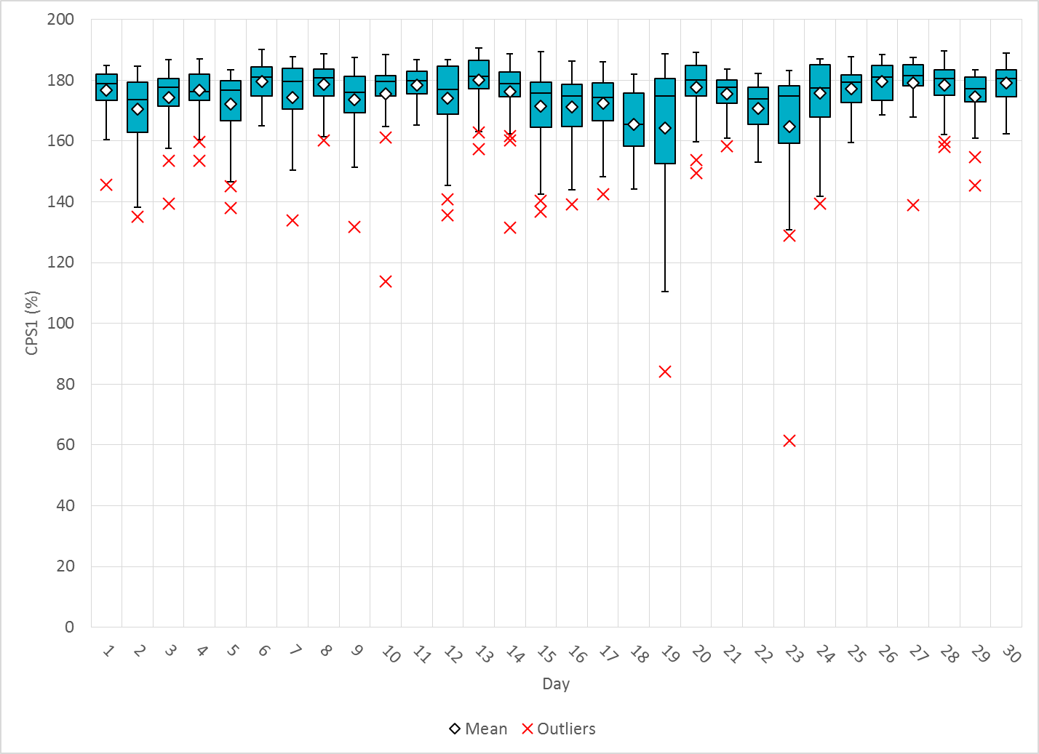
Hourly CPS1 by Day
Jun-19 CPS1 (%): 174.62
Notes:
Outliers:
6/23/2019 13:00 64%
Large expected generation deviation from conventional and wind at the middle of the hour.
6/19/2019 19:00 84.%
Large expected generation deviation from conventional and wind at the beginning and the end of the hour.

Slide 5
BAAL Exceedances & Violations
There were 0 BAAL exceedances in June

Slide 6
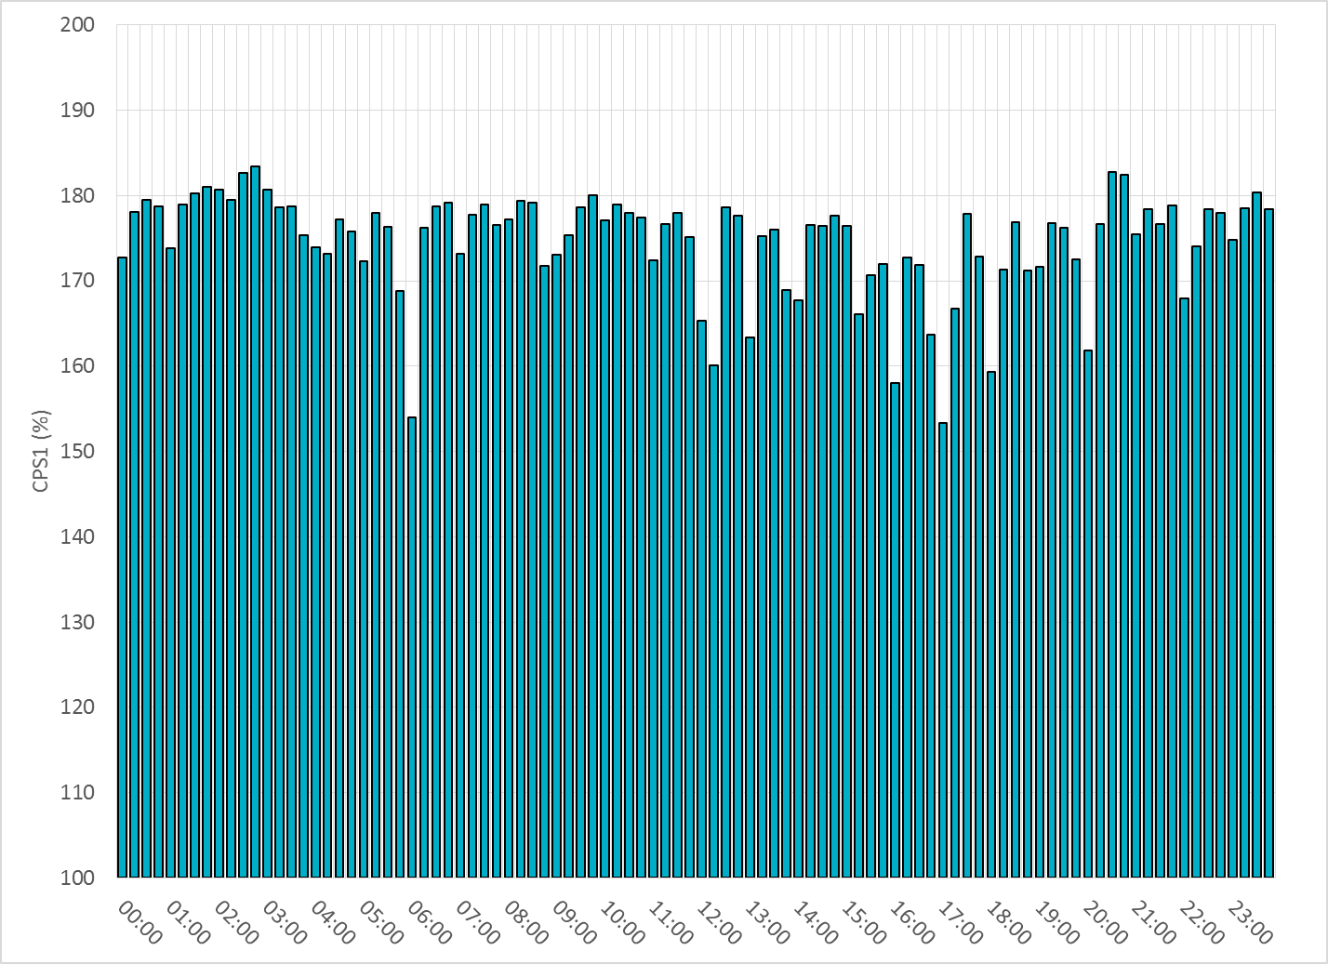
15-Minute Average CPS1%
Jun-19 CPS1 (%): 174.62

Slide 7
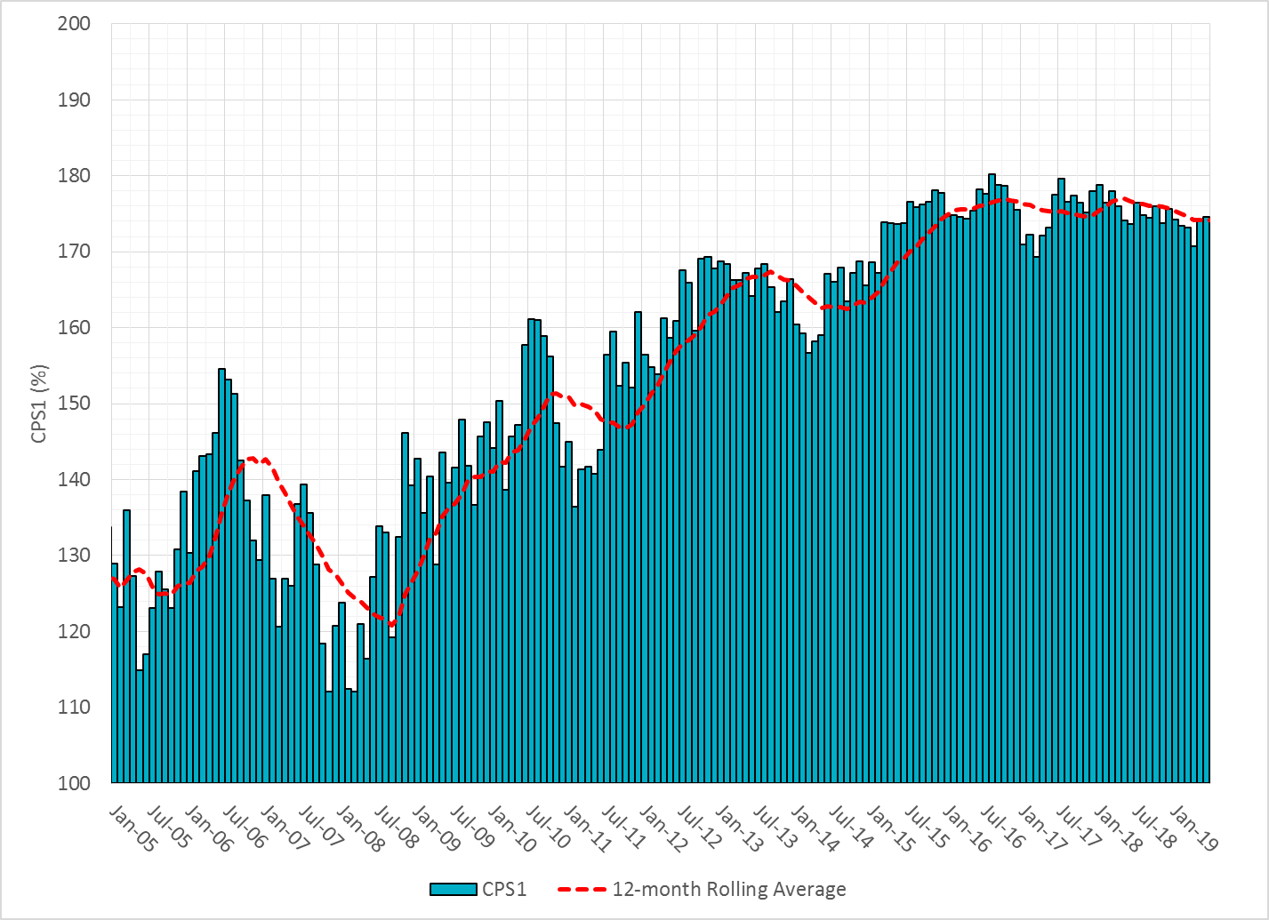
12-Month Rolling Average CPS1
Current 12-Month Rolling Average: 174.28%

Slide 8
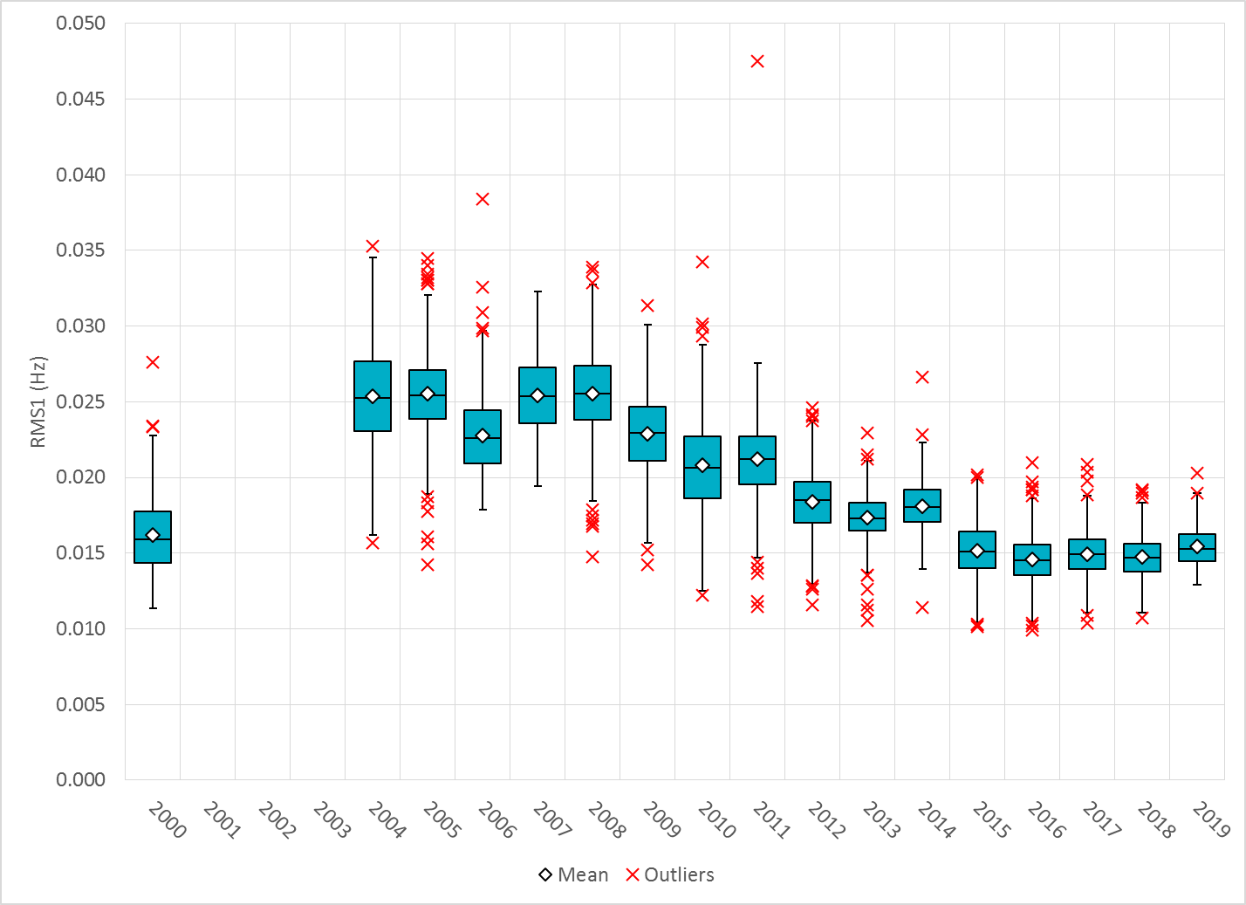
Daily RMS1 of ERCOT Frequency by Year
Notes:
Mean is 15.07 mHz

Slide 9
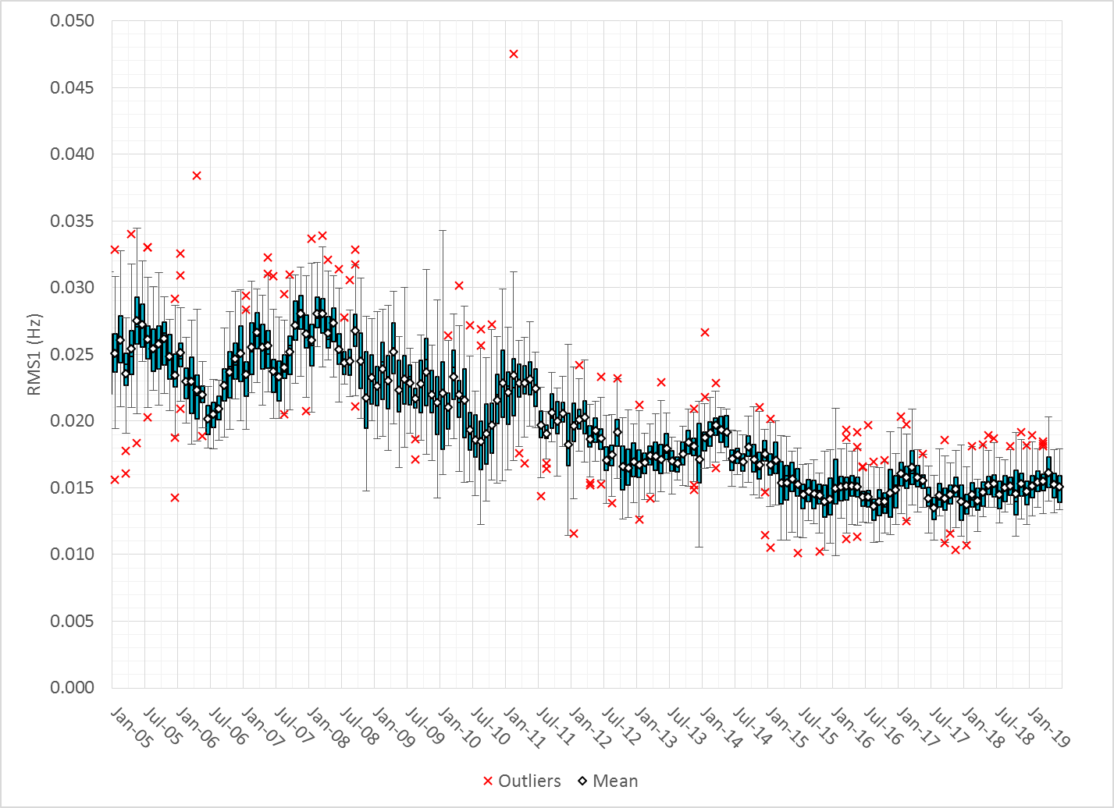
Daily RMS1 of ERCOT Frequency by Month

Slide 10
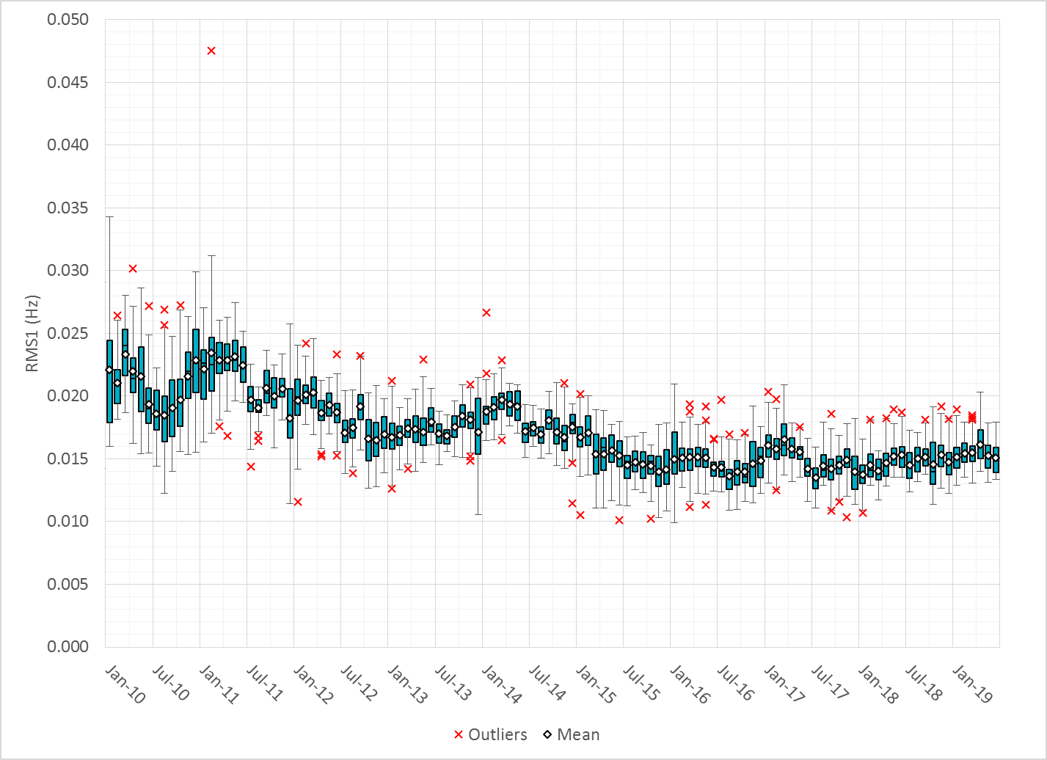
Daily RMS1 of ERCOT Frequency by Month
Notes:
Mean: 15.07 mHz
Min: 13.38 mHz
Max: 17.94 mHz

Slide 11
Frequency Profile Comparison

Slide 12
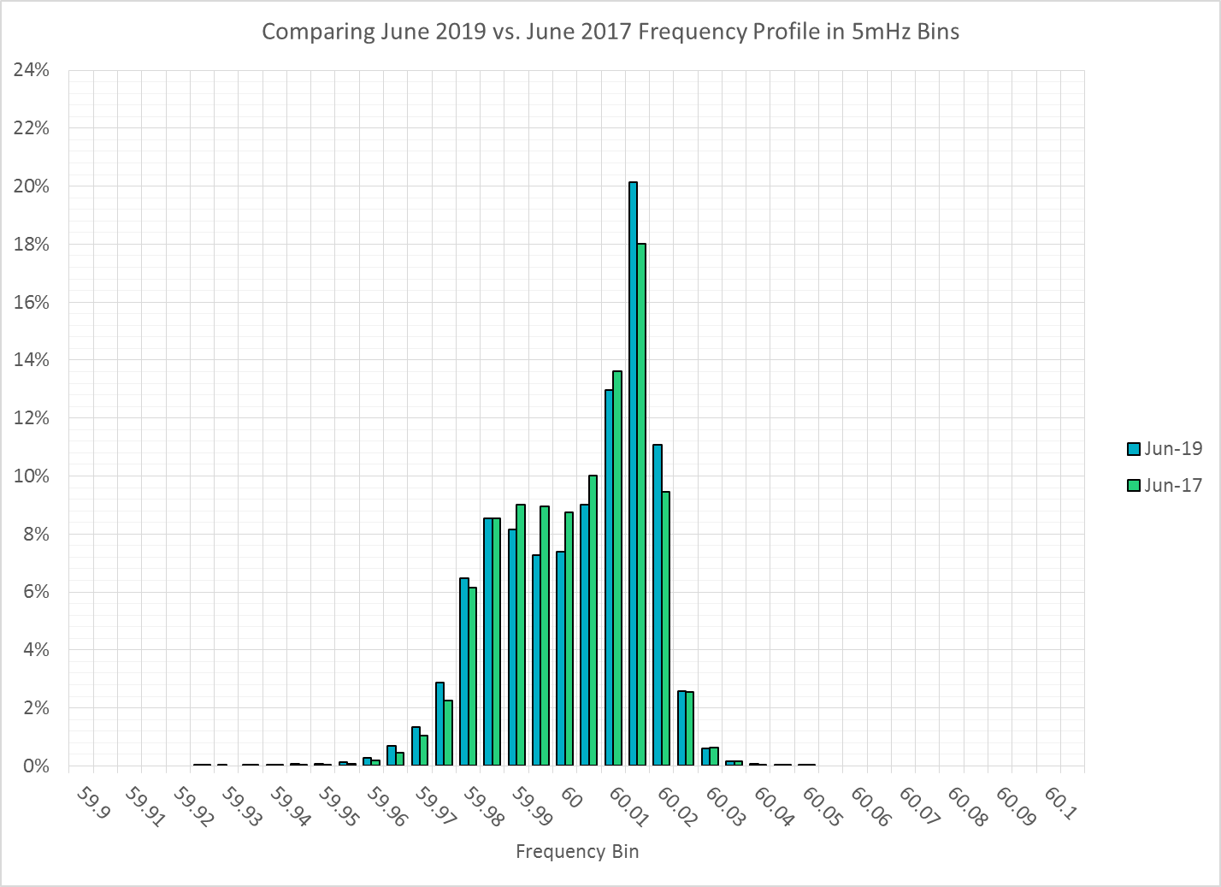
Frequency Profile Comparison

Slide 13
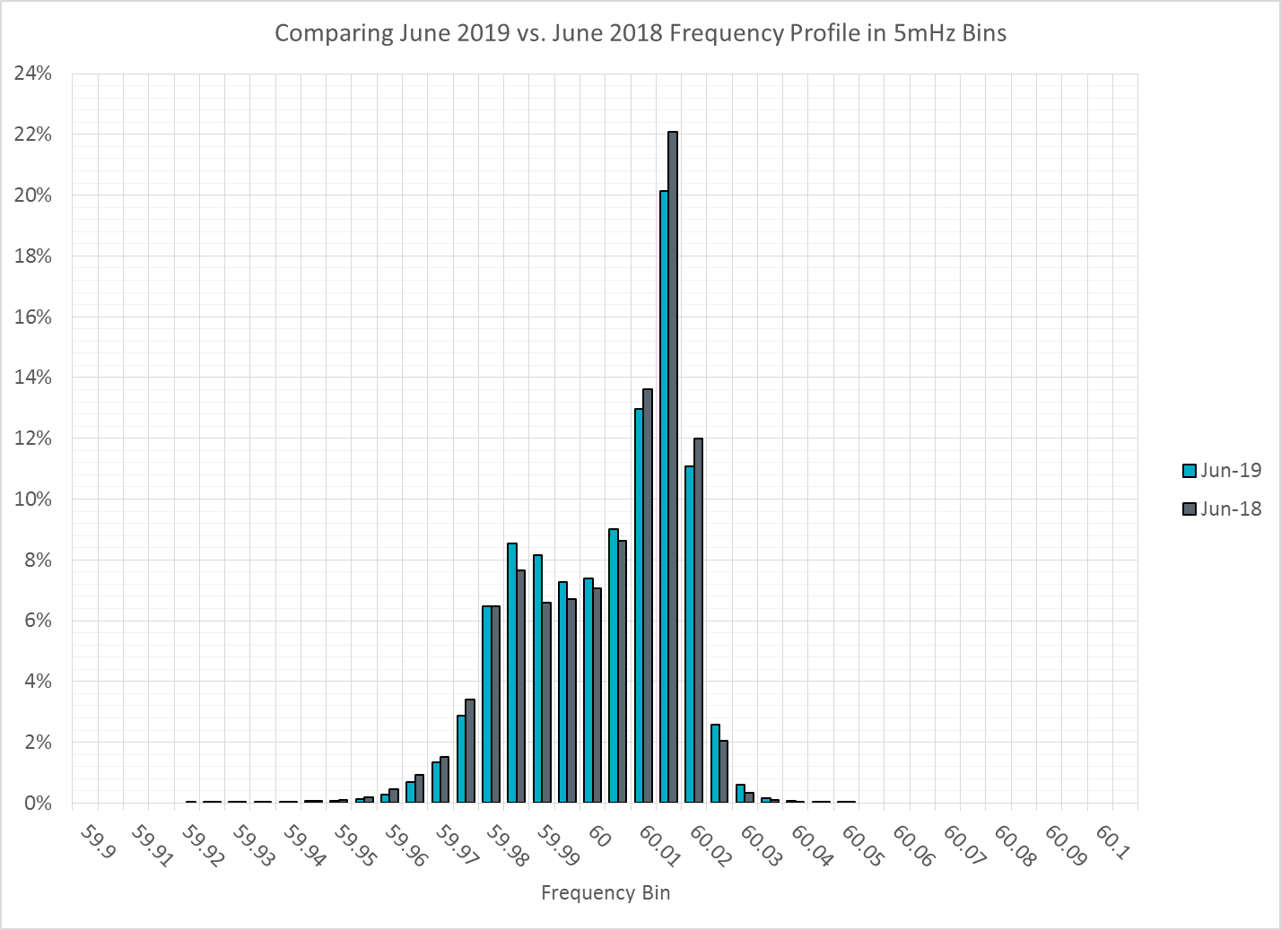
Frequency Profile Comparison

Slide 14
Time Error Correction

Slide 15
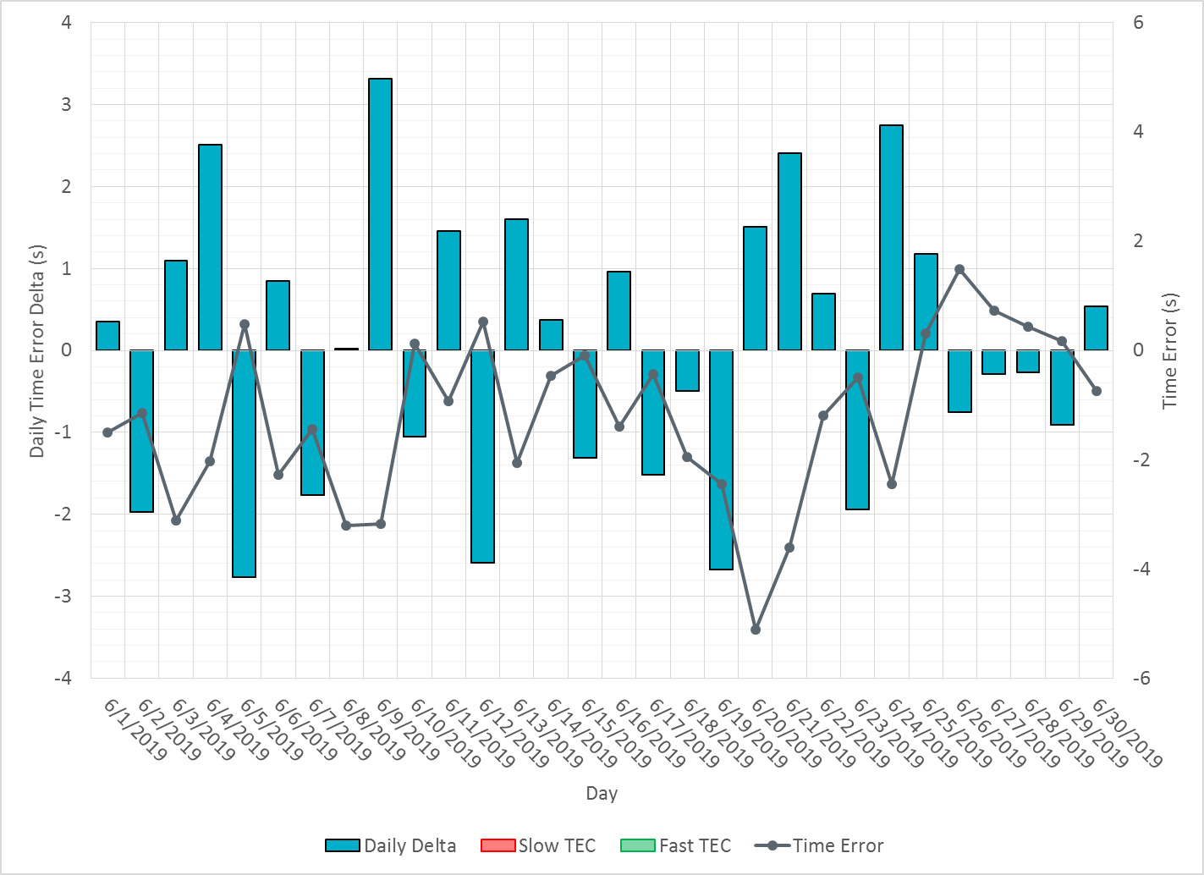
ERCOT Daily Time Error

Slide 16
Time Error Corrections Log Summary
There have been no time error corrections since December 2016

Slide 17
BAL-003 Performance

Slide 18
Op. Year 2018 BAL-003 Selected Events – Update
Notes:
BAL-003

Slide 19
Op. Year 2018 BAL-003 FRM Performance - Update

Slide 20
ERCOT Energy Statistics

Slide 21
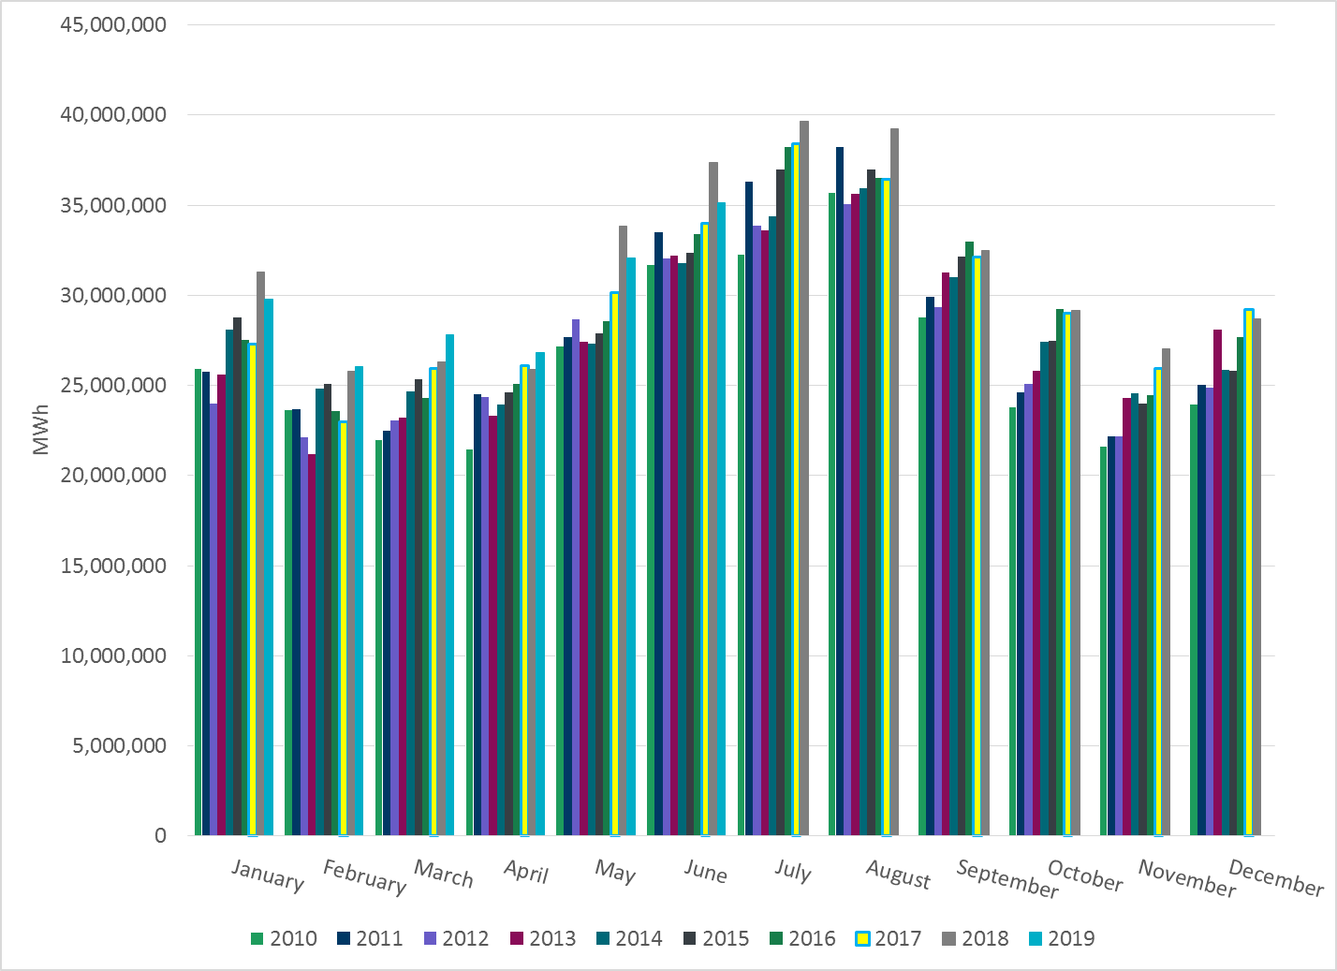
Total Energy
Notes:
35,157,820 MWh

Slide 22
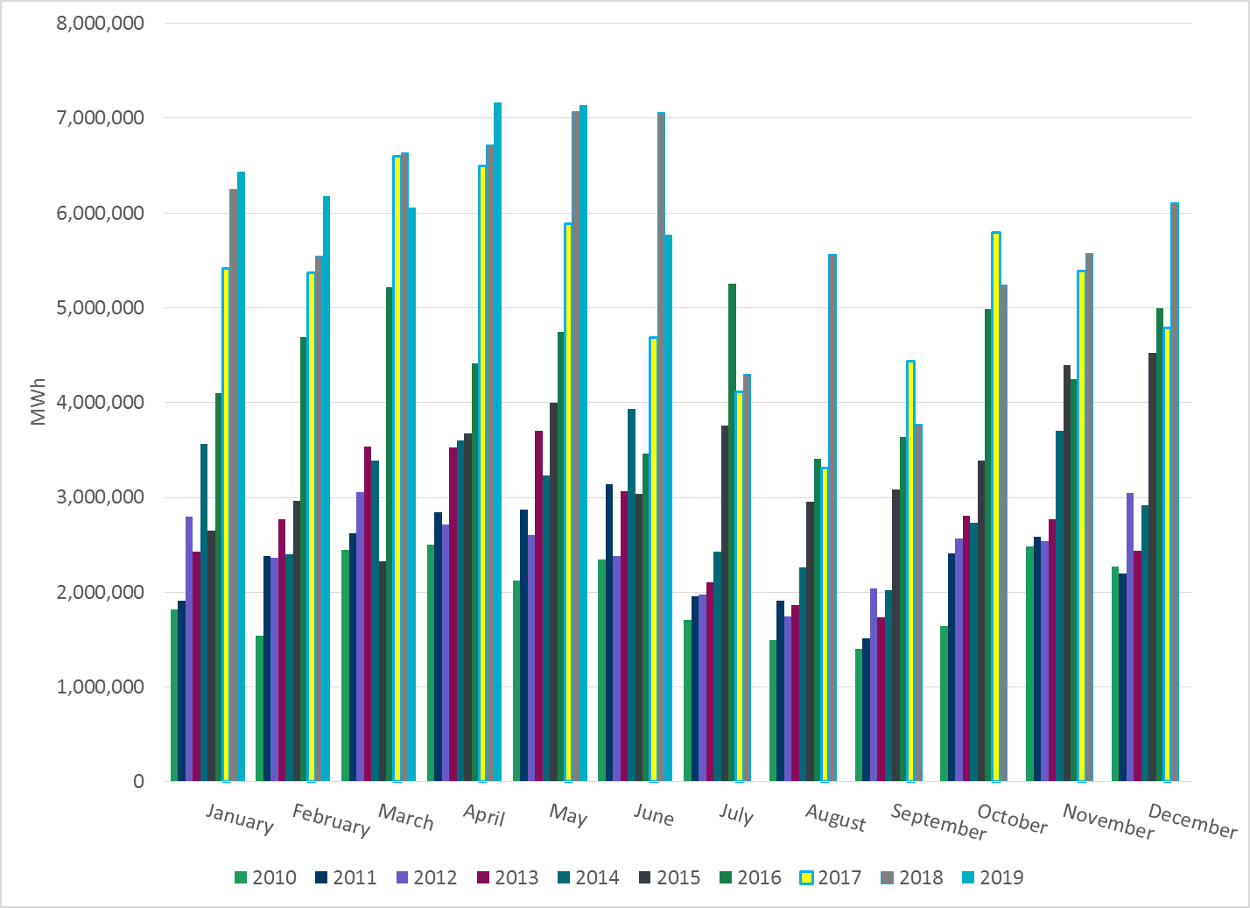
Total Energy from Wind Generation
Notes:
5,771,138 MWh

Slide 23
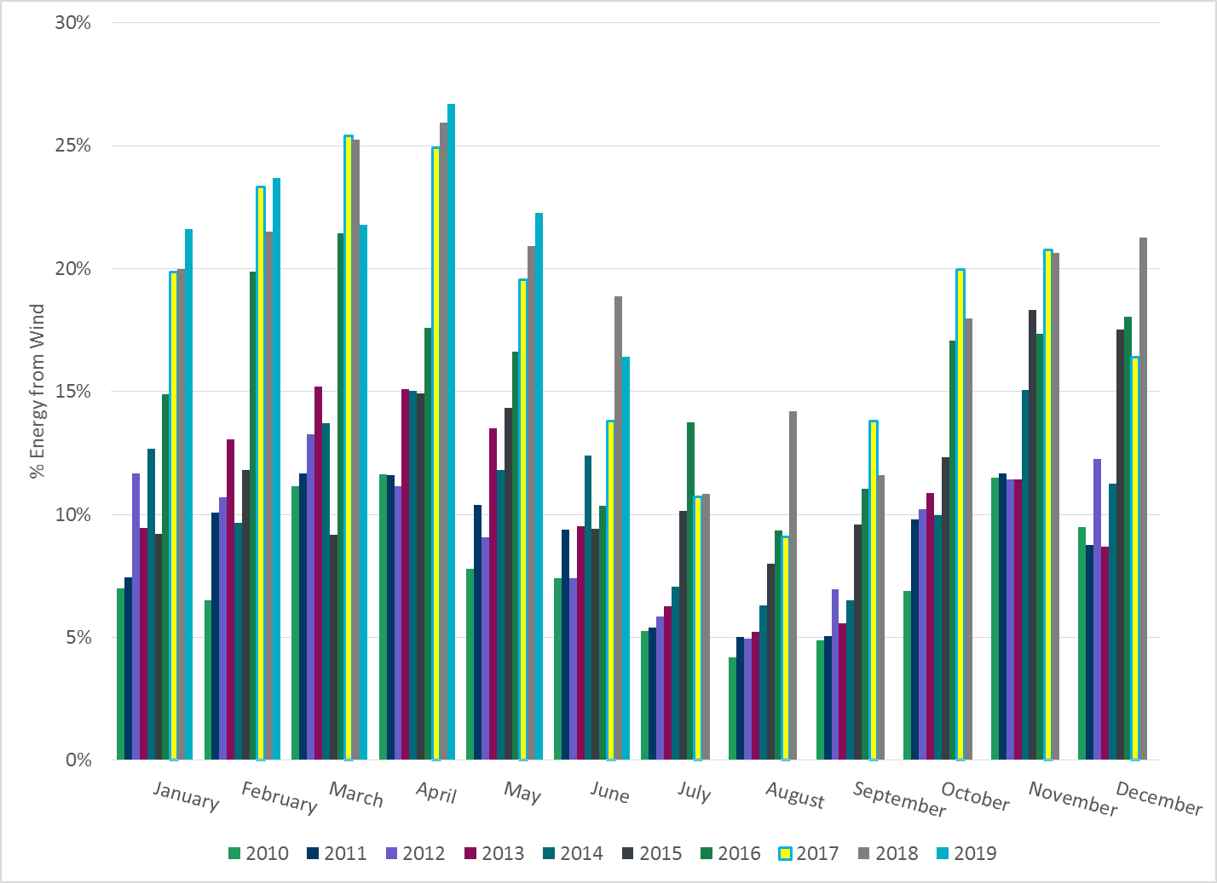
% Energy from Wind Generation
Notes:
16.41%

Slide 24
ERCOT System Inertia

Slide 25
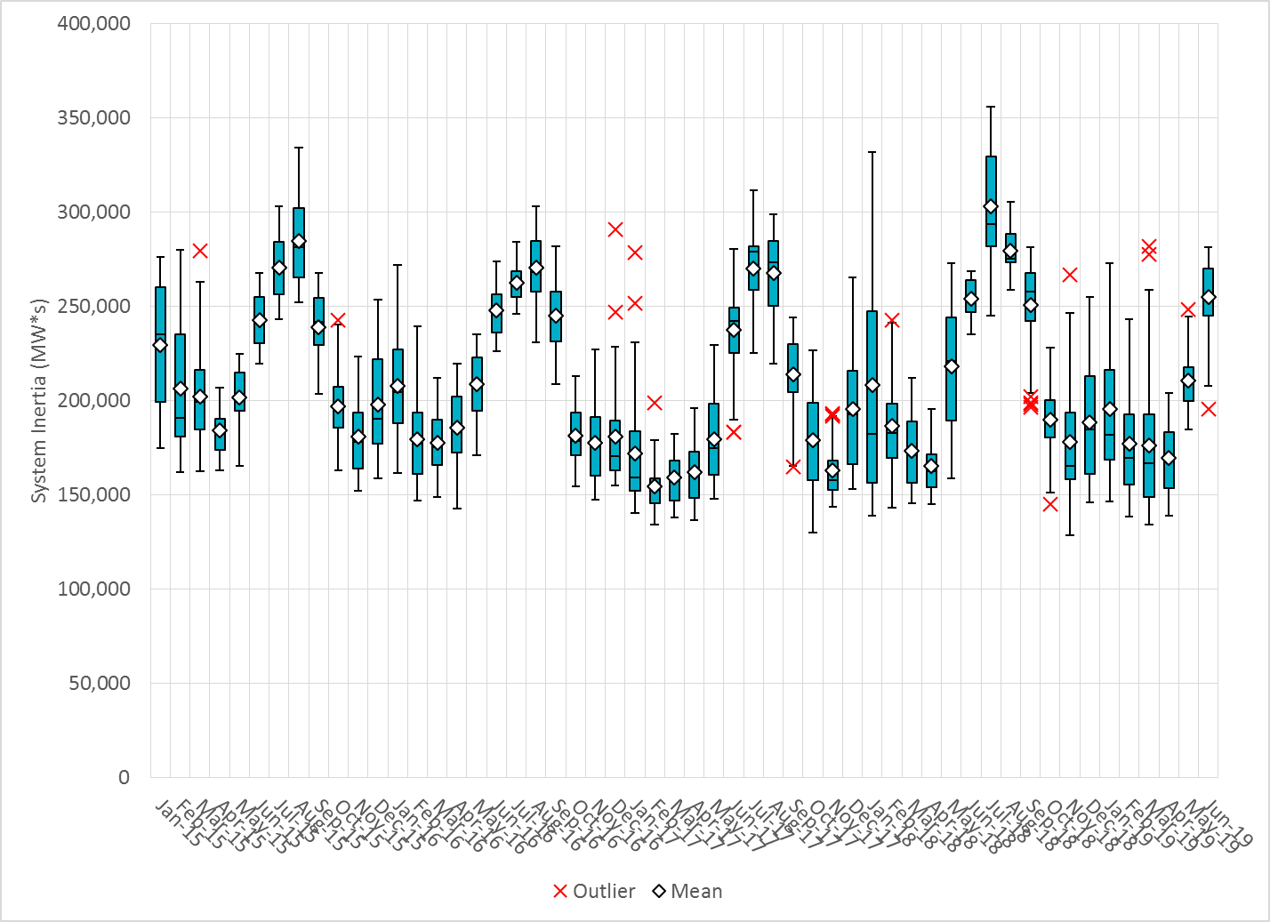
Daily Minimum System Inertia
Notes:
Minimum Inertia = 128,759 MW*s on 11/3/2018.
Previous Minimum was 130,014 MW*s on 10/27/2017. This was also our record wind day.
Data:
Mean: 255,097
Max: 281,561 on Jun 19th
Min: 195,835 on Jun 14th

Slide 26
Questions?
Thank you!

