Slide 1
Intra-Hour Wind Forecast Accuracy Updates (July 2019)
WMWG
Operations Analysis
July 22, 2019

Slide 2
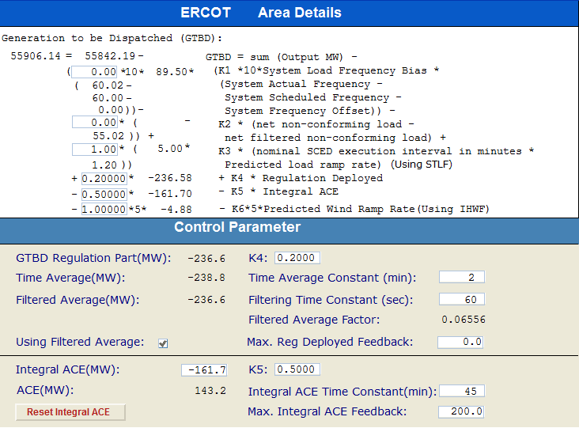
Current GTBD Parameters
Historical K factor tuning events:
No changes since 5/22 when ACE feedback components were increased
Notes:
3/12/18 – Integral ACE Time Constant Changed from 60 min to 45 min
5/17/18 – K4 Changed from 0.3 to 0.2 and K5 Changed from 0.4 to 0.5
12/4/18 – 10:05 AM – K6 Changed from 0 to 0.5
2/12/19 – 2:15 PM – K6 changed from 0.5 to 1.0
3/12/19 – 2:10 PM – PWRR Threshold from 10 to 15 MW/min
3/19/19 – 2:15 PM – PWRR Threshold from 15 to 20 MW/min
4/01/19 – 10:00 AM – K5 changed from 0.5 to 0.4 and Max. Integral ACE Feedback changed from 250 to 150
4/24/19 – 1:15 PM – Max. Integral ACE Feedback changed from 150 to 160. PWRR Threshold changed from 20 to 25.
5/22/19 – 1:10 PM – K5 changed from 0.4 to 0.5. Max. Integral ACE Feedback changed from 160 to 200. PWRR Threshold changed from 25 to 30.

Slide 3
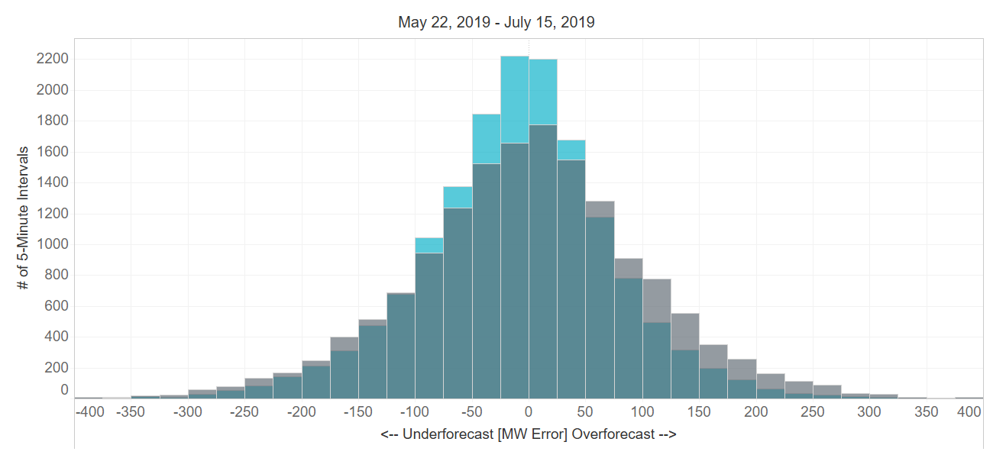
Projected Wind Ramp Rate (PWRR) Error
Performance Metric | SCED PWRR (12/4 – 5/22) | Persistence Ramp* (12/4 – 5/22) | SCED PWRR (5/22 –7/15) | Persistence Ramp* (5/22 – 7/15)
Monthly MAE (MW) | 66 | 75 | 65 | 80
Monthly MAE when 5-Min. Wind Ramp > 100 MW | 121 | 162 | 119 | 163
SCED PWRR
Persistence Ramp*
* Persistence Ramp assumes using a 0 MW wind ramp in PWRR

Slide 4
Appendix The following slides were presented at July PDCWG

Slide 5
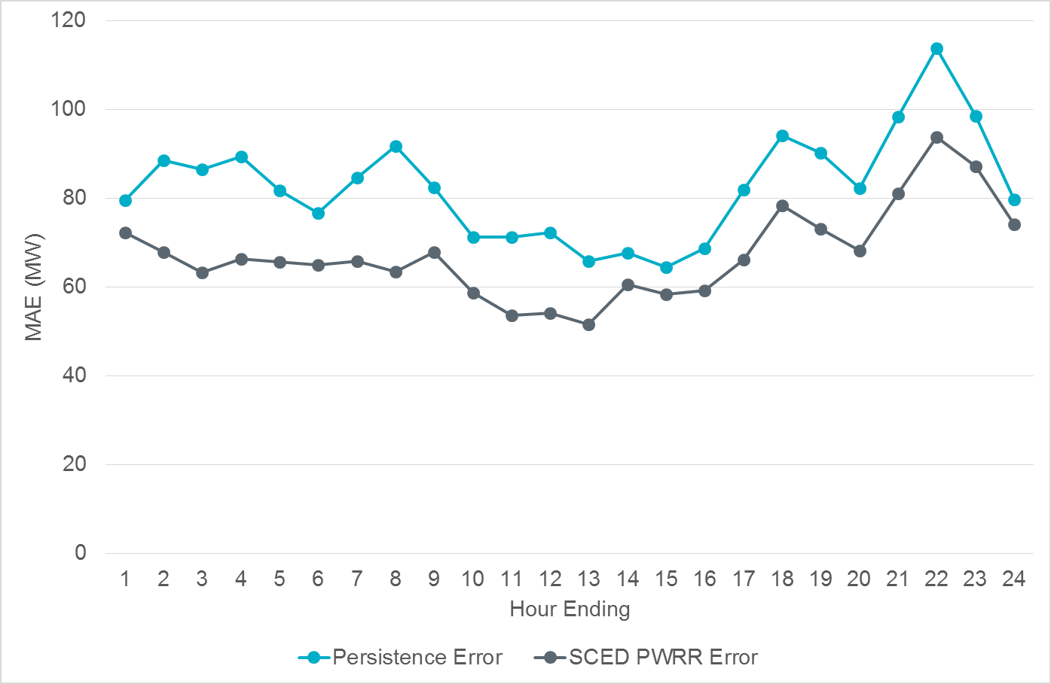
Intra-Hour Wind Ramp Forecast Error (June 2019)

Slide 6
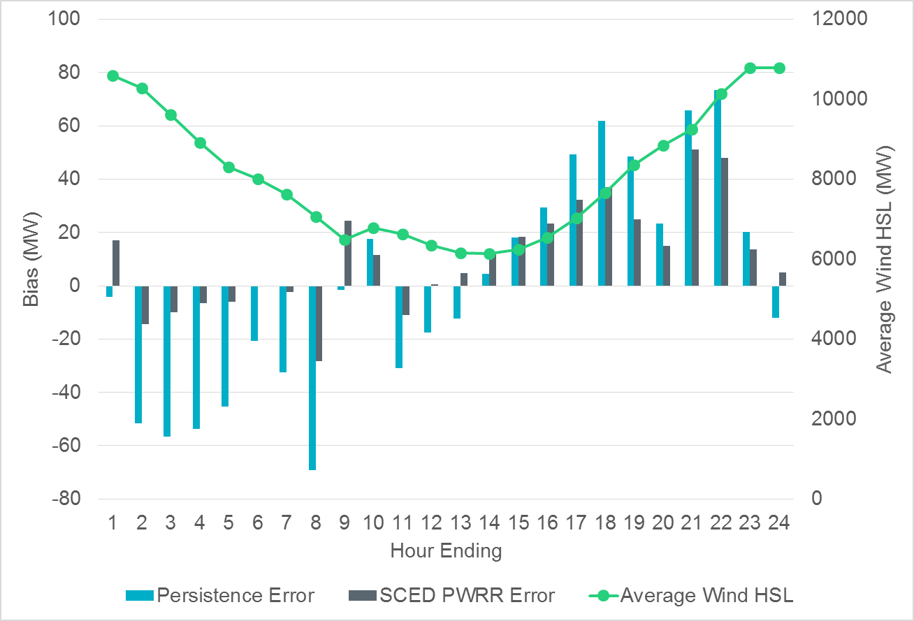
Intra-Hour Wind Ramp Forecast Error (June 2019)

