Slide 1
2020 Long-Term System Assessment Survey Results
July 2019
RPG Meeting
Notes:
Welcome to

Slide 2
Background
ERCOT presented initial input assumptions and preliminary results for the 2020 LTSA at the May RPG meeting:
  http://www.ercot.com/content/wcm/key_documents_lists/165286/2020_LTSA_Input_Assumptions_Initial_Data_and_Preliminary_Results_withSurvey.pptx
Following the May RPG meeting ERCOT solicited stakeholder feedback via an online survey
This presentation covers the results of that survey and subsequent changes made to the initial assumptions for the Current Trends Scenario

Slide 3
Respondents
16 individual responses received from 12 separate entities
Respondents represent a broad range of perspectives (Municipal, Cooperative, IOU-TSP, IOU-Generator, IOU-REP, Consumer/ Interest Groups)

Slide 4
Survey Results: Current Trends Scenario
The second page of the survey was designed to gather feedback on the assumptions used in the 2020 LTSA Current Trends Scenario

Slide 5
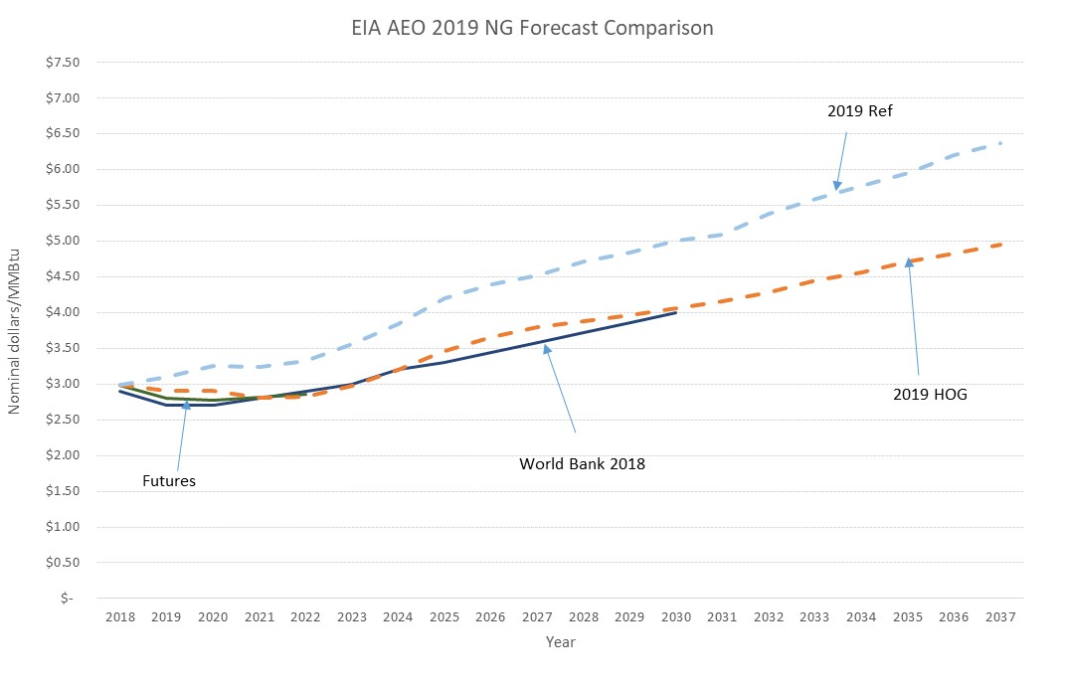
Survey Results: Natural Gas Price Assumption
Respondents were split on whether to use 2019 EIA AEO Reference Case or High Oil and Gas Resource and Technology Case
ERCOT will use Reference Case for 2020 LTSA Current Trends Scenario

Slide 6
Survey Results: New Unit Capital Cost Assumptions
Most respondents agreed or had no opinion on new unit capital cost assumptions
One comment that wind capital cost assumption was too high
  ERCOT has revised wind capital cost assumptions down based on provided references (see Appendix)
ERCOT also received follow up information for fossil fuel capital costs

Slide 7
Survey Results: Environmental Regulations
Most respondents agreed or had no opinion with the assumption to include no new environmental regulations in the Current Trends Scenario
Three responses favored adding regulations:
  “In light of recent severe air pollution episodes in Houston and growing public concern about climate change, new environmental regulations are inevitable.”
  “Suggest assume something like H.R. 763 is passed with a gradually increasing price on CO2 emissions beginning at $15/ton in 2022 and then increasing $10/ton per year thereafter.”
  “We anticipate some kind of carbon tax although not during the current administration. We are using 2028 as a proxy for some kind of burden on fossil.”

Slide 8
Survey Results: DER
Most respondents agreed with ERCOT’s DER assumptions
2 expressed desire to see higher solar DER growth
1 expressed desire to see higher natural gas DER growth

Slide 9
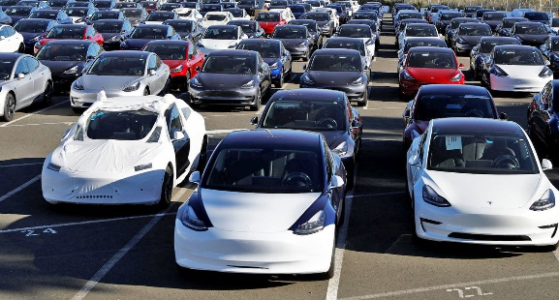
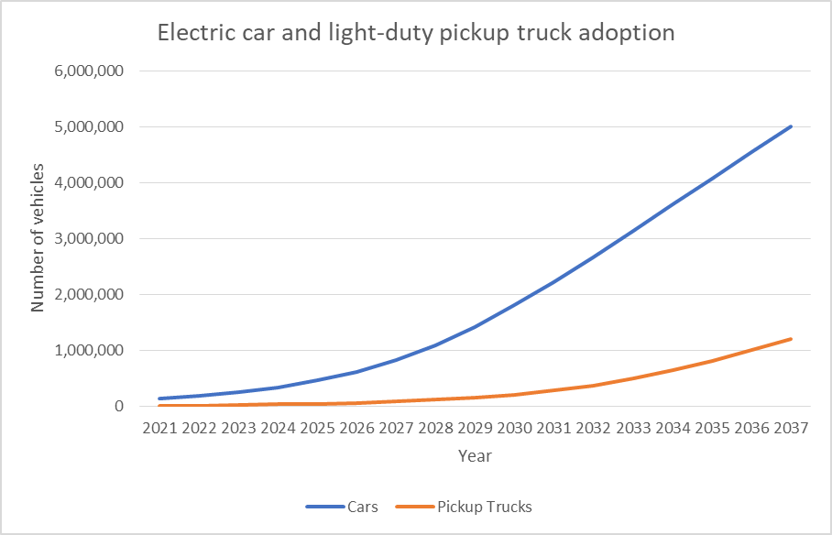
Survey Results: Electric Vehicle Adoption
Most respondents agreed with the assumption of 4 million electric cars and 800,000 electric light trucks by 2035
2.5 thought the numbers were too high
1 thought the numbers were too low

Slide 10
Survey Results: Generation Retirement
Most respondents did not agree with the assumption of having no fixed-aged retirements
Based on the feedback ERCOT has added the following fixed-aged retirement assumptions:
  Natural gas unit: 60 years old (~11 GW by 2035)
  Coal unit: 45 years old (~10 GW by 2035)
Oklaunion and two Decker units taken offline in Current Trends as well

Slide 11
Survey Results: Storage Assumptions
Responses regarding the question of how to improve storage modeling varied
  Some felt results were consistent with their in-house analysis (no significant storage adds)
  Some felt that some storage should be added
  No noteworthy references were provided

Slide 12
Summary of Current Trends Changes
Based on the survey feedback, ERCOT will make the following changes to the Current Trends Scenario assumptions:
  Use 2019 EIA AEO Reference Case natural gas price
  Adjust new unit capital cost assumptions
  Use fixed-age retirements for natural gas and coal units

Slide 13
Survey Results: Scenario Analysis
The last page of the survey was designed to gather input for determining other scenarios to study for the 2020 LTSA

Slide 14
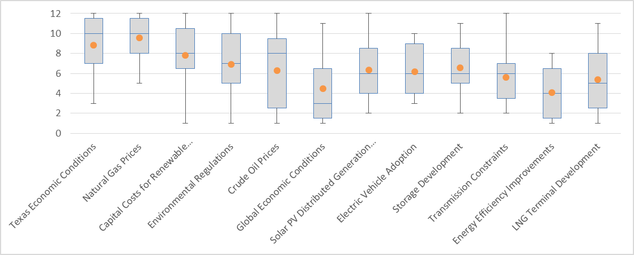
Survey Results: Long-Term Drivers
Drivers ranked 12 (highest impact) to 1 (lowest impact)
Other drivers: Federal subsidies (x2), Weather (x2), Population growth

Slide 15
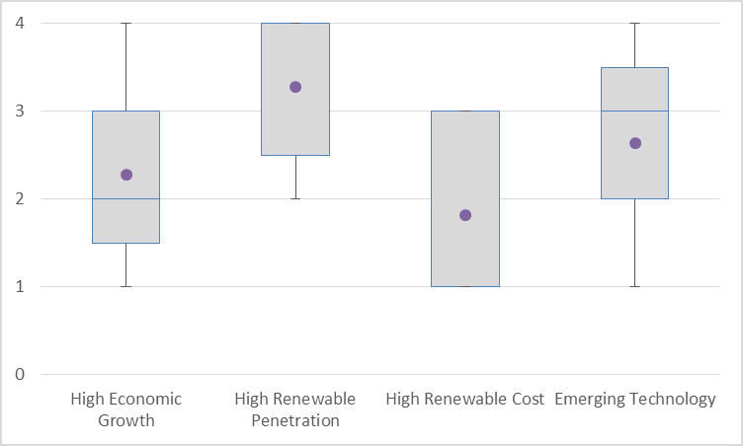
Survey Results: Usefulness of 2018 LTSA Scenarios

Slide 16
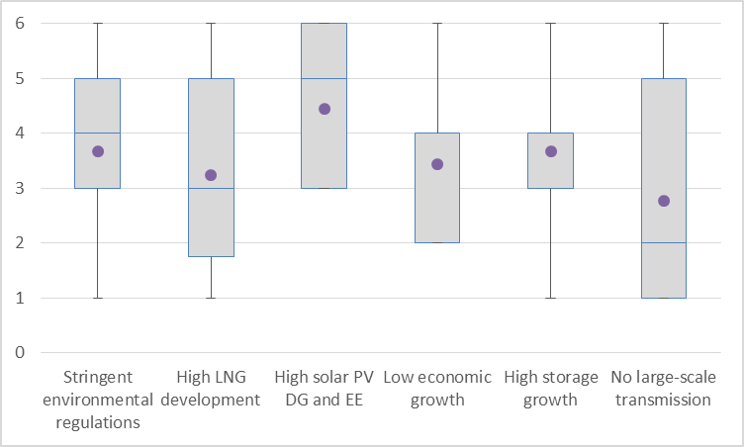
Survey Results: Potential 2020 LTSA Scenarios
Scenarios ranked highest (best) to lowest

Slide 17
2020 LTSA Process
Current Trends Preliminary Capacity Expansion
Gather Stakeholder Feedback
Finalize Current Trends Capacity Expansion
Develop Current Trends Transmission Expansion
Develop Load Forecast for Other Scenarios
Develop Capacity Expansion for Other Scenarios
Develop Transmission Expansion for Other Scenarios
Report
Develop ~4 Other Scenarios

Slide 18
Questions
Jeff Billo
Jeff.Billo@ercot.com
512.248.6334
?

Slide 19
Appendix

Slide 20
Revised New Unit Capital Costs for Current Trends Scenario

