Slide 1
REP and NOIE Demand Response Data Collection Process
July 15, 2019

Slide 2
Agenda
Antitrust Admonition
Agenda Review
REP Session
  Review REP input received pertaining to NPRR933
  REP Data Collection Schedule for 2019
  Review of REP Event Survey Questions
  REP Q&A
Break
NOIE Session
  Review NOIE input received pertaining to NPRR933
  Review of NOIE Event Survey Questions and Survey Schedule
  NOIE Q&A
Adjourn

Slide 3
NPRR 933 Objectives
To make annual report of price and demand response in ERCOT available on a more timely basis.
  Change report filing date to November 30 of the analysis year rather than March 31 of the following year.
  Would allow inclusion of analysis results in ERCOT’s summer in review filings.
  Would make timely inputs available for EORM (Economically Optimal Reserve Margin) analysis.
  Would make timely inputs available for LTSA (Long Term System Assessment) analysis.
  Would provide the capability to analyze significant high price and demand response events occurring in all months of the year on a timely basis.

Slide 4
NPRR 933 Objectives (Continued)
To improve the accuracy of the analysis findings to address:
  The incidence of high price events.
  The high churn rate in demand response participation.
To document specifics for LSE self-arranged load response reporting associated with §25.505, Reporting Requirements and the Scarcity Pricing Mechanism in the Electric Reliability Council of Texas Power Region.
To improve the data quality exchange between ERCOT and REPs.

Slide 5
REP and NOIE Input to NPRR933
September 30th Snapshot Date
  Many are concerned that the September 30th snapshot date would not provide adequate to get the data into ERCOT by the deadline.
  Some suggested moving it to either the end of August or mid September.
  ERCOT response:
  Based on the 2018 data collection process
    1/4 of the REPs submitted only 1 file
    1/3 of the REPs waited until November to send in their first file
    2/3 of the REPs need to submit 2 or more files
    Corrections on average took 10 business days
    Moving the snapshot date back would only decrease the accuracy of our analysis
    NPRR will be written to adjust this in future years if 2019 snapshot date proves to be unrealistic.
Exclusion clause for smaller REPs and NOIEs

Slide 6
REP and NOIE Input to NPRR933
Reporting Threshold to Exclude smaller REPs and NOIEs
  REPs requested a reporting threshold for them similar to what was used in 2018 for the NOIEs
  ERCOT Response:
  ERCOT will apply the following reporting thresholds for REPs and NOIEs in 2019.
  “ERCOT shall calculate the average summer weekday load for the preceding summer for each REP(NOIE); these averages shall be summed across all REPs(NOIE). For purposes of these calculations, the load of affiliated REPs(NOIEs) shall be aggregated. The largest REPs(NOIEs) that account for 95% (90% for NOIEs) of that total, shall submit information to ERCOT detailing their Customers’ participation in Demand and/or price response programs. ERCOT shall notify the contact person for each REP(NOIE) at least 60 days prior to the beginning of the data collection process of its reporting obligation.”

Slide 7
REP and NOIE Input to NPRR933
Quarterly Snapshots/Data Collection
  Near universal resistance to increase the number of data collections beyond the current annual data collection process citing cost.
  ERCOT Response:
  ERCOT will withdraw our request for quarterly snapshots.
  Based on the issued caused by the high churn rates identified by ERCOT the annual report for price responsive Demand Response in ERCOT will be limited to summer pricing event only. Will only capture the number of participating premises for each category moving forward.

Slide 8
REP and NOIE Input to NPRR933
Allow for alternate means to provide data to ERCOT (other than through NAESB protocol)
  Using NAESB for the smaller LSE’s can be difficult and cause excess delays that could be resolved if other forms for data submittal were allowed.
  ERCOT Response:
  ERCOT will allow other methods to be used for data submission but those methods will need to be previously agreed to by ERCOT.
  Discuss secure file transfer for methods other than NAESB.

Slide 9
REP and NOIE Input to NPRR933
Request ERCOT supply list of ESIIDs that each REP owns on the snapshot date and the start date with that REP
  This was a request to help minimize the error rates on the initial data submission caused by REP ownership errors
  ERCOT Response:
  This will be implemented for both the 2019 reporting year and included in NPRR933
  Discuss methods for sending these large data files.

Slide 10
REP Data Collection Schedule 2019
August 1, 2019
  ERCOT sends email notification to REP contact person for REPs that meet the reporting threshold
  REPs with no programs send email to ERCOT
September 30, 2019 (Snapshot date)
  REPs can start sending files to ERCOT
  ERCOT provides 2019 event survey links to REPs that meet threshold
October 7, 2019
  ERCOT provides REPs with list of ESIIDs they own on snapshot date
October 31, 2019
  ESIID submission deadline for files to ERCOT that meet required accuracy
  Event survey deadline (for REPs with OLC, PR, OTH)
November 29, 2019 - ERCOT completes 2019 summer assessment
March 31, 2020 - 2019 Annual Report of Demand Response due

Slide 11
REP ESIID Data Submission
Revised categories (proposed)
  Add categories to identify pricing products indexed on day-ahead and real-time prices
  To allow analysis of price response specific to high day-ahead prices … including days with normal real time prices
  BID – Block and Indexed Day Ahead Prices
  BIR – Block and Indexed Real Time Prices
  DAP – Day Ahead Pricing
  RTP – Real Time Pricing

Slide 12
REP ESIID Data Submission
Program Start Date
  Must not precede the REP-of-Record date for the customer occupying the premise on the snapshot date
  Report the date that customer first started participation on the program
  If the same customer was on the program and subsequently renewed contract and/or continued participation report the initial start date
  If the REP-of-Record date and the program start date precedes the previous snapshot date, and the program start date for the two submissions should match

Slide 13
REP ESIID Data Submission
Other Direct Load Control (OLC)
  Do not report ESIIDs if they participate on ERS or TDSP Standard Offer Programs
  Do not report ERS or TDSP Standard Offer related tests/events
Peak Rebate (PR)
  Report ESIIDs that were eligible to receive rebates even if no events were called
  Report all ESIIDs on the program … do not limit to those deemed by the REP to have responded
Other Voluntary Demand Response (OTH)
  Report all ESIIDs on the program … do not limit to those deemed by the REP to have responded

Slide 14
REP Event Survey Process
Event survey links sent only to REPs that meet the reporting threshold
There are no event surveys for pricing event products
  Real-time Pricing Rate
  Block and Index Rate
  Critical Peak Pricing Rate
There are three different retail DR event surveys
  Peak Rebate
  Other Load Control
  Other Voluntary Demand Response
Survey Monkey used as the survey tool
All survey responses are due by October 31

Slide 15
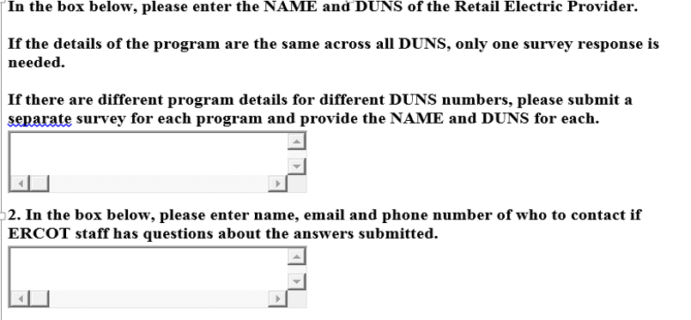
REP Survey Questions

Slide 16

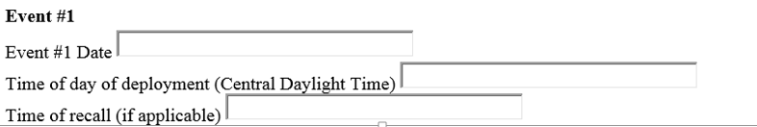

REP Survey Questions
Peak Rebate
3. Did you initiate any Peak Rebate Events during the 2019 reporting period
4.If you answered “Yes” please provide the following information for any event initiated during the 2019 reporting period
Was the Peak Rebate notification issued to all participants?
If no, provide details on which participants received the notification.

Slide 17
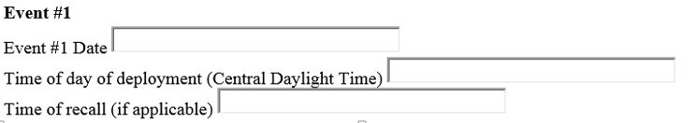
REP Survey Questions
Other Load Control
3. Did you, as the REP, either directly or through a business partner, initiate any direct load control of your customers enrolled in an “Other Load Control” product during the 2019 reporting period?
4. If you answered “Yes” please provide the following information for any events initiated during the 2019 reporting period.
Was the Other Load Control notification issued to all participants?
If no, provide details on which participants received the notification.

Slide 18

REP Survey Questions
Other Voluntary Demand Response
3. Did you, as the REP, either directly or through a business partner, initiate any direct load control of your customers enrolled in an “Other Voluntary Demand Response” product during the 2019 reporting period?

Slide 19
REP Q&A

Slide 20
Demand Response Data Definitions
4CP – incentives to reduce load based on actual or anticipated ERCOT 4-CP events. Incentives my be in the form of a component in the customer rate structure based on load at actual 4CP intervals. Incentives may also be based on anticipated 4CP events.
RTP – Real Time Pricing - retail prices for all hours or intervals based on ERCOT Real-Time Settlement Point Prices for the premise Load Zone, or other real-time wholesale price indicator(s).
DAP – Day Ahead Pricing - retail prices for all hours or intervals based on ERCOT Day-Ahead Settlement Point Prices for the premise Load Zone, or other day-ahead wholesale price indicator(s).

Slide 21
Demand Response Data Definitions
BIR – Block & Index Real Time – fixed pricing for a defined volume of usage, coupled with pricing for usage exceeding the block indexed to ERCOT Real-Time Settlement Point Prices for the premise Load Zone, or other real-time wholesale price indicator(s). Block prices and volumes may vary by time of day/week.
BID – Block & Index Day Ahead – fixed pricing for a defined volume of usage, coupled with pricing for usage exceeding the block indexed to ERCOT Day-Ahead Settlement Point Prices for the premise Load Zone, or other day-ahead wholesale price indicator(s). Block prices and volumes may vary by time of day/week.
CPP – Critical Peak Pricing –prices that rise during critical peaks: limited duration periods of time identified by the LSE that usually correlate to high prices in the real-time wholesale market. Critical peak events may occur a limited number of times per year and typically are communicated a day in advance.

Slide 22
Demand Response Data Definitions
PR – Peak Rebates – a retail offering in which the customer is eligible for a financial incentive paid for load reductions taken during periods of time identified by the LSE and communicated to the customer during the prior day or the event day or both. LSE has defined a method to identify whether a customer has responded and to quantify the response amount. Payment (rebate) to customer is based upon the level of the customer’s response.
  No Direct Load Control - The REP sends an email one day prior if high prices are forecasted, and sends a reminder text/tweet the morning of the following day. The REP identifies responding customers using a recent similar weather day as a baseline to estimate what the customer’s load would have been. If the customer’s actual load during the predicted intervals was lower than the baseline, the REP agrees to pay the customer $X/kWh of reduction.
  Direct Load Control - REP sends email one day prior if high prices are forecasted, and sends a reminder text/tweet the morning of the following day. When high prices materialize, the REP sends a signal to the customer’s web-enabled thermostat to increase its set point by 3 degrees. The REP establishes a baseline for the customer to estimate what the customer’s load would have been. If the customer’s actual load during the predicted intervals was lower than the baseline, the REP agrees to pay the customer $ X/kWh of reduction.

Slide 23
Demand Response REP Data Definitions
TOU – Time of Use — prices that vary across defined blocks of hours, with predefined prices and schedules. (As used here, does not apply to seasonal adjustments).

