Slide 1
Further Discussion on Reliability Unit Commitment under Real-Time Co-optimization
Aaron Townsend
RTCTF
July 12, 2019

Slide 2
Transmission and AS Maximum Shadow Prices in RUC Have Been Reviewed in the Stakeholder Process
At the request of stakeholders, in the first part of 2017 the transmission maximum shadow prices in RUC were reviewed, and following analysis and discussion were reduced by a factor of approximately 10
Discussions and presentations at QMWG on 1/13/2017, 1/30/2017, 2/27/2017, and 3/31/2017
Market notice of change sent on 4/6/2017
Change effective at 1300 on 4/7/2017
AS maximum shadow prices were reduced at the same time to maintain the same relationship between transmission and AS maximum shadow prices
The need for this change was discussed at the 3/31/2017 QMWG meeting
Actual values are on the following slides

Slide 3
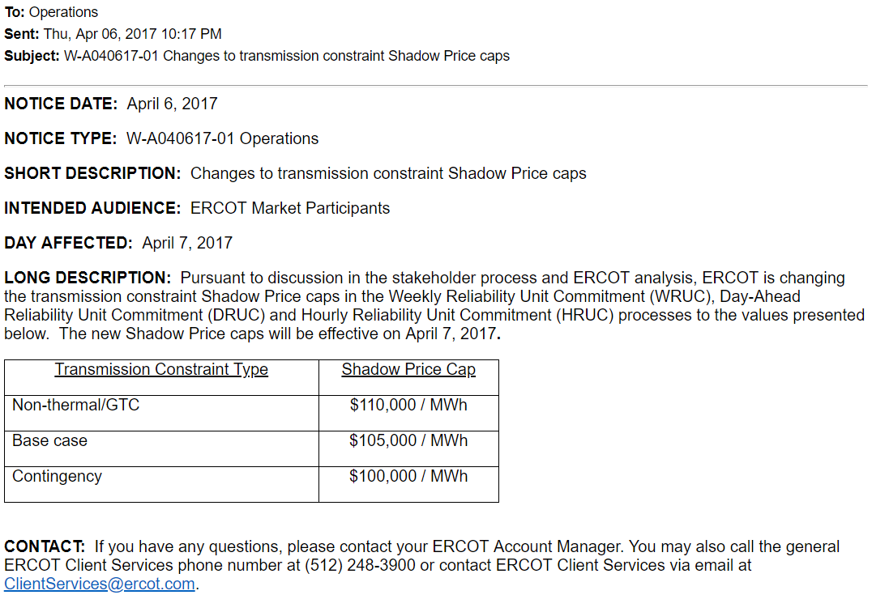
April 6, 2017 Market Notice

Slide 4
Maximum Shadow Price Values in DAM and RUC
Maximum Shadow Price Values ($/MWh)
Application | DAM | RUC prior to 4/7/2017 | RUC post 4/7/2017
Transmission Constraints
GTC | 1,000,000 | 1,000,000 | 110,000
Base case | 350,000 to 1,050,000 depending on voltage level | 350,000 to 1,050,000 depending on voltage level | 105,000
Contingency | 300,000 to 1,000,000 depending on voltage level | 300,000 to 1,000,000 depending on voltage level | 100,000
Power Balance Constraints
Over Generation | 5,000,000 | 5,000,000 | 5,000,000
Under Generation | 5,000,000 | 5,000,000 | 5,000,000
Ancillary Service Constraints
Regulation Down | 3,000,000 | 5,000 | 5,000
Regulation Up | 3,000,000 | 500,000 | 50,000
Responsive Reserve | 2,000,000 | 300,000 | 30,000
Non-spin Reserve | 1,000,000 | 200,000 | 20,000

Slide 5
Shams’s Example
This example is extremely unlikely for several reasons. It assumes that there is sufficient capacity online or offline to be 1 MW short of the load forecast plus AS Plan requirements, during the time with the highest AS Plan requirements (so that prices are lowest), that ERCOT cannot defer the decision to commit, that the least expensive qualified Resource costs $15,000 to commit, and that the RTM conditions are uniformly the same as the RUC forecasts.
In this extremely unlikely example a 1 MW shortage of NSRS results in ERCOT RUCing a 500 MW resource with $15,000 startup+min energy cost for the hour
In the RTM, the NSRS MCPC is $120/MWh after the pricing run.
Energy is likely to be somewhat higher, but to be conservative assume it is also $120/MWh.
Assume the 500 MW Resource has an LSL of 100 MW
LSL energy revenue is $120/MWh * 100 MW * 1 hour = $12,000
Neglect AS revenue—offer curves for RUCed Resources are not yet determined so the awarded quantity is uncertain
The RUCed Resource’s cost less its revenue is $3,000

Slide 6
Value of Commitment to Load in the Example
In the example, the Resource was committed by RUC for 1 MW of Non-spin
However, in the RTM it provided more than 1 MW of value
The ORDC reflects the value of reserves to load
In this example, assume all reserves are online (so lowest value for online capacity based on current ORDC)
From an economics perspective, the value of the commitment to load in the RTM is the area under the ORDC curve corresponding to the commitment, or about $17,800 in this example. This is significantly higher than the uplifted amount of $3,000.

Slide 7
ERCOT’s Position
RUC is a reliability backstop that is required to meet NERC requirements and maintain reliability. Ensuring RUC can meet the full AS Plan is critical to this function.
The RUC and SCED optimizations consider different problems
The SCED optimization is solving for dispatch
Only considers the incremental offers and penalty costs of AS (the RTM ASDCs)
The RUC optimization is solving for commitment
Considers additional costs in the form of startup and minimum energy costs
Therefore, using equivalent penalty costs between the two optimizations is not appropriate
This is the same reason that the transmission and power balance penalty costs are higher in RUC than in SCED
Co-optimization will already inherently reduce the need for RUC by giving more flexibility to the RUC optimization engine

Slide 8
ERCOT’s Position
At the minimum capacities in the AS Plan, prices will be high enough that even in the extreme case presented there will be minimal need for make-whole
RUC for capacity is system-wide, and the Reliability Deployment Price Adder addresses the system-wide price impacts of RUCs and will be further improved with the changes included in NPRR904
Incremental design changes to include AS demand curves increases the cost and schedule of changing the RUC system (vendor work: specifications, design, vendor testing, and ERCOT testing) for features that may or may not be used in the future
RUC currently protects the full AS Plan. Co-optimization should not change the status quo on this subject.

