Slide 1
MarkeTrak Training
Siebel Change

Slide 2
D2D Issues: Siebel Change/Info
Examples of Siebel Change/Info:
Service order status changes
Questions pertaining to transactions status updates where EDI message is present on ERCOT MIS. NOTE: If not present, then submit under “Missing Enrollment Transaction”
Questions pertaining to why a transaction was cancelled
Questions pertaining to Siebel not reflecting the correct status based on transaction(s) that the TDSP has submitted – TDSP timing issue due to several reasons. One Example: WorkAround(s) with MVI transactions submitted after TDSP has completed WorkAround request and power is ‘On’. TDSP would submit Siebel Change MT where CR agrees with the DateWanted for the Initial Read 867_04 matching when the WorkAround completed
Cancelling a Siebel service order after completion
Completing a Siebel service order after it was cancelled – limited to one year from original processing date

Slide 3
D2D Issues: Siebel Change/Info
Examples of Siebel Change/Info:
Start time issues
Questions pertaining to why an ESIID is not in ERCOT’s system
Changing a start time of a Siebel service order
A CR or TDSP can submit this subtype
Required fields on Submit:
ASSIGNEE
ESIID
Original Tran ID - BGN02 of the initiating transaction (814_01, 814_16, 814_24)
Comments – always encouraged

Slide 4
MarkeTrak Training
Data Extract Variance (DEV) Issue Subtypes

Slide 5
Data Extract Variance (DEV) Overview
Data Extract Variances (DEVs) are used to synchronize the data among all Market Participants (MPs)
What is a DEV? It's a discrepancy between the MP’s data and ERCOT’s extract data. There are two types of DEVs listed below:
DEV LSE (Load Serving Entity):
LSE DEVs are used to correct the MP's StartTime and/or StopTime for Rep of Record (ROR) synchronization Possible Talking point from TDTMS MarkeTrak Stats: LSE DEVs are submitted most frequently
DEV Non-LSE:
Non-LSE DEVs are used to synchronize ESI_ID Characteristics, Existence and/or usage data
“Invalid” DEV submissions involves the +/- (2 calendar day) window for the StartTime and/or StopTime. If your discrepancy is within this 2 day window and you attempt to file a DEV issue, ERCOT will ‘reject’ it. The correct action is to file a D2D Siebel Change MarkeTrak issue (Reference: MarkeTrak SubTypes Quick Reference)
“Valid” DEV submissions should only occur after transactions have been attempted to correct the discrepancy.

Slide 6
Data Extract Variance (DEV) Issues
There are many possible scenarios that may result in differences between ERCOT data and MP data. There are two Types of Data Extract Variances:
Invalid submission: Differences that have been found invalid and do not require resolution. A Data Extract Variance cannot be filed for ‘Invalid submission’.
Valid submission: Differences that are ‘Valid’ and do require analysis. A Data Extract Variance should be filed for ‘Valid submission’.
DEV issues should be filed for data discrepancies identified by comparing Extract data to the MP source system data.
DEV issues require that transactions have been tried to correct the data discrepancy (i.e. back dated MVI, 814_20 Update for ESIID Characteristics, etc.), if applicable.
DEV issues require the most recent SCR 727 Extract Addtime record to complete and update SCR 727 data extract.

Slide 7
Checkpoint Question
True or False
In order to synchronize a Move-In StartTime from May 1, 2019 to May 3, 2019, a MarkeTrak DEV LSE should be submitted
FALSE
Invalid submission via the +/- (2 calendar day) window.

Slide 8
Checkpoint Question
DEV Non-LSE MarkeTrak issues are submitted to synchronize the following:
ESI_ID Characteristics
Usage Data
ESI_ID Existence
A and C Only
All of the Above
All of the Above

Slide 9
MarkeTrak Training
Bulk Insert Process

Slide 10
Bulk Insert: Overview
MarkeTrak Bulk Insert functionality is a browser-driven, automated method of submitting multiple MarkeTrak Issues using the GUI. Through a web browser interface, a CSV file containing the data for a batch of issues is uploaded via the Bulk Insert workflow. The data contained in the CSV file will use the defined required field ordering that must be used for the issue type being submitted by the user.

Slide 11
Bulk Insert: CSV File
The data format required for Bulk Insert is a file which will contain a text-row list of data for Issues of common type and subtype. A text-row will be a set of Comma Separated Value (CSV) data fields, with these fields in an expected order based on their Issue type . Any text-row that does not conform to the expected order will not be processed by Bulk Insert.
If enabled, validations are performed on certain fields contained within the CSV file. All validations will default to “off”. If any processing validation flag is “blank”, the processing will assume the validation is turned “off”. If populated with “1” the validation is turned “on”. If enabled, validations are performed on the following fields:
Validation Types:
ESIID Duplicate Check
‘1’ indicates that Duplicate ESIID Check be performed. Will NOT submit issue with this check enabled if a duplicate issue is located in MarkeTrak containing this ESIID to which the submitter has access. Potentially duplicated issues will be returned in result set.
‘0’ indicates that Duplicate ESIID Check should be overridden. This option will submit the issue (given all criteria and validations met) regardless of potentially duplicated items in the MarkeTrak system.
If this field is left blank, a ‘0’ will automatically default in and the Duplicate ESIID Check will NOT be performed.

Slide 12
Bulk Insert: CSV File (cont.)
Global ID Duplicate Check
‘1’ indicates that Duplicate Global ID Check be performed. Will NOT submit issue with this check enabled if a duplicate issue is located in MarkeTrak containing this ESIID to which the submitter has access. Potentially duplicated issues will be returned in result set.
‘0’ indicates that Duplicate Global ID Check should be overridden. This option will submit the issue (given all criteria and validations met) regardless of potentially duplicated items in the MarkeTrak system.
If this field is left blank, a ‘0’ will automatically default in and the Duplicate Global ID Check will NOT be performed.
ESIID Validation
‘1’ indicates the submitter wishes to submit the ESIID for validation against the ERCOT Registration System. If the ESIID is not returned as valid, the issue will not be created
‘0’ indicates the submitter wishes to submit the item to the MarkeTrak system regardless of ESIID existence in the ERCOT Registration System.
If this field is left blank, a ‘0’ will automatically default in and the ESIID Validation check will NOT be performed.
ESIID Validation must be enabled for Premise Type to be returned .

Slide 13
Bulk Insert: CSV File (cont.)
Evaluation Window Validation
‘1’ indicates the submitter wishes to enable the Tran Type/SMRD evaluation rules for Cancel With Approval new Issues. If the evaluation rule is violated, the issue will not be created.
‘0’ indicates the submitter does NOT wish to enable the Tran Type/SMRD evaluation rules for Cancel With Approval new Issues. If the evaluation rule is violated, the violation will be ignored and the issue will be created.
If this field is left blank, a ‘0’ will automatically default and the Tran Type/SMRD evaluation rules for Cancel With Approval will NOT be performed.
Global ID Validation must be enabled for Evaluation Window Validation flag to be evaluated.
Global ID Validation
‘1’ indicates the submitter wishes to validate the Global ID involved with the submitted issue against the ERCOT Registration System. If the Global ID involved with issue is not in the ERCOT Registration System, the issue will not be created
‘0’ indicates the submitter does NOT wish to validate the Global ID involved with the submitted issue against the ERCOT Registration System.
If this field is left blank, a ‘0’ will automatically default and the Global ID Validation will NOT be performed.

Slide 14
Bulk Insert: CSV File (cont.)
Bulk Insert Templates:
Bulk Insert templates for every applicable subtype are available on the MarkeTrak Information Page. Below is a sample of the template for the Usage/Billing Missing subtype:
The definition of the data fields is as follows:
Required (Req)
Optional (Opt)
Not Applicable (N/A)
Required or Optional (R/O)
Required or Not Applicable (R/NA)
Optional or Not Applicable (O/NA)
DateTime format = ccyy-mm-ddThh:mm:ss eg: 2015-11-15T13:20:57
Date format = ccyy-mm-dd eg: 2015-11-15

Slide 15
Bulk Insert: CSV File Template
Once all data has been entered into the required fields the bulk insert template header row should be deleted before saving the file in the CSV format.
Before submission of the bulk insert CSV file the user should ensure all rows are accounted for in the file template to successfully pass validation for submission of the file.

Slide 16
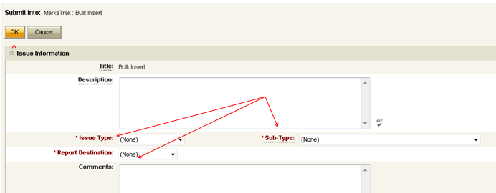
Bulk Insert: Submit
Submitting a Bulk Insert Issue:
The following fields must be populated for successful submission of Bulk Insert: Note: This is not for the CSV file.
Issue Type
Sub-Type
Report Destination
The Submitter selects OK

Slide 17
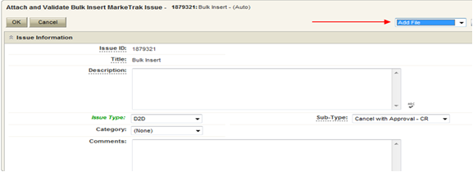
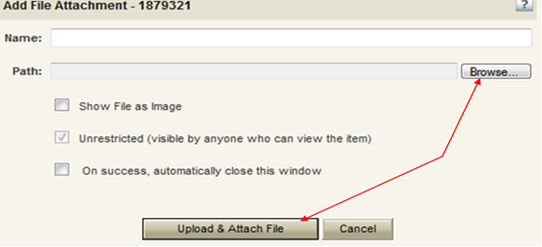
Bulk Insert: Submit (cont.)
From the Actions dropdown, select Add File
Select Browse, locate the CSV file for your Bulk Insert, and then press Upload & Attach File

Slide 18
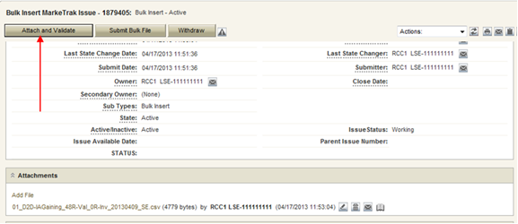
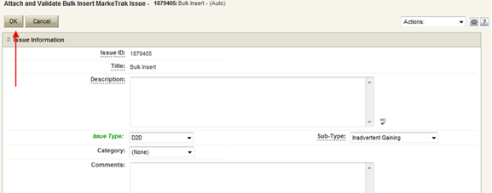
Bulk Insert: Submit (cont.)
Press Attach and Validate.
Once the file has been attached select OK to validate the format of the CSV file

Slide 19
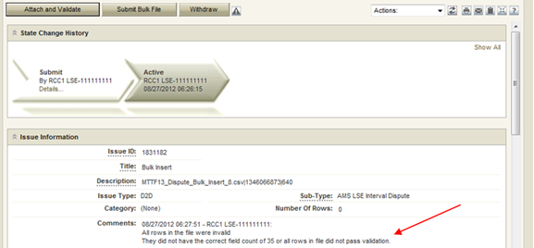
Bulk Insert: Submit (cont.)
Validation will be done on the uploaded file.
If the upload fails for incorrect number of columns or the file is formatted incorrectly it will not pass validation and, the comments section will display a failure message. The user will then have the option of correcting the CSV file. Once the file is corrected the file must be deleted before it can be re-attached. To delete the file, select the trash can icon(delete) next to the attached file and select “Delete File” from the resulting “pop up” window.

Slide 20
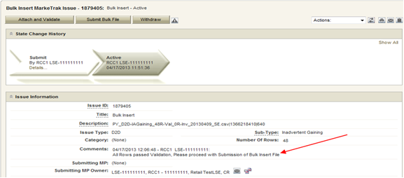
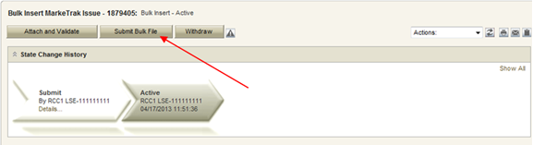
Bulk Insert: Submit (cont.)
If the upload is successful, a message indicating “All rows passed validation” will appear.
Select Submit Bulk File to create individual issues.

Slide 21
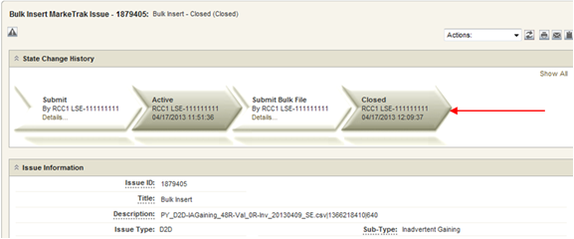
Bulk Insert: Submit (cont.)
After submitting the issue it will automatically close the Bulk Insert issue
When a Bulk Insert is submitted, the Bulk Insert MarkeTrak Number becomes the “parent” and will be populated on each individual MarkeTrak issue (which are the “children”) created by the Bulk Insert.

Slide 22
Bulk Insert: Validations
File format level validation is performed on the CSV file during the Attach and Validation transition to determine if the correct number of columns is present and will immediately return confirmation results back to MarkeTrak. This will show the number of rows that successfully uploaded and the number that did not upload due to an invalid number of columns.
Business data validations are also performed on the file and the results from this will be posted to the report destination selected during Submit. This validation is performed on the required field’s portion of the CSV file. The results will either post to the MarkeTrak issue or the Reports and Extracts Index on MIS, depending upon which report destination was selected upon Submit. This report will contain five additional fields, which will be added at the end of each row on the report. The additional fields will represent the following data:
Success or Fail: This field contains the word “success” or “fail”. Success will indicate the MarkeTrak issue was successfully submitted in MarkeTrak via bulk insert. Fail will indicate the MarkeTrak issue failed to be submitted in MarkeTrak via bulk insert.
Error Code: This code contains the error code of a failed attempt to submit a MarkeTrak issue via bulk insert. This field will only be populated when an issue has failed.
Error Message: This field contains the error message explaining why the MarkeTrak issued failed to be submitted via bulk insert. This field will only be populated when an issue has failed.
Date/Time Stamp: This field contains the date and time of when the issue was attempted to be submitted via bulk insert in MarkeTrak.
Issue ID: The field contains the MarkeTrak issue ID for successfully submitted issues.
Allow adequate time after submitting a bulk insert issue for the system to create each individual issue. This will take an average of just a few seconds for each issue or row submitted, but can add up if several are submitted at once.

Slide 23
Bulk Insert: Report Destination
Users have a choice during the submit process to post the results file as an attachment to the MarkeTrak issue or to the reports section on MIS. If MIS is the report destination selected, the results file will post to MIS and the user will need to download the file. To access MIS, select the MIS link at the top of the MarkeTrak GUI screen.

Slide 24
Bulk Insert: Report Destination
From within MIS, select the Retail link to access the reports.

Slide 25
Bulk Insert: Report Destination
Select the MarkeTrak Bulk Submissions Report link to access the .csv file.

Slide 26
Checkpoint Question
In what format should your Bulk Insert file be saved, prior to uploading into MarkeTrak?
*.pdf
*.txt
*.csv
*.xlsx
*.csv

Slide 27
Checkpoint Question
True or False:
Bulk Insert templates for every applicable subtype are available on the MarkeTrak Information Page.
True

