Slide 1
Introduction to RTC constraints
KP 1.3
Sai Moorty
Principal, Market Design and Analysis
June 21, 2019

Slide 2
Overview of Word Document Describing RTC constraints
Problem Statement: Part of KP 1.3
“For RTC clearing engine, develop new telemetry requirement and enhanced mathematical modeling to account for physical operational constraints of Resources.”
The accompanying Word document is “work in progress”,
Current status of Word document as of 6/21/2019:
Does not describe the treatment of:
Synchronous Condenser participating in RRS (PFR) and ECRS
Storage Resources modeled as a combination of a Generation Resource and a Controllable Load Resource participating in FRRS, FFR and “blocky” ECR
Fast Load Resource participating in FFR

Slide 3
Review Use of Generation Resource Statuses under RTC
Resource Status | Under RTC
ON | Available for energy and AS awards
ONOS | Energy participation same as today. Can participate in AS if offered
ONDSR | Energy participation same as today. Can participate in AS if offered.
ONOPTOUT | Considered to be same as ON
ONRUC | Considered to be same as ON (will have special treatment, e.g., AS offer floors)
OFFQS | Considered to be same as ON for energy, ECRS and NSPIN. Cannot be awarded Regulation or PFR
OFF | Not available to for energy, Regulation, PFR, or ECRS awards Available for NSPIN if qualified
ONREG | Status no longer needed
FRRSUP | Status no longer needed
ONOSREG | Status no longer needed
ONDSRREG | Status no longer needed
OFFNS | Status no longer needed
ONTEST | Energy participation same as today. Cannot be awarded AS
ONEMR | Considered to be same as ON, may appropriately set LSL and HSL to reflect operating limits
ONRR | More discussion required on both energy and AS participation
ONECRS | More discussion required on both energy and AS participation
ONFFRRRS | More discussion required on both energy and AS participation
OUT | Not available for energy or AS awards
EMR | Not available for energy or AS awards
STARTUP | Energy participation same as today. Cannot be awarded AS
SHUTDOWN | Energy participation same as today. Cannot be awarded AS
EMRSWGR | Not available for energy or AS awards

Slide 4
Review Use of Load Resource Statuses under RTC
ONRGL | Replace with ON
ONCLR | Replace with ON. Similar to GR with ON status
ONRL | Replace with ON. Not available for energy awards. Available for RRS and ECRS awards
ONECL | Replace with ON
ONFFRRRSL | Replace with ON
OUT | Not available for energy or AS
FRRSDN | Status no longer needed
FRRSUP | Status no longer needed
Feedback requested:
Please review table of Resource status and ERCOT comments and provide feedback

Slide 5
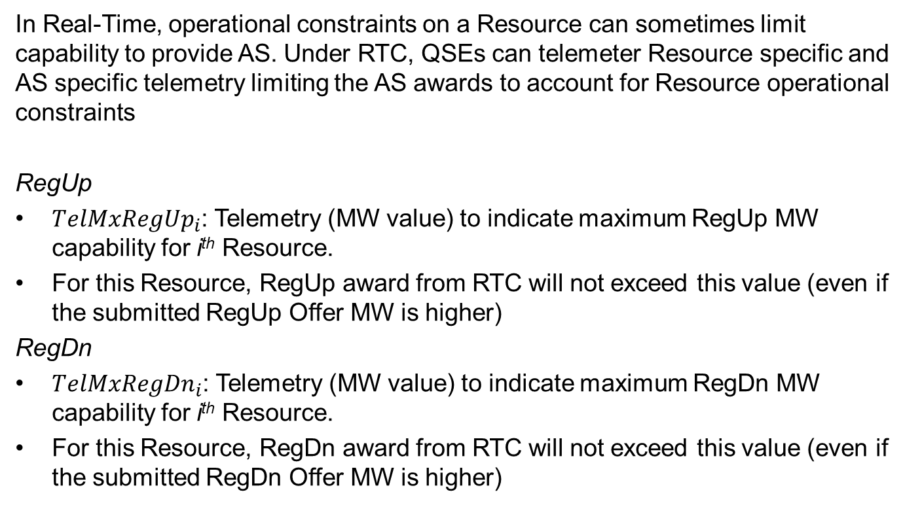
New Proposed Telemetry to Limit AS Awards under RTC
In Real-Time, operational constraints on a Resource can sometimes limit capability to provide AS. Under RTC, QSEs can telemeter Resource specific and AS specific telemetry limiting the AS awards to account for Resource operational constraints
RegUp
${TelMxRegUp}_{i}$: Telemetry (MW value) to indicate maximum RegUp MW capability for i^{th} Resource.
For this Resource, RegUp award from RTC will not exceed this value (even if the submitted RegUp Offer MW is higher)
RegDn
${TelMxRegDn}_{i}$: Telemetry (MW value) to indicate maximum RegDn MW capability for i^{th} Resource.
For this Resource, RegDn award from RTC will not exceed this value (even if the submitted RegDn Offer MW is higher)

Slide 6
New Proposed Telemetry to Limit AS Awards under RTC
RRS-PFR
${TelMxPFR}_{i}$: Telemetry (MW value) to indicate maximum PFR MW capability for i^{th} Resource.
For this Resource, PFR award from RTC will not exceed this value (even if the submitted PFR Offer MW is higher)
RRS-UFR
${TelMxRRSDn}_{i}$: Telemetry (MW value) to indicate maximum RRS MW capability for i^{th} UFR type Load Resource.
For this Resource, RRS award from RTC will not exceed this value (even if the submitted RRS Offer MW is higher)
* Similar telemetry for FFR not listed – will be described later

Slide 7
New Proposed Telemetry to Limit AS Awards under RTC
ECRS
${TelMxECRS}_{i}$: Telemetry (MW value) to indicate maximum ECRS MW capability for i^{th} Resource.
For this Resource, ECRS award from RTC will not exceed this value (even if the submitted ECRS Offer MW is higher)
NSPIN
${TelMxNSPIN}_{i}$: Telemetry (MW value) to indicate maximum NSPIN MW capability for i^{th} Resource.
For this Resource, NSPIN award from RTC will not exceed this value (even if the submitted NSPIN Offer MW is higher)
Feedback requested:
Is the provision of the additional new telemetry acceptable?
Are there other alternatives to inform ERCOT of reduced AS capability for use by RTC?

Slide 8
Summary of On-Line Generation Resource Constraints
${LSL}_{i}≤{LDL}_{i}≤{TelemMW}_{i}≤{HDL}_{i}≤{HSL}_{i}$
${HDL}_{i}=Min\left({HSL}_{i},\left({TelemMW}_{i}+{NRRUp}_{i}∗5\right)\right)$
${LDL}_{i}=Max\left({LSL}_{i},\left({TelemMW}_{i}−{NRRDn}_{i}∗5\right)\right)$
Other constraints that limit AS awards based on new telemetry, qualified MW, ramp rates (if applicable)
LSL
LDL
TelemMW
HDL
HSL

Slide 9


Summary of On-Line Generation Resource Constraints
LDL/LSL constraints to ensure energy and RegDn awards are feasible
$${MW}_{i}^{EnergyOfferAward}−{ScalingFactorDn×MW}_{i}^{RegDnAward}−{LDL}_{i} ≥0$$
$${MW}_{i}^{EnergyOfferAward}−{MW}_{i}^{RegDnAward}−{LSL}_{i} ≥0$$
$${MW}_{i}^{RegDnAward}$$
LSL
LDL
$${MW}_{i}^{EnergyOfferAward}$$
HDL
HSL

Slide 10



Summary of On-Line Generation Resource Constraints
HDL constraint to ensure energy and RegUp awards are feasible
$${HDL}_{i}−{MW}_{i}^{EnergyOfferAward}−{ScalingFactorUp×MW}_{i}^{RegUpAward} ≥0$$
$${MW}_{i}^{RegUpAward}$$
LSL
LDL
$${MW}_{i}^{EnergyOfferAward}$$
HDL
HSL

Slide 11





Summary of On-Line Generation Resource Constraints
HSL constraint to ensure energy and RegUp,RRS (PFR), ECRS and NSPIN awards are feasible
$${HSL}_{i}−{MW}_{i}^{EnergyOfferAward}−{MW}_{i}^{RegUpAward}−{MW}_{i}^{PFRAward}−{MW}_{i}^{ECRSAward}−{MW}_{i}^{NSPINAward}≥0$$
$${MW}_{i}^{PFRAward}$$
$${MW}_{i}^{RegUpAward}$$
LSL
LDL
$${MW}_{i}^{EnergyOfferAward}$$
HDL
HSL
$${MW}_{i}^{ECRAward}$$
$${MW}_{i}^{NSPINAward}$$

Slide 12
Combined Cycle Generation Resource Constraints
Checks on ensuring awards for RegUp, RegDn and PFR are feasible.
Capacity from CT1 and CT2 is frequency responsive
RTC models a single Resource representing the 2x1 CC configuration
Need information on what proportion of the Base Point of the 2x1 CC configuration will be provided by the combination of CTs (CT1+CT2)
Need information on the High and Low limits on the combination of CTs
CC component | Capacity | Frequency Responsive? | MW output
CT1 | 100 | Yes | 80
CT2 | 100 | Yes | 80
ST3 no duct burner | 200 | No | 160
ST3 with duct burner | 250 | No | 30
CT1
CT2
ST3 and/or
duct burner

Slide 13
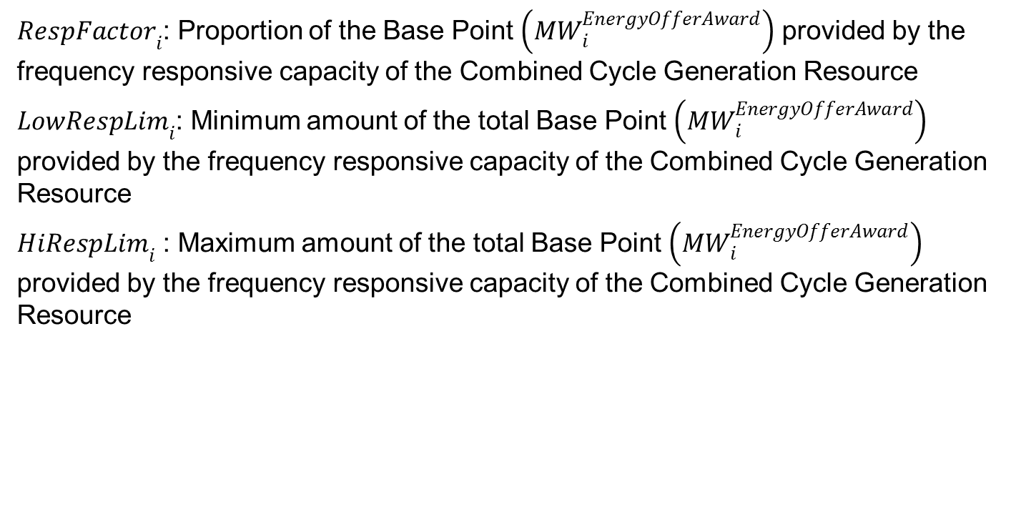
Combined Cycle Generation Resource Constraints
${RespFactor}_{i}$: Proportion of the Base Point $\left({MW}_{i}^{EnergyOfferAward}\right)$ provided by the frequency responsive capacity of the Combined Cycle Generation Resource
${LowRespLim}_{i}$: Minimum amount of the total Base Point $\left({MW}_{i}^{EnergyOfferAward}\right)$ provided by the frequency responsive capacity of the Combined Cycle Generation Resource
${HiRespLim}_{i}$ : Maximum amount of the total Base Point $\left({MW}_{i}^{EnergyOfferAward}\right)$ provided by the frequency responsive capacity of the Combined Cycle Generation Resource

Slide 14
Combined Cycle Generation Resource Constraints
Conditional Constraint 1: If the sum of RegUp and PFR award is greater than zero, then enforce additional constraint:
$${HiRespLim}_{i}−{RespFactor}_{i}×{MW}_{i}^{EnergyOfferAward}−{MW}_{i}^{RegUpAward}−{MW}_{i}^{PFRAward} ≥0$$
Conditional Constraint 2: If the RegDn award is greater than zero, then enforce additional constraint:
$${RespFactor}_{i}×{MW}_{i}^{EnergyOfferAward}−{MW}_{i}^{RegDnAward}−{LowRespLim}_{i} ≥0$$
Feedback requested:
Is the provision of the additional new telemetry acceptable?
Are there other alternatives to account for the frequency responsive capacity for Combined Cycle Generation Resources?

Slide 15
Self-Provision of RRS and ECRS from UFR type Load Resources
Issues that need more discussion:
Validation of self-provided telemetered RRS and ECRS amounts:
$TelSelfRRS$: Telemetry to indicate RRS MW amount self-provided by On-Line UFR type Load Resource
$TelSelfECRS$: Telemetry to indicate ECRS MW amount self-provided by On-Line UFR type Load Resource
Validation of self-provision of AS and AS trades submittal deadline at QSE portfolio level
During scarcity conditions when total PFR amount procured is less than 1150 MW, the sum of self-provided RRS and ECRS amounts can be greater than 60% of Total RRS procured

Slide 16
Discussion

