Slide 1
Battery Energy Storage Integration Issues and Assignments
Initial ROS Discussion
July 11, 2019

Slide 2
Background
ERCOT stakeholders discussed issues associated with the integration of Battery Energy Storage during a workshop held on April 23, 2019.
These issues were consolidated and summarized in a document which was presented along with potential working group assignments at the May 22 meeting of the Technical Advisory Committee (TAC).
TAC endorsed the issues list and proposed assignments.
The next four slides, taken from the TAC presentation, indicate the issues assigned to ROS.

Slide 3
Issue 2: Battery Energy Storage Operational Requirements
Summary: Establish technology-specific operational requirements for battery storage devices as part of an effort encompassing a review of all inverter-based resources
Assignment: Reliability and Operations Subcommittee (ROS)
Notes:
Technology-specific requirements will be needed when new resource definitions are implemented
Operational requirements will need to be specified for the devices when they are charging, discharging, and in transition
Specific topics:
  Voltage support and coordination
  Voltage/frequency ride through
  Frequency Support
  Dynamic model submittal requirements
  Measurement and monitoring
  Dynamic performance requirements
  A/S performance requirements and limitations
  A/S Testing requirements
  Repowering considerations for interconnection studies

Slide 4
Issue 5: Operations System Design Changes
Summary: Review design and requirement changes that allow ERCOT to better model battery energy storage devices in its Energy Management System (EMS)
Assignment: ROS
Notes:
Battery devices are currently modeled as two independent resources – a generation device and a Controllable Load Resources. EMS revisions (consistent with revisions made to MMS) will be required to model a battery device as one device that can extract and generate electricity.
  Review modeling requirements for downstream models used for operations reliability studies
  Revisions to Resource Integration and Ongoing Operations (RIOO) system and Network Model Management Systems (NMMS)
  Develop procedures for incorporating battery energy storage devices in operations and transmission planning studies and models

Slide 5
Issue 6: State of Charge/Limited Duration Considerations
Summary: Develop protocol revisions to account for consideration of state of charge of battery devices in day-ahead and real-time markets
Assignment: WMS and ROS
Notes:
Develop appropriate battery state of charge requirements/procedures for:
  Reliability-Unit Commitment (RUC)
  Day-Ahead Market awards
  Real-time dispatch
  ORDC and PRC
  Energy Emergency Alert (EEA) Procedures
  COPS submittals
  Communication and Implementation of Operational Limitations
  How to maximize value of battery energy devices to resource owners and to grid operations
  Use of limited duration devices to resolve transmission constraints
  Transmission planning study assumptions

Slide 6
Issue 7: Alternate Device Modeling Options
Summary: Assess potential alternate approaches to integrating coupled devices
Assignment: WMS and ROS
Notes:
AC-coupled devices with jointly controlled operations or non-physical device limitations
DC-coupled devices (multiple devices sharing inverters)

Slide 7
The Path Forward
ERCOT proposes to bring these issues (in small groups) to ROS for stakeholder discussion and possible assignment to working groups over the next few months.
When stakeholder consensus is achieved, the issues will be brought back to ROS and TAC.
When enough of these issues are resolved, ERCOT will incorporate these changes into a protocol revision request for further stakeholder review.
New issues identified during stakeholder discussions can be added to the overall list. The order these issues are addressed is also subject to stakeholder review.
ERCOT will develop a monthly summary of battery storage discussions at all the working groups and subcommittees and post this summary to the upcoming TAC meeting page.

Slide 8
Initial Issue for ROS
ERCOT proposes that ROS address whether batteries should have different operational requirements when charging and discharging.
Registered battery devices are currently registered and modeled as two devices – a generation device and a Controllable Load Resource (CLR). By current protocol language, when the battery is charging, it must comply with protocol requirements associated with CLRs.
A different set of requirements are currently applicable if the battery is discharging.
As part of this overall effort, ERCOT protocols and system models will be modified to account for each battery storage device as one device. When these model changes are complete, should there be one set of operational requirements for battery storage devices, or should different requirements apply when the batteries are charging and discharging?

Slide 9
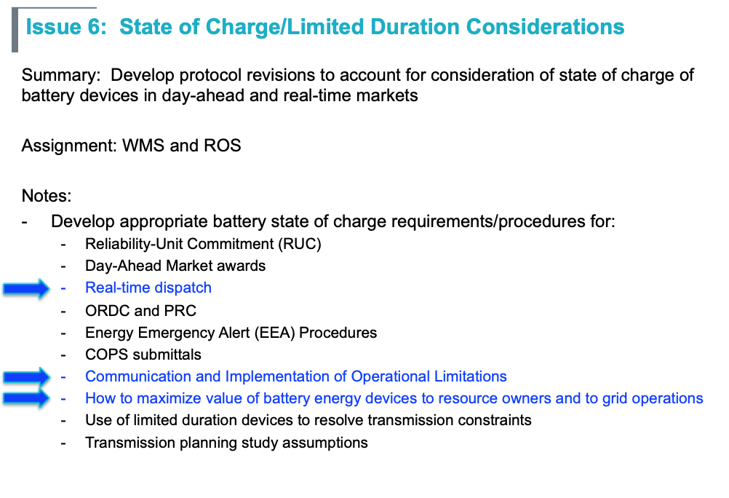
Initial Issue at WMS
In addition, ERCOT will bring to ROS in a future meeting the issue we presented to WMS yesterday, specifically: how battery resource owners should indicate their operational preferences in the real-time market.

Slide 10
Real-Time Dispatch
NPRR 915 defined a “Limited Duration Resource” resource attribute as follows:
  A Generation Resource less than 10 MW or a Load Resource less than 10 MW that may be unavailable to Security-Constrained Economic Dispatch (SCED) due to the need to maintain its current state of charge.
…and added the following language to protocols section 3.8.5:
If the QSE for a Limited Duration Resource (LDR), operating as a Generation Resource, does not want SCED to send Base Points to deploy the LDR, then the QSE shall set the telemetered Resource Status to OFF.
NPRR 915 was not intended to be a long-term solution, and it does not apply to all battery resources.

Slide 11
Communicating Dispatch Preferences
What are the ways that a battery storage resource QSE can indicate their dispatch preferences in the real-time market?
  Resource Status
  Resource Capability (HSL)
  Energy Offer Curve
  State of Charge
  Others
Considerations for limited duration resources:
  Battery may be scheduled to provide energy or A/S in a future hour
  QSE may believe energy or A/S prices will be higher in a future period
  Telemetered data should not obscure actual capability of the device
  QSE preferences may change due to market conditions

Slide 12
Appendix
The following slides provide the list of issues assigned to other subcommittees

Slide 13
Issue 1: Resource Definition
Summary: Develop appropriate terminology for protocol definitions of registered and unregistered battery energy storage devices
Assignment: Resource Definition Task Force (RTF)
Notes:
Prerequisite for establishing technology-specific requirements in protocols
Stakeholders have reviewed a proposed delineation of battery energy storage at RTF.

Slide 14
Issue 3: Wholesale Storage Load Treatment
Summary: Review process for approval of wholesale storage load (WSL) requests
Assignment: Wholesale Market Subcommittee (WMS)/Metering Working Group
Notes:
WSL requests for battery devices co-located with other resources
WSL for batteries at Private Use Networks (PUNs)
WSL for batteries connected to a DSP System (SODG with only aux load and SODG co-located with customer load)

Slide 15
Issue 4: Market System Design Changes
Summary: Review design and requirement changes that allow ERCOT to better model battery energy storage devices in its Market Management System (MMS)
Assignment: WMS
Notes:
Battery devices are currently modeled as two independent resources – a generation device and a Controllable Load Resources. MMS revisions will be required to model a battery device as one device that can extract and generate electricity.
Review device-specific assumptions and bidding requirements

