Slide 1
Market Credit Working Group update to the Wholesale Market Subcommittee
Bill Barnes NRG, Chair
Josephine Wan Austin Energy, Vice Chair
07/10/2019

Slide 2
MCWG update to WMS
General Update
June 19th Joint MCWG/CWG Meeting
7 NPRRS reviewed for their credit impacts
939NPRR Modification to Load Resources Providing RRS to Maintain Minimum PRC on Generators During Scarcity Conditions.
940NPRR Removal of Language Related to NPRR664, Fuel Index Price for Resource Definition and Real-Time Make-Whole Payments for Exceptional Fuel Cost Events.
942NPRR Clarification of Revised Transaction Limit Posting.
943NPRR Holiday Schedule Update.
944NPRR As Built Day-Ahead Market Energy Bid Curve Submission Validation.
948NPRR Instrument Transformer Testing Schedule and Removal of Reference to Fiber-Optic Current Transformers.
949NPRR January 1, 2023 Changes to EPS Meter Communications Path.
All operational without any credit impact.
Mass Transition Test Update

Slide 3
MCWG update to WMS
Overview of Financial Industry Entry Qualification Processes
ERCOT reviewed registration/qualification requirements/processes for the following organizations within the financial sector:
U.S. Commodity Futures Trading Commission (CFTC)
National Futures Association (NFA)
U.S. Securities and Exchange Commission (SEC)
Financial Industry Regulatory Authority (FINRA)
Texas State Securities Board (TSSB)
Chicago Mercantile Exchange (CME)
Chicago Board of Trade (CBOT)
New York Mercantile Exchange (NYMEX)
Commodity Exchange (COMEX)
ERCOT will be conducting similar reviews for:
The Nasdaq Stock Market (NASDAQ)
The Intercontinental Exchange (ICE)

Slide 4
MCWG update to WMS
Overview of Financial Industry Entry Qualification Processes
FINRA
Designated by SEC to oversee registration of securities brokers/dealers, and investment advisors
Registration:
General information gathering
Criminal, financial, regulatory, bankruptcy, and civil judicial disclosures
Qualifications: (FINRA rule 1014(a))
Pass Securities Industry Essentials (SIE) exam and appropriate Series qualification exam (Series 7, etc.)
Capable of complying with the law; has appropriate financial controls, net capital, communication and operational systems, supervisory systems, records keeping system, etc.
Application Review: (FINRA rule 1014(b) and (c))
Background Check: education records, military status, employment status, foreign activities, RAP sheet, etc.
Timeline: Firms have 30 days to submit form to register new hires, and FINRA has 15 days to complete the background checks
If applicant does not meet qualifications, a presumption exists that the application should be denied
Appeals:
Process set out in FINRA rules 1015-1019

Slide 5
MCWG update to WMS
Detailed Review of Greenhat Default Findings & Recommendations (See June 19 2019 MCWG page)
Cross reference to ERCOT credit rules and practices
Recommendation A - PJM Advances Best Practices into the Credit Policy under the FERC Tariff
Recommendation B – Clarify the Role of PJM as Manager of Risk in Financial Markets
Recommendation C - PJM builds a new keen awareness beyond just company names and market operational procedures
Recommendation D - PJM implements technical practices to protect all members from a bad actor in FTR Markets
Recommendation E - PJM adds new expertise sorely needed for decision making in financial markets
Recommendation F - PJM Enriches forward FTR market information so that PJM & market may better assess risks and rewards
Recommendation G - PJM makes organizational changes to open the door to a new outlook for robust RTO financial markets

Slide 6
MCWG update to WMS
Surety Bond Discussion
16.11.3 Alternative Means of Satisfying ERCOT Creditworthiness Requirements
(c) The Counter-Party may give a surety bond naming ERCOT as the beneficiary.
The surety bond must be signed by a surety acceptable to ERCOT, in its sole discretion and must be in the form of ERCOT’s standard surety bond form approved by the ERCOT Board. No modifications to the form are permitted.
The surety bond must be issued by an insurance company with a minimum rating of A- with S&P or Fitch or A3 with Moody’s.
Surety bonds are subject to a limit of $10 million per Counter-Party per insurer and an overall limit of $100 million per insurer for all ERCOT Counter-Parties.
MCWG discussion: Surety Bond limits and timing of payment by the Surety.
Revisions to the Surety Bond form will be proposed by an ERCOT stakeholder for review at a future CWG/MCWG meeting.

Slide 7
MCWG update to WMS
ERCOT Credit Exposure Updates
Market-wide average TPE increased from $322.6 million to $324.0 million
The increase in TPE is due to slightly higher Forward Adjustment Factors in May
Discretionary Collateral is defined as Secured Collateral in excess of TPE,CRR Locked ACL and DAM Exposure.
Average Discretionary Collateral increased from $796.3 million to $870.7 million
The increase in Discretionary Collateral is largely due to increase in Secured Collateral
Number of active Counter-Parties decreased from 241 to 239
No unusual collateral call activity

Slide 8
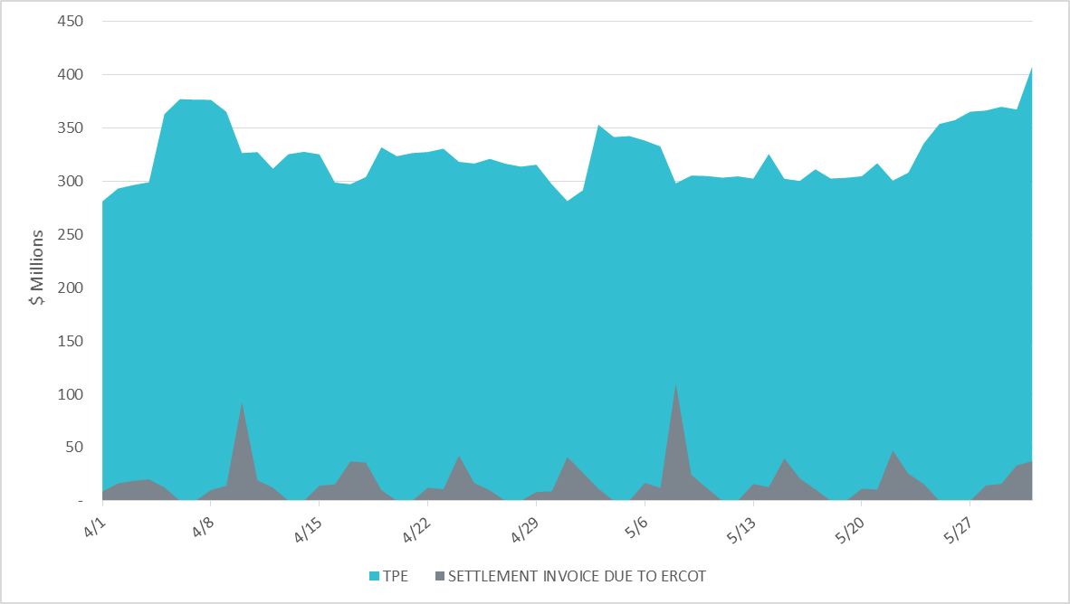
MCWG update to WMS

Slide 9
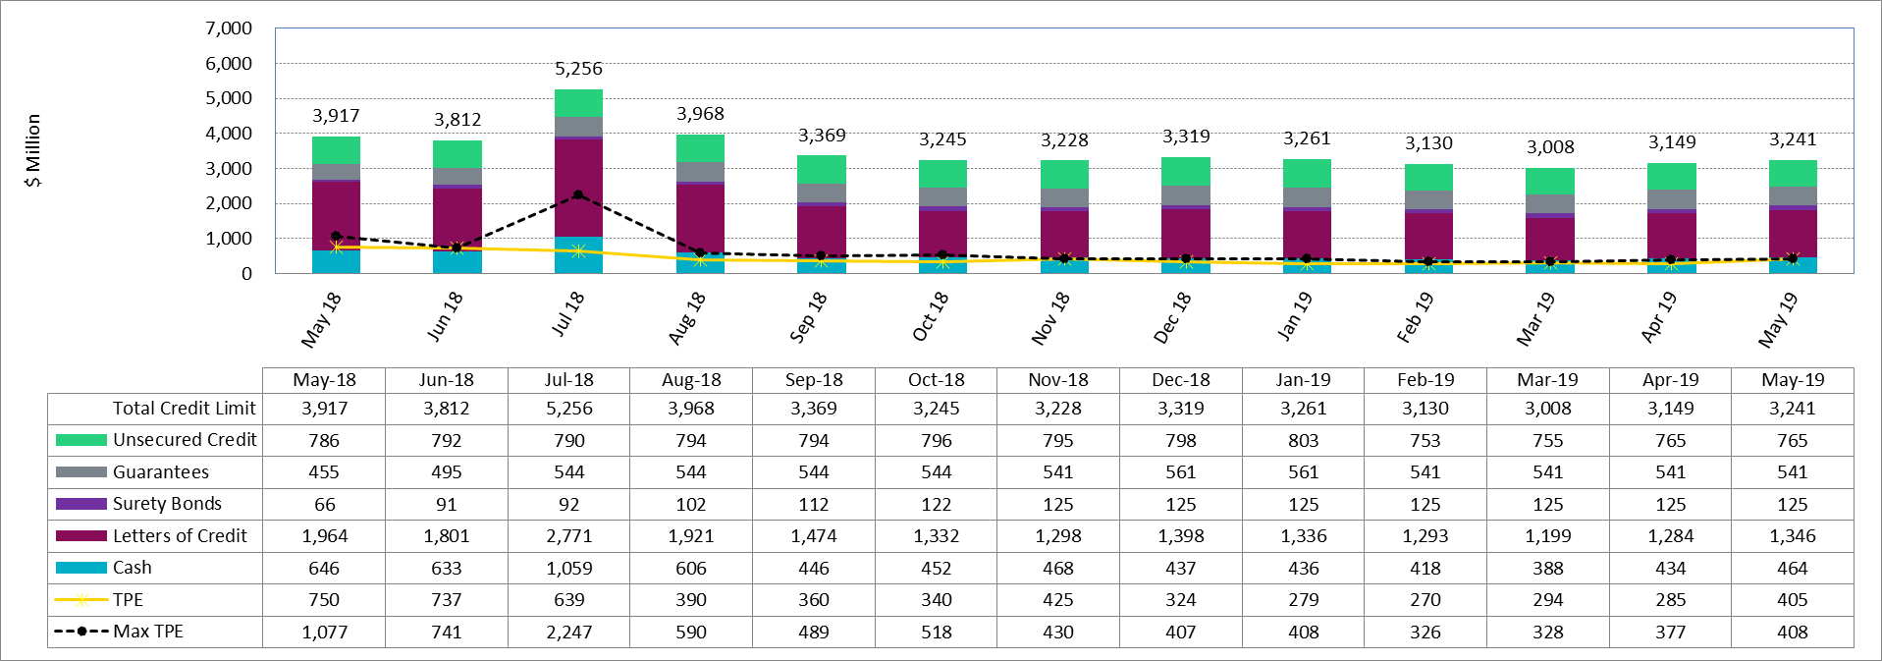
MCWG update to WMS

Slide 10
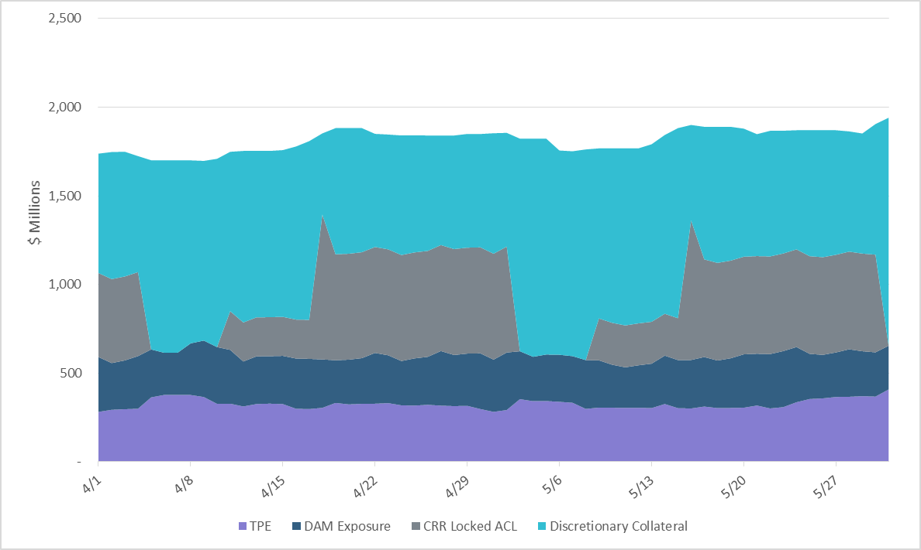
MCWG update to WMS
Note: Discretionary collateral doesn’t include Unsecured Credit Limit or parent guarantees

Slide 11
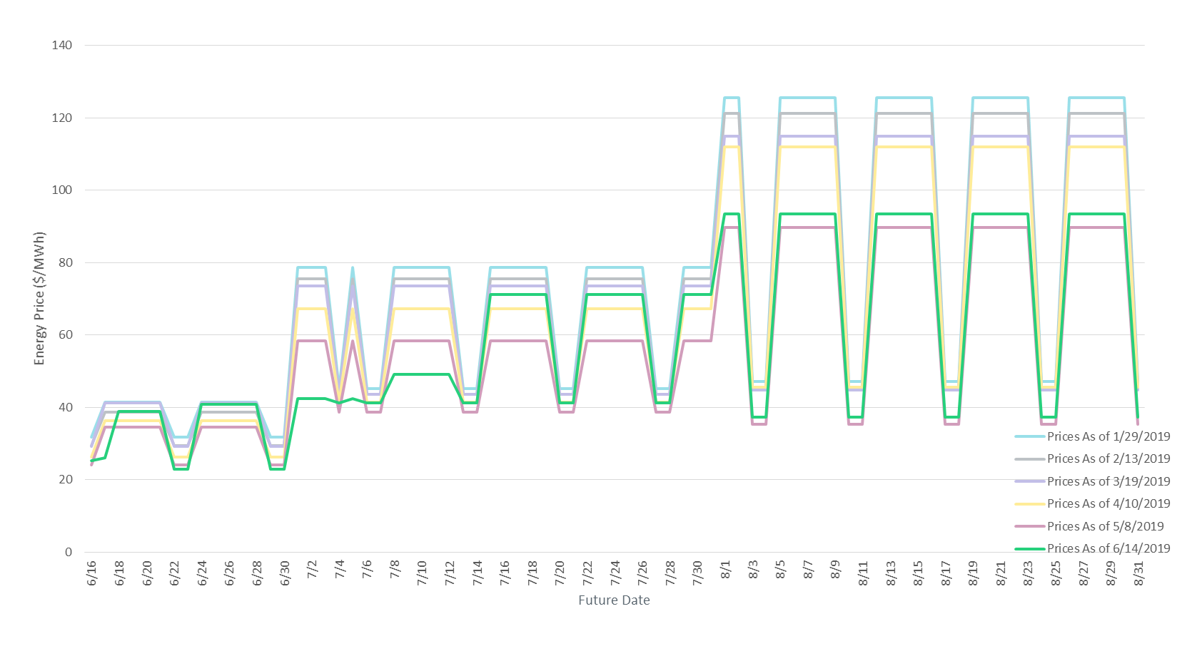
MCWG update to WMS

