Slide 1
ERCOT Electricity Market Design, SCED, Data and May 30, 2019
Wholesale Market Working Group Meeting
June 24, 2019
Ron McNamara, PhD
First Principles Economics, LLC

Slide 2
Review of What We Know
On May 30, 2019 at approximately 2:50PM (14:50:04) there was a loss of generation capacity available to SCED for dispatch of between 6,000 – 7,000MW.
As a result SCED pushed locational marginal prices to the maximum - $9,000/MW.
There was no minimum frequency alert.
The Bus Average LMPs for the intervals 14:30-14:45, 14:45-15:00 and 15:00-15:15 were $40.53, $1359.13 and $29.50 respectively
The system wide load for the three intervals was 55,405 MWs, 55,507 MWs, and 55,697 MWs respectively.
The approximate total cost of electricity for the three intervals was $561,391, $18,860,307, and $410,765 respectively.
There was a completely unjustifiable wealth transfer of >$18 million.
This was without any exaggeration a failure of the market
It was an extremely important event because it highlights a number of issues.
Let’s work to make the market better.
No benefit to assigning blame…although the market monitor should investigate the responsible QSE for market manipulation and the potential gains made from financial trading.
Earlier in the day (11:42:24) a similar loss of capacity available for dispatch occurred.

Slide 3
Five Issues
This event itself was problematic and so too has been the response.
This was a serious event…yet the response by ERCOT, the PUCT and the Market Participants (at least as evidenced by what took place at the WMS Meeting on June 4th) has been surprisingly “accepting.”
More than $18 million dollars was unjustifiably taken from one set of market participants.
The possibility of a reliability event was created by ERCOT (incorrectly) calling a substantial amount Emergency Response Service.
The cost of power exchanged on financial exchange rose dramatically as have margin requirements for those transacting on the exchanges.
Raises the cost of electricity to all Texas consumers.
The event was entirely artificial…there was no sudden loss of generation, no unforeseen increase in demand, no transmission outage.
The event raises four fundamental issues that need to be addressed by ERCOT, the market participants and the PUCT.

Slide 4
First Issue – Market Design Part 1
The design, implementation and operation of the ERCOT market should be reviewed in light of the fact that raw market participant provided data apparently flows directly into the SCED process with no QA/QC process applied to the data.
The first question to be asked is whether this represents an endemic/organic problem.
With respect to the issue it is not obvious that the PUCT, Market Participants and possibly ERCOT itself are aware that ERCOT made a decision to be “different” than other markets.
And certainly there is no understanding of why this decision was made…what the costs and benefits of the decision were…and whether or not the decision is (or has been) in the best interest of the market and Texas.
“In the Nodal Market, ERCOT and the QSE share responsibilities for the Real-Time dispatch of Resources.” (BP ERCOT and QSE Operations Practices During the Operating Hour). This begs the question: Who is driving the bus? Is it ERCOT or the QSE? (The rationale for this decision pre-dates the nodal market…and is still as flawed now as it was then.)
But then this begs the question of why QSE’s were not eliminated when ERCOT went to nodal pricing.
QSE’s need not exist (they never did)…they are simply a legacy.
The alternative – that should be adopted – is to use State Estimator Data…like MISO and PJM.
Don’t believe this event could happen in either of those markets.
Absent that solution, the only alternative is for ERCOT to put more and more checks and filters on data supplied by the QSE’s…which then obviously raises the same question – if ERCOT is required to validate and confirm all of the data supplied by the QSE…then why is the QSE submitting the data in the first place?
Alternatively ERCOT can continue to allow insane and discriminatory results like those of May 30th to occur.
This is - by far - the most important issue/solution.

Slide 5
Second Issue – Market Design Part 2
Before settlement prices are published they should be reviewed not just for “technical” correctness but whether they also adhere to economic fundamentals.
It does not take an advanced to degree in economics to look at the following data and not suspect there was something wrong with SCED in the middle interval
Whether or not the price was calculated “correctly” is irrelevant – it was clearly the “wrong” price.
If they don’t already have the discretionary authority (I believe they do) ERCOT should be given the authority to confirm that prices broadly reflect economic fundamentals and to re-price when prices do not adhere to economic fundamentals.
ERCOT may be uncomfortable with this discretion.
This is the way other markets operate and should be the way ERCOT operates.
Interval (May 30, 2019) | LMP | System Load
14:30 | $40.53 | 55,405 MWs
14:45 | $1359.13 | 55,507 MWs
15:00 | $29.50 | 55,697 MWs

Slide 6
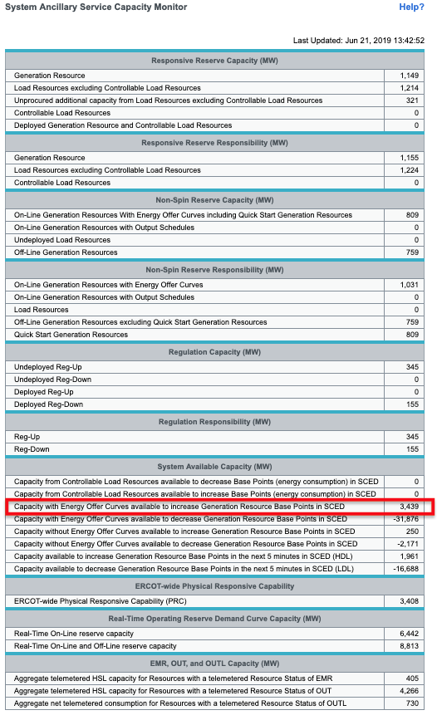
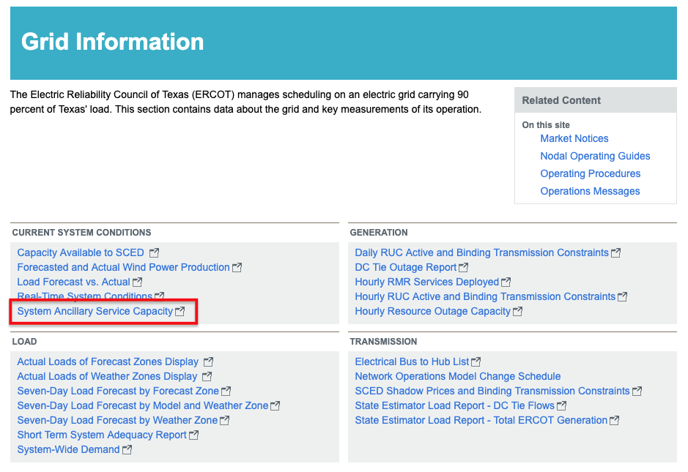
Third Issue – SCED Operation Part 1
The problem that occurred on May 30, 2019 at 2:50 is not an isolated event.
Start with data found here: ….which looks like this:
And is defined as:

Slide 7
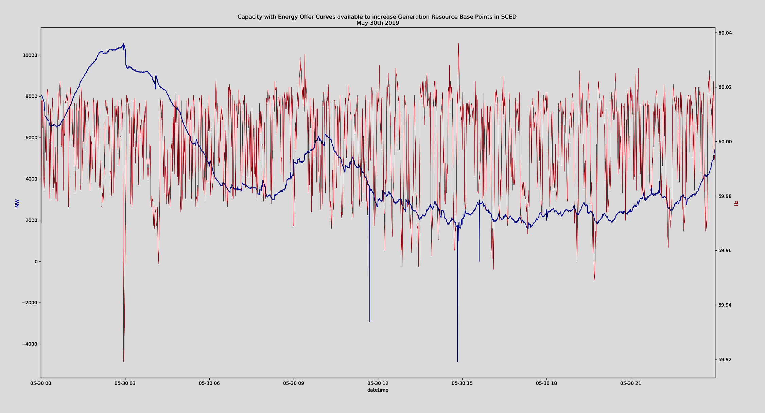
Third Issue – SCED Operation Part 2
The data below is for May 30th…the blue line is the Capacity With Energy Offer Curves available to increase Generation Resource Base Points in SCED, i.e., the excess capacity available for SCED dispatch…the red line is frequency
Loss of capacity due to “bad” telemetry. No associated movement in frequency. No price effect.
Loss of capacity due to a QSE setting HSL=LSL=0. No associated movement in frequency. Price rises to $9000.

Slide 8
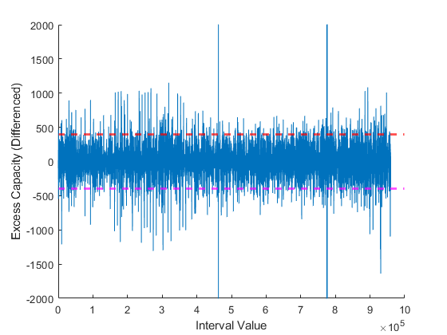
Third Issue – SCED Operation Part 3
The graph below plots the change from one interval to the next in Capacity With Energy Offer Curves available to increase Generation Resource Base Points in SCED since March 1, 2019 for every interval. There were 959,825 intervals. The two horizontal lines in the center of the graph indicate interval-to-interval deviations of at least +/- 400MW.

Slide 9
Third Issue – SCED Operation Part 3
Some statistics on the data from the previous graph:
10 largest increases in excess capacity (in MWs) from one interval to the next
10 largest decreases in excess capacity from one interval to the next:
1. | 6630 | 6. | 1084
2. | 6495 | 7. | 1072
3. | 6163 | 8. | 1034
4. | 2973 | 9. | 1031
5. | 1152 | 10. | 1029
1. | -6555 | 6. | -1307
2. | -6513 | 7. | -1298
3. | -5837 | 8. | -1284
4. | -2740 | 9. | -1211
5. | -1639 | 10. | -1188

Slide 10
Third Issue – SCED Operation Part 3
In total there were 324 instances when available excess capacity increased by at least 400MW from one interval to the next and 343 instances when available excess capacity fell by at least 400MW from one interval to the next.
Of the 324 instances when available capacity increased by at least 400 MW from one interval to the next, on 17 occasions the increase was eliminated in the very next interval. In a further 10 instances the increase was eliminated within 3 intervals.
Of the 343 instances when available capacity fell by at least 400 MW from one interval to the next, on 23 occasions the decreases was reversed in the very next interval. In a further 5 instances the decrease was eliminated within 3 intervals.
Thus there were 667 instances when available capacity increased or decreased by at least 400 MW from one interval to the next from March 1, 2019 to June 20, 2019 and (at a minimum) in 55 of those instances the entire change in available capacity was erased within 3 intervals.
Remember an interval is between 5 and 15 seconds!
Thus it is reasonable to conclude that on at least 55 occasions, the SCED process produced fictitious quantities for Capacity With Energy Offer Curves available to increase Generation Resource Base Points in SCED.
…55 occurrences in less than 4 months…and that is at a minimum!

Slide 11
Fourth Issue – QSE Data Provision and Market Monitoring
We are unaware as to whether all data submissions provided by each Qualified Scheduling Entity to ERCOT are subject to review by the Market Monitor.
Given the “shared responsibility ” of ERCOT and the QSE’s for the real-time dispatch of resources, it is imperative that the market monitor review every data submission made by a QSE.
Given the ability for QSE supplied data to directly affect dispatch and the locational marginal prices, this review should be completed before prices are finalized and published.
The review should occur automatically and not on a (after-the-fact) case-by-case basis.
Furthermore, the Market Monitor should coordinate with financial exchanges so that they can understand the overall affect of an “incorrect” price created by the submission of faulty data by a QSE.

