Slide 1
NPRR928
Cybersecurity Incident Notification
Workshop I
Juliana Morehead, Assistant General Counsel
Brandon Gleason, Senior Corporate Counsel
Mike Allgeier, Director of Critical Infrastructure Security
June 25, 2019

Slide 2
Workshop Overview
  Why? How?
  Texas Legislation: 86th Legislature – Update
  NPRR928 v. NERC Reliability Standard CIP-008-5
  NPRR928 Details
  Examples – Cybersecurity Incident Notification Form
  Next Steps

Slide 3
NPRR928, Cybersecurity Incident Notification
Why?
To provide ERCOT and Market Participants (MPs) with increased awareness of cybersecurity incidents that have the potential to impact systems and networks that interface with ERCOT
To help mitigate and prevent interruption to the ERCOT System and market operations
To help protect against future Cybersecurity Incidents
How?
By establishing notification responsibilities for MPs and ERCOT

Slide 4
Summary of NPRR928
Definition: Cybersecurity Incident
A malicious/suspicious act that compromises/disrupts a computer network/system of ERCOT, a MP (or its agent) that transacts with ERCOT, which could foreseeably jeopardize the reliability/integrity of the ERCOT System or market operations.
Protected Information
Disclosures to Governmental Cybersecurity Oversight Agencies
Government agency (or delegate) with cybersecurity oversight under its purview
Limited purpose: Ensuring the safety/security of the ERCOT System or market operations
Receiving agency/entity to maintain confidentiality; ERCOT to notify MP of any disclosure
Definition/New Contact Type: Cybersecurity Contact
Notification: Cybersecurity Incident Notification Form
New standard form
Alternative methods for communicating Cybersecurity Incident information also available
Market Notice
Material impact to ERCOT or MP systems/networks → Market Notice with general information

Slide 5
History of NPRR928
03/20/2019 | NPRR928 Posted
04/10/2019 | ERCOT Comments
04/11/2019 | Protocol Revisions Subcommittee (PRS) Discussion: Good concept; Definition may be too broad Why not “Cyber Security” instead of “Cybersecurity”? Emailing a form may not be secure Examples in form do not match definition State legislation may address the issues Many undefined “problems”
05/03/2019 | Critical Infrastructure Protection Working Group (CIPWG) Discussion: Can ERCOT utilize E-ISAC for reporting? Timing requirement for reporting: Suggested change from “immediate” notification to “as soon as practicable” Should Interconnecting Entities (IEs) be subject to NPRR928 Delete examples from the notification form Form appears burdensome
Noted MP concerns:
PRS
CIPWG

Slide 6
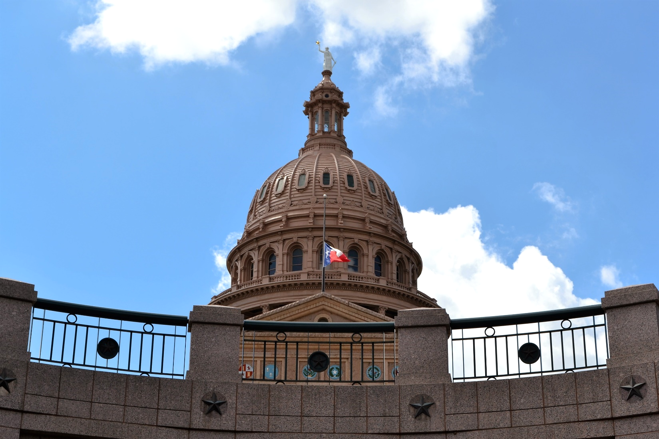
Texas Legislation
86th Legislature

Slide 7
Texas Legislation — 86th Legislature
Senate Bill 64 (Cybersecurity for Information Resources)
Effective 9/1/19
Public Utility Commission of Texas (Commission) to establish a program to monitor cybersecurity efforts among utilities that provides guidance on cybersecurity best practices and facilitates the sharing of information between utilities
Requires ERCOT to conduct an internal cybersecurity risk assessment and submit an annual report to the Commission regarding compliance with applicable cybersecurity and information security laws
Senate Bill 475 (Grid Security Council)
Effective Immediately
Establishes the Texas Electric Grid Security Council; Council to facilitate the creation, aggregation, coordination, and dissemination of best security practices for the electric industry
  Council: Presiding Commissioner, ERCOT CEO & Governor (or designated representative)
Senate Bill 936 (Cybersecurity Monitor)
Effective 9/1/19
Requires engagement of a Cybersecurity Monitor to:
  Manage cybersecurity outreach
  Facilitate best practices and training
  Review voluntary self-assessments
  Research and develop best practices for cybersecurity
  Report to the Commission on cybersecurity preparedness
Recent Texas legislation did not materially impact NPRR928.

Slide 8
Access to ERCOT Systems

Slide 9
ERCOT System Access Under NPRR928
Market Participant
Access
to
ERCOT Systems
Public Website (Login/Password)
Texas Renewable Energy Credit Account
(www.texasrenewables.com)
EDI
(ANSI ASC X12)
Retail Transactions
Internet
(all MP types)
MFA Applications
(Login/Password/Other)
RIOO-IS (including IEs)
FlighTrak
Citrix
(Digital Cert)
Macomber Map
SOTEEMS
WebFG
Firewall
MIS
(via Digital Cert)
MMS
Outage Scheduler
CRR MUI
NMMS
MarkeTrak (Retail Transaction Resolution)
MP Service Requests
Settlement/Billing Dispute Resolution
MP Data Extracts/Reports
Testing Sites (SOTE,MOTE,RMTE)
WAN
(QSEs/
TDSPs)
ICCP
EMS
See Appendix C for Acronym Key

Slide 10
What is a Cybersecurity Incident?
NPRR928 v. CIP-008-05

Slide 11
ERCOT MPs Registered with NERC
ERCOT MPs:
939
Only NERC-registered entities are subject to the NERC Reliability Standards, including CIP-008
Less than 25% of ERCOT MPs are registered with NERC
ERCOT MPs currently have no legal obligation to report cybersecurity incidents directly to ERCOT
ERCOT MPs registered with NERC:
191

Slide 12
Definition – NPRR928
  Cybersecurity Incident
  A malicious act or suspicious act that compromises or disrupts a computer network or system of ERCOT, a [MP], or a [MP’s] agent that transacts with ERCOT, or its agent, which could foreseeably jeopardize the reliability or integrity of the ERCOT System or ERCOT market operations.
See Appendix A for explanation as to why ERCOT chose to utilize Cybersecurity as a single word.

Slide 13

Definition – NPRR928
  Cybersecurity Incident
Reliability/
Integrity
ERCOT/
MP/
MP’s Agent
Computer
Network/System
Malicious/
Suspicious
Act
Compromises/Disrupts
Foreseeably Jeopardizes
ERCOT System
or
Market Operations

Slide 14
Definitions – NERC CIP-008-5*
Cyber Security Incident
A malicious act or suspicious event that: (1) Compromises, or was an attempt to compromise, the Electronic Security Perimeter or Physical Security Perimeter, or (2) Disrupts, or was an attempt to disrupt, the operation of a BES Cyber System.
Reportable Cyber Security Incident
A Cyber Security Incident that has compromised or disrupted one or more reliability tasks of a functional entity.
*FERC approved CIP-008-6 on June 20, 2019 with an 18 month implementation timeline. Version 6 expands the definition of Cyber Security Incident to include Electronic Access Control or Monitoring Systems (EACMS) and the scope of the reporting requirement to include attempts to compromise “Applicable Systems.”
See also Appendix B - NERC Reliability Standard CIP-008-5

Slide 15

Definitions – NERC CIP-008-5
Reportable Cyber Security Incident
Functional Entity’s Electronic/Physical
Security
Perimeter
Reliability Tasks
Compromises/
Attempted Compromise
Malicious Act/
Suspicious
Event
Compromises/Disrupts
of a
NERC-registered entity
Disrupts/
Attempted Disruption
Operation of a Functional Entity’s
BES Cyber System

Slide 16
Reporting Requirements
NPRR928 v. CIP-008-05

Slide 17
Reporting Requirements: NPRR928 Information Flow
MPs report or ERCOT identifies a Cybersecurity Incident
ERCOT determines if
the event may materially impact
computer networks
or systems of
ERCOT/MPs
ERCOT will notify MPs via Market Notice
Broader reporting requirement focused on the ERCOT System (reliability) and ERCOT market operations
All MPs subject to reporting requirement, regardless of NERC registration
Provides ERCOT greater visibility and a more direct communication path
Requires ERCOT to alert MPs of potential material impacts

Slide 18

Reporting Requirements: E-ISAC Information Flow
E-ISAC determines whether communication to its membership via portal or other method to its membership is warranted
E-ISAC analyzes report
NERC-registered
Entity reports a Cyber Security Incident
Reporting requirement focused on ensuring reliability
Only NERC-registered entities are subject to reporting requirement under CIP-008-5
Limited scope of “Reportable Cyber Security Incidents”
Membership in E-ISAC is VOLUNTARY and reporting is typically ANONYMOUS

Slide 19
ERCOT Systems Subject to CIP-008-5
Market Participant
Access
to
ERCOT Systems
Public Website (Login/Password)
Texas Renewable Energy Credit Account
(www.texasrenewables.com)
EDI
(ANSI ASC X12)
Retail Transactions
Internet
(all MP types)
MFA Applications
(Login/Password/Other)
RIOO-IS (including IEs)
FlighTrak
Citrix
(Digital Cert)
Macomber Map
SOTEEMS
WebFG
Firewall
MIS
(via Digital Cert)
MMS
Outage Scheduler
MMS
Outage Scheduler
CRR MUI
NMMS
MarkeTrak (Retail Transaction Resolution)
MP Service Requests
Settlement/Billing Dispute Resolution
MP Data Extracts/Reports
Testing Sites (SOTE,MOTE,RMTE)
BES
Cyber Systems
WAN
(QSEs/
TDSPs)
ICCP
EMS

Slide 20
NPRR928
PROTOCOL CHANGES

Slide 21
Protected Information
Cybersecurity Incident Information
Protocol Section 1.3.1.1(hh)
Information provided to ERCOT under new Protocol Section 16.19, Cybersecurity Incident Notification, will be considered Protected Information under the Protocols.
Caveat: ERCOT may disclose “general information” concerning a Cybersecurity Incident in a Market Notice for the purpose of assisting MPs in mitigating risk associated with such incident.
  Any such Market Notice will not contain:
    Information identifiable to a specific MP; or
    Critical Energy Infrastructure Information (CEII).

Slide 22
Disclosure Exception
Exception - Protocol Section 1.3.6(1)(l)
ERCOT may disclose Cybersecurity Incident information to a “governmental cybersecurity oversight agency or delegated entity” for the purpose of ensuring the safety and/or security of the ERCOT System or market operations.
  ERCOT considers a “governmental cybersecurity oversight agency” to be a government agency (or delegate) with cybersecurity oversight under its purview
Disclosure Parameters:
  Only to a governmental cybersecurity oversight agency or delegated entity
  For the sole purpose of ensuring the safety/security of the ERCOT System/market operations
Confidentiality Assurance - Protocol Section 1.3.4(3)
Before disclosure, ERCOT will obtain assurance that the recipient agency/entity will maintain confidentiality of the information.
MP Notification - Protocol Section 1.3.6(1)(l)
As soon as practicable, ERCOT will notify MP of any disclosure

Slide 23















Governmental Cybersecurity Oversight Agency Examples
Federal/National
State

Slide 24
Cybersecurity Contact
New Definition & Contact Type: Cybersecurity Contact
Contact designated by MP, as the primary point of contact for communications between the MP and ERCOT with respect to Cybersecurity Incidents
Temporary Cybersecurity Contact - Protocol Section 16.19(3)(a)
  MP may designate a temporary Cybersecurity Contact for a particular Cybersecurity Incident pursuant to Section 16.19, Cybersecurity Incident Notification
Updating/Maintaining Cybersecurity Contact Information
Notice of Change of Information (NCI) (Protocol Section 23, Form E)

Slide 25

Market Notice
ERCOT Determination
  Any Cybersecurity Incident that may have a material impact on ERCOT/MP networks/systems
Market Notice
  Will not identify disclosing MP or CEII
  May be limited to impacted MPs

Slide 26
Market Notice Example
NOTICE DATE: January 1, 2020
NOTICE TYPE: M-A010120-01 General
SHORT DESCRIPTION: Cybersecurity Incident
INTENDED AUDIENCE: All Market Participants
DAY AFFECTED: January 1, 2020
LONG DESCRIPTION: On January 1, 2020, a Market Participant reported the receipt of fraudulent phishing emails from an address appearing to have originated from ERCOT. ERCOT has determined that these email messages did not originate from ERCOT. The emails include a URL that, when clicked, directs users to a malicious website where users are required to enter their user credentials.
The email address used in these phishing emails is services@ercot.com, and the emails contain the following subject line: “ERCOT market training opportunities.”
The email address services@ercot.com is not an ERCOT email address. Market Participants should not open emails with this address.
Please be on alert for these fraudulent emails, and take appropriate security measures to prevent opening/transmitting these emails.
ADDITIONAL INFORMATION: Market Participants that receive the phishing email are encouraged to report the event to ERCOT by submitting a Cybersecurity Incident Notification to NCSI@ercot.com, or if you are unable to securely send the notice, you may call the ERCOT HelpDesk at (512) 248-6800 or contact your ERCOT Account Manager to request a secure means of sending the Notice of Cybersecurity Incident.
CONTACT: If you have any questions, please contact your ERCOT Account Manager. You may also call the general ERCOT Client Services phone number at (512) 248-3900 or contact ERCOT Client Services via email at ClientServices@ercot.com.

Slide 27
Cybersecurity Incident Notification
MP Notification to ERCOT
Upon discovery of a Cybersecurity Incident, MP must immediately notify ERCOT
Extends to incidents that compromise/disrupt the network/system of an MP’s agent that transacts with ERCOT
Notice of Cybersecurity Incident (Form)
Alternatives available if MP unable to securely send/submit form

Slide 28



Cybersecurity Incident Notification (Form)
ERCOT Proposed Changes
Reportable Cybersecurity Incident Examples
Various methods for notifying ERCOT of a Cybersecurity Incident
  Email (NCSI@ercot.com); may be encrypted/PW protected
  Other secure means upon MP request
  Verbal with receipt verification

Slide 29
Notification Examples

Slide 30
Example 1: Ransomware
→ Ransomware attack on QSE’s control network that interfaces with ERCOT; QSE represents various REs
CYBERSECURITY INCIDENT NOTIFICATION
Details
Date and Time the Cybersecurity Incident was discovered: | June 12, 2019 08:00am
Has the Cybersecurity Incident been resolved? | No
Physical location of affected network(s), system(s) &/or application(s): | 123 Any St., Somewhere, TX 76543
Have Local/State/Federal Authorities been notified of the Cybersecurity Incident? If so, please identify the notified entities. | OE-417 report filed June 12, 2019 at 08:45am
Description
Provide a description of the Cybersecurity Incident: On June 12, 2019 at approximately 08:00 am, Company noticed several ransomware messages on computers containing Generation Management System (GMS). Information Technology (IT) notified employees, via email, of a potential infection on corporate workstations, and advised employees to power off their workstations. Backup control plan implemented and QSE operations has been switched to backup control center.
Provide a description of the type of information/data that may have been compromised: Loss of control system servers and unable to use the Corporate network. Phones are working.
Incident Response
Please provide a description of steps that have been taken to remediate the Cybersecurity Incident (e.g., no action taken; system disconnected from network; log files examined; etc.): Notified Executive Management and IT. Waiting for Incident Response team.
Please provide an ongoing log of activities taken during the Cybersecurity Incident response process:
Date/Time | Activity
June 12, 2019 08:25am | Notified Corporate IT, Incident Response Team on the way

Slide 31
Example 1: Ransomware
Market Participant
Access
to
ERCOT Systems
Public Website (Login/Password)
Texas Renewable Energy Credit Account
(www.texasrenewables.com)
EDI
(ANSI ASC X12)
Retail Transactions
Internet
(all MP types)
MFA Applications
(Login/Password/Other)
RIOO-IS (including IEs)
FlighTrak
Citrix
(Digital Cert)
Macomber Map
SOTEEMS
WebFG
Firewall
MIS
(via Digital Cert)
MMS
Outage Scheduler
CRR MUI
NMMS
MarkeTrak (Retail Transaction Resolution)
MP Service Requests
Settlement/Billing Dispute Resolution
MP Data Extracts/Reports
Testing Sites (SOTE,MOTE,RMTE)
WAN
(QSEs/ TDSPs)
ICCP
EMS

Slide 32
Example 2: Distributed Denial of Service (DDOS)
→ Ongoing DDOS attack against a REP, impacting its ability to send/receive retail transactions, submit MarkeTrak issues, and access extract information
CYBERSECURITY INCIDENT NOTIFICATION
Details
Date and Time the Cybersecurity Incident was discovered: | June 12, 2019 08:15am
Has the Cybersecurity Incident been resolved? | No
Physical location of affected network(s), system(s) &/or application(s): | 123 Any St., Somewhere, TX 76543
Have Local/State/Federal Authorities been notified of the Cybersecurity Incident? If so, please identify the notified entities. | No
Description
Provide a description of the Cybersecurity Incident: On June 12, 2019 at approximately 08:15 am, Company noticed a loss of internet. At 08:30 am Company’s Internet Service Provider (ISP) notified Company of a detected DDOS attack to Company’s network. Company’s email and phones (VOIP) are currently disabled; Company is unable to interface and communicate with ERCOT and Market Participant systems.
Provide a description of the type of information/data that may have been compromised: Loss of communication capabilities only; no known data loss
Incident Response
Please provide a description of steps that have been taken to remediate the Cybersecurity Incident (e.g., no action taken; system disconnected from network; log files examined; etc.): Network troubleshooting with Company ISP.
Please provide an ongoing log of activities taken during the Cybersecurity Incident response process:
Date/Time | Activity
June 12, 2019 08:30am | After verifying loss of the Internet, email, website and phone services, the IR plan was initiated. ISP also gave notice of DDOS outage.

Slide 33
Example 2: Distributed Denial of Service (DDOS)
Market Participant
Access
to
ERCOT Systems
Public Website (Login/Password)
Texas Renewable Energy Credit Account
(www.texasrenewables.com)
EDI
(ANSI ASC X12)
Retail Transactions
Internet
(all MP types)
MFA Applications
(Login/Password/Other)
RIOO-IS (including IEs)
FlighTrak
Citrix
(Digital Cert)
Macomber Map
SOTEEMS
WebFG
Firewall
MIS
(via Digital Cert)
MMS
Outage Scheduler
CRR MUI
NMMS
MarkeTrak (Retail Transaction Resolution)
MP Service Requests
Settlement/Billing Dispute Resolution
MP Data Extracts/Reports
Testing Sites (SOTE,MOTE,RMTE)
WAN
(QSEs/ TDSPs)
ICCP
EMS

Slide 34
Example 3: Insider Threat
→ Digital Certificate belonging to QSE/CRRAH employee compromised due to insider threat
CYBERSECURITY INCIDENT NOTIFICATION
Details
Date and Time the Cybersecurity Incident was discovered: |  | June 12, 2019 04:15am
Has the Cybersecurity Incident been resolved? |  | Yes
Physical location of affected network(s), system(s) &/or application(s): |  | 123 Any St., Somewhere, TX 76543
Have Local/State/Federal Authorities been notified of the Cybersecurity Incident? If so, please identify the notified entities. |  | No
Description
Provide a description of the Cybersecurity Incident: On June 12, 2019 at approximately 04:15 am, Company noticed bids from the previous DAM that were allegedly sent from Company to ERCOT; these bids did not originate from Company; Company identified the transactions as potentially fraudulent, and began an internal investigation. At 05:15 am, Company’s Human Resources (HR) Department received an email from a former employee, demanding 20 bitcoin; the former employee threatened additional action (continued submission of bids) if Company did not pay.
Provide a description of the type of information/data that may have been compromised: Digital Certificate compromised.
Incident Response
Please provide a description of steps that have been taken to remediate the Cybersecurity Incident (e.g., no action taken; system disconnected from network; log files examined; etc.): USA revoked Digital Certificate
Please provide an ongoing log of activities taken during the Cybersecurity Incident response process:
Date/Time | Activity
June 12, 2019 04:35am | Contacted USA
June 12, 2019 05:28am | USA Digital Certificate

Slide 35
Example 3: Insider Threat
Market Participant
Access
to
ERCOT Systems
Public Website (Login/Password)
Texas Renewable Energy Credit Account
(www.texasrenewables.com)
EDI
(ANSI ASC X12)
Retail Transactions
Internet
(all MP types)
MFA Applications
(Login/Password/Other)
RIOO-IS (including IEs)
FlighTrak
Citrix
(Digital Cert)
Macomber Map
SOTEEMS
WebFG
Firewall
MIS
(via Digital Cert)
MMS
Outage Scheduler
CRR MUI
NMMS
MarkeTrak (Retail Transaction Resolution)
MP Service Requests
Settlement/Billing Dispute Resolution
MP Data Extracts/Reports
Testing Sites (SOTE,MOTE,RMTE)
WAN
(QSEs/ TDSPs)
ICCP
EMS

Slide 36
Example 4: Phishing
→ TDSP email account compromised causing the transmission of emails containing credential harvesting links to ERCOT and other MPs
CYBERSECURITY INCIDENT NOTIFICATION
Details
Date and Time the Cybersecurity Incident was discovered: | June 12, 2019 10:35am
Has the Cybersecurity Incident been resolved? | Yes
Physical location of affected network(s), system(s) &/or application(s): | 123 Any St., Somewhere, TX 76543
Have Local/State/Federal Authorities been notified of the Cybersecurity Incident? If so, please identify the notified entities. | Reported to E-ISAC; Report # ABC123
Description
Provide a description of the Cybersecurity Incident: On June 12, 2019 at 10:35 am, Company received an email that appeared to have originated from ERCOT. Following review of the email, Company determined that the email did not come from ERCOT, but was a credential harvesting/phishing email. Company has identified at two least two employees whose user IDs and passwords were compromised. Both employees have changed their passwords.
Provide a description of the type of information/data that may have been compromised: User ID and password but mitigated with changing the password soon after the compromise.
Incident Response
Please provide a description of steps that have been taken to remediate the Cybersecurity Incident (e.g., no action taken; system disconnected from network; log files examined; etc.): Reviewed email and will block similar in the future.
Please provide an ongoing log of activities taken during the Cybersecurity Incident response process:
Date/Time | Activity
June 12, 2019 10:35am | Received notification of a possible credential harvesting phishing email
June 12, 2019 10:40am | Sent in the Indicators of Compromise to the E-ISAC portal

Slide 37
Example 4: Phishing
Market Participant
Access
to
ERCOT Systems
Public Website (Login/Password)
Texas Renewable Energy Credit Account
(www.texasrenewables.com)
EDI
(ANSI ASC X12)
Retail Transactions
Internet
(all MP types)
MFA Applications
(Login/Password/Other)
RIOO-IS (including IEs)
FlighTrak
Citrix
(Digital Cert)
Macomber Map
SOTEEMS
WebFG
Firewall
MIS
(via Digital Cert)
MMS
Outage Scheduler
CRR MUI
NMMS
MarkeTrak (Retail Transaction Resolution)
MP Service Requests
Settlement/Billing Dispute Resolution
MP Data Extracts/Reports
Testing Sites (SOTE,MOTE,RMTE)
WAN
(QSEs/ TDSPs)
ICCP
EMS

Slide 38
Example 5: Unexpected Third Party System Outage
→ Third Party Agent of LSE is unable to perform retail transactions with ERCOT on behalf of LSE due to actual/suspected Cybersecurity Incident
CYBERSECURITY INCIDENT NOTIFICATION
Details
Date and Time the Cybersecurity Incident was discovered: | June 12, 2019 08:00am
Has the Cybersecurity Incident been resolved? | No
Physical location of affected network(s), system(s) &/or application(s): | 123 Any St., Somewhere, TX 76543
Have Local/State/Federal Authorities been notified of the Cybersecurity Incident? If so, please identify the notified entities. | No
Description
Provide a description of the Cybersecurity Incident: On June 12, 2019 at approximately 08:00 am, Company was notified by its EDI service provider (Agent) of an unscheduled outage due to an unspecified cybersecurity issue; Agent did not provide Company with a timeframe for when services might return; Company is unable to reach Agent by phone or email.
Provide a description of the type of information/data that may have been compromised: Unknown
Incident Response
Please provide a description of steps that have been taken to remediate the Cybersecurity Incident (e.g., no action taken; system disconnected from network; log files examined; etc.): No action taken; Awaiting information from EDI service provider.
Please provide an ongoing log of activities taken during the Cybersecurity Incident response process:
Date/Time | Activity
June 12, 2019 8:25 am | Terminated all connectivity with EDI provider until their cybersecurity issue is resolved.

Slide 39
Example 5: Unexpected Third Party System Outage
Market Participant
Access
to
ERCOT Systems
Public Website (Login/Password)
Texas Renewable Energy Credit Account
(www.texasrenewables.com)
EDI
(ANSI ASC X12)
Retail Transactions
Internet
(all MP types)
MFA Applications
(Login/Password/Other)
RIOO-IS (including IEs)
FlighTrak
Citrix
(Digital Cert)
Macomber Map
SOTEEMS
WebFG
Firewall
MIS
(via Digital Cert)
MMS
Outage Scheduler
CRR MUI
NMMS
MarkeTrak (Retail Transaction Resolution)
MP Service Requests
Settlement/Billing Dispute Resolution
MP Data Extracts/Reports
Testing Sites (SOTE,MOTE,RMTE)
WAN
(QSEs/ TDSPs)
ICCP
EMS

Slide 40
Example 6: Stolen Credentials
→ IMRE Digital Certificate possible compromise with associated attempted compromise of ERCOT’s MIS Portal
CYBERSECURITY INCIDENT NOTIFICATION
Details
Date and Time the Cybersecurity Incident was discovered: | June 12, 2019 08:00am
Has the Cybersecurity Incident been resolved? | No
Physical location of affected network(s), system(s) &/or application(s): | 123 Any St., Somewhere, TX 76543
Have Local/State/Federal Authorities been notified of the Cybersecurity Incident? If so, please identify the notified entities. | Market Notice sent at 09:15am
Description
Provide a description of the Cybersecurity Incident: On June 12, 2019 at approximately 08:00am ERCOT received cybersecurity alerts of attempted compromise of the MIS portal by an IMRE Digital Certificate user account. At 08:40am the IMRE Cybersecurity Contact verified the user’s Digital Certificate might have been compromised from a stolen laptop.
Provide a description of the type of information/data that may have been compromised: Possible MIS secure information
Incident Response
Please provide a description of steps that have been taken to remediate the Cybersecurity Incident (e.g., no action taken; system disconnected from network; log files examined; etc.): Digital Certificate disabled and offending IP Address blocked
Please provide an ongoing log of activities taken during the Cybersecurity Incident response process:
Date/Time | Activity
June 12, 2019 8:15 am | Blocked offending IP Address
June 12, 2019 08:45am | Disabled Digital Certificate

Slide 41
Example 6: Stolen Credentials
Market Participant
Access
to
ERCOT Systems
Public Website (Login/Password)
Texas Renewable Energy Credit Account
(www.texasrenewables.com)
EDI
(ANSI ASC X12)
Retail Transactions
Internet
(all MP types)
MFA Applications
(Login/Password/Other)
RIOO-IS (including IEs)
FlighTrak
Citrix
(Digital Cert)
Macomber Map
SOTEEMS
WebFG
Firewall
MIS
(via Digital Cert)
MMS
Outage Scheduler
CRR MUI
NMMS
MarkeTrak (Retail Transaction Resolution)
MP Service Requests
Settlement/Billing Dispute Resolution
Testing Sites (SOTE,MOTE,RMTE)
MP Data Extracts/Reports
WAN
(QSEs/ TDSPs)
ICCP
EMS

Slide 42
Next Steps

Slide 43
Next Steps
Continue to table NPRR928 at PRS
ERCOT Comments by July 17, 2019
Stakeholder Comments by August 9, 2019
2nd Workshop August/September 2019

Slide 44
Appendix

Slide 45

Appendix A – “Cybersecurity” as a Single Word
Merriam-Webster defines Cybersecurity as “measures taken to protect a computer or computer system (as on the Internet) against unauthorized access or attack.”
The U.S. Department of Commerce’s National Institute of Standards and Technology (NIST) and Texas Legislature also utilize the term as a single word.
On occasion, NIST has split the term to distinguish security of cyber assets from physical security assets, as “physicalsecurity” is not a commonly recognized/defined term.
ERCOT primarily chose to adopt the term as a single word based on how the Texas Legislature has chosen to utilize under statute.
ERCOT expects the Commission will similarly use the single word “Cybersecurity” in future rulemakings.

Slide 46
APPENDIX B - NERC Reliability Standard CIP-008-5
CIP-008-5 Requirement R1, Table R1, Part 1.2*
  “Each Responsible Entity shall document one or more Cyber Security Incident response plan(s) that collectively include . . . [o]ne or more processes to determine if an identified Cyber Security Incident is a Reportable Cyber Security Incident and notify the Electricity Sector Information Sharing and Analysis Center (ES-ISAC), unless prohibited by law. Initial notification to the ES-ISAC, which may be only a preliminary notice, shall not exceed one hour from the determination of a Reportable Cyber Security Incident” (emphasis added).**
  Cyber Security Event:
  “A malicious act or suspicious event that: (1) Compromises, or was an attempt to compromise, the Electronic Security Perimeter or Physical Security Perimeter or, (2) Disrupts, or was an attempt to disrupt, the operation of a BES Cyber System.”
  Reportable Cyber Security Event:
  “A Cyber Security Incident that has compromised or disrupted one or more reliability tasks of a functional entity.”
*FERC approved CIP-008-6 on June 20, 2019 with an 18 month implementation timeline. Version 6 expands the definition of Cyber Security Incident to include Electronic Access Control or Monitoring Systems (EACMS) and the scope of the reporting requirement to include attempts to compromise “Applicable Systems.”.
**The Electricity Sector Information Sharing and Analysis Center (ES-ISAC) is now known as the Electricity Information Sharing and Analysis Center (E-ISAC).

Slide 47
APPENDIX C - Acronym Key
MPIM | Market Participant Identity Management | Digital Certificate access
MFA | Multi-Factor Authentication | User name, password & additional means of authentication
RIOO-IS | Resource Integration & Ongoing Operations Interconnection Services | GINR Process - Generation Interconnection or Change Request
EDI | Electronic Data Interchange | Electronic communications to facilitate retail transactions using American National Standards Institute Accredited Standards Committee X12 (ANSI ASC X12)
PGP | Pretty Good Privacy | Encryption program that provides privacy and authentication for data communication
TXSET | Texas Standard Electronic Transactions | Facilitates retail business processes
MIS | Market Information System | Electronic communications interface (web portal) that provides a single point of access for MPs, PUCT, and ERCOT staff to view/transmit market information
MMS | Market Management System | User interface that allows MPs to create, update and cancel submissions with respect to trades, Resource-specific submissions, bids and offers, schedules, self-arranged Ancillary Services (AS), Resource parameters, awards, notices, Verbal Dispatch Instructions (VDI), etc.
CRR MUI | Congestion Revenue Rights Market User Interface | Application used by CRR Account Holders and Counter-Parties to view and submit CRR market data
NMMS | Network Model Management System | ERCOT database that contains a model of the ERCOT interconnection; basis for applications used in reliability, market analysis and system planning
Outage Scheduler | Application used by TSPs and QSEs to submit outage notices or requests for outages
MarkeTrak | Application used by ERCOT, LSEs, and TDSPs to track retail market issues and data discrepancies
ICCP | Inter-Control Center Communications Protocol | Real-time data exchange protocol that provides features for data transfer, monitoring and control over WANs
WAN | Wide Area Network | Telecommunications network over a geographical distance for computer networking
EMS | Energy Management System | System of computer-aided tools used by ERCOT operators to monitor and control generation and transmission on the ERCOT Grid.
CITRIX | Software that allows users to access applications without installing application on the end-user’s device.
SOTEEMS | System Operations Test Environment for the Energy Management System | An environment used by TSPs to view the current ERCOT System model.
WebFG | A user interface used by TSPs to access the SOTEEMS – Accessed through CITRIX.
Macomber Map | A visualization tool used by ERCOT operations, and MPs for training simulations.

Slide 48
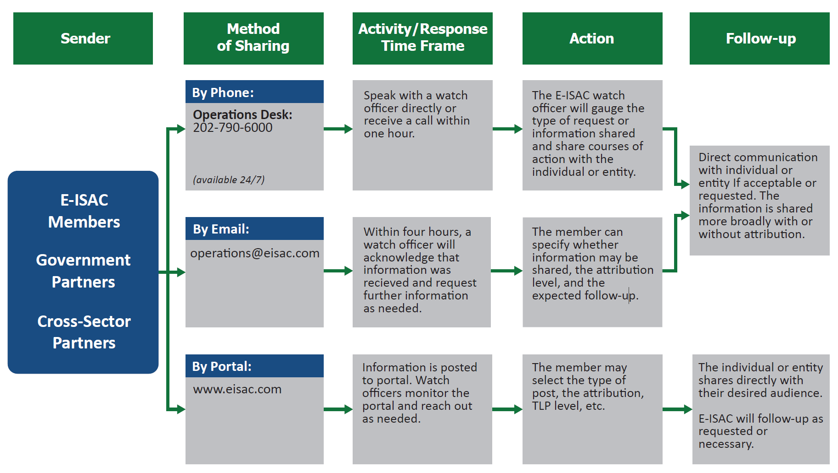
APPENDIX D - Reporting Requirements: E-ISAC Information Flow

