Slide 1
ERCOT Reporting of Outaged Resource Capacity
Market Analysis
ERCOT
WMWG
June 24th, 2019

Slide 2
Agenda
Where to find Outage Capacity data
Causes of Differences
Summary

Slide 3
Where to Find Outaged Capacity Data
There are 4 different places to either monitor or derive outaged capacity
System Ancillary Service Capacity Monitor
Hourly Resource Outage Capacity
60-Day SCED Disclosure Report
60-Day COP Disclosure Report

Slide 4
System Ancillary Service Capacity Monitor
The sum of all telemetered HSL capacity for Resources with a telemetered Resource Status of OUT or EMRSWGR
Data from QSE/Resource provided SCADA telemetry
  Includes ALL Resources providing SCADA telemetry
  Includes Seasonally Mothballed Resources but not permanently Mothballed Resources
Where to find this report:
ercot.com → Grid Information, or
MIS → Applications → System Ancillary Service Capacity Monitor (link)

Slide 5
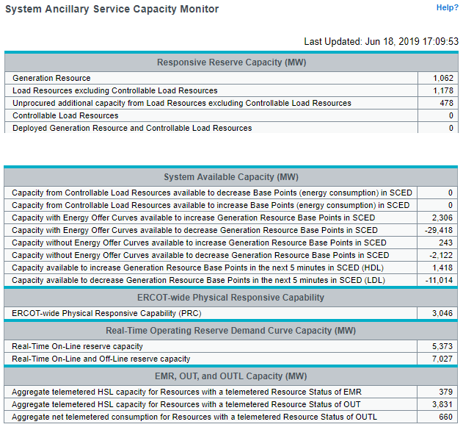
System Ancillary Service Capacity Monitor
…AS Responsibility/Capacity, System Available Capacity…

Slide 6
Hourly Resource Outage Capacity
System total at hour granularity for each of Conventional Resources, Intermittent Renewable Resources (IRRs), and New Equipment Energization
Report generated includes the current Operating Hour through to 7 days out
Data from Outage Scheduler
  Accepted and Approved Resource Outages
  Includes Resource HSL Derates
  Excludes all permanently Mothballed Resources and capacity of old equipment being retired
Where to find this report:
ercot.com → Grid Information → Generation, or
MIS → Reports (link)

Slide 7
Differences Between Reported Out Capacity
Capacity that would show up in the Hourly Resource Outage Capacity but not in the System Ancillary Service Capacity Monitor
Cause of Difference
Equipment Derate | 2,483
Resources on Outage w/ RT HSL = 0 | 2,854
Resources w/ Outage in OS but not RT | 291
Emergency Switchable Generation |  | 54
HSL Error Between OS and RT |  | 27
Capacity that would show up in the System Ancillary Service Capacity Monitor but not in Hourly Resource Outage Capacity

Slide 8
60-Day SCED Disclosure Report
Resource level
First 5-Minute SCED Interval of each 15-Minute Settlement Interval
System total Outaged Capacity can be calculated by summing the HSL of all Resources with a Telemetered Resource Status of OUT or EMRSWGR
Similar to System Ancillary Service Capacity Monitor with a few exceptions:
  Excludes Seasonal Mothballed Resources (and other Non-Market Participating Resources)
  HSL of IRRs with a Resource Status of OUT set to 0
Where to find this report:
ercot.com → Market Information → Market Reports, or
MIS → Reports (link)

Slide 9
Differences Between Reported Out Capacity
Capacity that would show up in the System Ancillary Service Capacity Monitor but not in the 60-Day SCED Disclosure Report
Cause of Difference
IRR on Outage with RT HSL > 0 | 353
Seasonal Mothballed | 0

Slide 10
60-Day COP Disclosure Report
Resource level (and CC configurations)
Operating Day and Operating Hour
Includes only records where the COP was changed for Resource/Hour
To compare HSL from SCED to HSL from COP:
  Use most recent update for each Resource before Operating Hour
  Compare only the HSL for the ONLINE CC configuration
  HSL of IRRs with a Resource Status of OUT set to 0
  Newly energized equipment (not yet commissioned) could be OUT and in SCED report but not have a COP entry
  Differences will stem mostly from the fact that sometimes HSL is treated differently between the two applications
Where to find this report:
ercot.com → Market Information → Market Reports, or
MIS → Reports (link)

Slide 11
Summary
System Ancillary Service Capacity Monitor reports the system total HSL of Resources with an OUT or EMRSWGR Resource Status
  Includes seasonally mothballed Resources
  Some Resources may set HSL telemetry to 0 when OUT
Hourly Resource Outage Capacity report shows the system total Outaged Capacity of Approved and Accepted Outages
  Includes Resource Derates
  Some Resources are able to exit their Outage and come online in RT
60-Day SCED Disclosure Report will be similar to System Ancillary Service Capacity Monitor with a few exceptions:
  Excludes Seasonal Mothballed Resources (and other Non-Market Participating Resources)
  HSL of IRRs with a Resource Status of OUT set to 0
60-Day COP Disclosure Report can be used to compare 60-Day SCED Disclosure Report

Slide 12
Questions?
Thank you!!

