Slide 1
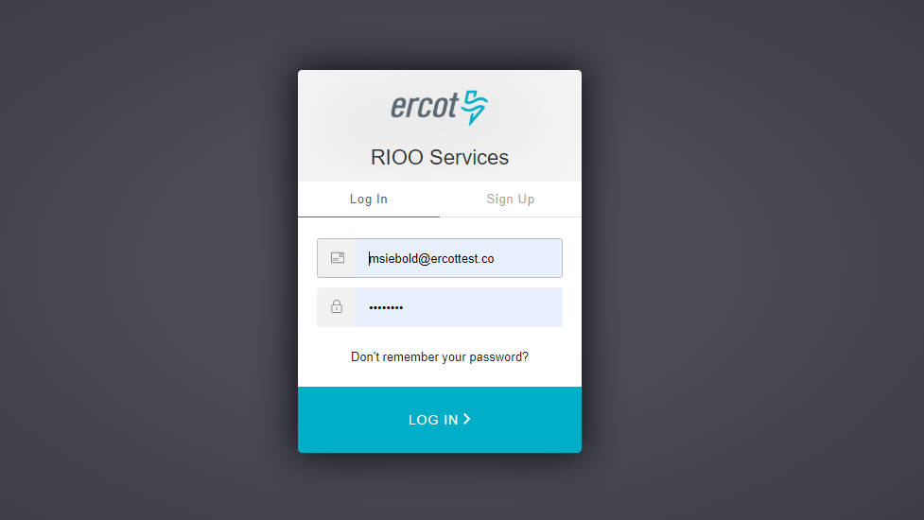

Slide 2
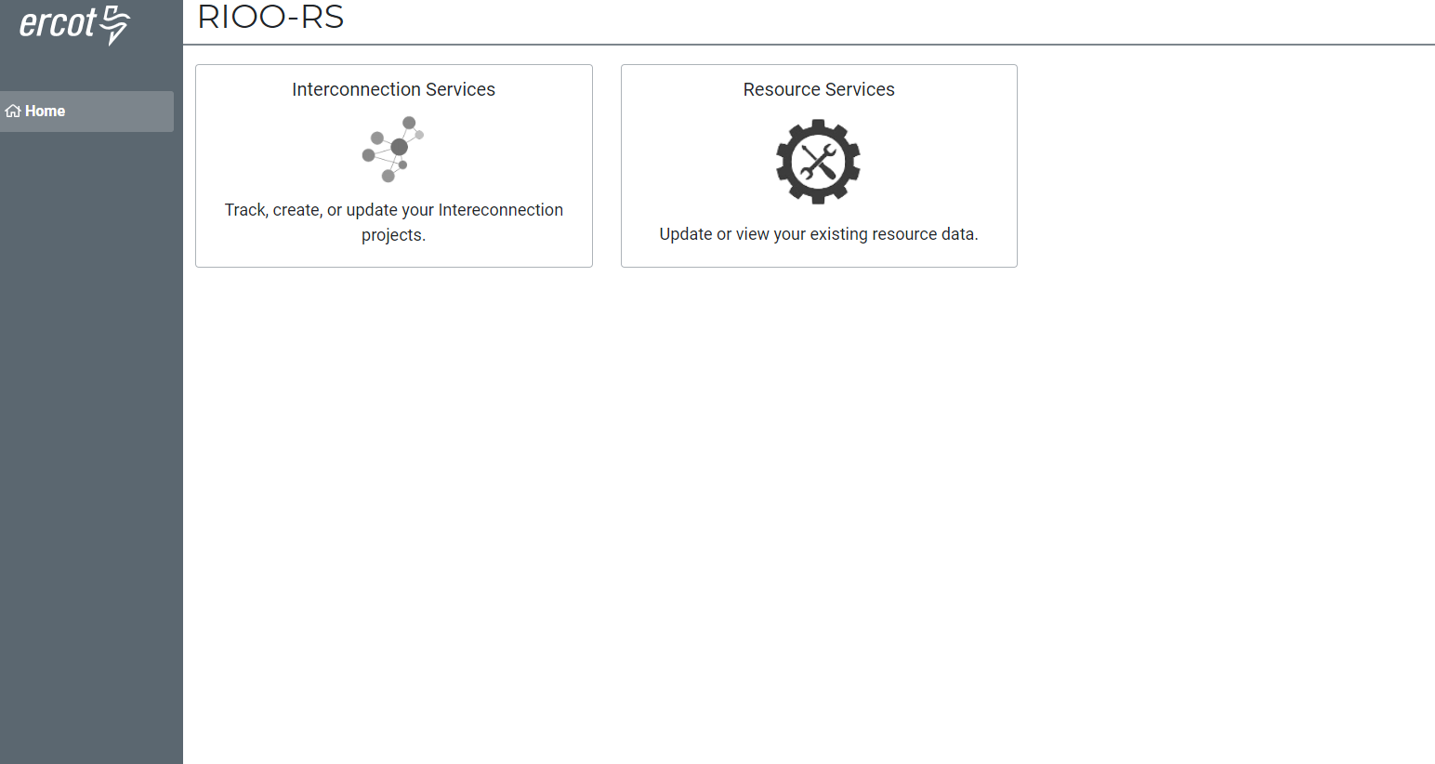
…
Settlement Only
Distributed Generation

Slide 3
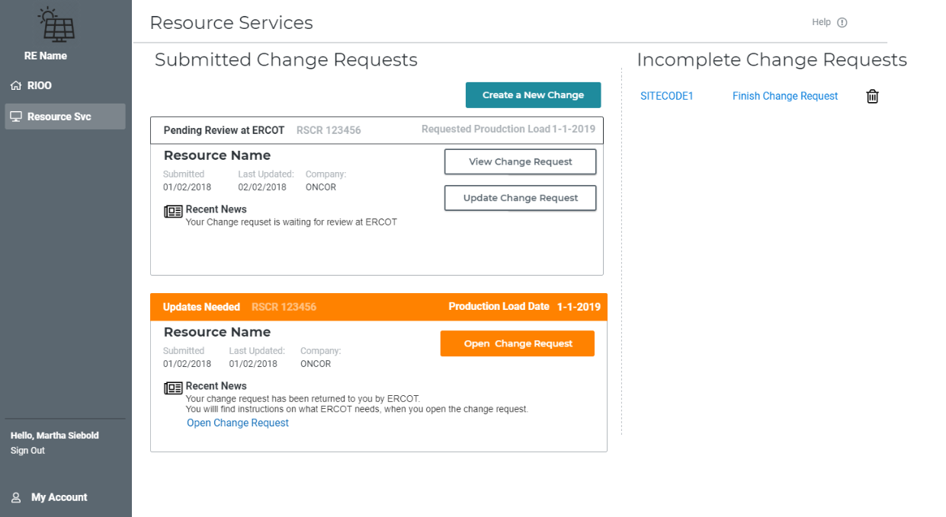

Slide 4
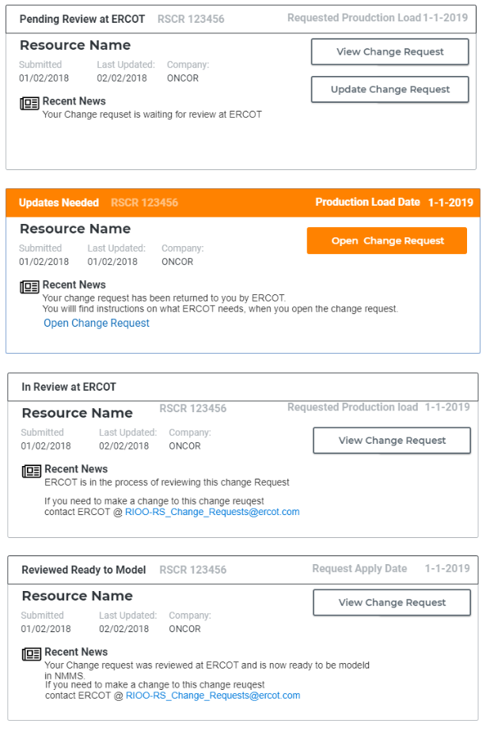
Change Request – Lifecycle
Pending Review
(just submitted to ERCOT)
Returned to RE
(ERCOT sent it back to RE)
In Review at ERCOT
(ERCOT is looking at CR)
Reviewed Ready to Model
(This is Ready for a CAMR)

Slide 5
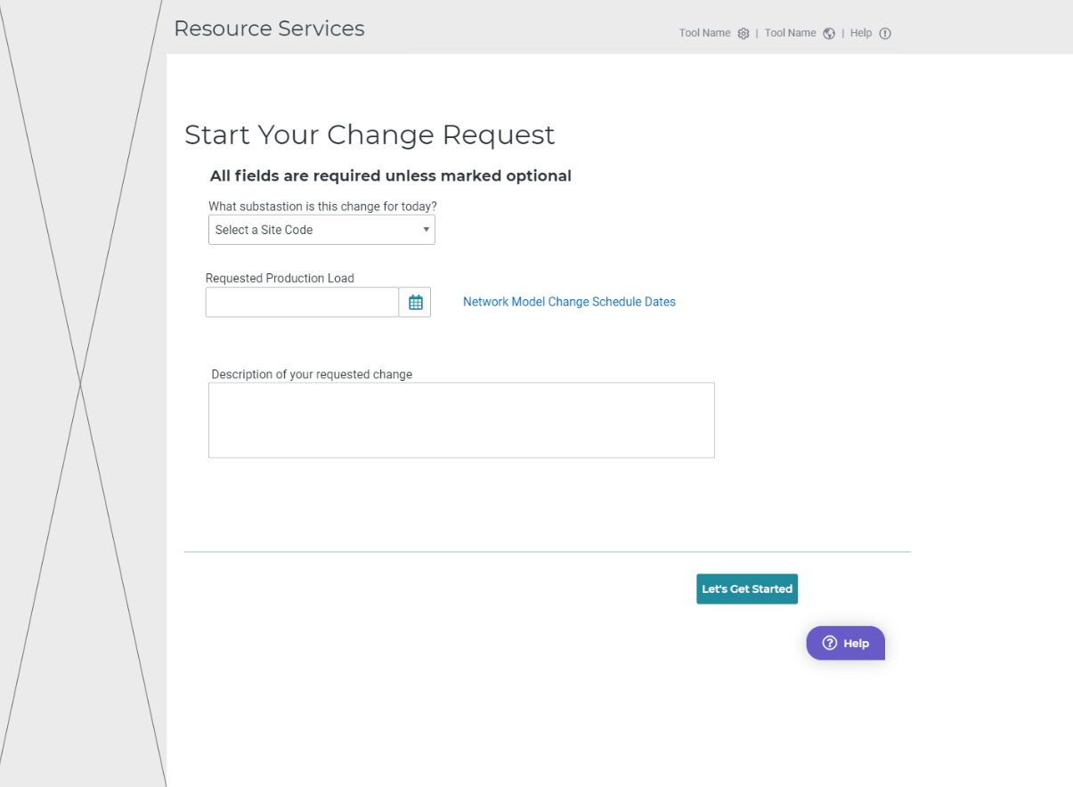

Slide 6
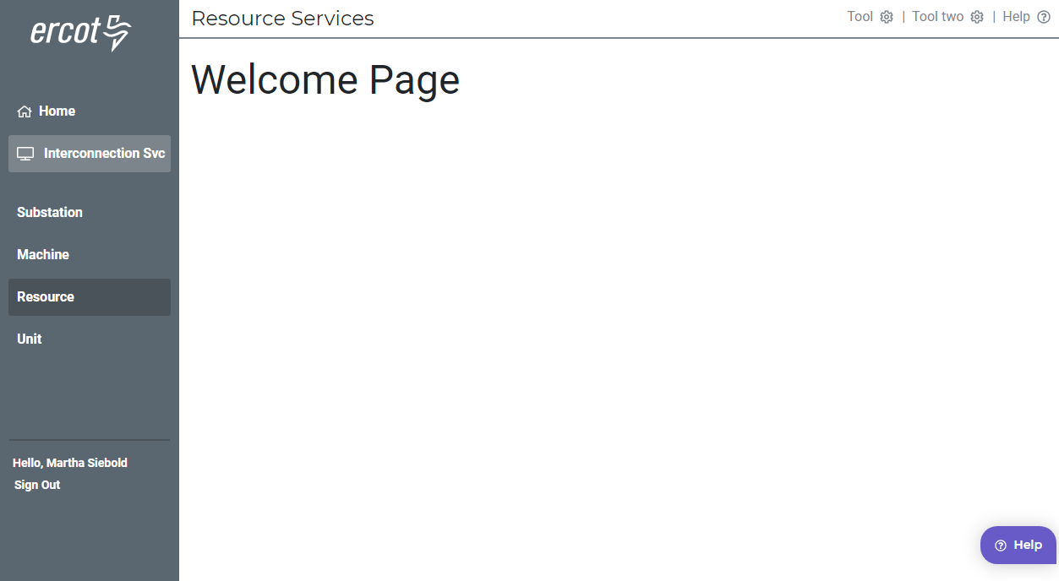

Slide 7
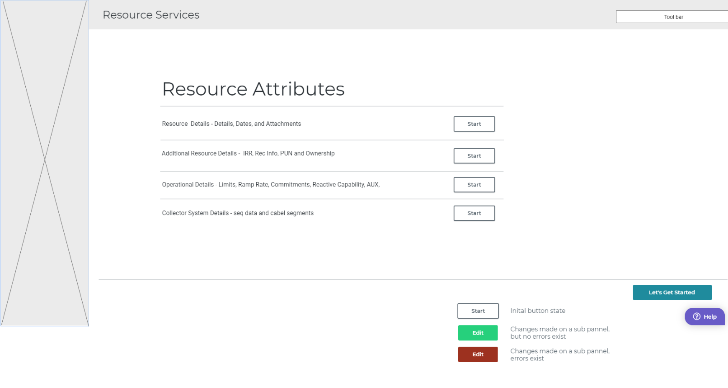

Slide 8
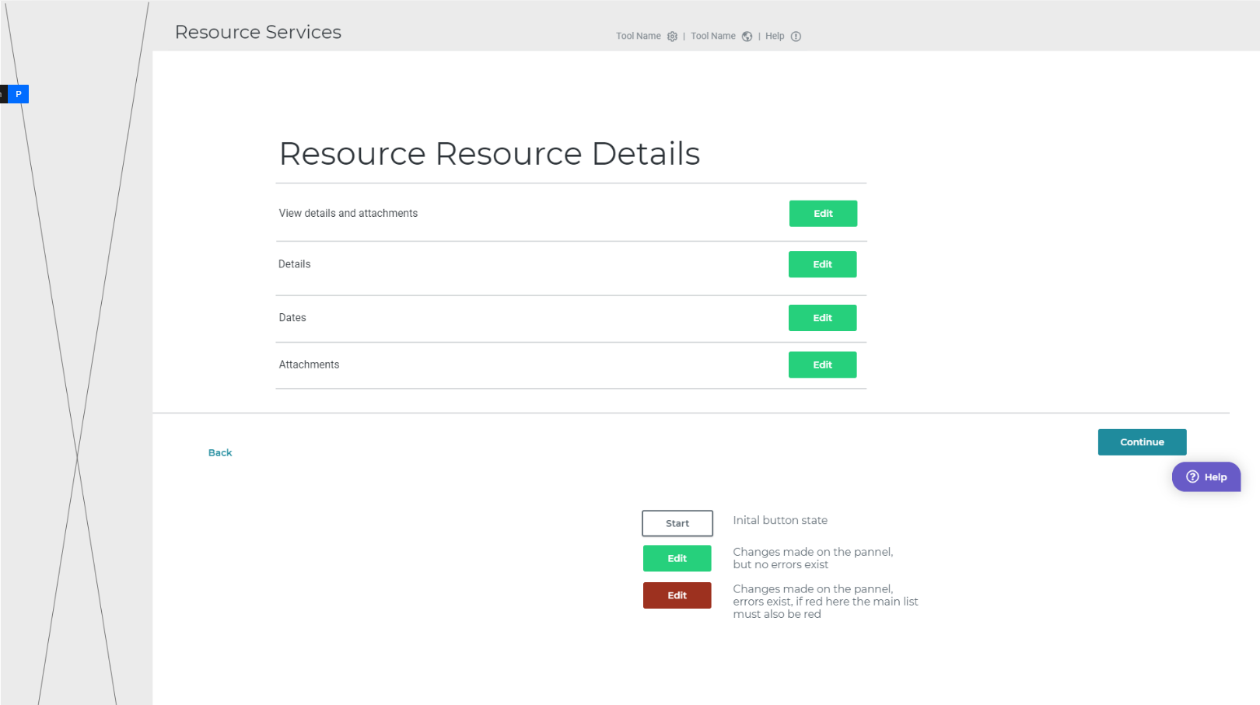

Slide 9
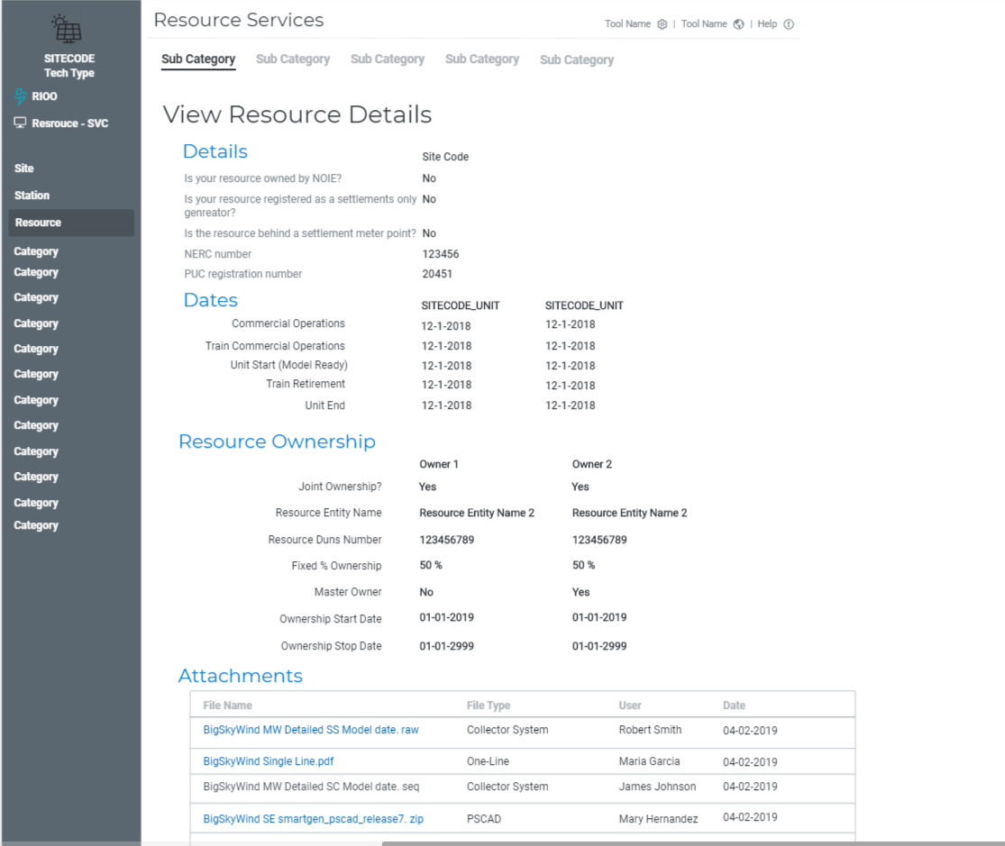

Slide 10
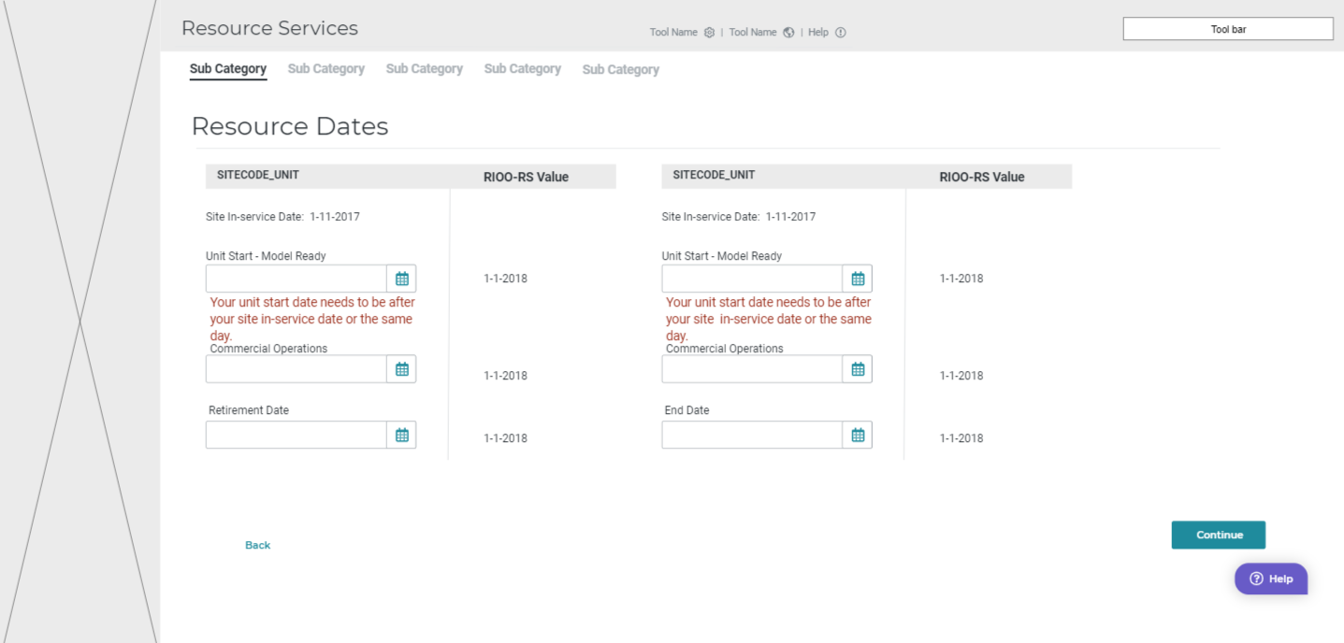

Slide 11
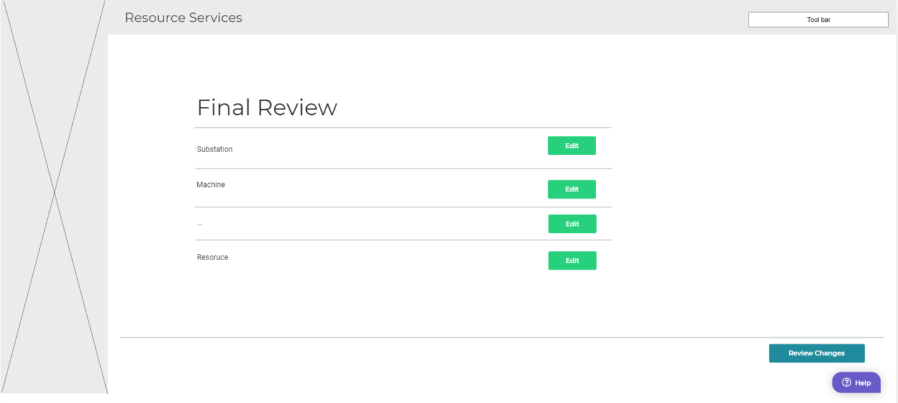

Slide 12
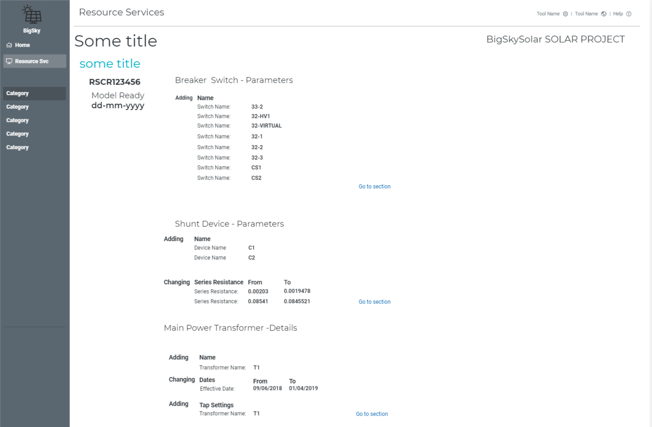
Submit

Slide 14
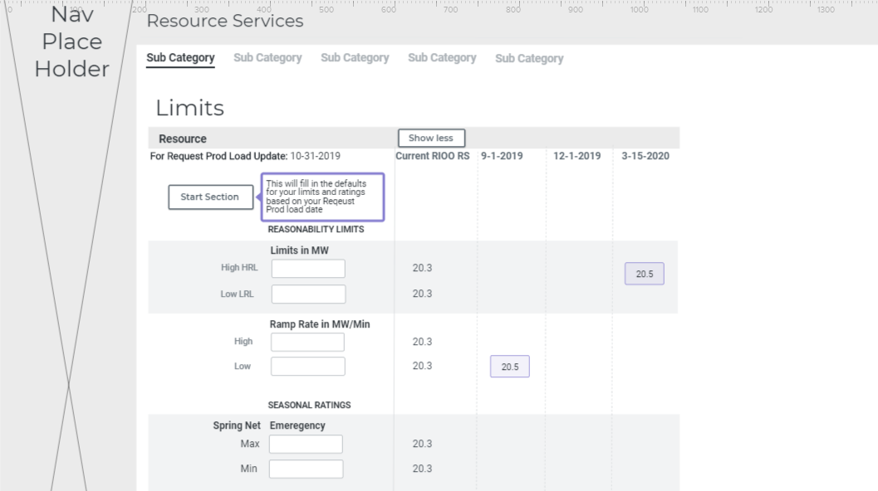
Time Line of Change

