Slide 1
DSWG Energy Storage Update – 6/21/19
ERCOT stakeholders discussed issues associated with the integration of Battery Energy Storage during a workshop held on April 23, 2019. (http://www.ercot.com/calendar/2019/4/23/176494)
These issues were consolidated and presented along with potential working group assignments for review at the May 22 Technical Advisory Committee, and will be discussed at the WMS and ROS July meetings. [Summary provided on slide 2.] (http://www.ercot.com/content/wcm/key_documents_lists/163985/12._ERCOT_Reports.zip)
ERCOT gave an update of the activities regarding storage at the Resource Definition Task Force on June 13. (http://www.ercot.com/calendar/2019/6/13/172651-RTF) Participants reached consensus on several proposed definitions as shown in the ERCOT Presentation that follows.
ERCOT is currently reviewing the protocols to understand the extent of the changes that would be required if implementing the proposed definitions.

Slide 2
Battery Energy Storage Integration Issues and Proposed Assignments
Issue 1: Resource Definition [RTF]
Develop appropriate terminology for protocol definitions of registered and unregistered battery energy storage devices
Issue 2: Battery Energy Storage Operational Requirements [ROS]
Establish technology-specific operational requirements for battery storage devices as part of an effort encompassing a review of all inverter-based resources
Issue 3: Wholesale Storage Load Treatment [WMS – Metering WG]
Review process for approval of wholesale storage load (WSL) requests
Issue 4: Market System Design Changes [WMS]
Review design and requirement changes that allow ERCOT to better model battery energy storage devices in its Market Management System (MMS)
Issue 5: Operations System Design Changes [ROS]
Review design and requirement changes that allow ERCOT to better model battery energy storage devices in its Energy Management System (EMS)
Issue 6: State of Charge/Limited Duration Considerations [WMS & ROS]
Develop protocol revisions to account for consideration of state of charge of battery devices in day-ahead and real-time markets
Issue 7: Alternate Device Modeling Options [WMS & ROS]
Assess potential alternate approaches to integrating coupled devices

Slide 3
Resource Definition Task Force
Energy Storage Terminology Proposal
June 13, 2019

Slide 4
Previously Proposed Energy Storage Definition
“Energy storage assets are capable of receiving electric
energy and storing it in any form for the sole purpose of later injecting some portion of that energy back into the transmission or distribution system.”
It is acknowledged that, similar to the way different technologies are accommodated as Generation Resources, specific registration, qualification and requirements will be developed for the various technologies that would be registered as Energy Storage Resources by the appropriate working groups.

Slide 5
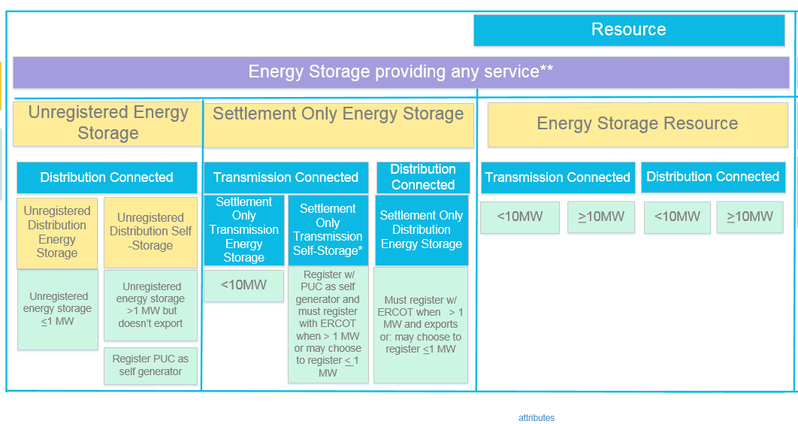
Proposed Energy Storage Framework
Primarily Residential/ Commercial Energy Storage “BTM”
Primarily Grid scale batteries not in A/S market
Primarily Grid scale batteries providing A/S
**Service includes load reduction, 4CP response, exported energy, etc.

Slide 6
Proposed Energy Storage Resource Definitions
Energy Storage Resource (ESR)
An Energy Storage asset capable of providing energy or Ancillary Service to the ERCOT System and is registered with ERCOT as an Energy Storage Resource (ESR).
Distribution Energy Storage Resource (DESR)
An Energy Storage Resource (ESR) connected to the Distribution System that is either:
(1) Greater than ten MW and not registered with the Public Utility Commission of Texas (PUCT) as a self-generator; or
(2) Ten MW or less that chooses to register as an ESR to participate in the ERCOT markets.
Transmission Energy Storage Resource (TESR)
An Energy Storage Resource (ERS) connected to the ERCOT transmission system that is either:
(1) Greater than ten MW and not registered with the Public Utility Commission of Texas (PUCT) as a self-generator; or
(2) Ten MW or less that chooses to register as a Generation Resource to participate in the ERCOT markets.

Slide 7
Proposed Energy Storage Resource Definitions
Settlement Only Energy Storage (SOES)
An Energy Storage asset that is settled for imported/exported energy only, but may not participate in the Ancillary Service markets, Reliability Unit Commitment (RUC), Security-Constrained Economic Dispatch (SCED), or make energy offers. These units are comprised of:
Settlement Only Distribution Energy Storage (SODES)
An Energy Storage asset that is connected to the Distribution System with a rating of:
(1) One MW or less that chooses to register as an SODES; or
(2) Greater than one and up to ten MW that is capable of providing a net export to the ERCOT System and does not register as a Distribution Energy Storage Resource (DESR).
Settlement Only Transmission Energy Storage (SOTES)
An Energy Storage asset that is connected to the ERCOT transmission system with a rating of ten MW or less.
Settlement Only Transmission Self-Energy Storage (SOTSES)
An Energy Storage asset that is connected to the ERCOT transmission system with a rating of one MW or more and does not export energy to the ERCOT System.

Slide 8
Proposed “Unregistered Energy Storage” Definitions
Term “Unregistered” carried over from existing ERCOT protocol terminology for “Unregistered DG”
Concerns have been raised that this implies that systems aren’t registered at all
Systems *should* be registered with DSP.⁺
Self Generators * should* be registered with the PUC.⁺
Proposed term is “Non-ERCOT Registered Systems”
ERCOT registration not required for systems:
Equal to or Less than 1 MW
Greater than 1 MW but registered with the PUC as a Self Generator and does not export.
⁺ Not an ERCOT requirement

Slide 9
Existing Generation Nomenclature – should be similar to Energy Storage
Transmission Generation Resource (TGR) Transmission-connected Registered with ERCOT as GR Participates in the market SCED A/S Modeled in ERCOT systems Telemetry, etc. I |  | Settlement Only Transmission Generator (SOTG) Transmission-connected less than 10 MW Registered with ERCOT as SOG Settled for exported energy only Intermittent sources will typically export based on fuel availability. Self-dispatched may choose to export based on prices Modeled in ERCOT systems Reliability systems only Not scheduled/dispatchable II | Settlement Only Transmission Self-Generator (TSG) Transmission-connected Registered with PUC as a Self-Generator and registered with ERCOT as SOG May occasionally export, but does not generate with the intent to sell at wholesale If it exports, then settled for exported energy only Continuous exports will be re-evaluated for TGR Modeled in ERCOT systems Reliability systems only Not scheduled/dispatchable III
Distribution Generation Resource (DGR) Distribution connected Registered with ERCOT as GR >10 MW require to register as GR Participates in the market SCED A/S Pseudo-Modeled in ERCOT systems Future--Modeling light? Telemetry, etc. IV |  | Settlement Only Distribution Generator (SODG) Distribution connected but less than 10 MW Registered with ERCOT as SOG Settled for exported energy only Intermittent sources will typically export based on fuel availability. Self-dispatched may choose to export based on prices Mapped in ERCOT systems Not scheduled/dispatchable Telemetry not required V | Unregistered Distribution Self-Generator (UDSG) Distributed generation greater than 1 MW co-located with larger load, but smaller than minimum facility load. Registered with PUC as a Self-Generator but not registered with ERCOT May not export—otherwise must register with ERCOT as SODG. Neither Mapped nor modeled in ERCOT systems (future mapping?) VI | Unregistered Distributed Generator (UDG) Distribution connected less than 1 MW No requirement for registration Reported by DSP per PUCT 25.211(n) (competitive choice) Reported by NOIEs per ERCOT protocol 10.2.2.1.b(ii) for 50kW -1 MW Not reported by NOIEs for <50kW Neither Mapped nor modeled in ERCOT systems ERCOT settles as negative load in competitive choice areas once meter configuration updated to DG . VII

