Slide 1
RTC RUC Settlement
Austin Rosel
June 21, 2019

Slide 2
Impacted Settlements
RUC Make-Whole Payment
RUC Clawback Charge
RUC Capacity Short Charge

Slide 3
RUC Make-Whole and Clawback Charge
Units that receive a RUC commitment will be able to submit AS offers and be awarded AS in Real-Time.
This revenue should be considered in RUC Make-Whole and Clawback in the same manner as other Resource revenues.

Slide 4
RUC Make-Whole and Clawback Charge
RUC Guarantee – Ensures the QSE with a RUC Committed Resource is made whole for startup and minimum energy costs. There are no proposed changes to the RUC Guarantee.
RUC Make-Whole Payment – Uses revenues above costs to offset the RUC Guarantee. Propose that revenues for Real-Time AS Awards be included in revenues.
RUC Clawback Charge – If revenues are in excess of the RUC Guarantee, excess revenue is clawed back (subject to clawback factors). Propose that revenues for Real-Time AS awards be included in the revenues.

Slide 5
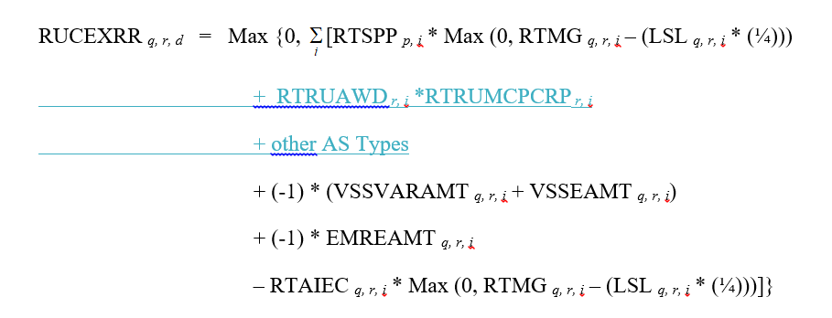
RUC Make-Whole and Clawback Charge
Example of how AS revenues would be considered.
RUCEXRR_{q,r,d} = Revenue Less Cost Above LSL During RUC-Committed Hours

Slide 6
RUC Capacity Short Charge
Today, RUC only considers Resource capacity between HASL and LASL when determining dispatch.
  Capacity beyond HASL and LASL is reserved to provide AS.
Separately, if there is an issue with meeting AS needs, the SASM process is used.
Under RTC, the RUC engine will be adjusted to ensure sufficient capacity to meet both energy and AS simultaneously and the SASM process goes away.
As a result, capacity short charges will also be adjusted to expose QSEs with an AS Supply Responsibility not covered with qualified AS capacity to capacity short charges

Slide 7
RUC Capacity Short Charge
A QSE will be exposed to the capacity short charge due to:
  An overall shortage in energy plus AS Supply Responsibility,
  Shortages in AS capability to meet AS Supply Responsibility.
    Excess capacity that isn’t AS qualified can’t be used to offset an AS shortage.
For each QSE:
  the maximum {overall shortage, AS shortage} will be used to allocate RUC Make Whole costs via the capacity short charge.
The cap on the QSE’s maximum capacity short charge does not change.

Slide 8
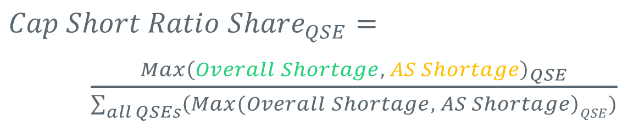
RUC Capacity Short Charge - Ratio Share
$${Cap Short Ratio Share}_{QSE}=$$
$\frac{{Max\left(Overall Shortage, AS Shortage\right)}_{QSE}}{\sum_{all QSEs}{\left(Max(Overall Shortage, AS Shortage\right)QSE)}}$

Slide 9
RUC Capacity Short Charge
For illustrative simplicity the following explanation and examples do not include:
  Capacity Trades,
  Energy Trades, and
  DAM Energy Sales and Purchases.
All of these activities will be considered in the final equations similarly to how they are currently considered in the RUC Capacity Short Charge.

Slide 10
RUC Capacity Short Charge (simplified example)
Example of overall shortage
  Load = 90
  AS Supply Responsibility = 20
  AS Capability = 20
  HSL = 100
  Total capacity commitment of the Resource is 110 MW, leaving a 10MW capacity shortage.

Slide 11
RUC Capacity Short Charge (simplified example)
Example of overall shortage with AS capability surplus
  Load = 80
  AS Supply Responsibility = 20
  AS Capability = 30
  HSL = 100
  Total capacity commitment of the Resource is 100 MW, which is equal to the HSL of the Resource.
  The AS capability is 10 MW more than the AS Supply Responsibility. The QSE has sufficient AS capability and sufficient capacity overall and will not be exposed to the Capacity short charge.

Slide 12
RUC Capacity Short Charge (simplified example)
Example of AS shortage but no overall shortage
  Load = 60
  AS Supply Responsibility = 20
  AS Capability = 15
  HSL = 100
  Total capacity commitment of the Resource is 80, which is less than the HSL of the Resource. However the AS Supply Responsibility is 5 MW greater than the AS capability of the Resource, therefore the 5 MW shortage will expose the QSE to the Capacity short charge.

Slide 13
RUC Capacity Short Charge – Overall Shortage
The overall shortage, looks at the HSL, AS Supply Responsibility and Real-Time Load, similar to the current RUC Capacity Short Charge.
    Overall Shortage _{QSE} =
    Max {0, -1 * [HSL – (RTAML + online AS Supply Responsibility)]}

Slide 14
RUC Capacity Short Charge - AS Shortage
AS Capability
  The amount of AS a Resource is qualified to provide may not be available for the operating hour being evaluated.
  AS Capability will be measured by the AS offers that are available just before the RUC data snapshot.
  The AS offers for an individual Resource will be validated against the COP information for that Resource (e.g., Resource Status, HSL, and LSL).

Slide 15
RUC Capacity Short Charge - AS Shortage
AS Capability
  Due to linked offers, separating AS capability by AS product for settlement is not trivial.
  Linked AS offers cannot be easily segmented into AS products as the AS capability available for one product is reduced by awards for another product.
  When RUC snapshot data used in the capacity short charge is captured, there are no AS awards available to help guide segmentation.

Slide 16
RUC Capacity Short Charge - AS Shortage
Example of an AS offer for an online Generation Resource:
Value | Price ("x" if there is a price)
 | Reg-Up | RRS | ECRS | Non-Spin | Reg-Down
MW1 | x | x | x | x
MW2 | x | x | x | x
MW3 |  | x | x | x
MW4 |  |  | x | x
MW5 |  |  |  | x
MW6 |  |  | x
MW7 |  |  |  |  | x
MW8 |  |  |  |  | x
How to allocate MW1 capability for each product?
AS Capability needs to be separated by product to ensure capability for lower cost AS products does not cover the supply responsibility for higher cost AS products. E.g. RRS covered with Non-Spin capability

Slide 17
RUC Capacity Short Charge - AS Shortage
ERCOT developed a methodology to ensure capability for lower cost AS products does not cover the supply responsibility for more higher cost AS products.
Perform a check by AS product, but only allow AS capability for “higher” products to cover supply responsibility for “lower” products via a hierarchy.
This approach is potentially more lenient, but limits the complexity of the calculations.
Value | Price ("x" if there is a price)
 | Reg-Up | RRS | ECRS | Non-Spin | Reg-Down
MW1 | x | x | x | x
MW2 | x | x | x | x
MW3 |  | x | x | x
MW4 |  |  | x | x
MW5 |  |  |  | x
MW6 |  |  | x
MW7 |  |  |  |  | x
MW8 |  |  |  |  | x

Slide 18
RUC Capacity Short Charge - AS Shortage
AS Capability | AS Supply Responsibility
RU | RU
RR | RR
RU + RR | RU + RR
RU + RR + ECRS | RU + RR + ECRS
RU + RR + ECRS + NSPIN | RU + RR + ECRS +NSPIN
Each row would be checked for a shortage
Do a final check of overall AS
Take the maximum shortage

Slide 19
RUC Capacity Short Charge - AS Shortage
Example of how AS Capability would be calculated.
AS Shortage is 5 MW
AS Product | Responsibility
RU | 20
RR | 15
ECRS | 10
NSPIN | 15
Value | Price ("x" if there is a price)
 | Reg-Up | RRS | ECRS | Non-Spin | Reg-Down*
10 | x | x | x | x
10 | x | x | x | x
10 |  | x | x | x
10 |  |  | x | x
10 |  |  |  | x
10 |  |  | x
10 |  |  |  |  | x
10 |  |  |  |  | x
AS Product | Capability | Responsibility | AS Shortage
RU | 20 | 20 | 0
RR | 30 | 15 | 0
RU + RR | 30 | 35 | 5
RU + RR + ECRS | 50 | 45 | 0
RU + RR + ECRS + NSPIN | 60 | 60 | 0
* Reg-Down will be calculated separately and added to AS Shortage calculated above. Please final equations below for specific formulation.

Slide 20
Draft Principles
Revenues from Real-Time Ancillary Service awards will be used to offset the RUC Guarantee for the RUC Make-Whole Payment.
Revenues from Real-Time Ancillary Service awards will be included as revenues in the RUC Clawback charge.

Slide 21
Draft Principles
QSEs with AS Supply Responsibility greater than their AS capability will be allocated a portion of RUC Make Whole costs via the RUC Capacity Short Charge.
QSEs short on energy capacity will continue to be allocated a portion of the RUC Make Whole costs via the RUC Capacity Short Charge.
  Surpluses in AS capability above AS Supply Responsibility will be allowed to offset energy capacity shortages.
AS capability will be based on AS Offers validated against COP information.
  Surpluses in certain AS products will be allowed to offset AS Supply Responsibilities for other AS products via a hierarchy.

Slide 22
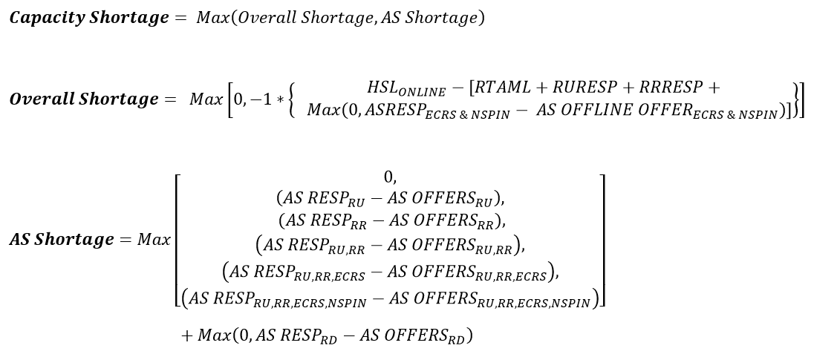
RUC Capacity Short Charge - Equations

Slide 23
Feedback
Please provide feedback and questions to austin.rosel@ercot.com by June 28, 2019.

Slide 24
Appendix
AS Supply Responsibility (NP4.4.7.4)
  The net amount of Ancillary Service capacity that the QSE is obligated to deliver to ERCOT.
  Current Definition
    [Self Arranged AS + AS Sales + DAM AS Awards + SASM Awards + RUC Committed AS amounts] – [AS Purchases + AS Failure to Provide + AS Infeasible + Reconfiguration MW]
  This definition will be updated with Real-Time Co-Optimization.

Slide 25
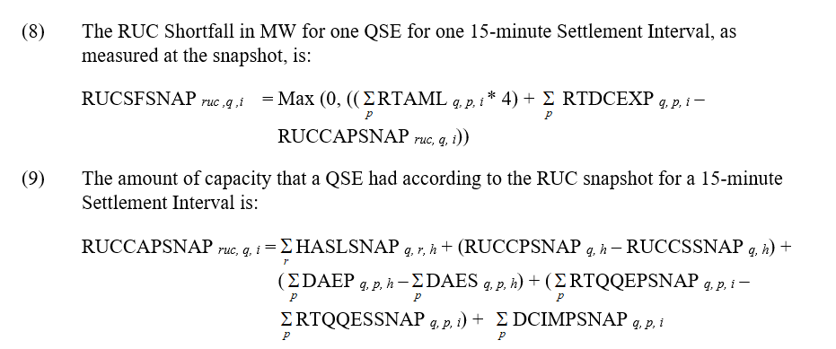
Appendix
RUC Capacity Shortfall

Slide 26
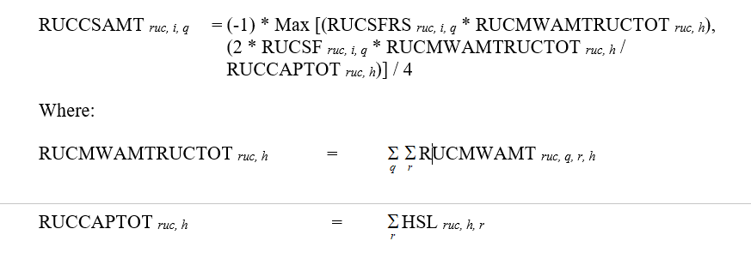
Appendix
RUC Capacity Short Charge

Slide 27
Appendix
RUC Clawback Factors
DAM Offer? | Hours Impacted | Normal Clawback | EEA Clawback
Yes | RUC Committed | 50% | 0%
 | QSE Clawback | 0% | 0%
No | RUC Committed | 100% | 50%
 | QSE Clawback | 50% | 50%

Slide 28
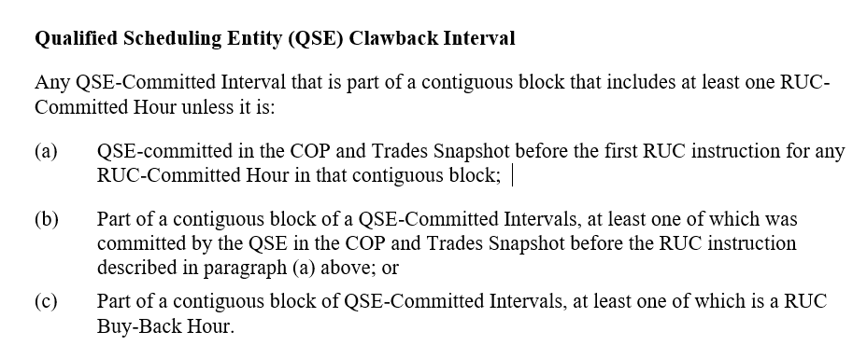
Appendix
Definition of QSE Clawback Interval

