Slide 1
Credit Exposure Update
Spoorthy Papudesi
Credit Work Group
ERCOT Public
June 19, 2019

Slide 2
Monthly Highlights Apr 2019- May 2019
Market-wide average TPE increased from $322.6 million to $324.0 million
The increase in TPE is due to slightly higher Forward Adjustment Factors in May
Discretionary Collateral is defined as Secured Collateral in excess of TPE,CRR Locked ACL and DAM Exposure.
Average Discretionary Collateral increased from $796.3 million to $870.7 million
The increase in Discretionary Collateral is largely due to increase in Secured Collateral
Number of active Counter-Parties decreased from 241 to 239
No unusual collateral call activity

Slide 3
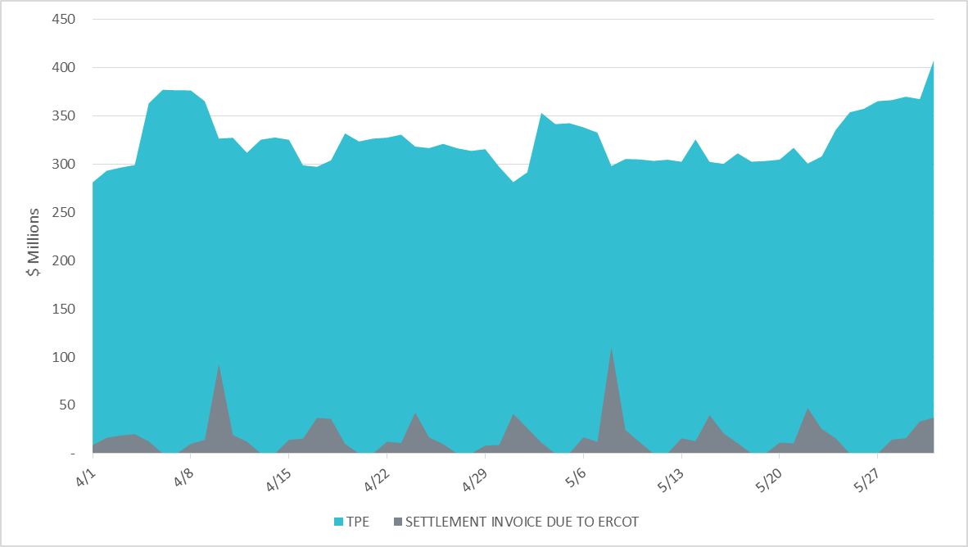
Settlement Invoice Charges/TPE Apr 2019- May 2019

Slide 4
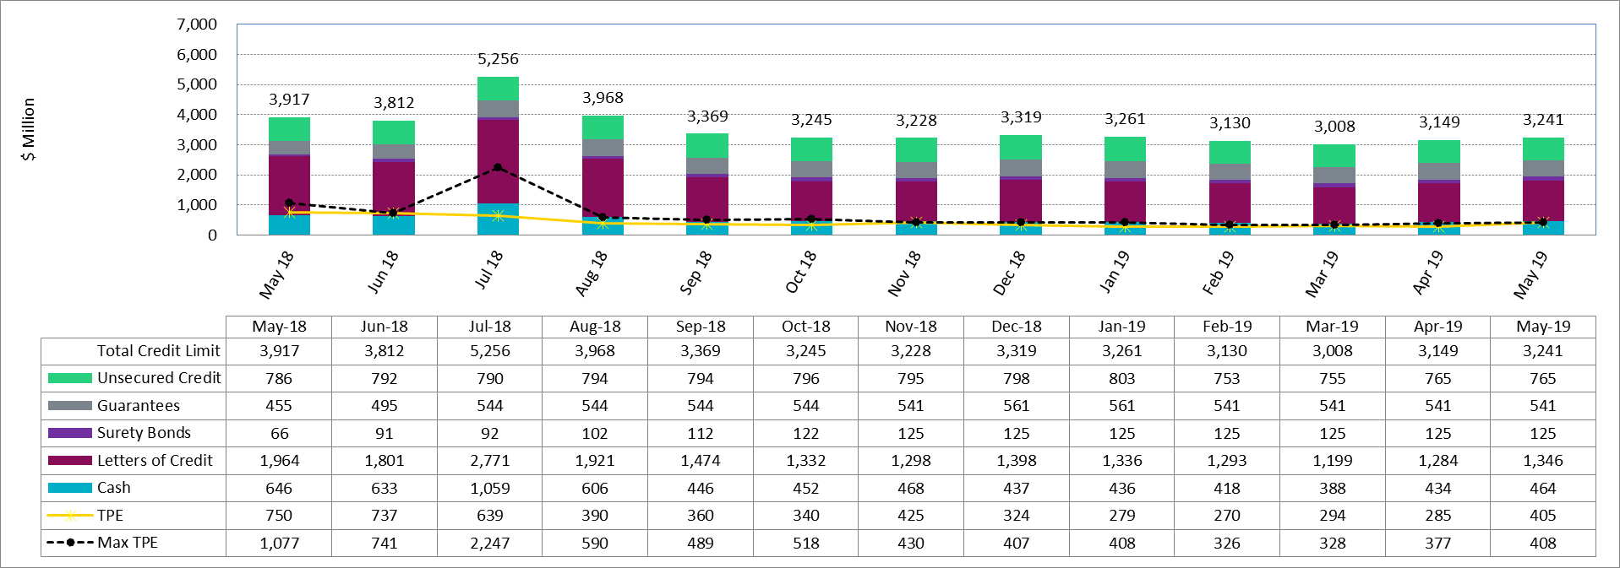
Available Credit by Type Compared to Total Potential Exposure (TPE)
*Numbers are as of month end except for Max TPE

Slide 5
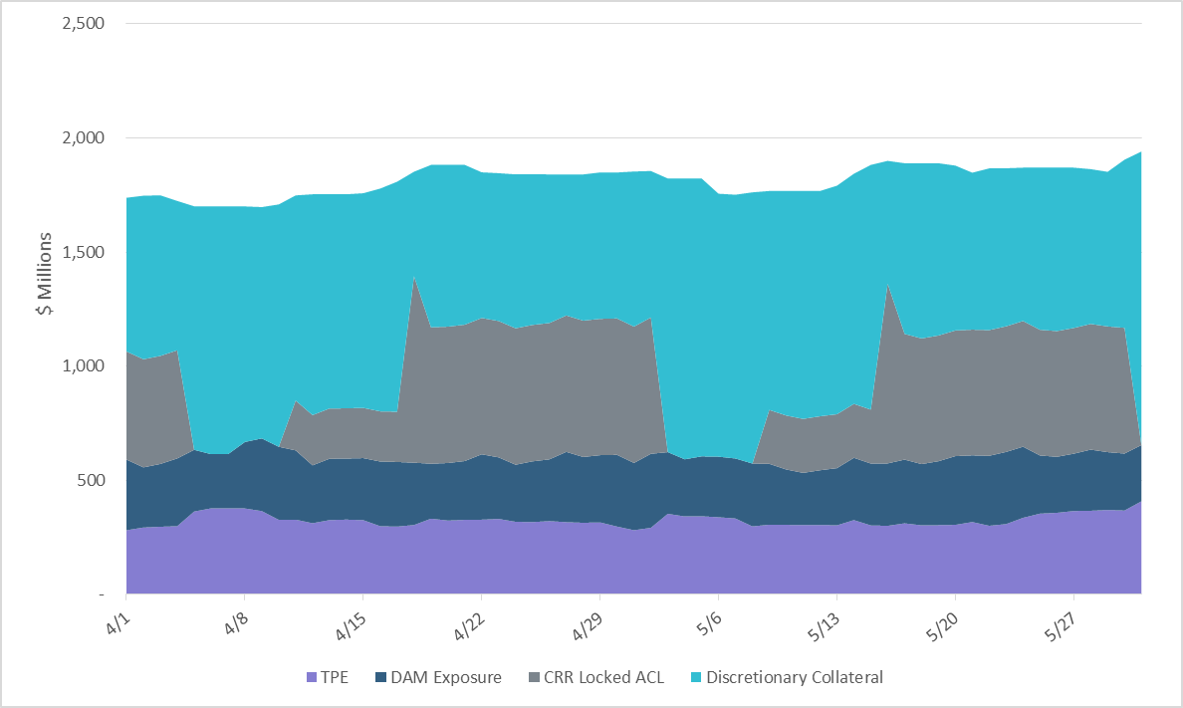
Discretionary Collateral April 2019- May 2019
At a Counter-Party level, no unusual changes were noted
Note: Discretionary collateral doesn’t include Unsecured Credit Limit or parent guarantees

Slide 6
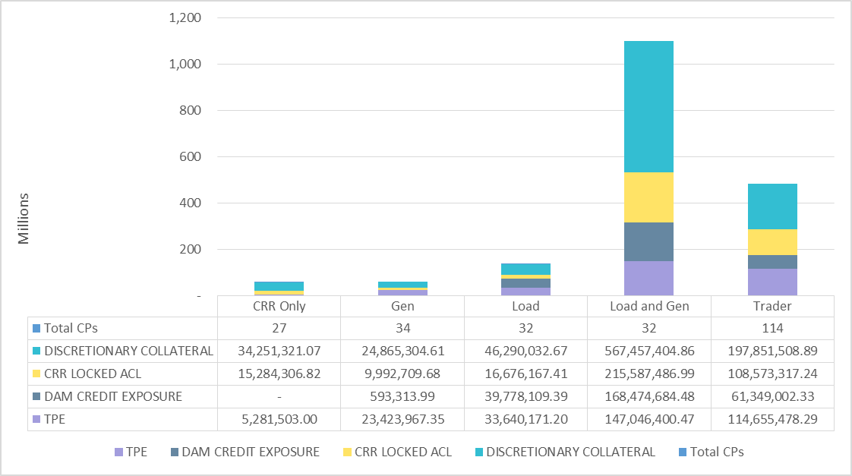
TPE and Discretionary Collateral by Market Segment- May 2019
Load and Generation entities accounted for the largest portion of discretionary collateral

Slide 7
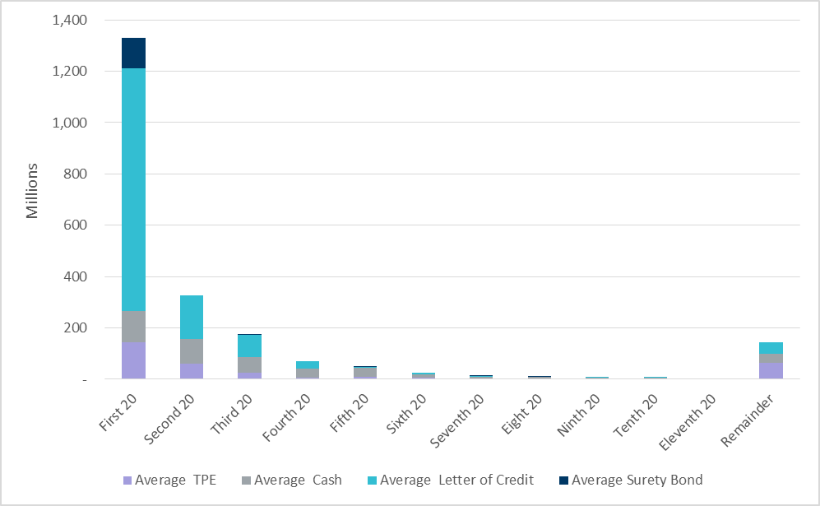
Secured Collateral distribution/ TPE- May 2019
Posting of discretionary collateral is relatively concentrated.
Secured Collateral: Letter of Credit, Surety Bond or Cash

Slide 8
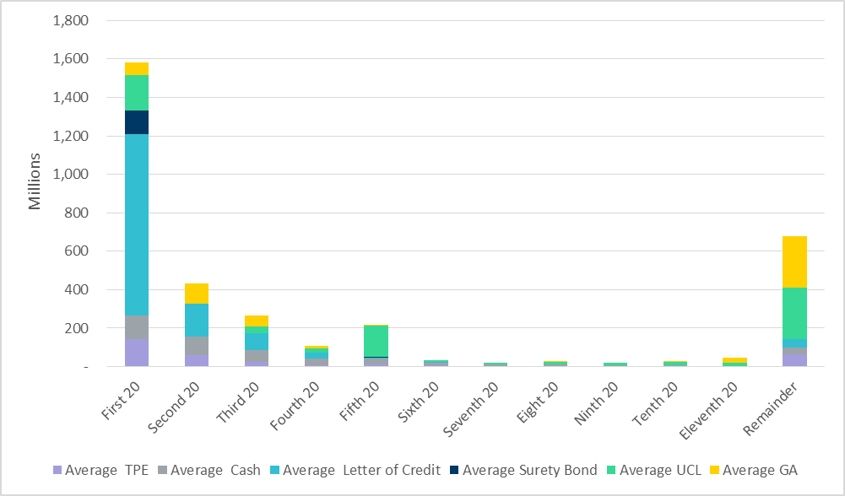
Secured Collateral and Unsecured Credit Limit (UCL) distribution/ TPE- May 2019
TPE in the last bucket is mostly covered by Guarantees and UCL

Slide 9
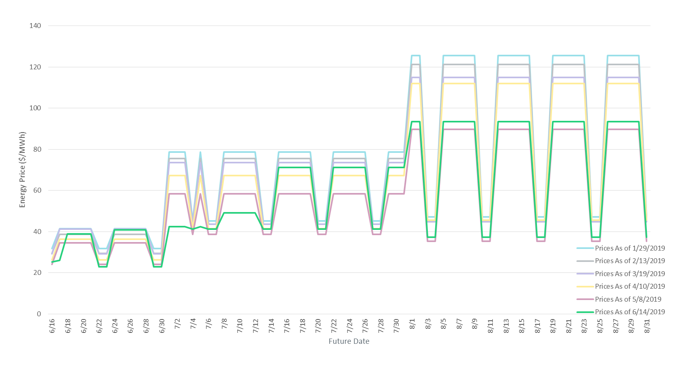
ICE Daily Average Prices April-August 2019
*Daily Average Price = (Peak price*16 +Off-Peak price*8)/24

Slide 10
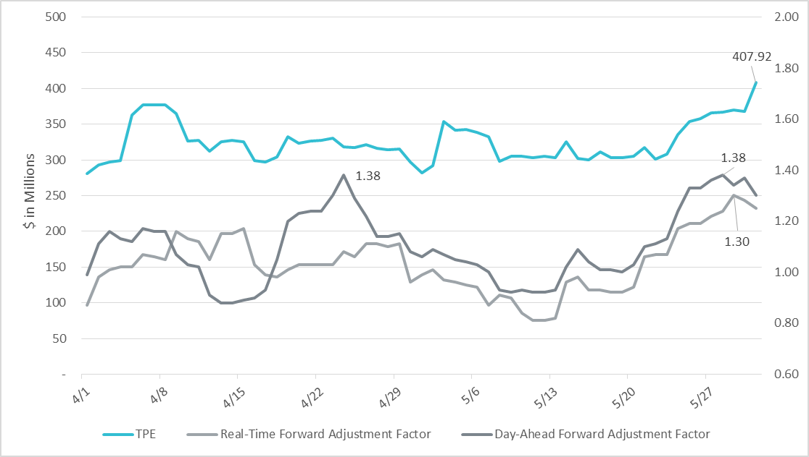
TPE and Forward Adjustment Factors Apr 2019- May 2019
TPE moved in conjunction with forward adjustment factors
The Real-Time (RFAF) and Day-Ahead (DFAF) forward adjustment factors capture the ratio of forward ERCOT North prices to actual prices.

Slide 11
Appendix

Slide 12
Summary of Distribution by Market Segment
Category | Counter-Party Distribution |  |  | Average TPE Distribution |  |  | Average Excess Collateral Distribution
 | Apr-19 | May-19 | Change | Apr-19 | May-19 | Change | Apr-19 | May-19 | Change
CRR Only | 10.79% | 11.30% | 0.51% | 0.97% | 1.63% | 0.66% | 2.55% | 2.57% | 0.02%
Generation Only | 14.11% | 14.23% | 0.12% | 7.01% | 7.23% | 0.21% | 4.20% | 2.24% | -1.96%
Load Only | 14.52% | 13.39% | -1.13% | 13.10% | 10.38% | -2.72% | 11.34% | 10.11% | -1.23%
Load and Gen | 13.69% | 13.39% | -0.30% | 44.55% | 45.38% | 0.83% | 58.27% | 58.69% | 0.42%
Trader | 46.89% | 47.70% | 0.81% | 34.36% | 35.38% | 1.02% | 23.64% | 26.39% | 2.75%

Slide 13
Summary of Distribution by Rating Group
Rating Group | Counter-Party Distribution |  |  | Average TPE Distribution |  |  | Average Excess Collateral Distribution
 | Apr-19 | May-19 | Change | Apr-19 | May-19 | Change | Apr-19 | May-19 | Change
AAA | 0.00% | 0.00% | 0.00% | 0.00% | 0.00% | 0.00% | 0.00% | 0.00% | 0.00%
AA- to AA+ | 4.15% | 4.18% | 0.03% | 2.02% | 2.01% | -0.01% | 2.01% | 1.98% | -0.03%
A- to A+ | 7.05% | 7.11% | 0.06% | 15.54% | 10.73% | -4.80% | 21.39% | 21.89% | 0.50%
BBB- to BBB+ | 12.03% | 12.13% | 0.10% | 27.52% | 22.90% | -4.63% | 27.96% | 28.29% | 0.33%
Investment Grade | 23.24% | 23.43% | 0.19% | 45.08% | 35.64% | -9.45% | 51.35% | 52.16% | 0.80%
BB- to BB+ | 3.73% | 2.93% | -0.81% | 19.15% | 24.79% | 5.64% | 11.98% | 11.59% | -0.39%
B- to B+ | 2.07% | 2.09% | 0.02% | 2.96% | 2.57% | -0.39% | 1.88% | 1.71% | -0.17%
CCC+ and below | 0.00% | 0.00% | 0.00% | 0.00% | 0.00% | 0.00% | 0.00% | 0.00% | 0.00%
Not Rated | 70.95% | 71.55% | 0.59% | 32.80% | 37.00% | 4.20% | 34.79% | 34.54% | -0.25%
Non-investment Grade | 76.76% | 76.57% | -0.19% | 54.92% | 64.36% | 9.45% | 48.65% | 47.84% | -0.80%

Slide 14
Distribution of TPE by Rating and Category
Rating Group | CRR Only | Generation Only | Load Only | Load and Generation | Trader | Total TPE | Percent TPE
AAA | 0 | 0 | 0 | 0 | 0 | 0 | 0.00%
AA- to AA+ | 661,878 | 0 | 323,435 | 5,520,446 | 0 | 6,505,759 | 2.01%
A- to A+ | 85,528 | 0 | 3,042,437 | 24,006,772 | 7,650,297 | 34,785,034 | 10.73%
BBB- to BBB+ | 5,521 | 8,162,951 | 18,772,696 | 26,759,853 | 20,490,628 | 74,191,649 | 22.90%
Investment Grade | 752,927 | 8,162,951 | 22,138,568 | 56,287,071 | 28,140,925 | 115,482,442 | 35.64%
BB- to BB+ | 0 | 0 | 8,004,099 | 43,856,917 | 28,482,547 | 80,343,563 | 24.79%
B- to B+ | 0 | 77,985 | 0 | 5,483,021 | 2,769,768 | 8,330,774 | 2.57%
CCC+ and below | 0 | 0 | 0 | 0 | 0 | 0 | 0.00%
Not Rated | 4,528,576 | 15,183,031 | 3,497,505 | 41,419,391 | 55,262,238 | 119,890,742 | 37.00%
Non-Investment Grade | 4,528,576 | 15,261,017 | 11,501,604 | 90,759,329 | 86,514,553 | 208,565,079 | 64.36%
Total TPE | 5,281,503 | 23,423,967 | 33,640,171 | 147,046,400 | 114,655,478 | 324,047,520 | 100.00%
Percent TPE | 1.63% | 7.23% | 10.38% | 45.38% | 35.38% | 100.00%

Slide 15
Distribution of Excess Collateral by Rating and Category
Rating Group | CRR Only | Generation Only | Load Only | Load and Generation | Trader | Excess Collateral | Percent Excess Collateral
AAA | 0 | 0 | 0 | 0 | 0 | 0 | 0.00%
AA- to AA+ | 6,843,426 | 0 | 20,790,585 | 12,955,038 | 0 | 40,589,049 | 1.98%
A- to A+ | 14,114,248 | 0 | 65,557,563 | 318,503,754 | 50,149,704 | 448,325,269 | 21.89%
BBB- to BBB+ | 3,144,479 | 25,253,724 | 62,276,543 | 303,258,365 | 185,407,557 | 579,340,667 | 28.29%
Investment Grade | 24,102,154 | 25,253,724 | 148,624,691 | 634,717,156 | 235,557,262 | 1,068,254,986 | 52.16%
BB- to BB+ | 0 | 0 | 42,165,462 | 175,898,941 | 19,374,349 | 237,438,753 | 11.59%
B- to B+ | 0 | 251,052 | 0 | 30,320,205 | 4,374,826 | 34,946,084 | 1.71%
CCC+ and below | 0 | 0 | 0 | 0 | 0 | 0 | 0.00%
Not Rated | 28,433,474 | 20,446,552 | 16,260,769 | 361,114,613 | 281,266,792 | 707,522,202 | 34.54%
Non-Investment Grade | 28,433,474 | 20,697,605 | 58,426,231 | 567,333,760 | 305,015,968 | 979,907,038 | 47.84%
Total Excess Collateral | 52,535,628 | 45,951,328 | 207,050,922 | 1,202,050,915 | 540,573,229 | 2,048,162,023 | 100.00%
Percent Excess Collateral | 2.57% | 2.24% | 10.11% | 58.69% | 26.39% | 100.00%
Note: Excess collateral doesn’t include Unsecured Credit Limit

Slide 16
Bottom Quintile Distribution of Excess Collateral by Rating and Category
Rating Group | CRR Only | Generation Only | Load Only | Load and Generation | Trader | Total Quintile Excess Collateral | Percent Quintile Excess Collateral | Percent Total Excess Collateral
AAA | 0 | 0 | 0 | 0 | 0 | 0 | 0.00% | 0.00%
AA- to AA+ | 0 | 0 | 0 | 0 | 0 | 0 | 0.00% | 0.00%
A- to A+ | 198,640 | 0 | 0 | 0 | 0 | 198,640 | 5.38% | 0.01%
BBB- to BBB+ | 146,825 | 103,488 | 0 | 0 | 6,785 | 257,098 | 6.96% | 0.01%
Investment Grade | 345,464 | 103,488 | 0 | 0 | 6,785 | 455,737 | 12.34% | 0.02%
BB- to BB+ | 0 | 0 | 0 | 0 | 0 | 0 | 0.00% | 0.00%
B- to B+ | 0 | 0 | 0 | 0 | 144,594 | 144,594 | 3.91% | 0.01%
CCC+ and below | 0 | 0 | 0 | 0 | 0 | 0 | 0.00% | 0.00%
Not Rated | 88,961 | 232,976 | 306,240 | 84,549 | 2,380,420 | 3,093,146 | 83.75% | 0.15%
Non-Investment Grade | 88,961 | 232,976 | 306,240 | 84,549 | 2,525,014 | 3,237,739 | 87.66% | 0.16%
Total Quintile Excess Collateral | 434,425 | 336,464 | 306,240 | 84,549 | 2,531,799 | 3,693,477 | 100.00% | 0.18%
Percent Quintile Excess Collateral | 11.76% | 9.11% | 8.29% | 2.29% | 68.55% | 100.00%
Percent Total Excess Collateral | 0.02% | 0.02% | 0.01% | 0.00% | 0.12% | 0.18%

Slide 17
Bottom Quintile Distribution of Average TPE by Rating and Category
Rating Group | CRR Only | Generation Only | Load Only | Load and Generation | Trader | Quintile Average TPE | Percent Quintile Average TPE | Percent Total Average TPE
AAA | 0 | 0 | 0 | 0 | 0 | 0 | 0.0% | 0.00%
AA- to AA+ | 0 | 0 | 0 | 0 | 0 | 0 | 0.0% | 0.00%
A- to A+ | 1,136 | 0 | 0 | 0 | 0 | 1,136 | 0.0% | 0.00%
BBB- to BBB+ | 3,175 | 9 | 0 | 0 | 3,215 | 6,399 | 0.0% | 0.00%
Investment Grade | 4,312 | 9 | 0 | 0 | 3,215 | 7,536 | 0.1% | 0.00%
BB- to BB+ | 0 | 0 | 0 | 0 | 0 | 0 | 0.0% | 0.00%
B- to B+ | 0 | 0 | 0 | 0 | 0 | 0 | 0.0% | 0.00%
CCC+ and below | 0 | 0 | 0 | 0 | 0 | 0 | 0.0% | 0.00%
Not Rated | 15,720 | 410,599 | 269,991 | 10,383,193 | 2,991,829 | 14,071,332 | 99.9% | 4.34%
Non-Investment Grade | 15,720 | 410,599 | 269,991 | 10,383,193 | 2,991,829 | 14,071,332 | 99.95% | 4.34%
Quintile Average TPE | 20,032 | 410,608 | 269,991 | 10,383,193 | 2,995,044 | 14,078,868 | 100.0% | 4.34%
Percent Quintile Average TPE | 0.1% | 2.9% | 1.9% | 73.8% | 21.3% | 100.0%
Percent Total Average TPE | 0.01% | 0.13% | 0.08% | 3.20% | 0.92% | 4.34%

Slide 18
Questions

