Slide 1
CDR Reporting Practices /
May CDR-SARA Review /
Commission Order to Amend Electric Substantive Rule §25.505
Pete Warnken
Manager, Resource Adequacy
June 14, 2019
Notes:
Welcome to

Slide 2
Discussion Items
Current CDR Reporting Practices
  Handling of units unavailable due to extended outages/derates
  Repower/upgrade projects
  Renewable Distributed Generation units
May 2019 CDR/SARA Review
How to handle public announcements of planned unit retirements
Commission Order to Amend Electric Substantive Rule §25.505

Slide 3
Current CDR Reporting Practices

Slide 4
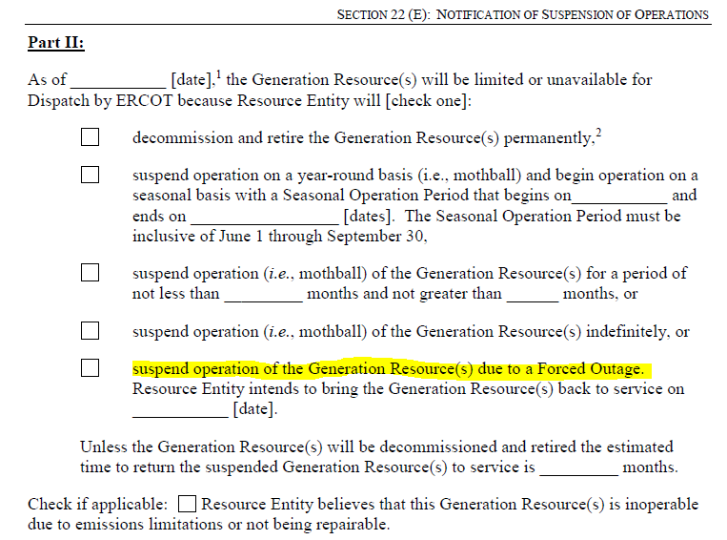
Extended Outages
Extended outages/derates
  Affects units for which a Notification of Suspension of Operations (NSO) has been submitted indicating an extended Forced Outage greater than 180 days; per Protocols, NSO not posted on MIS

Slide 5
Extended Outages
Outaged units are not removed from the applicable Operational Resource section of the Capacities tabs
The line item, Operational Capacity Unavailable due to Extended Outage or Derate, is intended to “reverse” the capacity amounts reported in the Operational Resource sections; Gregory Power Partners example:
Due to possible commercial sensitivity, individual unit names not identified in Extended Outage line item

Slide 6
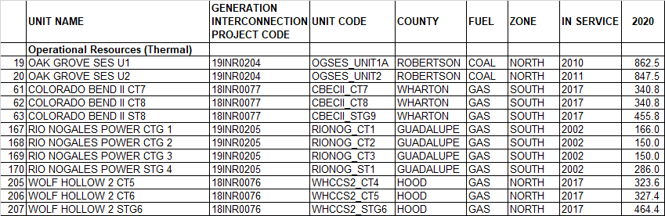
Repower/Upgrade Projects - Thermal
CDR eligibility criteria don’t apply to upgrade projects (power augmentation, performance improvement packages, etc.)
Show up in the CDR when new RARF data is entered into the RARF_HUB database, and based on the expected in-service date; not classified as CDR planned resources
Operational resource line items reflect the updated installed capacities, and INR numbers reported if GINR studies required

Slide 7
Repower/Upgrade Projects - Wind
Wind repowering (replacing wind turbines or major turbine components such as blades and nacelles) is a new trend
  Currently 27 wind repower projects under study; 15 involve no capacity change
  Net increase to installed capacity is 85 MW, and the net change to the summer capacity contribution is 13 MW; three projects resulting in capacity derates (aggregate -47 MW)
  Most projects are designed to increase wind output efficiency at lower wind speeds and extend lifespan rather than increase maximum capacity
For CDR reporting, ERCOT currently uses a 10-megawatt “net change” installed capacity threshold for including the new project capacity
  As with thermal resource upgrade projects, capacity changes are reflected in the Operational resource line items, and INR numbers included to identify the upgrade projects

Slide 8
SARA/CDR Review

Slide 9
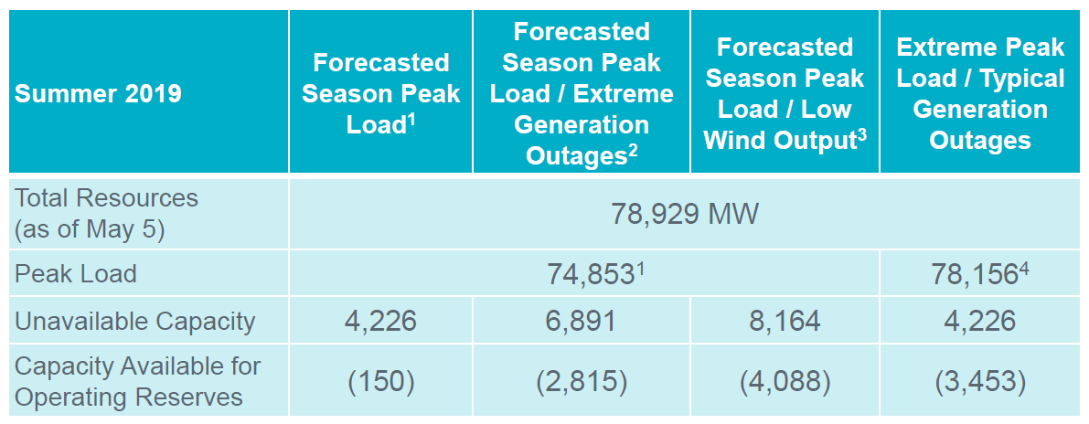
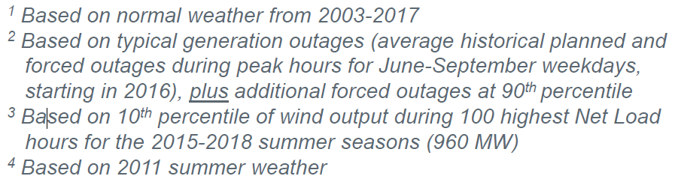
Final Summer SARA

Slide 10
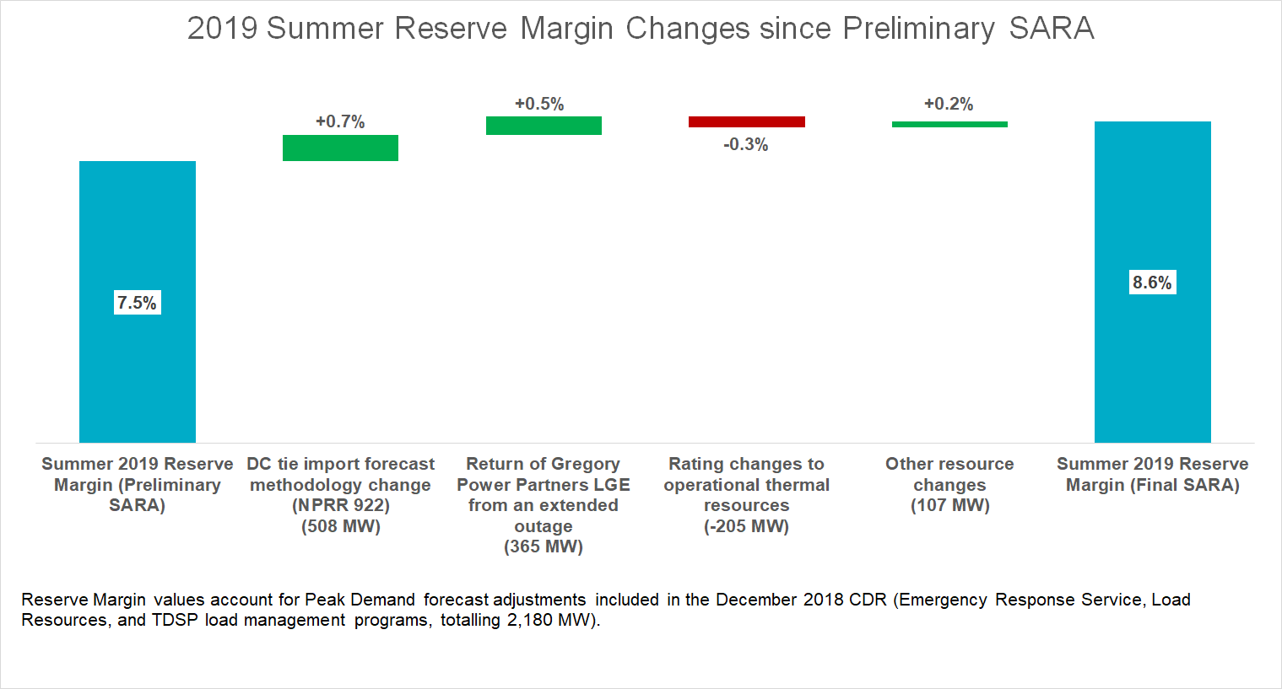
Reserve Margin Change, Prelim vs final SARA

Slide 11

2019 Summer Planning Reserve Margin Calculation
Inputs:
  Total Resources (SARA)………………………………...........78,929 MW
  Peak Demand (SARA)…………………………………….......74,853 MW
  Voluntary Load Reduction Resources (Dec. 2018 CDR)……2,180 MW
$PRM=\frac{78,929 −(74,853 −2,180)}{74,853−2,180}$ x 100 = 8.6%

Slide 12
Commission Order to Amend Electric Substantive Rule §25.505

Slide 13
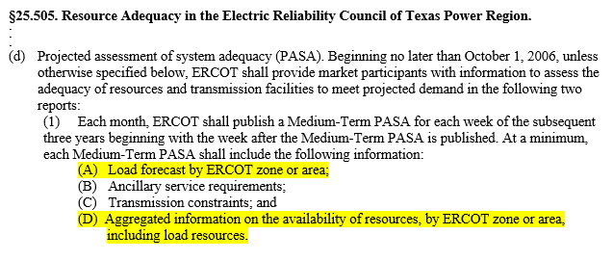
Medium-term PASA Requirement
Requirement for a medium-term projected assessment of system adequacy (PASA) has been removed from Substantive Rule §25.505(d)(1)
Requirements (A) and (D) addressed by posting the 36-Month Resource Capacity Report on MIS (Grid > Forecasts > Medium-Term System Adequacy)

Slide 14
36-Month Resource Capacity Report
Weekly resource forecasts are composed of the following:
  Seasonal sustainable ratings for operational units and those planned resources that meet CDR eligibility criteria, and are expected to be in service on or before the relevant forecasted peak day
    Solar and wind resource capacities adjusted with peak average capacity contribution percentages
    Resources reported by Houston, North, South, West and total ERCOT forecast zones
  Maintenance and planned outages/derates from the Outage Scheduler that fall on the relevant forecasted peak day
  Forecasted Load Resources providing Responsive Reserves from the latest CDR
Weekly peak load forecasts based on latest official Long-Term Load Forecast

Slide 15
36-Month Resource Capacity Report
ERCOT is questioning the value of this Report to the Market, and is proposing to eliminate it via an NPRR
In lieu of this report, ERCOT would work with Market Participants to identify and provide more useful alternative data
  Reach out to parties that regularly download the report to understand what they use it for, and what aspects of it are most important

Slide 16
Other §25.505 impacts
ERCOT is determining the disposition of the other medium-term PASA reports; options for a report include:
  Move it to another suitable webpage
  Discontinue it if redundant with respect to other reports
ERCOT’s Legal Department is taking the lead in developing an NPRR that addresses all Rule §25.505 amendments

