Slide 1
NPRR902 Workshop III
Chad V. Seely
Vice President and General Counsel
Nathan Bigbee
Assistant General Counsel
Jonathan Levine
Senior Corporate Counsel
Doug Fohn
Senior Corporate Counsel
June 17, 2019

Slide 2
NPRR902 Workshop III: Agenda
Introduction
Where we are today (what has happened since Workshop II)
  March 13 ERCOT Comments
  May 3 Oncor Comments
  June 3 ERCOT Comments
Review of primary changes in Oncor and ERCOT Comments
Next steps and contact information

Slide 3
Introduction
NPRR902, sponsored by ERCOT, was posted September 28, 2018.
Purpose: To clarify parties’ responsibilities regarding ERCOT Critical Energy Infrastructure Information (ECEII).
Key Features:
Adopts ERCOT-specific definition, “ERCOT Critical Energy Infrastructure Information (ECEII).”
Sets forth a list of items that are presumptively deemed ECEII.
Clarifies the restrictions imposed on parties that receive or (in some instances) create ECEII.
Provides a framework for the submission of ECEII to ERCOT.
Creates a process for contesting ERCOT determinations regarding confidentiality status.

Slide 4
Where we are today
9/28/18: NORR902 posted
12/4/18: NPRR902 Workshop I – Reviewed purpose, concept and NPRR language
1/31/19: NPRR902 Workshop II – Discussed concerns raised by parties following Workshop I
3/13/19: ERCOT Comments – Clarifications based on points raised at Workshops I & II
5/3/19: Oncor Comments – Removed restrictions placed on internal handling of ECEII; replaced with requirement to have internal procedures to ensure proper restriction and security of ECEII
6/3/19: ERCOT Comments – Accepted framework proposed in Oncor comments and proposed additional clarifications
6/17/19: NPRR902 Workshop III

Slide 5
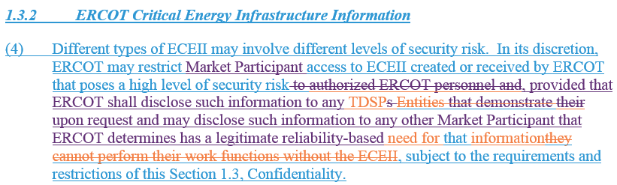
Review of Primary Changes in Oncor and ERCOT Comments
Intent of paragraph is to recognize current practice of limiting access to highly-sensitive ECEII to specific Market Participants.
Oncor proposed revisions (orange) to allow TDSPs to access ECEII that ERCOT has determined poses a high level of security risk.
ERCOT proposed additional revisions (purple) that would provide ERCOT discretion to disclose ECEII to other Market Participants when ERCOT determines that a legitimate reliability-based need exists. Examples:
  SSR analysis results (for a particular Resource Entity)
  Black Start cranking paths (for Resource Entities with Black Start Resources)

Slide 6
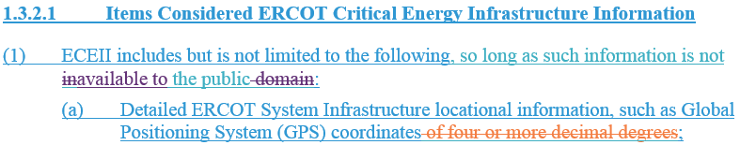
Review of Primary Changes in Oncor and ERCOT Comments
Oncor proposed to delete “of four or more decimal degrees.” Detailed locational information about transmission infrastructure such as GPS coordinates should be considered ECEII regardless of the number of decimal degrees presented.
GPS information that is available to the public (e.g., Google Maps listings, which extend to six decimal degrees) is excluded from ECEII.

Slide 7
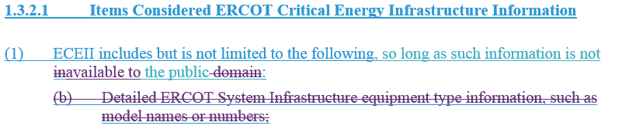
Review of Primary Changes in Oncor and ERCOT Comments
After further discussion with Oncor and other interested parties, ERCOT proposed to delete paragraph (1)(b) due to concern that this item was overly broad and would be difficult to administer.
If an equipment model name or number or other detailed equipment type information could foreseeably be useful to a person planning an attack on ERCOT System infrastructure and otherwise satisfies the definition of ECEII in Section 2.1, such information would still be considered ECEII despite the deletion of paragraph (1)(b). A Disclosing Party could request ECEII treatment pursuant to paragraph (h) of Section 1.3.2.1.

Slide 8
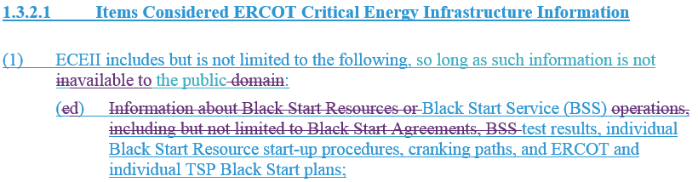
Review of Primary Changes in Oncor and ERCOT Comments
During discussion at the May 9 PRS meeting, concern was expressed that this item was too broad.
ERCOT proposed revisions to recognize that Black Start Agreements are already specifically excluded from Protected Information, and to limit this item to information that can be assumed to contain information that meets the definition of ECEII in Section 2.1.

Slide 9
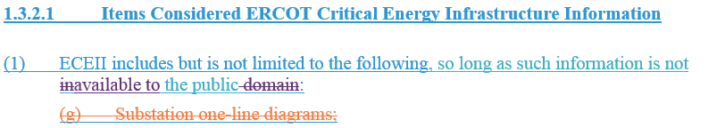
Review of Primary Changes in Oncor and ERCOT Comments
Oncor proposed to delete paragraph (1)(g). Substation one-line diagrams can contain varying level of detail depending on the use, and are included in numerous ERCOT and TSP reports.
If a particular substation one-line diagram could foreseeably be useful to a person planning an attack on ERCOT System infrastructure and otherwise satisfies the definition of ECEII in Section 2.1, it would still be considered ECEII despite the deletion of paragraph (1)(g). A Disclosing Party could request ECEII treatment pursuant to paragraph (h) of Section 1.3.2.1.

Slide 10
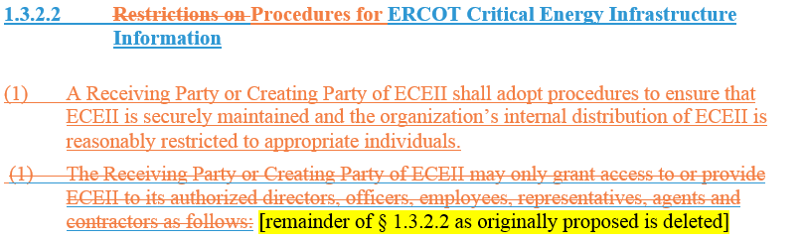
Review of Primary Changes in Oncor and ERCOT Comments
Oncor and other parties expressed concern that the extent of the restrictions proposed in NPRR902 would trigger extensive compliance requirements for Market Participants.
Oncor proposed to replace Section 1.3.2.2 as originally proposed, which placed various restrictions on the handling of ECEII within an organization, with a requirement that Receiving and Creating Parties have internal procedures to ensure ECEII is securely maintained and internal distribution is reasonably restricted.

Slide 11
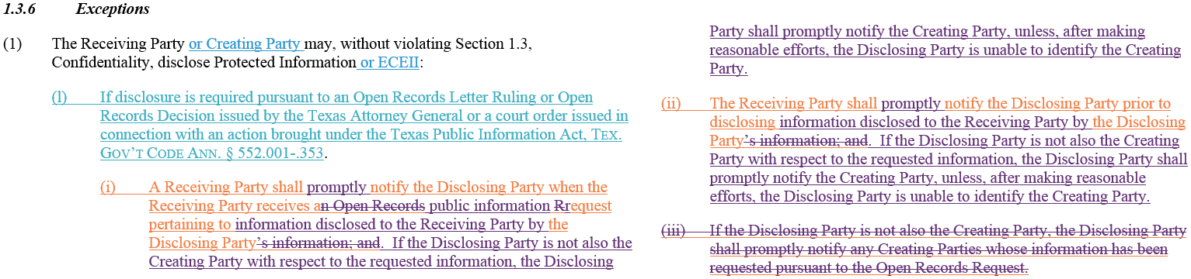
Review of Primary Changes in Oncor and ERCOT Comments
Based on comments at Workshop II, ERCOT proposed to add paragraph (1)(l) to except ECEII from disclosure restrictions where disclosure is required pursuant to an Open Records Letter Ruling or Decision issued by the Texas Attorney General or a court order issued in connection with an action brought under the Texas Public Information Act (PIA).
Oncor proposed revisions (orange) to add notification requirements for Receiving and Disclosing Parties related to Open Records Requests.
ERCOT proposed revisions (purple) to clarify that a Disclosing Party that is not also the Creating Party must notify any Creating Party of the receipt of any request for information under the PIA, or of any disclosure of information in response to such a request, and creates an exception to these Creating Party notice requirements when, after making reasonable efforts, the Disclosing Party is unable to identify the Creating Party.

Slide 12
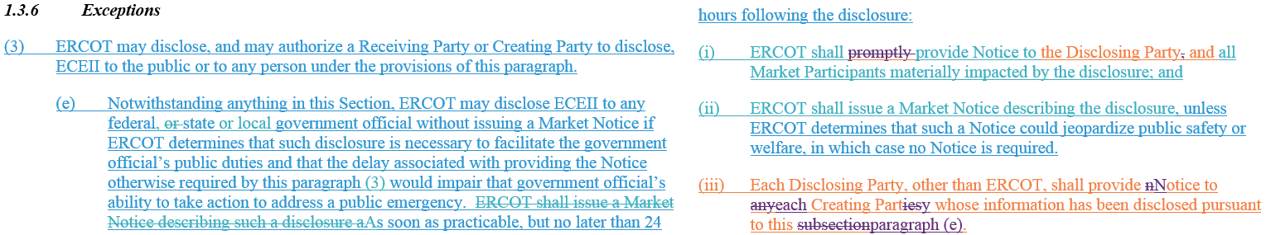
Review of Primary Changes in Oncor and ERCOT Comments
Intent of paragraph is to allow ERCOT a limited right to disclose ECEII in a public emergency.
Oncor proposed revisions (orange) to require notification from ERCOT to the Disclosing Party, and from the Disclosing Party to any Creating Party whose information has been disclosed.
ERCOT proposed revisions (purple) to delete “promptly” from ERCOT’s notice requirement in subparagraph (i) since notice is already required to be provided “as soon as practicable, but no later than 24 hours following the disclosure,” and to make other minor clarifications.

Slide 13
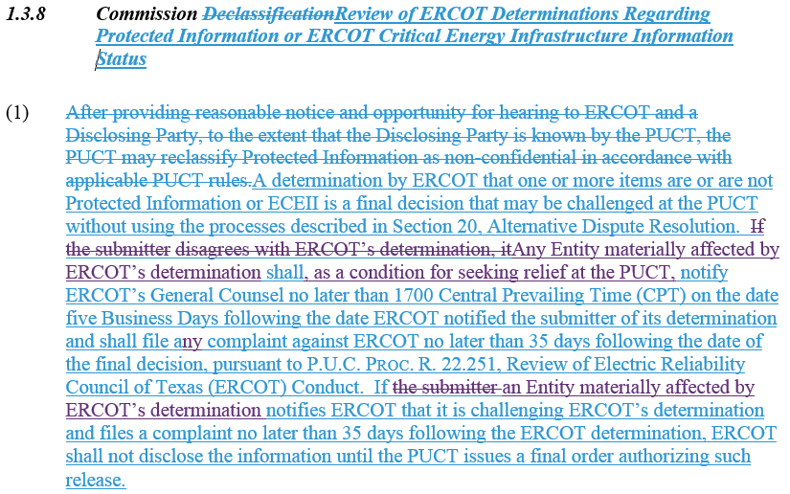
Review of Primary Changes in Oncor and ERCOT Comments
ERCOT proposed revisions to recognize that “any Entity materially affected by ERCOT’s determination” may challenge an ERCOT determination as to Protected Information or ECEII status.

Slide 14

Next Steps
Next PRS meeting: July 17, 2019
Next steps?

Slide 15
Contact Information
Chad.Seely@ercot.com | (512) 225-7035
Nathan.Bigbee@ercot.com | (512) 225-7093
Jonathan.Levine@ercot.com | (512) 225-7017
Douglas.Fohn@ercot.com | (512) 275-7447

