Slide 1
ERCOT Frequency Control Report
May 2019
ERCOT
Operations Planning
PDCWG | June 12th, 2019

Slide 2
Summary of May 2019
CPS1: 170.77%
Current CPS1 12-Month Rolling Average: 174.20%
2 BAAL Exceedances
1 hourly CPS1 scores below 100%
BAAL-003 Events have updated through 2018
2018 BAAL-003 FRM Performance: -843.17
2019 RMS1 Statistics
  Mean: 15.23 mHz
  Min: 13.11 mHz
  Max: 17.86 mHz
Energy Statistics
  Total Energy: 32,055,184 MWh
  Wind Energy: 7,138,610 MWh
  Percent Energy from Wind Generation: 22.27%
Minimum System Inertia
  Mean: 210,959
  Max: 248,468 on May 31st
  Min: 184,909 on May 17th

Slide 3
Frequency Control
CPS1, BAAL, & RMS1

Slide 4
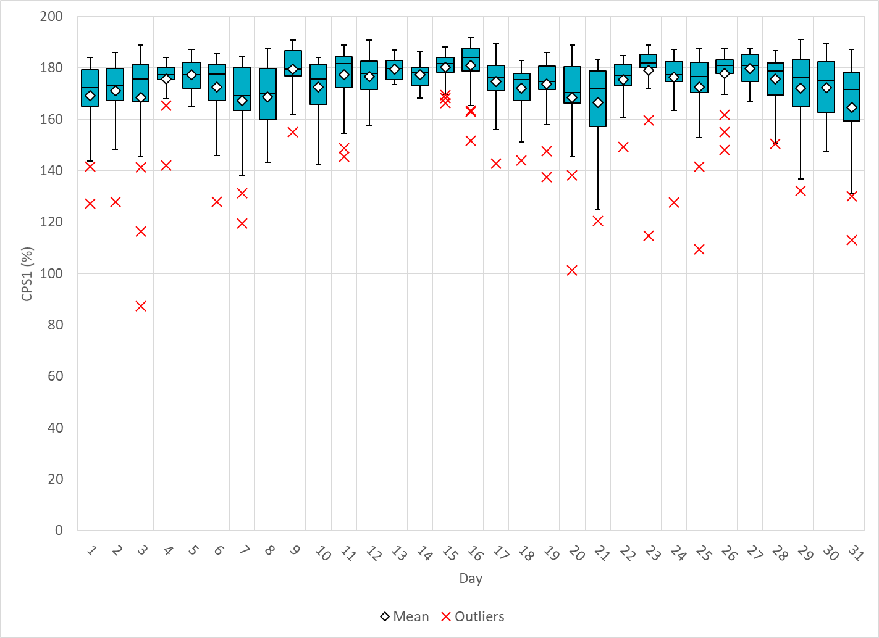
Hourly CPS1 by Day
May-19 CPS1 (%): 174.07
Notes:
Outliers:
4/4/2019 18:00 96.94%
Large expected generation deviation. Unit ramped down 600 MW within the hour, not following BP. Solar decreased by 500 MW in 15 minutes. Reg Up exhausted the majority of the hour
4/6/2019 02:00 6.09%
Wind ramped by >4,000 MW throughout the hour. Large expected generation deviation. A few units not following BP. Reg Up exhausted the majority of the hour
4/18/2019 17:00 98.84%
Several wind units tripped off due to a system disturbance. Non-conforming load increased by 100 MW. Solar ramped-down by 200 MW within the hour. Reg Up exhausted the majority of the hour
4/18/2019 18:00 88.79%
Wind ramped down by >2,000 MW throughout the hour. Solar ramped down by >500 MW throughout the hour. Reg up exhausted majority of the hour.
4/27/2019 02:00 98.52%
Wind ramped down by <2,500 MW throughout the hour. Large expected generation deviation. Unit ramps back faster than BP when below LSL. A few units no following BP. Reg Up exhausted the majority of the hour.

Slide 5
BAAL Exceedances & Violations
There were 2 BAAL exceedances in May
  May 31, 2019
    Unit Trip at 11:56:47
    Loss of 368 MW
    Less than 59.91 Hz for 1 minute
  May 31, 2019
    Unit Trip at 21:06:33
    Loss of 849 MW
    Less than 59.91 Hz for 1 minutes

Slide 6
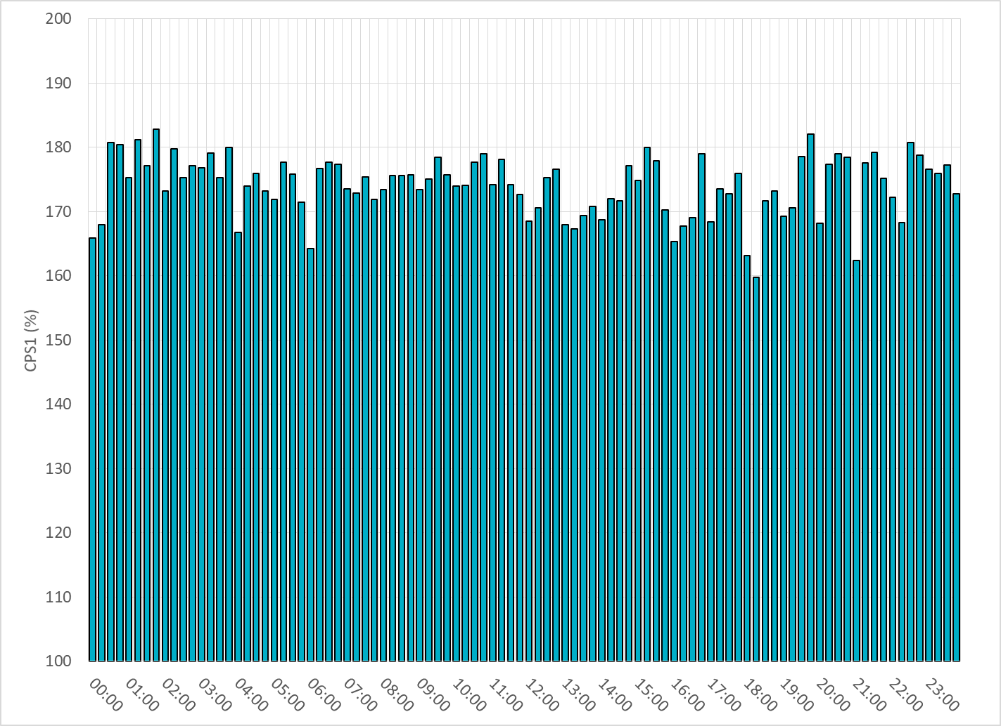
15-Minute Average CPS1%
May-19 CPS1 (%): 174.07

Slide 7
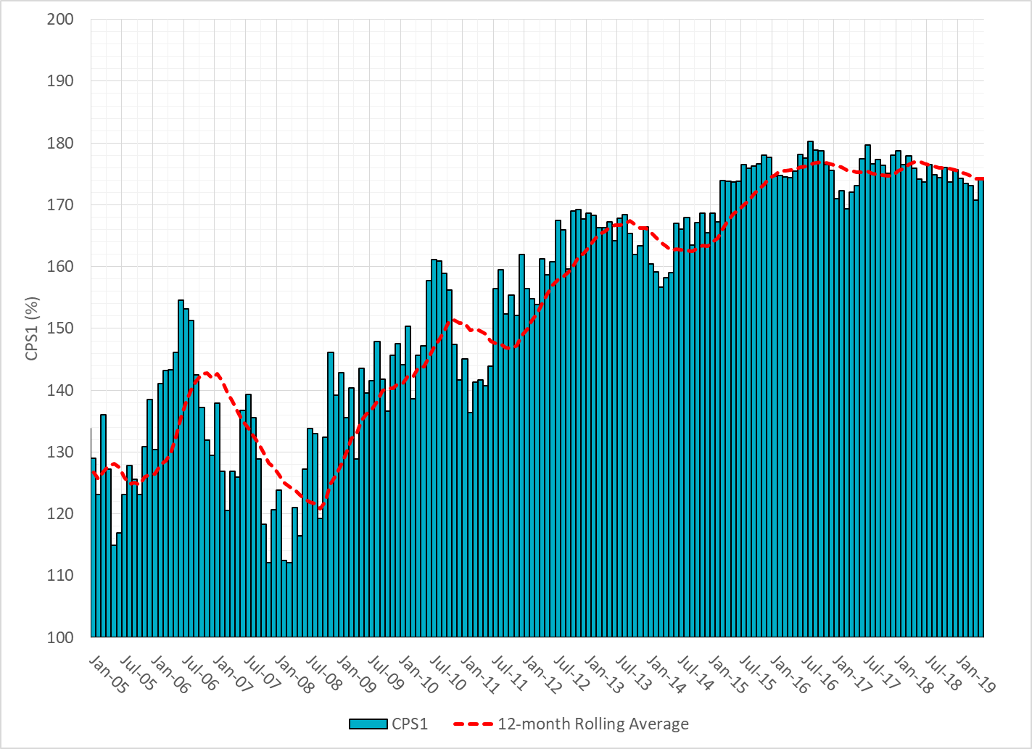
12-Month Rolling Average CPS1
Current 12-Month Rolling Average: 174.20%

Slide 8
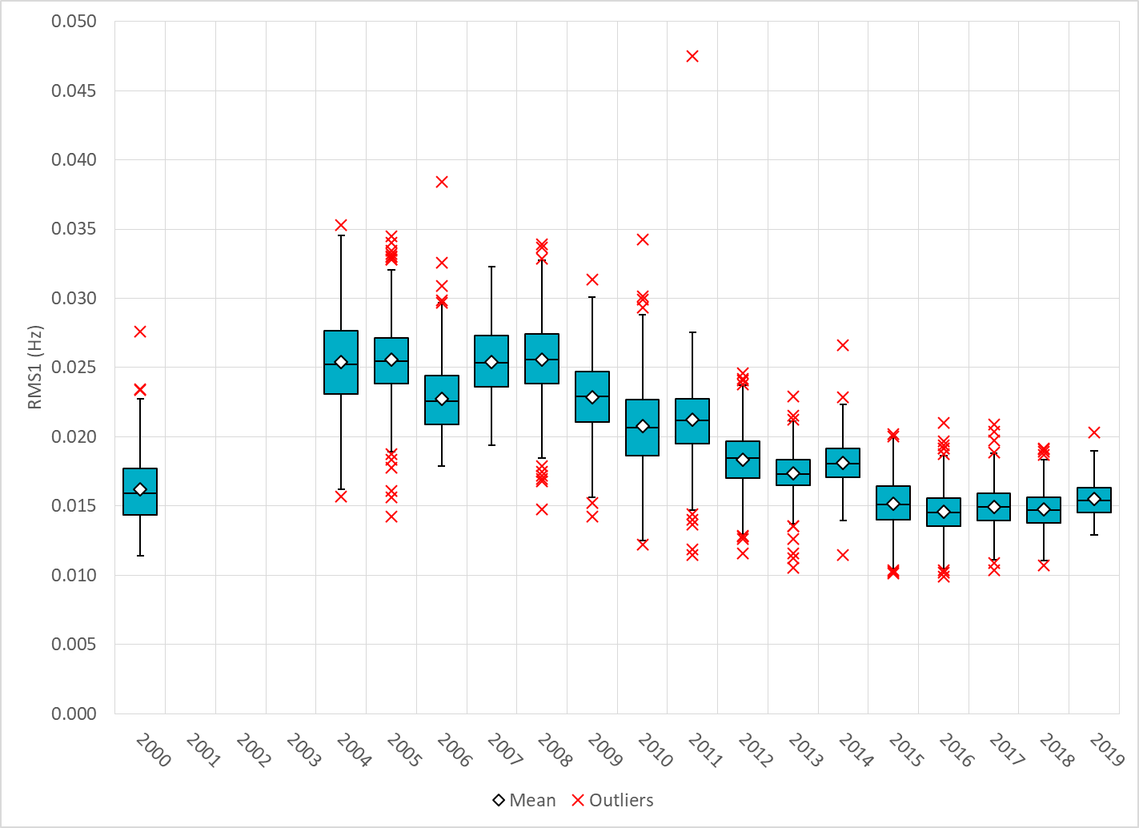
Daily RMS1 of ERCOT Frequency by Year
Notes:
Mean is 15.50 mHz

Slide 9
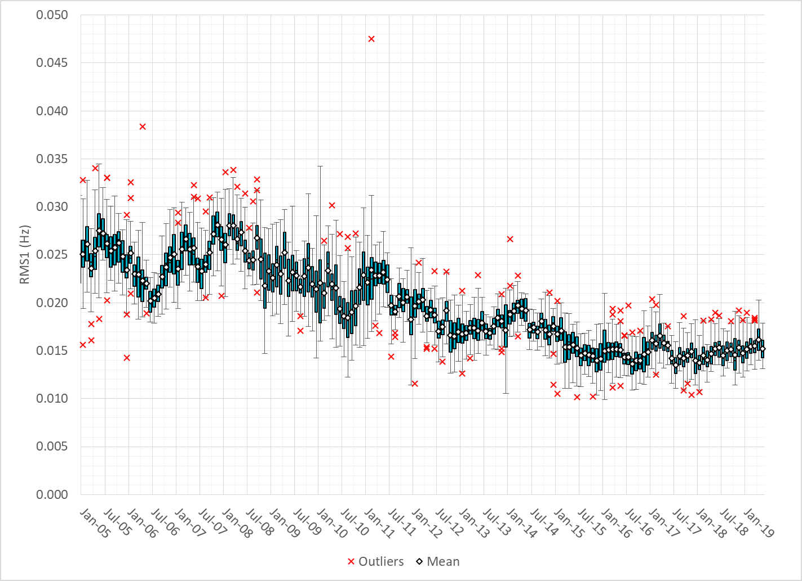
Daily RMS1 of ERCOT Frequency by Month

Slide 10
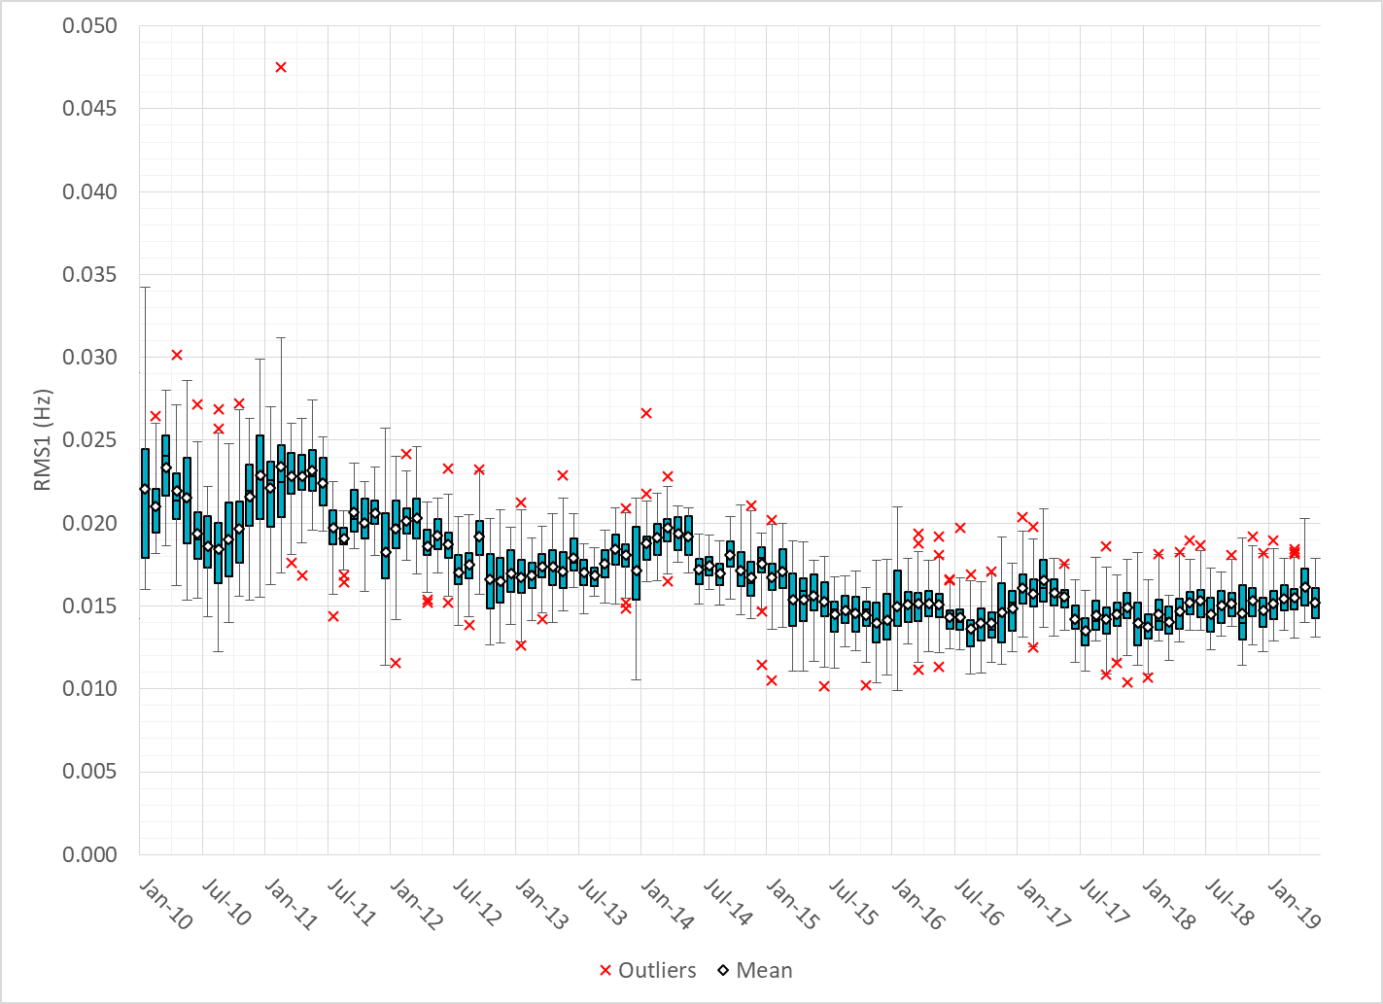
Daily RMS1 of ERCOT Frequency by Month
Notes:
Mean: 15.23 mHz
Min: 13.11 mHz
Max: 17.86 mHz

Slide 11
Frequency Profile Comparison

Slide 12
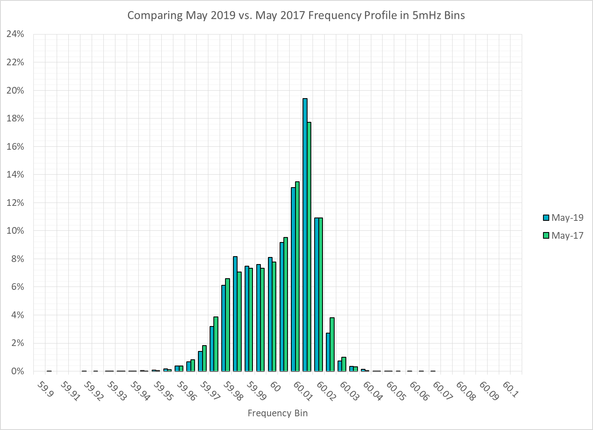
Frequency Profile Comparison

Slide 13

Frequency Profile Comparison

Slide 14
Time Error Correction

Slide 15
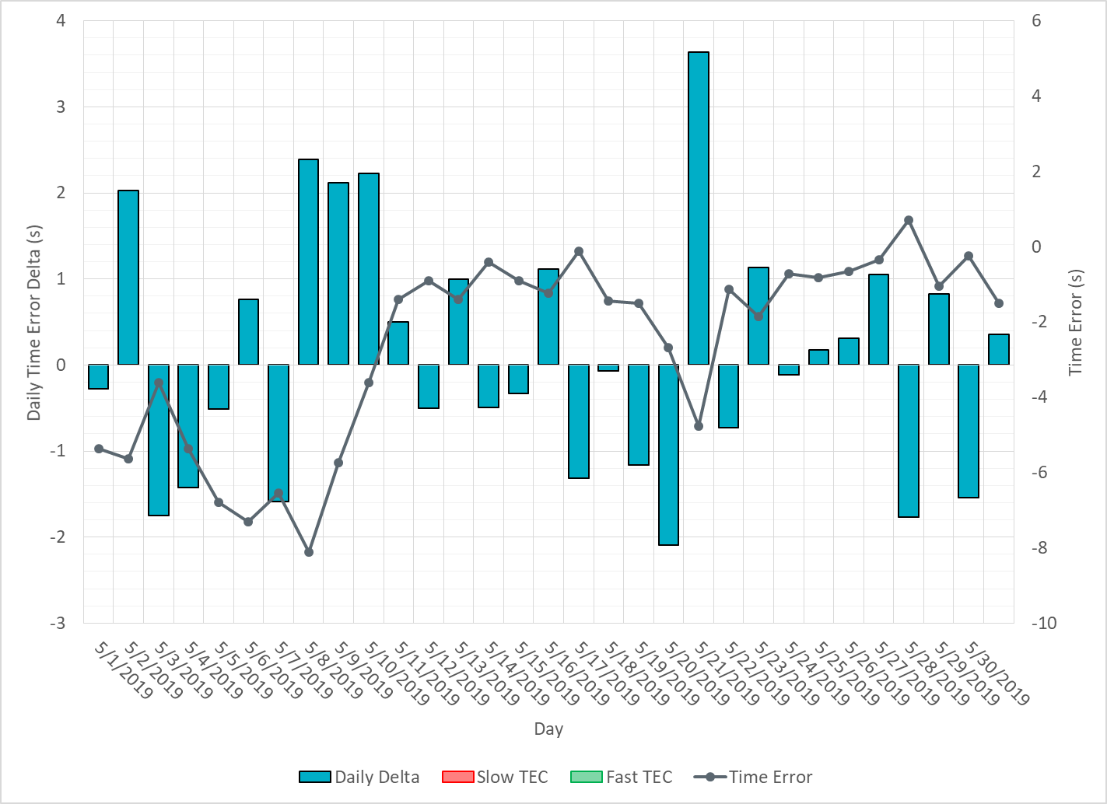
ERCOT Daily Time Error

Slide 16
Time Error Corrections Log Summary
There have been no time error corrections since December 2016

Slide 17
BAL-003 Performance

Slide 18
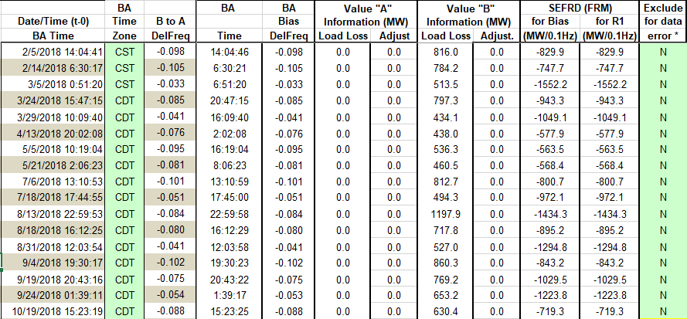
Op. Year 2018 BAL-003 Selected Events

Slide 19
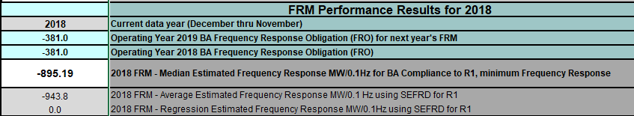
Op. Year 2018 BAL-003 FRM Performance
Notes:
FRM Changed to -895 from -759 on April 1st at 10 AM

Slide 20
Op. Year 2018 BAL-003 Selected Events – Update
Notes:
BAL-003

Slide 21
Op. Year 2018 BAL-003 FRM Performance - Update

Slide 22
ERCOT Energy Statistics

Slide 23
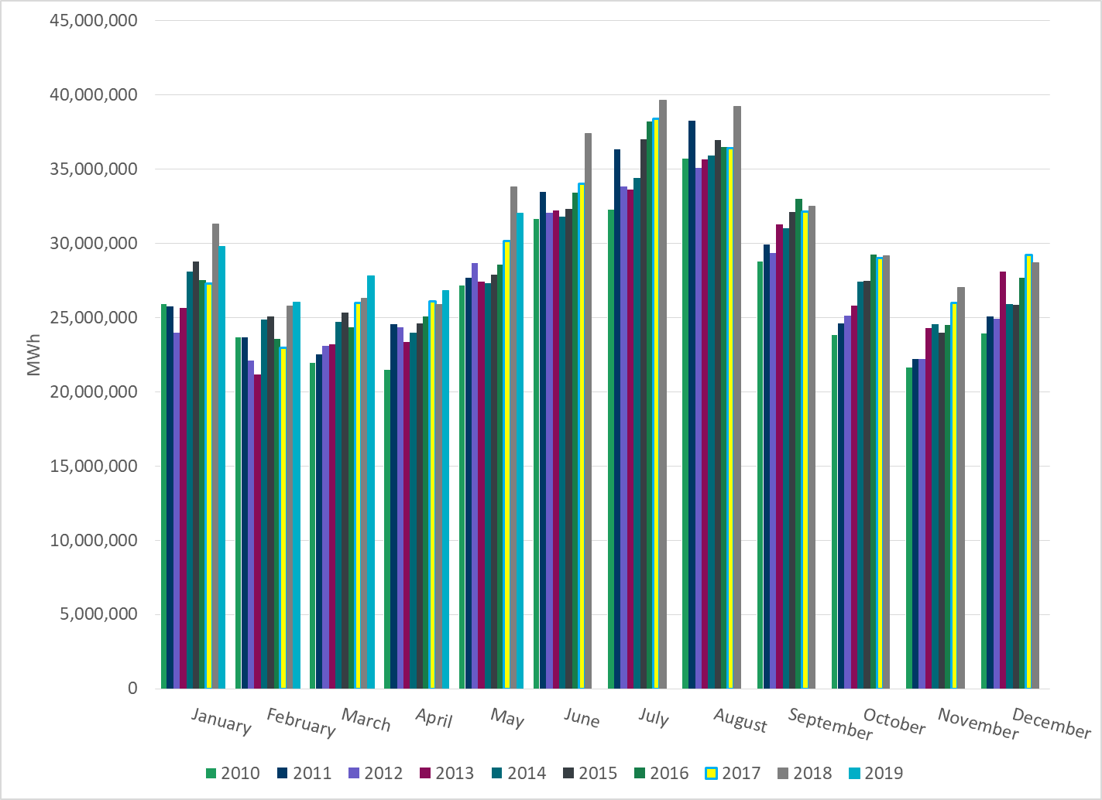
Total Energy
Notes:
32,055,184 MWh

Slide 24
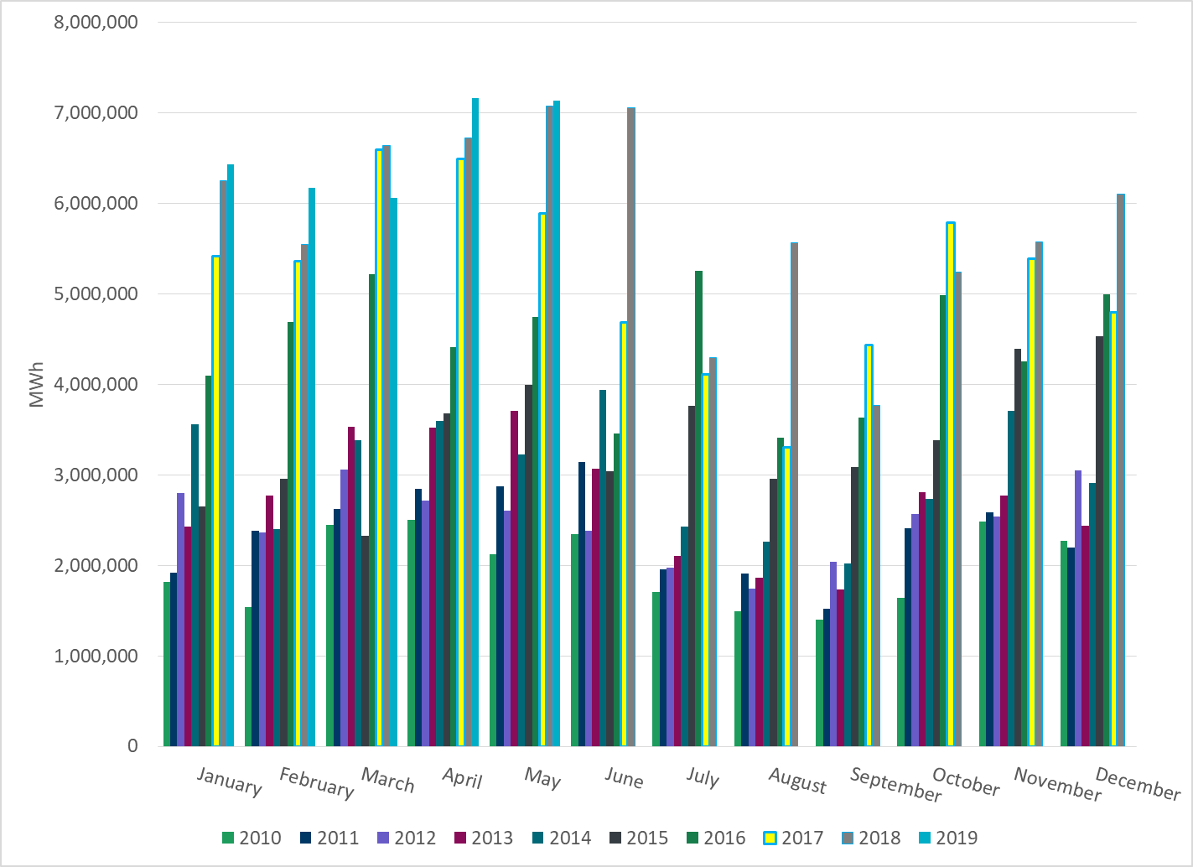
Total Energy from Wind Generation
Notes:
7,138,610 MWh

Slide 25
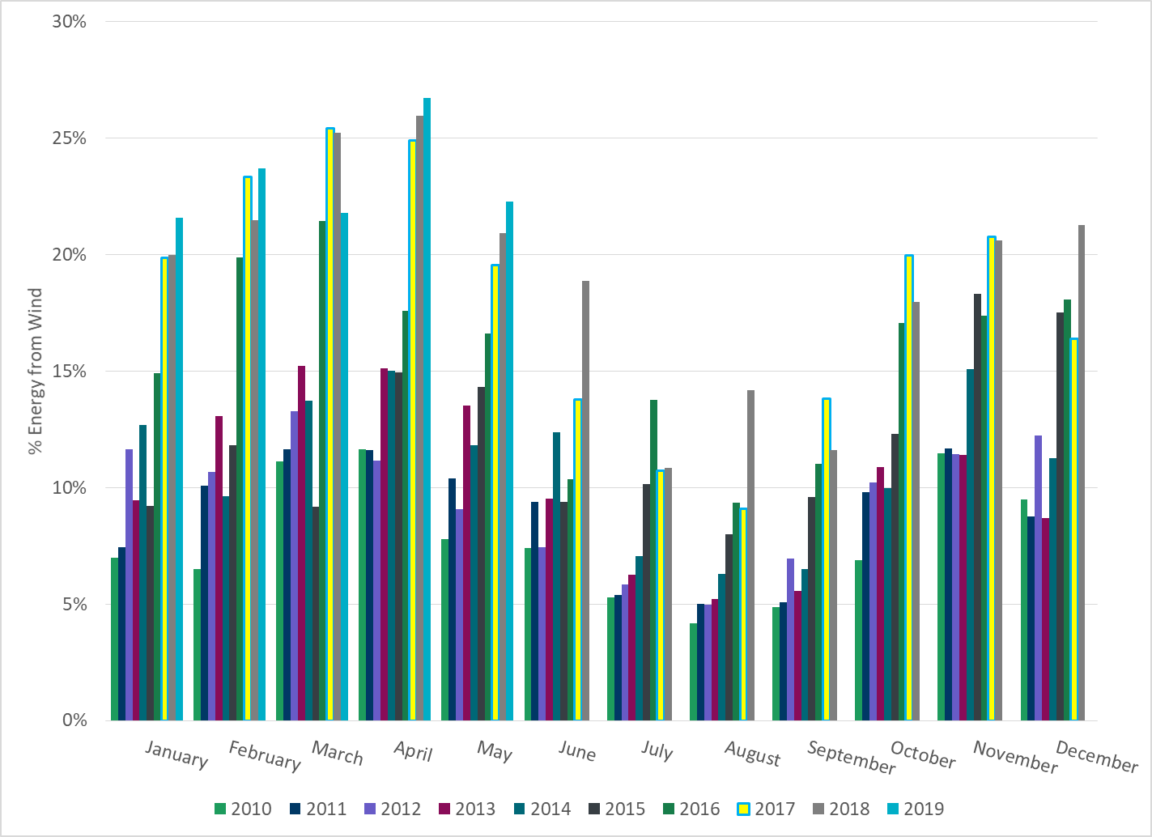
% Energy from Wind Generation
Notes:
22.27%

Slide 26
ERCOT System Inertia

Slide 27
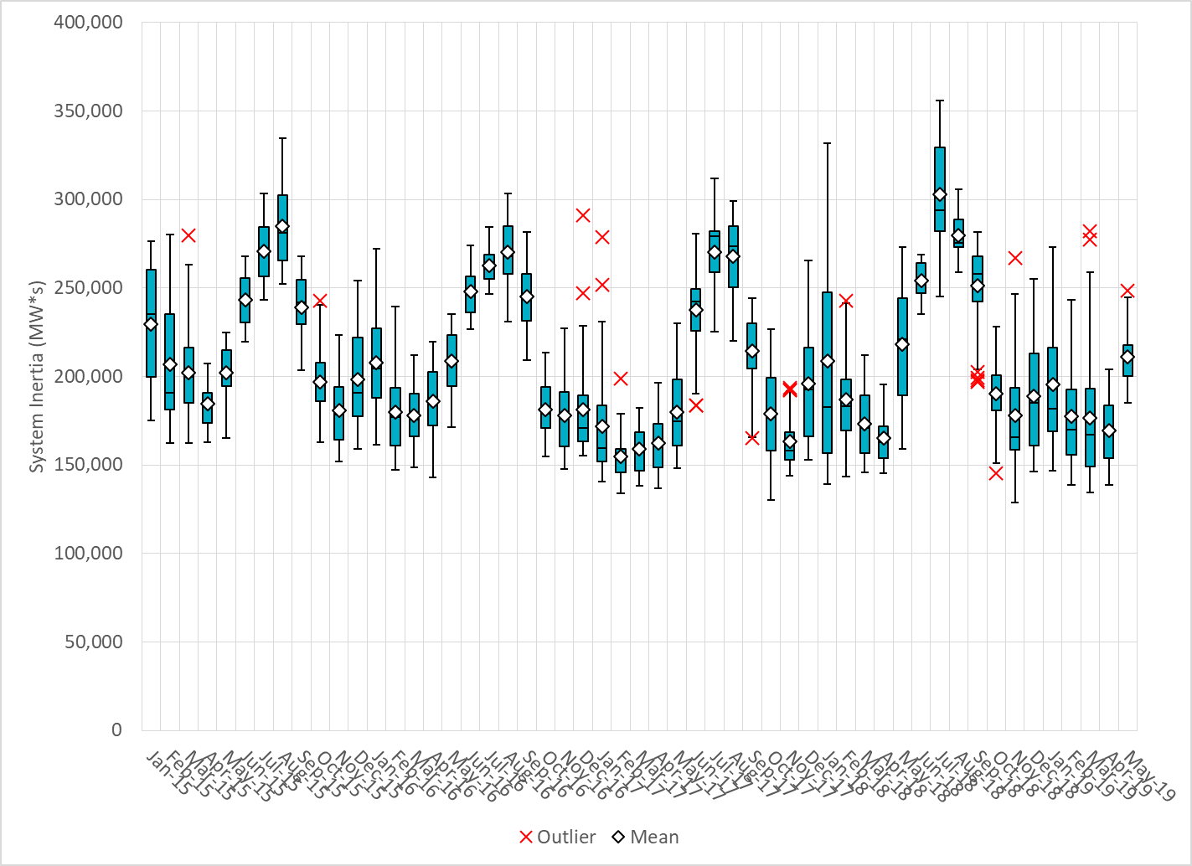
Daily Minimum System Inertia
Notes:
Minimum Inertia = 128,759 MW*s on 11/3/2018.
Previous Minimum was 130,014 MW*s on 10/27/2017. This was also our record wind day.
Data:
Mean: 210,959
Max: 248,468 on May 31st
Min: 184,909 on May 17th

Slide 28
Questions?
Thank you!

