Slide 1
ERCOT DC Ties
ERCOT
Operations Planning
June 12th, 2019

Slide 2
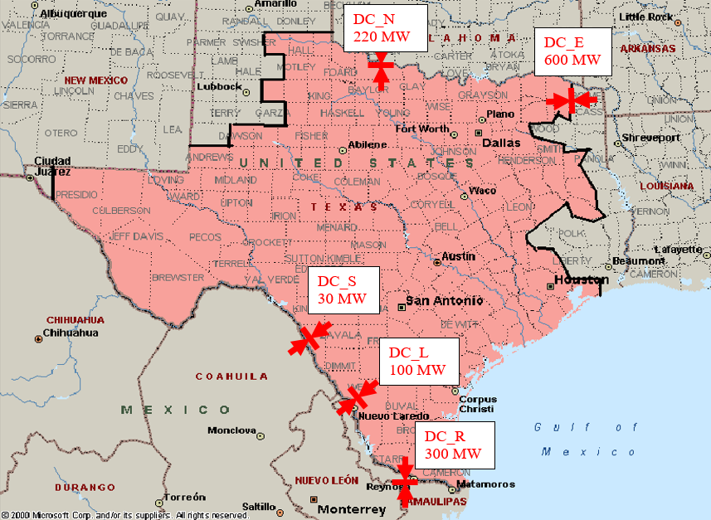

Slide 3
ERCOT DC Ties
ERCOT Protocols allow QSEs to submit bilateral schedules that use the ERCOT DC-Ties by submitting energy schedules for the exports/imports with matching NERC E-Tags
ERCOT is responsible for approving/rejecting the E-Tags that are submitted to ensure ERCOT BA can support requested flows (NERC Standard INT-006-4 R1).

Slide 4
ERCOT DC Ties
DC_R
  Minimum 15 MW Schedule
  Minimum 50 MW/Min Ramp
DC_N
  Minimum 22 MW Schedule
DC Tie Operator will notify the ERCOT Transmission Desk regarding expected large change in schedules
DC tie schedules are not visible to SCED for 5-minute dispatch
Operating Procedures: Here
  ERCOT DC Tie Operations
  DC Tie Operating Procedure

Slide 5
ERCOT Operations
South Ties
  ERCOT completes additional analysis on the ties connected to CENACE due to the limited amount of transmission in the Valley.
  CENACE Provides Daily Limits to ERCOT for the next day
  ERCOT also runs Daily Limit Calculations for Day-Ahead and real- time as needed
  Physical Capability vs Advisory Limits
    ERCOT Operators will use the Physical Capability of the tie to Accept/Reject schedules
    The Advisory Limits reflect the maximum transfer across the DC Ties that ERCOT expects to be able to reliably serve, and is an indication to the Market that schedules submitted above the Advisory Limits may be curtailed in real-time.

Slide 6
ERCOT Schedule Curtailments/Rejection
Operator can curtail/reject DC Tie Schedules for the following reasons:
  Forced Outage or derate on the DC Tie in real-time
  To address System Operation Limits (SOLs) or Interconnection Reliability Operating Limit Violation (IROLs) exceedances
  To prevent overscheduling of a DC Tie
  To address Local, or system wide emergency events (such as EEA)
    ERCOT can curtail exports and request emergency energy from CENACE if available
    ERCOT can curtail exports and notify QSE to request emergency energy across SPP DC Ties
    ERCOT will also begin to RUC units online as needed

Slide 7
Inadvertent Energy
Hourly difference between ERCOT’s actual interchange and ERCOT’s scheduled interchange across DC-Ties is tracked by ERCOT using telemetry and validated with ERCOT Polled Settlement (EPS) meters
Inadvertent Energy payback will be arranged between ERCOT, CENACE, and SPP so that the account balances remain as close to zero as possible. This will be accomplished by biasing the DC-Ties in the desired direction.
Inadvertent Energy Pay Back will be paid back “in kind”
  On-Peak Inadvertent Energy paid back during On-Peak
  Off-Peak Inadvertent Energy paid back during Off-Peak

Slide 8
System Change Request (SCR) #800
Incorporate DC Tie scheduled ramp into Security-Constrained Economic Dispatch (SCED)
DC Tie Ramp Rate (DCTRR) will be calculated from the scheduled system-wide DC Tie ramp times 5 as a configurable factor om Generation To Be Dispatched (GTBD)
This SCR will improve the dispatch of Base Points to Resources to account for the scheduled ramping of DC Ties, will reduce the amount of Regulation Service deployed, and will aid in reducing frequency recovery duration following events that occur at times with significant DC Tie scheduled ramps.

Slide 9
Additional Action Items
Impacts on Regulation during DC Tie Ramp
Largest Net Load Ramp

Slide 10
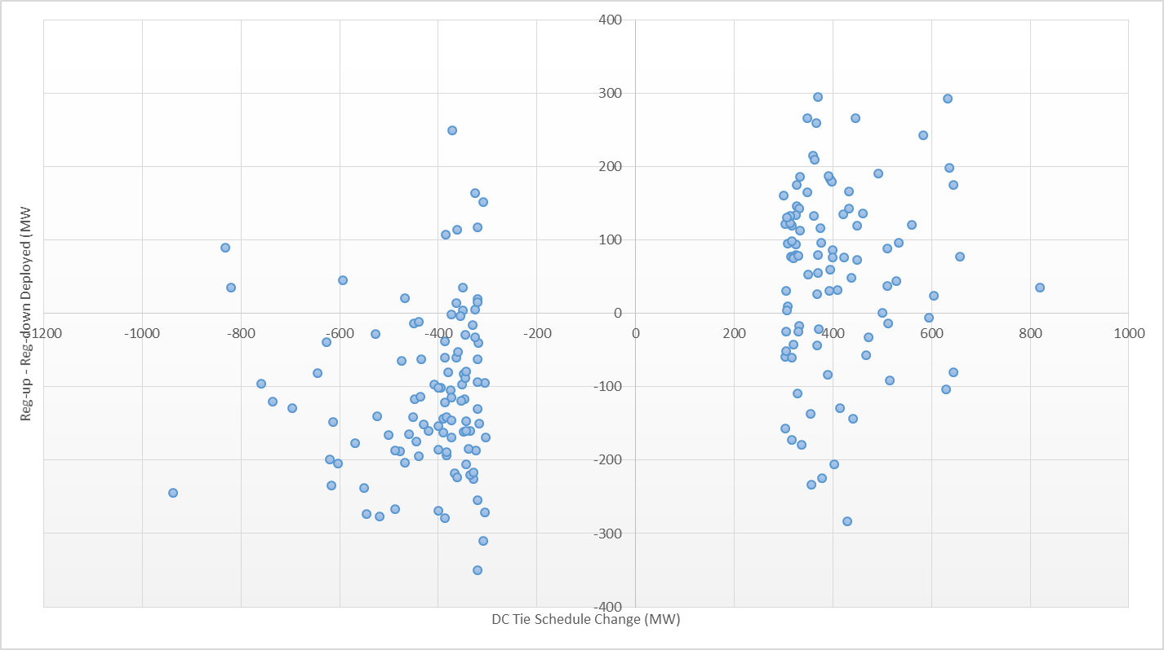
Regulation and DC Tie Ramp Greater Than 300 MW

Slide 11
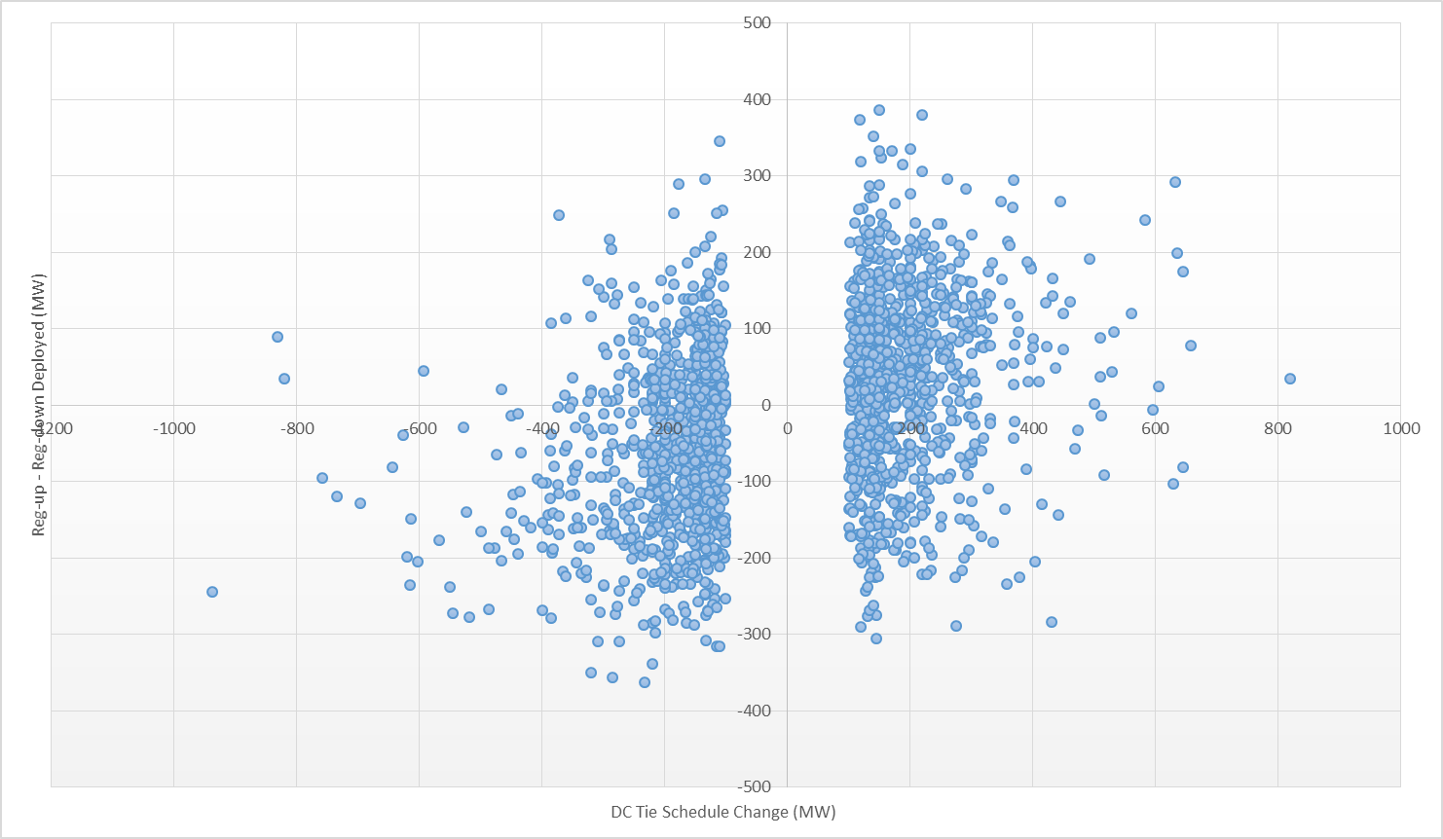
Regulation and DC Tie Ramp Greater Than 100 MW

Slide 12
Largest Net Load Ramp
The net-load ramp is defined as the change in net-load (load minus wind and PVGR generation) during the defined time horizon.
Data provided monthly in the ERCOT Operations Report for ROS.
Notes:
Data provided monthly in the ERCOT Operations Report for ROS.

Slide 13
Questions?
Thank you!

Slide 14
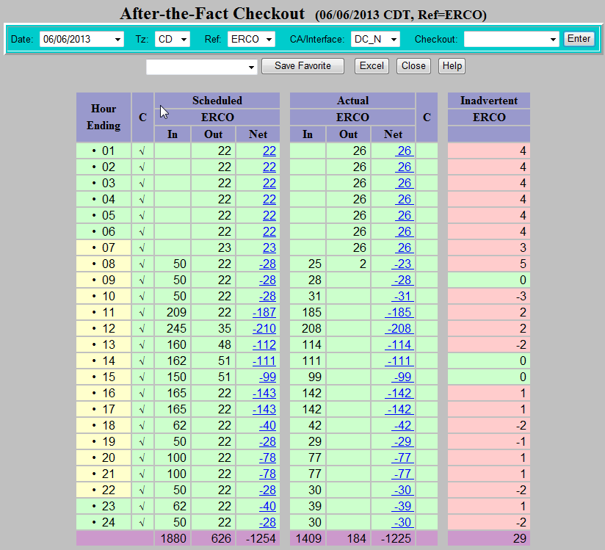
Daily Inadvertent Energy Review

Slide 15
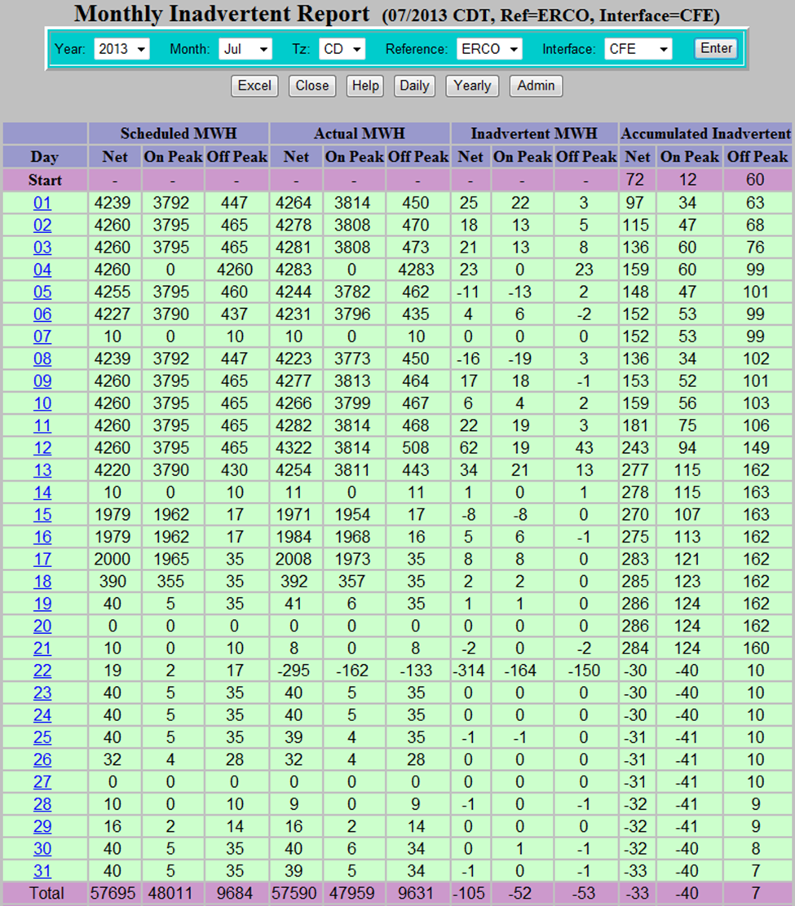
Monthly Inadvertent Energy Report

Slide 16
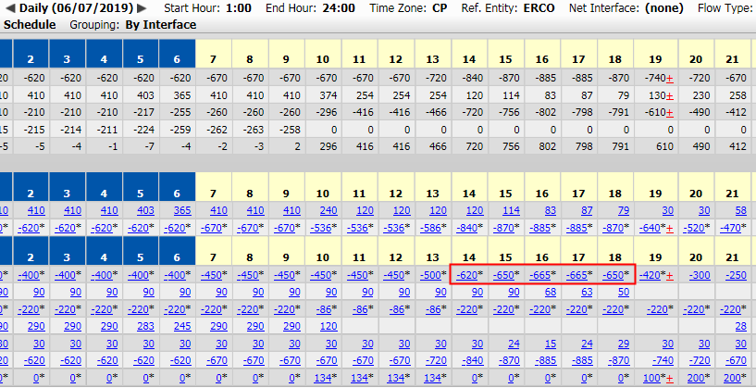
DC Tie Over-Schedule

