Slide 1
MSWG
Update to WMS
June 5, 2019

Slide 2
NPRR885 Must-Run Alternatives (MRA) Presentation and Discussion
MSWG to continue deep dive at June meeting to answer questions and make desktop edits (uniform capitalization, grammar, “expressed as MW”)
Changes to Section 9
Unlike ERS, Settlement does not occur on known cycle
Unlike Black Start, it is not charged in every hour
Likely less uplift than RMR, but less predictable
Possible New NPRR supporting the effort of NPRR885

Slide 3
Action Item: NPRR885 Must-Run Alternative Discussion
How verification data will flow to QSEs
Generation Resources vs Demand Response & Other Resources
QSE representation and deployment frequency
MRA Agreement will have basics terms; Pay as Bid
VDI timestamps critical (time-weighting in calculations are in seconds)
Performance Report (45 days after a Deployment Event)
Section 3 via Reports (Availability Factor, Event Performance, Interval Performance)
Section 6 via Extracts (charge types and determinants)
Timing of data
Initial Settlement accuracy depends on meter data timing
Final Settlement may or may not have 45-day post Performance Report
Need to be sure Payments and Charges completed on True-up
Nodal Protocol Section 9 may need description of the MRA Settlement timeline

Slide 4
UFE Report Needs a home audience. The previously deemed appropriate subcommittee was COPS. http://www.ercot.com/content/wcm/key_documents_lists/174590/2018_UFE_Analysis_Report.pptx Broad appeal for TDSPs, Planning and Settlement WMS or combination?

Slide 5
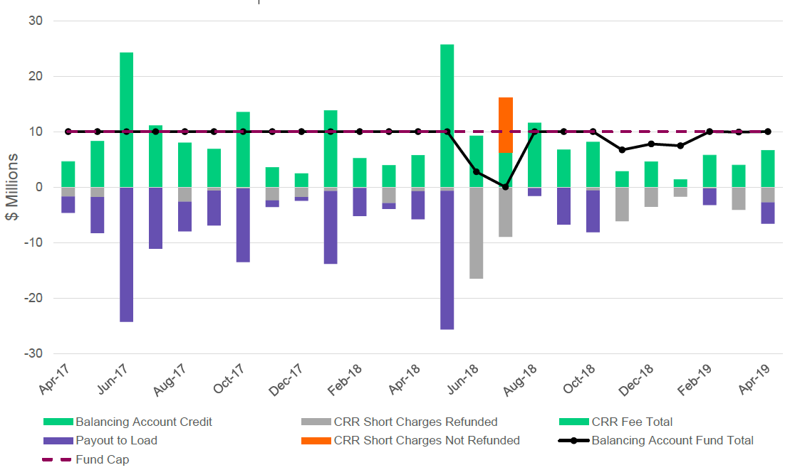
CRRBAFBBAL trending just below $10MM, MSWG does not see any reason to raise the FUNDCAP at present. (draft graph from ERCOT presentation to TAC)

Slide 6
Next MSWG meeting will be
June 25, 2019 at 1:00pm

