Slide 1
Market Credit Working Group update to the Wholesale Market Subcommittee
Bill Barnes NRG, Chair
Josephine Wan Austin Energy, Vice Chair
06/05/2019

Slide 2
MCWG update to WMS
General Update
May 15th Joint MCWG/CWG Meeting
5 NPRRS reviewed for their credit impacts
823NPRR Amend the Definition of an Affiliate
904NPRR Revisions to Real-Time On-Line Reliability Deployment Price Adder for ERCOT-Directed Actions Related to DC Ties
931NPRR As Built Hub Average Calculation
932NPRR Addition of Load to Existing Load Zone
935NPRR Post All Wind and Solar Forecasts
All operational without any credit impact

Slide 3
MCWG update to WMS
Review of ERCOT CRR Portfolio Liquidation
Straw-man Proposal to change CRR Repossession Process
Dollars needing to be paid or charged as a result of the repossessed CRRs in a default should be tracked and eventually flow in settlements to/from the default uplift allocation process
Simplify as much as possible to reduce implementation cost
Three categories:
CRRs settling during the current month OR the prompt month and the default occurs late in the current month (auction bid window is already closed/ there is not enough time to hold a one-time special auction)
If an auction cannot be held due to timing, then ERCOT will create a placeholder CRRAH to accept transfer of defaulted CRRs
CRR will continue to exist and ownership would go to a “tracking” entity
If charge in DAM, short pay for the Operating Day
If payment in DAM, add to defaulted entity collateral (Hold the money in collateral default entity then true up, reconcile everything at the ~180-day default uplift settlement)

Slide 4
MCWG update to WMS
Review of ERCOT CRR Portfolio Liquidation – Cont.
2. Small positively valued portfolios
Blow a threshold of $X, evaluate based on the most recent ACP (Auction Clearing Price), continue with current one-time auction approach
Finalizes the default quickly for small portfolios
If no bids are received (still only allow positive bids), proceed with liquidation similar to large portfolios
ERCOT discretion to reject? For example, what if only one bid is received and it is 1% of the ACP value. Propose to only allow positive bid?
3. Negatively valued portfolios or large positively valued portfolios
Above a threshold of $X, based on mark-to-market value (ACP), or if the one-time auction fails/is rejected, CRR market operator would offer in all the repossessed CRRs on an individual basis at a very low price in the next available auction for that time period until all CRRs are sold.
Could take as much as 6 months, depending
The payment or charge from that auction would track against the default dollars.
Must have an offer price established: -$0.01 for OPT, -$XXX for OBL
In the unlikely case the OBL doesn’t clear, dissolve the capacity
ERCOT has the option to rerun auction with fewer offers or maybe hold some back and wait until next auction
Next Steps: ERCOT will draft an NPRR

Slide 5
MCWG update to WMS
Market Entry Qualifications
ERCOT legal updated the group that:
They are currently working to develop a risk matrix with several buckets for market entry qualification
They will look at how other financial markets and ISO conduct their respective market entry qualification
They will also review the PJM recommendation, investigation report for Greenhat default

Slide 6
MCWG update to WMS
Review Report and Findings on Greenhat Default
PJM Greenhat consultant recommendation
The PJM Greenhat report is 46 pages with 5 recommendation pages
PJM staff prepared a response largely agreeing to the recommendations made by the independent consultant in May 2019
Some recommendations in the report is not applicable to ERCOT or ERCOT has already with a policy in place to take care the matter
Focus on the recommendation pages, identify the key areas and propose to the Finance and Audit (F&A) Committee
Next Steps: CWG Chair and ERCOT staff will work on summary of findings and address how ERCOT meets the items brought up in the PJM Greenhat report then circulate the document to group for comment. Target to have this document available for the group to review in June.

Slide 7
MCWG update to WMS
ERCOT Credit Exposure Updates
Market-wide average TPE increased from $298.5 million to $322.6 million
The increase in TPE is due to slightly higher Forward Adjustment Factors in April
Discretionary Collateral is defined as Secured Collateral in excess of TPE,CRR Locked ACL and DAM Exposure.
Average Discretionary Collateral decreased from $926.7 million to $796.3 million
The decrease in Discretionary Collateral is largely due to increase in CRR Locked ACL during April
Number of active Counter-Parties increased from 237 to 241
No unusual collateral call activity

Slide 8
MCWG update to WMS

Slide 9
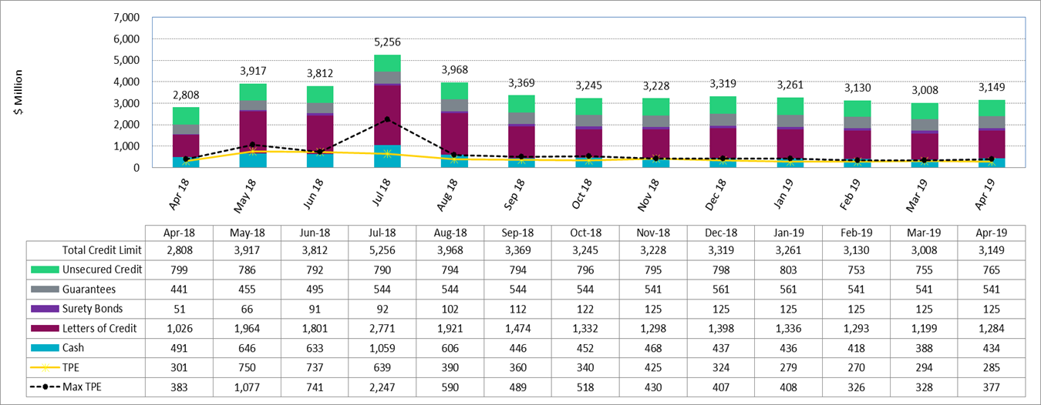
MCWG update to WMS

Slide 10
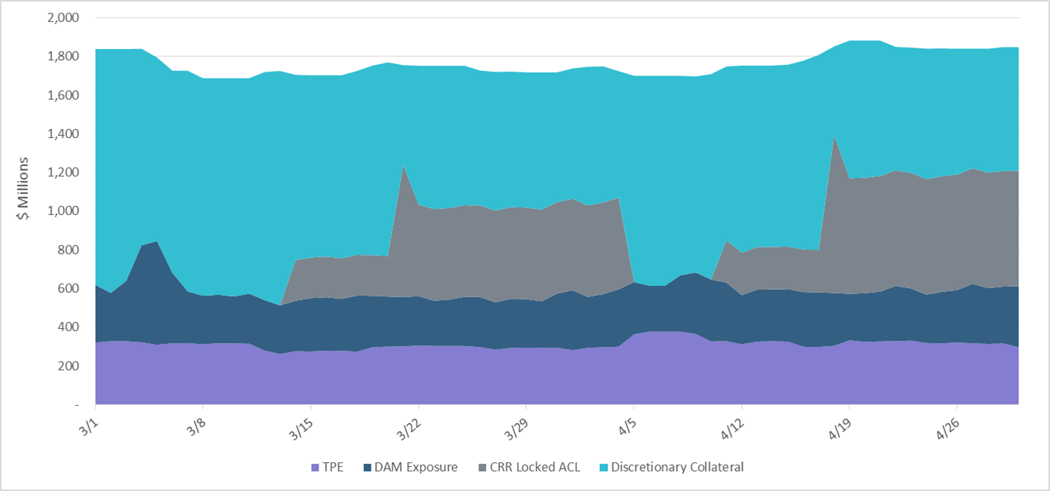
MCWG update to WMS
Discretionary collateral -only include letter of credit, surety bond, guarantee and NO unsecured credit

Slide 11
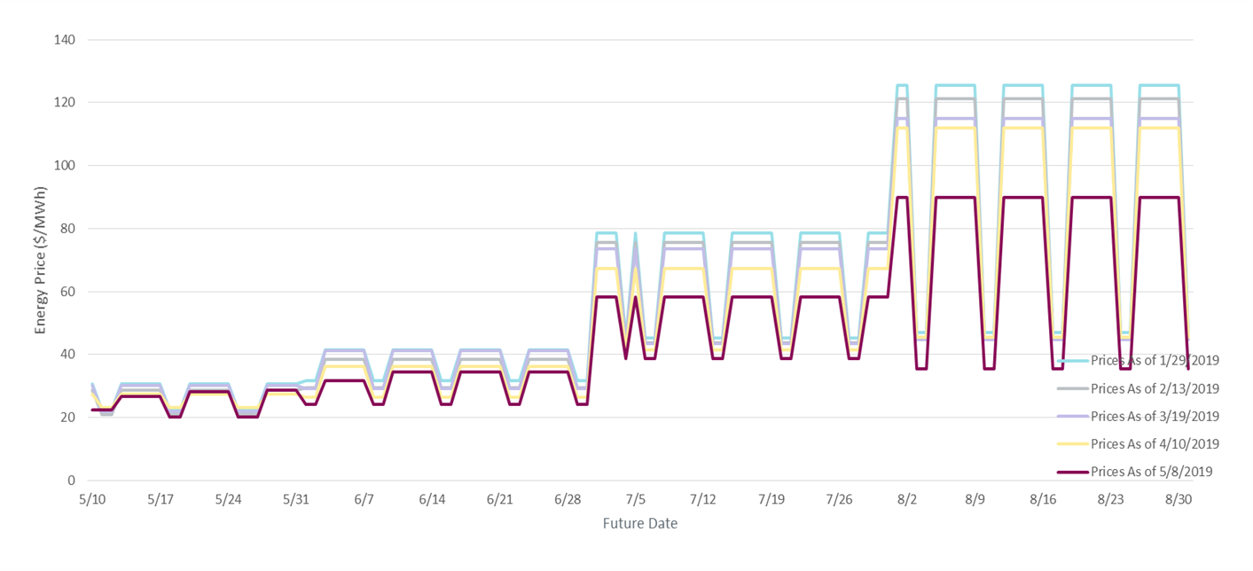
MCWG update to WMS

Slide 12
MCWG update to WMS
CMM Tech Refresh Update
Phase 1A – Implement NPRRs 648, 683, 743, 760, and 800 via the existing CMM application
Phase 1B – Implement modern architecture, user improvements, and NPRRs (519, 620, 660, 741 and 755*)
Phase 2 - Implement user improvements and NPRRs (484-1B, 829, 867, 907)
The following NPRRs will implemented on June 2, 2019
NPRR 519 – Exemption of ERS- Only QSEs from Collateral and Capitalization Requirements
NPRR 620 – Collateral Requirements for Counter-Parties with No Load or Generation
NPRR 660 – Remove CRR State Change Adder
NPRR 741 – Clarification to TPE and EAL Credit Exposure Calculations
NPRR 755 – Data Agent Only QSE Registration – will implemented on June 15, 2019

