Slide 1
TDTMS Update
RMS
June 4th, 2019

Slide 2
TDTMS
Recreating Reports
Update
Usage and Billing – Dispute
Started Documenting Data Requirements
Initial Findings: Approximately 50% of the U&B Disputes for January were initiated by one MP
MarkeTrak Enhancements
MT Subtype Volumes
Chart A&B
TDTMS to start creating an enhancements list for a potential MT upgrade

Slide 3
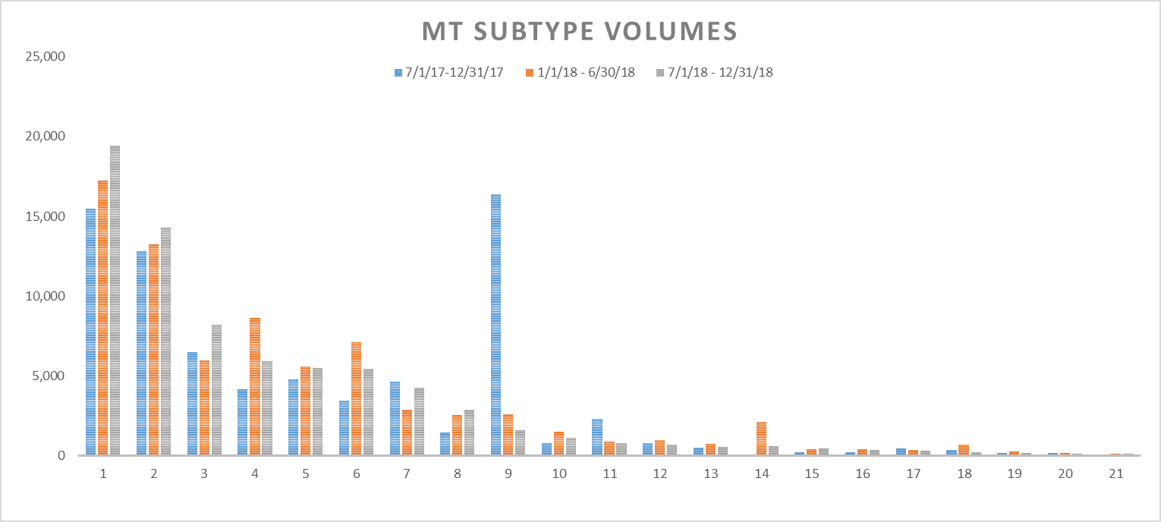
Chart A: MT Subtype Volumes

Slide 4
Chart B: MT Subtype Data

Slide 5
TDTMS
Next Meeting
ERCOT MetCenter
June 20th
On the Agenda: Reviewing Switch Hold Subtype

