Slide 1
NPRR 885
Must-Run Alternative (MRA) Details and Revisions Resulting from PUCT Project No. 46369, Rulemaking Relating to Reliability Must-Run Service
MSWG Meeting – May 28, 2019

Slide 2
NPRR 885 MRA Definitions
MRA Service
  The use by ERCOT, under contracts with QSEs, of capacity and energy as an alternative to RMR service
This presentation is focused on performance metrics for MRA Service provided by Demand Response and Other Generation

Slide 3
NPRR 885 MRA Definitions
Other Generation MRA
  Settlement Only Generators
  Unregistered distributed generators
  Provides MRA service by exporting energy to the ERCOT grid
Demand Response MRA
  Load that provides MRA service by reducing energy consumption in response to an ERCOT instruction
Weather Sensitive MRA
  Load that provides MRA service by reducing energy consumption in response to an ERCOT instruction
  Load meets weather sensitivity requirements

Slide 4
NPRR 885 MRA Definitions
MRA Contracted Hours
  Hours during which an MRA is contracted under an agreement to provide MRA Service
MRA Contracted Months
  Months during which an MRA is contracted under an agreement to provide MRA Service
MRA Site
  An individually metered component of an aggregated MRA

Slide 5
NPRR 885 MRA Service Overview
Procurement subject to Board Approval … must be a cost effective alternative to contracting with an RMR
ERCOT will issue an RFP
QSE’s offer, if accepted, is subject to the terms of the RFP, the MRA agreement, and ERCOT protocols
QSE may submit multiple offers … no duplication allowed
Minimum offer 5 MW
QSE must be capable of receiving VDI and XML instructions from ERCOT (at least initially VDI)
QSE must submit availability plan for current and next 6 operating days and continuously update it
Telemetry required at the MRA-level
No dual commitment during MRA hours (AS, ERS, TDSP SOP)

Slide 6
NPRR 885 MRA Offer
Required information for an offer:
Offered capacity for all months, days of week and hours
  Resource ID, ESIID, Unique Meter ID for the MRA
  If an aggregated MRA, list of all sites and capacity allocated to each site
  If MRA or MRA Site is in NOIE territory, the substation from which service is provided
Start-up time
Stand-by price: $/MW/Hour
Event Deployment price: $ per deployment event
Variable price: $/MWh
Target availability

Slide 7
NPRR 885 MRA Other Requirements
Demand Response MRAs may not be deployed more than once per day
Substitutions are allowed
  ERCOT approval required
  Obligations same as original … one or more whole days
  Reliability benefit must greater than or equal to the original MRA
MRA may be dispatched by ERCOT at any time during contracted hours
ERCOT may issue deployment instruction prior to the beginning of the contracted hours … MRA must meet obligations at start of contracted hours
If deployed during contracted hours, the ramp period will be considered in establishing the deployment period

Slide 8
NPRR 885 MRA Other Requirements
ERCOT will develop a baseline for a Demand Response MRA as described in the “Default Baseline Methodology” document posted on ERCOT website
Metering
  15-minute interval meter required for the MRA and for each site in an aggregated MRA
  In competitive areas of ERCOT, data will come from ERCOT systems
  In NOIE areas, data will have to be submitted to ERCOT by NOIE TDSP
  Interval data will be adjusted to include distribution losses (if loss study on file with ERCOT)

Slide 9
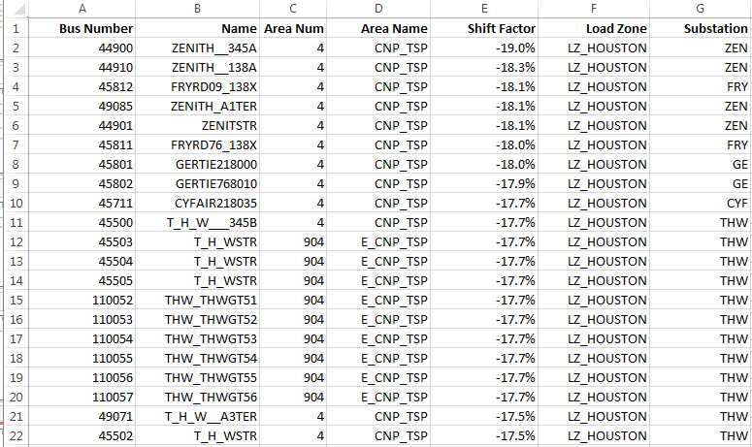
NPRR 885 MRA Shift Factors
Excerpt from Greens Bayou MRA evaluation

Slide 10
NPRR 885 MRA Availability Measurement
Availability for Other Generation and Demand Response MRAs will be evaluated on a monthly basis
  If meter data is missing for an interval, the MRA will be treated as unavailable for that interval
  For a Demand Response MRA, an interval is deemed available if
    The availability plan indicates the MRA capacity is available for the interval
    Effective Actual MW > 95% of the effective contracted capacity
      Effective Actual MW = -1 × shift factor × MRA metered load
      Effective Contracted Capacity = -1 × shift factor × MRA Contracted Capacity
    For an aggregated MRA, the Effective Actual MW = -1 × sum across all sites of the MRA site shift factor × MRA site metered load
    For an aggregated MRA, the Effective Contracted Capacity = -1 × sum across all sites of the MRA site shift factor × MRA site’s allocated share of the MRA Contracted Capacity

Slide 11
NPRR 885 MRA Availability Measurement
Availability for Other Generation and Demand Response MRAs will be evaluated on a monthly basis
  For an Other Generation MRA, an interval is deemed available if
    The availability plan indicates the MRA capacity is available for the interval
    Export to the ERCOT system = 0
  Monthly availability is the ratio of available intervals to contracted intervals for the month
  Intervals excluded from the calculation
    Intervals during an MRA deployment or test
    Intervals on the day of a deployment or test following the ERCOT recall instruction
    Intervals during a TDSP outage or meter failure

Slide 12
NPRR 885 MRA Test/Event Performance
MRA Event Performance Reduction Factor (MRAEPRF)
  Calculated using 15-minute interval data (aggregated if applicable) for the MRA
  Time-weighted average of the MRA Interval Performance Factors (MRAIPF) for the 15-minute intervals of the test/event
  Intervals included in the calculation
    Start with the first interval of the deployment period (partial or full), and
    End with the last full 15-minute interval of the deployment period
    End of the last contracted hour for the day
  Example:
  Instruction issued at 12:50 PM … MRA has 15-minute start-up time
  Deployment begins at 1:05 PM; recall instruction issued at 4:10 PM
Deployment period ends at 4:00 PM
Deployment length is 175 minutes
First partial interval weight is 0.0571 (10/175)
All other intervals weight is 0.0857 (15/175)

Slide 13

NPRR 885 MRA Interval Performance Factor
Variable | Unit | Description
MRAIPF_{q,r,i} | None | Interval performance factor of MRA_{r} QSE q, Settlement Interval i.
IntFrac_{i} | None | (Interval end time in minutes - Interval start time in minutes) / 15
Effective Base_Mw_{i} Demand Response MRA | MW | Aggregated sum of the product of -1, the MRA Site Shift Factor, and MRA Site baseline MW estimated by ERCOT for all MRA Sites in MRA for interval i.
Effective Base_Mw_{i} Other Generation MRA | MW | Aggregated sum of the product of -1, the MRA Site Shift Factor, and MRA Site injection MW values for all MRA Sites in MRA for interval i.

Slide 14
NPRR 885 MRA Interval Performance Factor
(continued)
Variable | Unit | Description
Effective Actual_MW_{i} Demand Response MRA | MW | Aggregated sum of the product of -1, the MRA Site Shift Factor, and MRA Site actual metered Site MW values for all MRA Sites in MRA for interval i.
Effective Actual_MW_{i} Other Generation MRA | MW | 0
Effective Contracted Capacity_Mw_{i} | MW | Aggregated sum of the product of -1, the MRA Site Shift Factor, and MRA Site portion of the MRA contracted capacity for all MRA Sites in MRA for interval i.
i | None | A 15-minute settlement interval
q | None | A QSE
m | None | A month index
r | None | An MRA

Slide 15
NPRR 885 MRA Test/Event Performance
If MRAEPRF for an MRA < 0.95 for an event ERCOT, it will be reduced to the square of the initial factor.
  Each MRAIPF will be reduced accordingly
For a Weather sensitive MRA, the decision to apply the reduction will be based on the normalized peak demand reduction across all deployment intervals in the contract period
  If greater than 95% of the largest contracted capacity in any hour, no reduction applied
For multiple deployments (test or actual event) in a month, the MRAEPRF for the month shall be the time-weighted average of the MRAIPFs for all tests/events in the month
  If the squaring described above is applied, the reduced MRAIPFs will be used in this calculation

Slide 16
NPRR 885 MRA Test/Event Performance
Co-located Demand Response and Other Generation
  The Demand Response MRA is is physically located with the Other Generation MRA
  If an aggregation, each MRA Site in a Demand Response MRA is physically located with an MRA Site in the Other Generation MRA
  Contracted hours must be the same for both MRAs
  The Demand Response MRA is not providing Weather-Sensitive MRA
  Event performance is calculated using the sums of the respective quantities from the two MRAs

Slide 17
NPRR 885 MRA Testing
ERCOT test prior to the initial MRA Contracted Month
ERCOT may test during any contracted month
  Weather sensitive MRAs no more than 2 tests per month
  Demand Response and Other Generation MRAs no more than 1 per month
  If an actual deployment in a month, no subsequent tests that month
  Test duration <= 1 hour

Slide 18
NPRR 885 MRA TDSP Report
ERCOT will provide monthly reports to TDSPs regarding MRAs and MRA Sites contracted in their territories
  QSE representing the MRA
  A list of ESIIDs, Resource IDs, Unique Meter IDs
  For Resource IDs, the date reported by the QSE as the interconnection date
  Aggregated MRA capacity in the TDSP service area by substation (competitive) or zip code (NOIE)

Slide 19
Questions?
ON
OFF
craish@ercot.com 512/248-3876

