Slide 1
GIC System Model Building Update
Eric Meier
Model Administration
5/16/2019

Slide 2
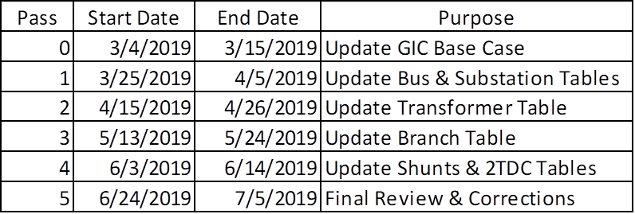
GIC Model Building Schedule

Slide 3
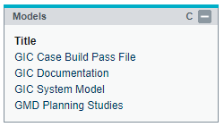
GIC MIS Postings
MIS -> Groups and Rules -> Transmission Service Provider Information
  GIC Case Build Pass File – Will contain all the information needed for each pass
  GIC Documentation – Modeling Expectations, Contact List
  GIC System Model – Completed GIC Models
  GMD Planning Studies – GIC Study material (for ERCOT Planning)
Viewing the material requires the ICE_M_VIEW_TO role for your digital certificate

Slide 4
Submission Naming Convention
Company_GIC_TSP_Template
Replace Company with your Company
Add the pass and revision information at the end of the file name
Final Name:
  ERCOT_GIC_Template_Pass_3
  ERCOT_GIC_Template_Pass_3_Rev2

Slide 5
Submissions
Send all submissions to GMDData@ercot.com
  I’ve received some submissions to my email. Please send them to GMDData@ercot.com
For questions, please call or email Eric Meier:
  Eric.Meier@ercot.com
  512-248-6770
Alternatively – email GMDData@ercot.com

Slide 6
Pass Two Submissions

Slide 7
Pass Two Submissions Cont.
Most submissions were on time
  However fixes for data issues were not all included
Folks said they had no changes when they had data issues
  Be sure to review the data issues and address any that are related to your equipment
  For transformers that have a TSP and RE bus, let me know
Four idevs were submitted

Slide 8
GIC Flows
At the end of Pass Two after correcting for data issues, ERCOT tried to run GIC flows.
This was not successful due to:
  Non PSSE Acceptable Vector Groups (Fixed)
  Transformers whose ends are in different stations
  Buses missing from the GIC DC Model that are in the GIC AC Model
Other non-error causing issues:
  Shunts in the DC Model but not in the AC Model
  Branches in the DC Model but not in the AC Model

Slide 9
Data Issues
Error- Two winding transformer substations are different, should be same
  From bus 1 substation “A” To bus 2 substation “B” Circuit "1“
Error- No substation specified for bus 9999999, provide that using GIC data file
There is a mix of TSP and RE issues
Many of the transformers are connected to both RE and TSP buses

Slide 10
Unit Retirements
Does the task force agree that generation retirements should be included in the case?

Slide 11
Pass Three
Pass Three began on 5/13
End Date: 5/24
The goal is to update the branch table and resolve outstanding issues that are preventing the calculation of GIC flows
Look at the text file – it has the issues preventing the GIC flows from solving in PSSE
More information on case issues will be posted to MIS as well

Slide 12
Adding Elements to the DC Model
When adding elements:
There must be a 1 in the Modification Column
ID (ID1 for FixedShunts) must be blank
Set SUM = TRUE if the element is in the SUM case
Set MIN = TRUE if the element is in the MIN case
Set both SUM and MIN to TRUE if the element is in both cases

Slide 13
Modifying Elements in the DC Model
When modifying elements:
There must be a 1 in the Modification Column
ID (ID1 for FixedShunts) must be the ID (ID1) provided in the template
  This cannot be modified or edited
SUM and MIN should already be set otherwise:
  Set SUM = TRUE if the element is in the SUM case
  Set MIN = TRUE if the element is in the MIN case
  Set both SUM and MIN to TRUE if the element is in both cases

Slide 14
Deleting Elements to the DC Model
When Deleting elements:
There must be a Delete in the Delete Column
ID (ID1 for FixedShunts) must be the ID (ID1) provided in the template
  This cannot be modified or edited
No other info needs to change

Slide 15
Other Template Info
Do not make changes to the Excel Sheet Names or delete any sheets
If there are no changes to be made on a particular sheet, all the data (except the column titles in Row 1) can be deleted before submission
You may modify the spreadsheet so it only contains changes from your company
  See the attached example template which only modifies the three substations on the sheet and nothing else

Slide 16
TSP Face To Face Meeting
ERCOT has determined a TSP face to face meeting is necessary.
This is to resolve issues that both prevent the GIC Model from solving and to address data issues leading to poor GIC flow solutions
This meeting has been scheduled for June 12th, the day after the June PGDTF meeting
  ERCOT MET Room 168

Slide 17
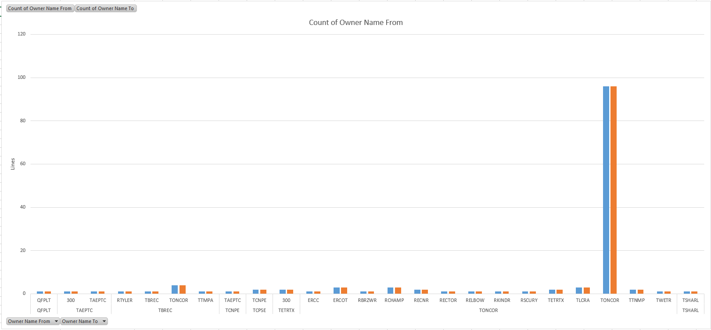
Line Lengths > 160 km by Owner
To
From

Slide 18
Questions?
If you have any questions, please reach out to: Eric.Meier@ercot.com
512-248-6770

