Slide 1
Intra-Hour Wind Forecast Accuracy Updates (May 2019)
WMWG
Operations Analysis
May 20, 2019

Slide 2
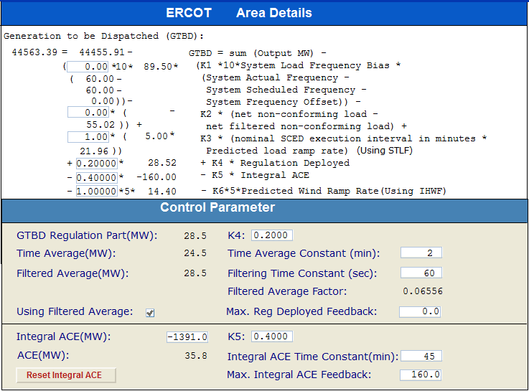
Current GTBD Parameters
Historical K factor tuning events:
4/24/19 - Max Integral ACE Feedback changed from 150 to 160 and PWRR Threshold changed from 20 to 25
Notes:
3/12/18 – Integral ACE Time Constant Changed from 60 min to 45 min
5/17/18 – K4 Changed from 0.3 to 0.2 and K5 Changed from 0.4 to 0.5
12/4/18 – 10:05 AM – K6 Changed from 0 to 0.5
2/12/19 – 2:15 PM – K6 changed from 0.5 to 1.0
3/12/19 – 2:10 PM – PWRR Threshold from 10 to 15 MW/min
3/19/19 – 2:15 PM – PWRR Threshold from 15 to 20 MW/min
4/01/19 – 10:00 AM – K5 changed from 0.5 to 0.4 and Max. Integral ACE Feedback changed from 250 to 150
4/24/19 – 1:15 PM – Max. Integral ACE Feedback changed from 150 to 160. PWRR Threshold changed from 20 to 25.

Slide 3
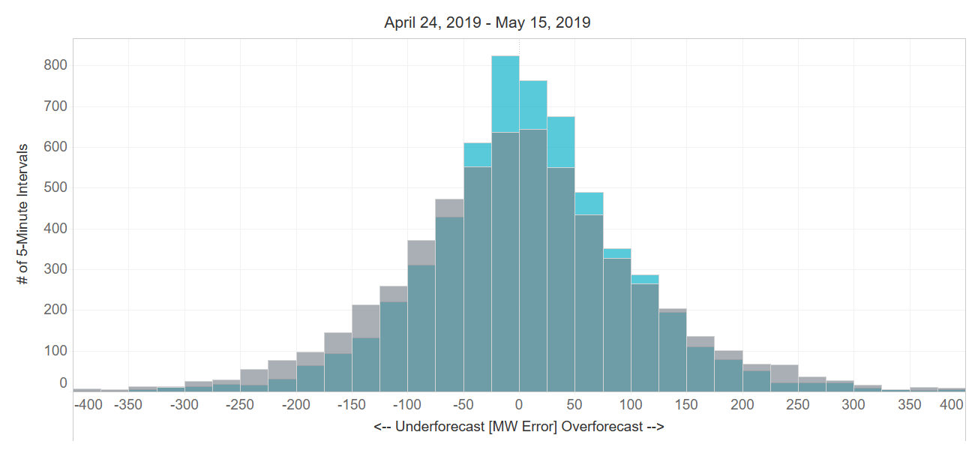
Projected Wind Ramp Rate (PWRR) Error
Performance Metric | SCED PWRR (12/4 – 3/19) | Persistence Ramp* (12/4 – 3/19) | SCED PWRR (4/24 – 5/15) | Persistence Ramp* (4/24 – 5/15)
Monthly MAE (MW) | 66 | 78 | 69 | 84
Monthly MAE when 5-Min. Wind Ramp > 100 MW | 128 | 165 | 126 | 170
SCED PWRR
Persistence Ramp*
* Persistence Ramp assumes using a 0 MW wind ramp in PWRR

Slide 4
Appendix The following slides were presented at March PDCWG

Slide 5
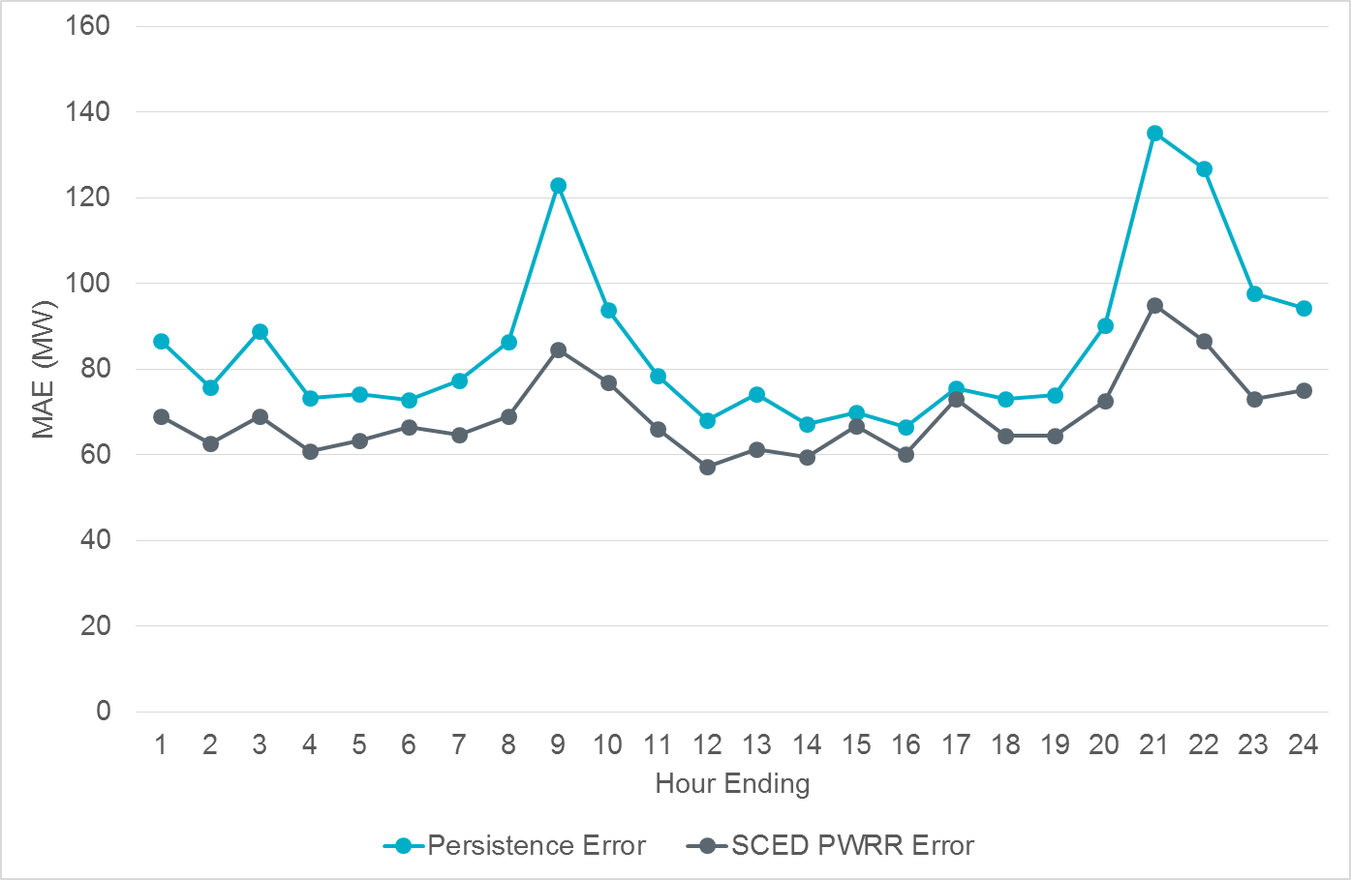
Intra-Hour Wind Ramp Forecast Error (April 2019)

Slide 6
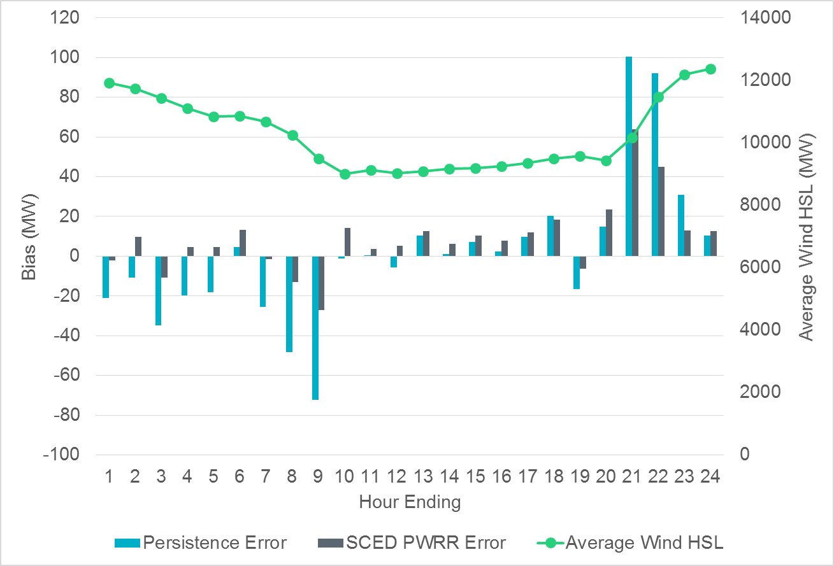
Intra-Hour Wind Ramp Forecast Error (April 2019)

