Slide 1
ERCOT API Security Changes
Leo Angele
ERCOT IT
ERCOT Public
May 14, 2019

Slide 2
Agenda
Infrastructure upgrades in ERCOT Production environment
Security updates for API communication

Slide 3
Introduction
This presentation will answer the following questions:
  Who is affected by these changes?
  What is changing in relation to API Security?
  How is the handshake level Client Digital Certificate used in API communication?
  What is the timeline for the API Security change?
  What steps do Market Participants need to take for API access?
  What are the risks of not preparing prior to the API Security change?

Slide 4
Target Audience
Who is affected by these changes?
  All Application Programmatic Interfaces (API’s) connecting to ERCOT environments for ERCOT’s External Web Services (EWS), including submissions and Get List/Report functionality, and access to the MarkeTrak API

Slide 5
What API Security Changes?
What is changing in relation to API security?
  ERCOT has identified a configuration issue that is causing the system to not validate that API communication is being submitted with a valid ERCOT issued Client Digital Certificate at the handshake level
  ERCOT will implement a configuration change to ensure that API communication is being sent with a handshake level valid ERCOT issued Client Digital Certificate as well as having each message signed with a valid ERCOT issued Client Digital Certificate
  Market Participants that are not currently submitting API communication with a valid ERCOT issued Client Digital Certificate will see a disruption in service if not corrected

Slide 6
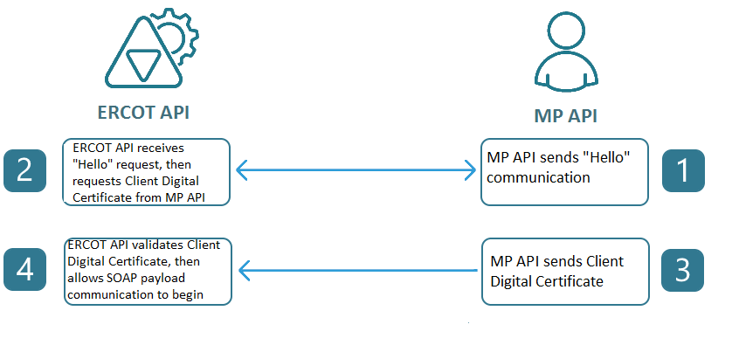
API communication
  The diagram below explains API communication and the use of Client Digital Certificates within the handshake

Slide 7
Timeline
What is the timeline for the Upgrade?
  ERCOT’s MOTE/RMTE URLs were configured on March 7, 2018 to facilitate Market Participant testing
  ERCOT has provided testing time in MOTE/RMTE to ensure all Market Participants had adequate time to prepare for the production migration
  All API’s connecting to ERCOT’s Production External Web Services will need to have the API security changes in place prior to May 29, 2019 @ 3:30 PM CDT

Slide 8
Preparation for May 29, 2019
What do Market Participants need to do to prepare?
  Ensure that API communication is being sent with a handshake level valid ERCOT issued Client Digital Certificate as well as having each message signed with a valid ERCOT issued Client Digital Certificate prior to May 29, 2019 @ 3:30 PM CDT

Slide 9
Validate Existing API Communication
ERCOT can validate an MP’s readiness for May 29th
  Provide your ERCOT Account Manager with the following information:
    DUNS
    API_EmployeeID
    Approximate time of API communication to ERCOT
  ERCOT will inspect API communication for handshake-level Client Digital Certificate

Slide 10
May 29, 2019 Risks
  What are the risks of not preparing prior to the described changes?
  Failure to ensure that API communication is being sent with a handshake level valid ERCOT issued Client Digital Certificate before May 29, 2019 will affect the availability of:
    Programmatic communication
      External Web Services (EWS)
      Application Programmatic Interface (API) submissions
      Get List/Report functionality
    Access to the MarkeTrak API

Slide 11
Questions and Answers
Do I have to revoke/reissue all of my user’s Digital Certificates?
  No, ERCOT is just enforcing that a valid Client Digital Certificate is being presented during the handshake.
Does this affect everyone?
  No, only applications currently connecting to ERCOT’s EWS API system and applications receiving ERCOT issued API Notifications. Access to ERCOT’s secure UI’s will not be affected by these changes.
As an IMRE type MP, do we need to take any action on this?
  IMRE’s typically don’t use an API to query/download data and they do not make submissions.
What needs to be changed on our side?
  You must ensure that the API communication to ERCOT is being sent with a handshake level valid ERCOT issued Client Digital Certificate.
I tried connecting to MOTE/RMTE but I could not connect. Do I need any certificate to connect to this environment? If so how do I get it?
  Yes, you need a MOTE/RMTE certificate to test in the MOTE/RMTE environment (testmisapi.ercot.com or testmisapi.wan.ercot.com if you are a WAN user). Your USA can issue an appropriate user or API certificate for you.
ERCOT has been making a lot of changes to the API. Are there any other changes coming?
  Yes, ERCOT is currently evaluating the inclusion of TLS 1.2 and the deprecation of the SSLv3, TLS1.1 and TLS1.0 protocols.

Slide 12
Additional Security Changes
ERCOT’s production EWS API currently only supports 3 security protocols for secure communication.
  TLS1.1
  TLS1.0
  SSLv3
Deprecation of SSLv3 security protocol coming in June 2019
Inclusion of TLS1.2 security protocol also coming in June 2019
ERCOT’s MOTE/RMTE EWS & MarkeTrak API’s are currently configured for testing with TLS1.2 and without SSLv3.

Slide 13

Discussion

