Slide 1
2019 TRANSMISSION PROJECTS
ERCOT RPG May 14, 2019
ROBERT LONA - MANAGER TNMP TRANSMISSION

Slide 2
2019 SUBSTATION PROJECTS
SUBSTATION | ISD | LOAD COMPOSITION
SADDLEBACK | MAY | EXISTING 69KV
 |  | TRANSFERRED TO 138KV
 |  | NEW CONTRACTED
COTTONWOOD | MAY | NEW CONTRACTED
BARILLA DRAW | JULY | EXISTING 138KV
 |  | NEW CONTRACTED
MONUMENT DRAW | JULY | NEW CONTRACTED
COUNTY ROAD | SEPT. | EXISTING 69KV
 |  | TRANSFERRED TO 138KV
ELM STREET | OCT. | EXISTING 69KV
 |  | TRANSFERRED TO 138KV
COYOTE SPRINGS | OCT. | EXISTING 69KV
 |  | TRANSFERRED TO 138KV
 |  | NEW CONTRACTED

Slide 3
2019 REACTIVE PROJECTS
REACTIVE DEVICE | DEVICE PARAMETERS | ISD
CAYMUS 138KV CAPACITOR BANK | 60 MVAR (3X20 MVAR) | MAY
 | 80 MVAR (4X20 MVAR) 2021SP
COLIE FIELD 138KV CAPACITOR BANK | 60 MVAR (3X20 MVAR) | JUNE
 | 20 MVAR (1X20 MVAR) | 2020SP
 | 40 MVAR(2X20 MVAR) | 2021SP
KEYSTONE 60KV CAPACITOR BANK | 10 MVAR(1X10 MVAR, RELOCATED) | JUNE
IH-20 ABB STATCOM | +/- 190 MVAR | AUGUST
TRANSPECOS 138KV CAPACITOR BANK | 60 MVAR (3X20 MVAR) | AUGUST
 | 80 MVAR (4X20 MVAR) 2021SP
KERMIT #2 69KV CAPACITOR BANK | 10 MVAR(2X5 MVAR, RELOCATED) | DECEMBER

Slide 4
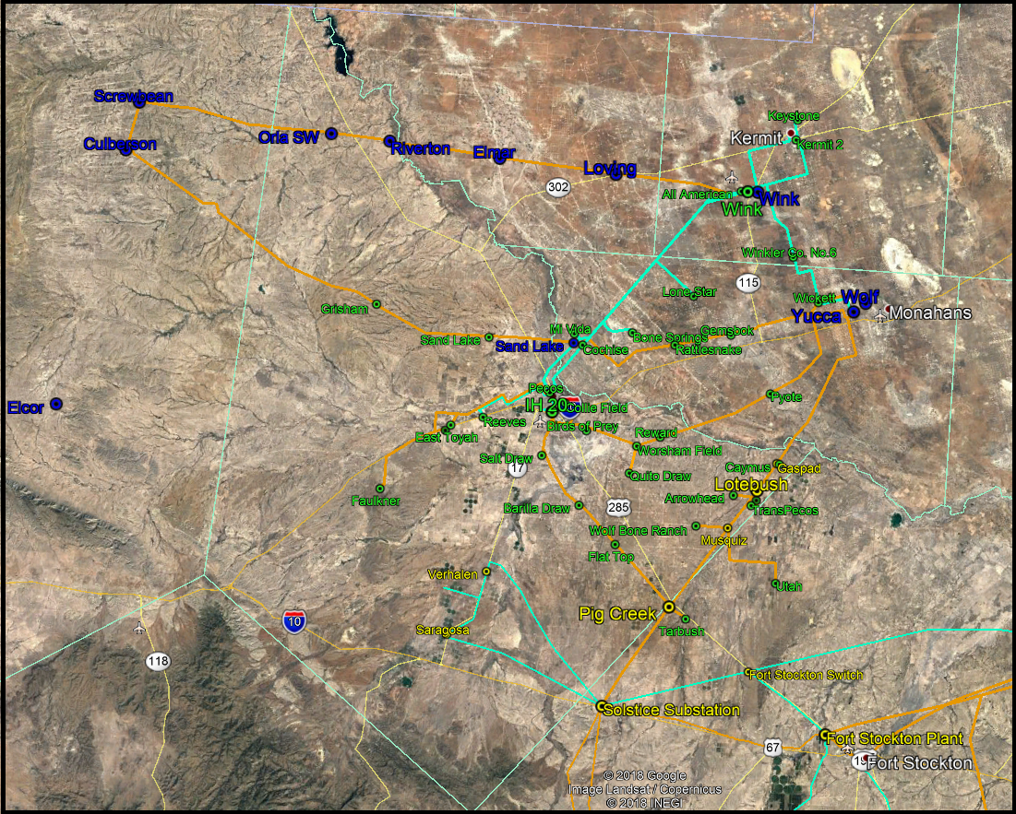
Current West Texas System

Slide 5
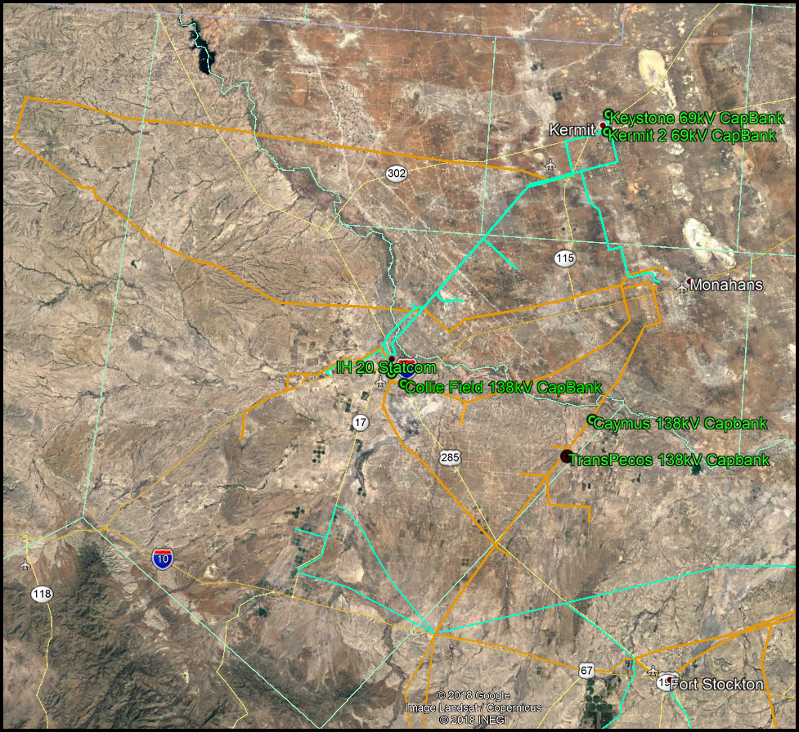
TNMP 2019 Projects - Reactive Support

Slide 6
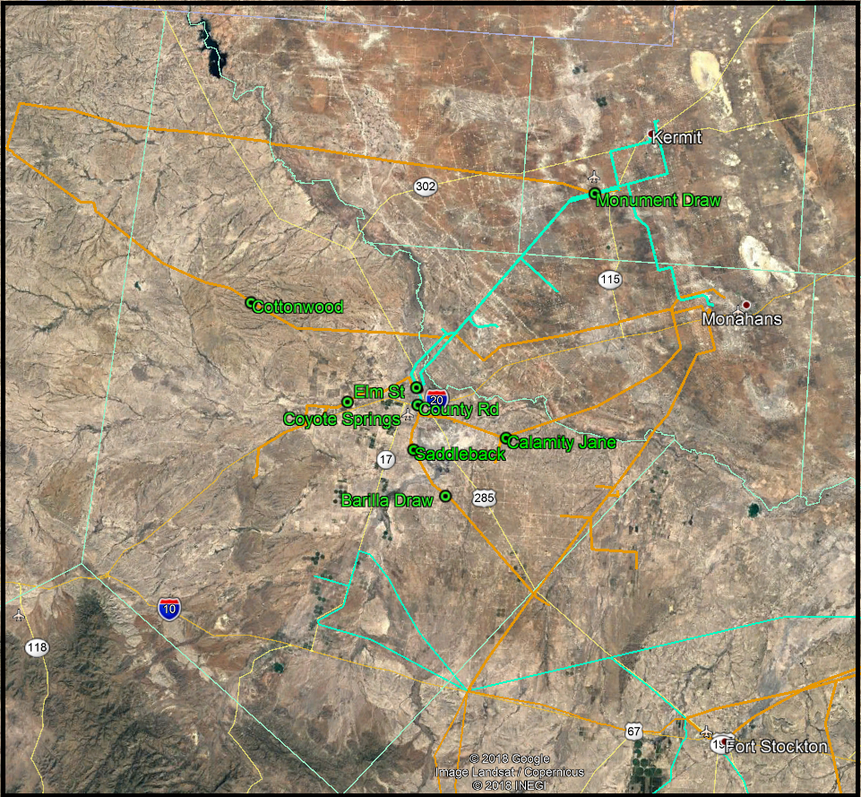
TNMP 2019 Projects - Substations

Slide 7
Line K: Rebuild and 138kV Conversion
LINE K EXISTING 32 MILE 69KV TRANSMISSION LINE
REPLACE WITH SINGLE 1926 ACSR-TW (CUMBERLAND)
DOUBLE CIRCUIT CAPAABLE
RATED FOR 409 MVA
48 MW TOTAL CONTRACTED LOAD 2019
90 MW TOTAL CONTRACTED LOAD 2019 -2025
150 MW TOTAL CONTRACTED/N0N-CONTRACTED LOAD 2019 - 2025

Slide 8
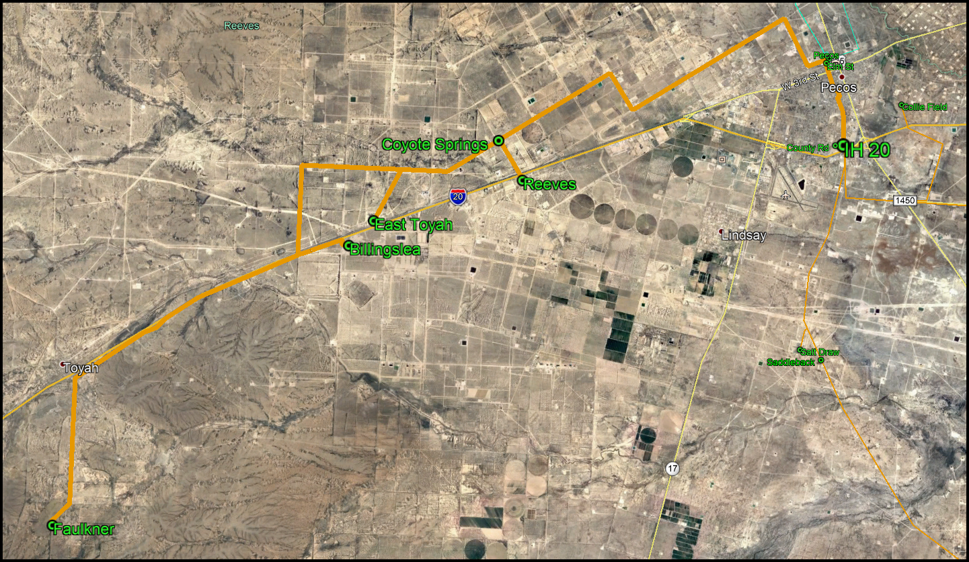
Line K: Rebuild and 138kV Conversion

