Slide 1
ONCOR FAR WEST TX UPDATE
Presentation for ERCOT RPG Meeting
on May 14, 2019
Austin, TX – ERCOT MET Center
Assets Planning
Business and Operations Support
Oncor Electric Delivery Co LLC
Plans are subject to change due to factors including, but not limited to, load, generation, engineering, system protection and system topology.

Slide 2
2019 Planned Transmission Projects
  Spring 2019 – Schedule In Service
      Construct New Sand Lake 138 kV Switch
      Construct Horseshoe Springs 138 kV Switch
      Install Horseshoe Springs 138 kV Capacitors
      Install Horseshoe Draw Dynamic Reactive Device
      Install second circuit on Wink – Yukon 138 kV Line
      Construct New Horseshoe Springs – Owl Hills 138 kV Line
      Rebuild Wink – No Trees 138 kV Line
      Install series reactor at Wolf & Yucca 138 kV Switch
      Install Moss 345/138 kV autotransformer #2
      Rebuild Screwbean Tap – Screwbean 138 kV Line
      Install Yucca Drive 138 kV Capacitors
  Fall 2019 – Scheduled In Service
      Construct New Riverton – Sand Lake 138 kV Line
      Construct Quarry Field 138 kV Switch
      Install Quarry Field 138 kV capacitors
      Install Rondo Dynamic Reactive Device
      Rebuild Garden City – Shipwreck 69 kV Line

Slide 3
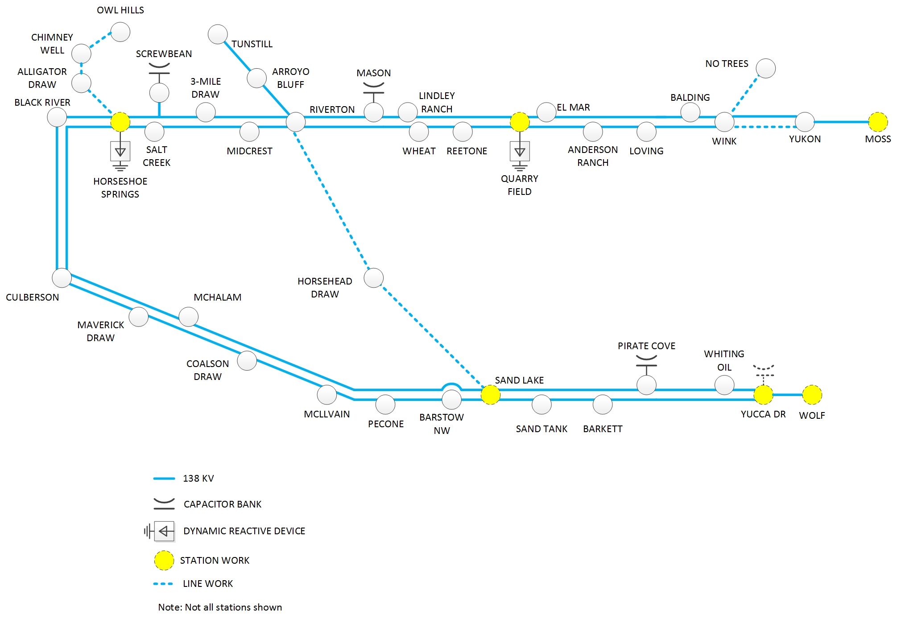
2019 Transmission Improvements

Slide 4
2020 Planned Transmission Projects
  Spring 2020 – Scheduled In Service
      Rebuild Cowden North – Odessa North 138 kV Line
      Rebuild Andrews County South – No Trees 138 kV Line
      Construct New Owl Hills – Tunstill 138 kV Line
      Construct New Kyle Ranch – Quarry Field 138 kV Line*
  Fall 2020 – Scheduled In Service
      Construct New Riverton – Odessa EHV / Moss 345 kV Line
      Construct New Riverton 345 kV Switch
      Install Riverton – Sand Lake 345 kV Line*
      Construct New Sand Lake 345 kV Switch
      Construct New Sand Lake – Solstice 345 kV Line*
      Construct New Wolf 345 kV Switch
      Rebuild Shipwreck – Midkiff 69 kV Line
      Construct New Riverton – Kyle Ranch 138 kV Line* (2021)
      *Pending CCN Regulatory proceedings

Slide 5
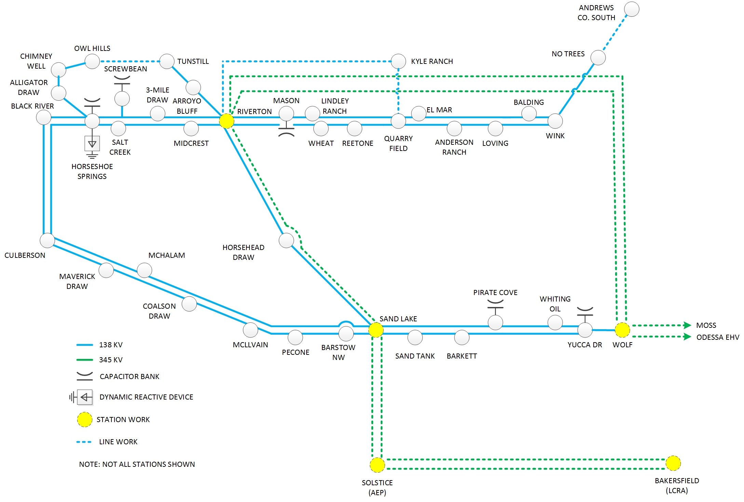
2020 Improvements

Slide 6
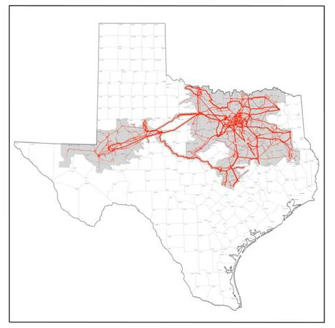
Far West Texas Projects
Far West Texas Project
  Approved by ERCOT Board of Directors in Jun 2017
  Odessa EVH – Riverton 345 kV Line
  Bakersfield – Solstice 345 kV Line
Far West Texas Project 2
  Approved by ERCOT Board of Directors on June 2018
  Close 345 kV loop and new 138 kV lines
Dynamic Reactive Devices Project
  Approved by ERCOT Board of Directors on June 2018
  Immediate voltage support needs due to load increases
  Expected in-service in 2019
Odessa EHV – Riverton 345 kV Line
  Critical Status approved by ERCOT BOD Feb 2018
  CCN filed at PUC in March 2018
  CCN Approved by PUC in Sept 2018.
Riverton – Sand Lake – Solstice – Bakersfield 345 kV Lines
  Critical Status approved by ERCOT BOD June 2018
  CCNs filed at PUC November 2018

Slide 7

QUESTIONS/DISCUSSION

