Slide 1
Credit Exposure Update
Spoorthy Papudesi
Credit Work Group
ERCOT Public
May 15, 2019

Slide 2
Monthly Highlights Mar 2019- Apr 2019
Market-wide average TPE increased from $298.5 million to $322.6 million
  The increase in TPE is due to slightly higher Forward Adjustment Factors in April
Discretionary Collateral is defined as Secured Collateral in excess of TPE,CRR Locked ACL and DAM Exposure.
  Average Discretionary Collateral decreased from $926.7 million to $796.3 million
  The decrease in Discretionary Collateral is largely due to increase in CRR Locked ACL during April
Number of active Counter-Parties increased from 237 to 241
No unusual collateral call activity

Slide 3
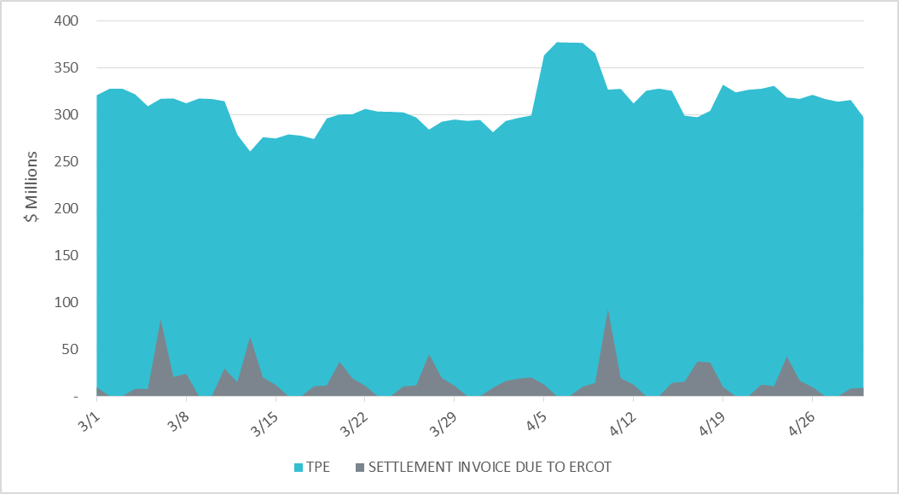
Settlement Invoice Charges/TPE Mar 2019- Apr 2019

Slide 4
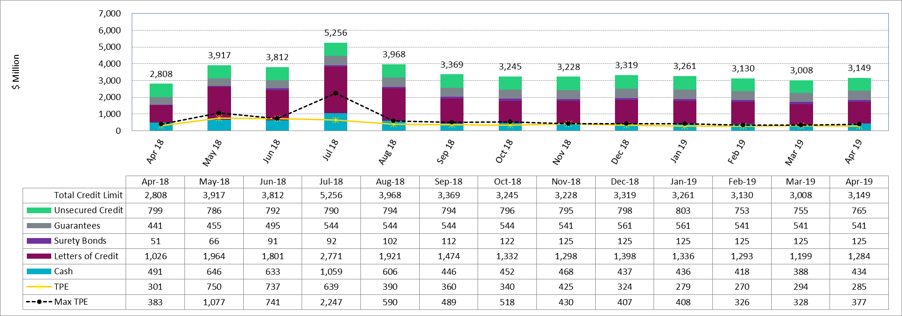
Available Credit by Type Compared to Total Potential Exposure (TPE)
*Numbers are as of month end except for Max TPE

Slide 5
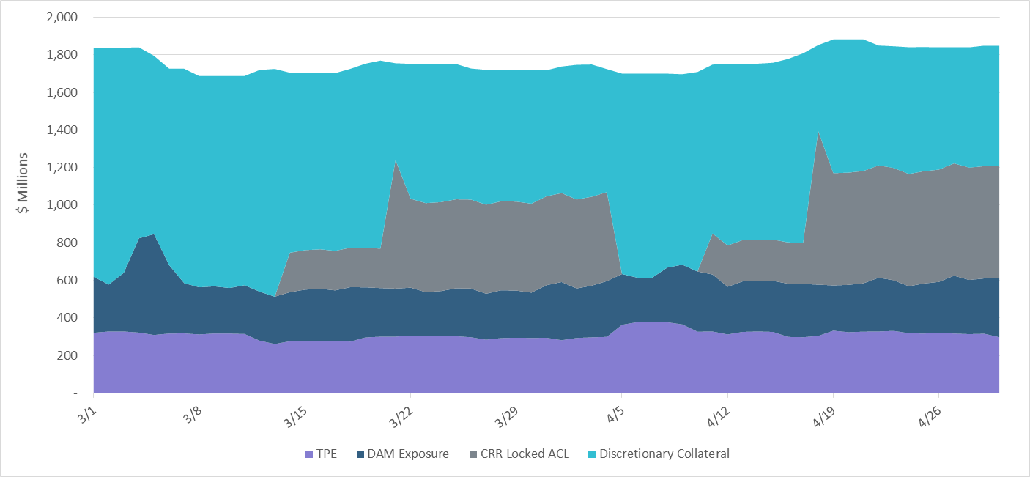
Discretionary Collateral Mar 2019- Apr 2019
At a Counter-Party level, no unusual changes were noted
Note: Discretionary collateral doesn’t include Unsecured Credit Limit or parent guarantees

Slide 6
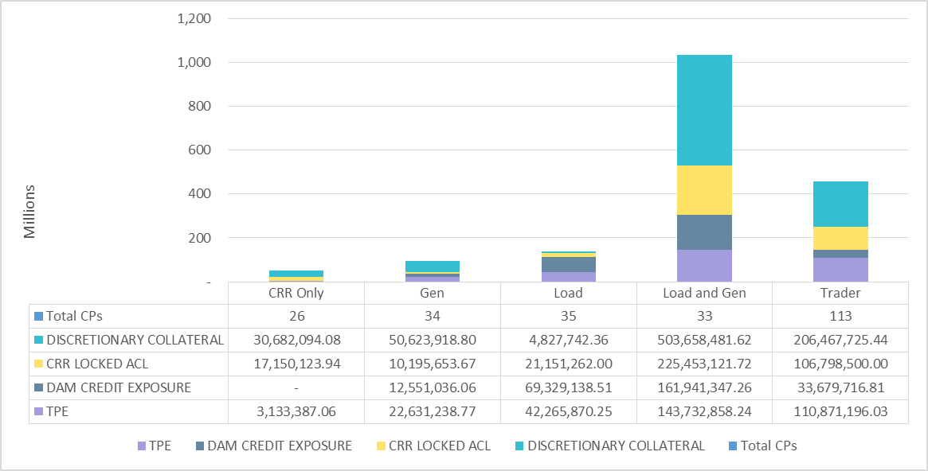
TPE and Discretionary Collateral by Market Segment- Apr 2019
Load and Generation entities accounted for the largest portion of discretionary collateral

Slide 7
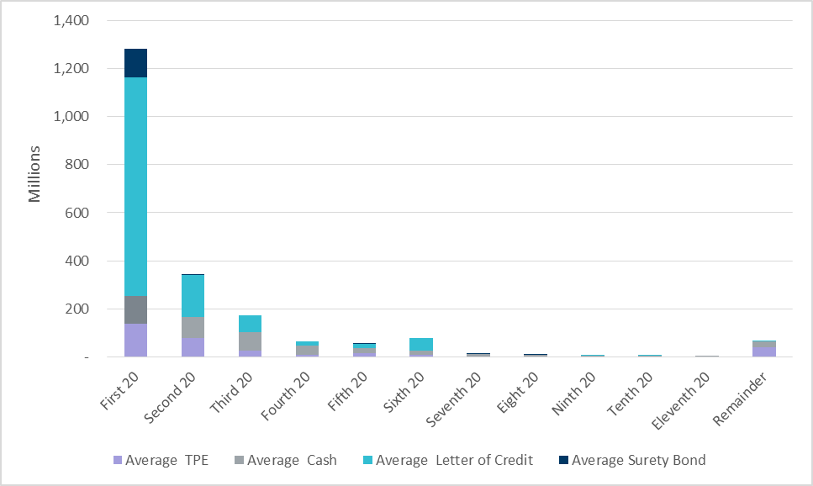
Secured collateral distribution/ TPE- Apr 2019
Posting of discretionary collateral is relatively concentrated.

Slide 8
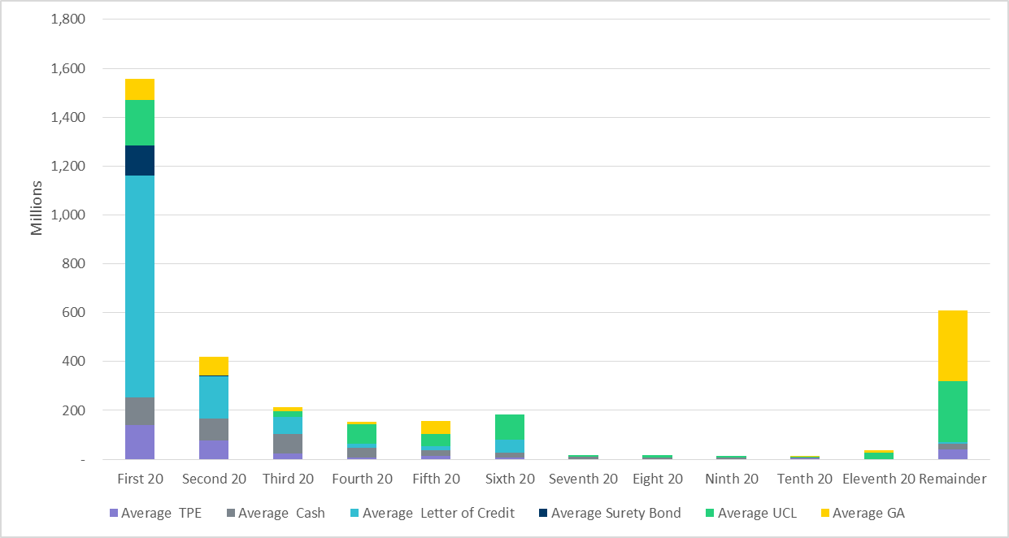
Secured collateral and Unsecured Credit Limit (UCL) distribution/ TPE- Apr 2019
TPE in the last bucket is mostly covered by Guarantees and UCL

Slide 9
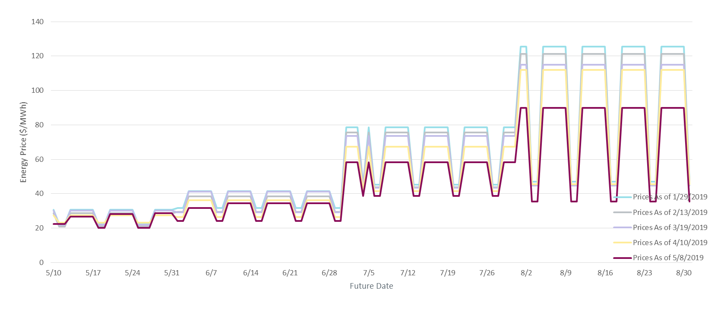
ICE Daily Average Prices April-August 2019
*Daily Average Price = (Peak price*16 +Off-Peak price*8)/24

Slide 10
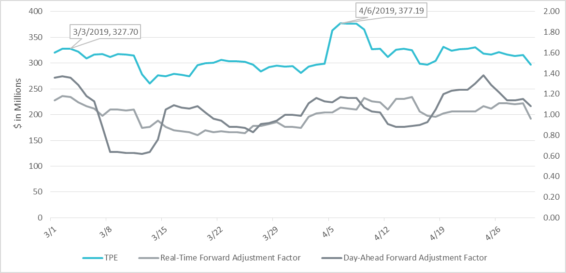
TPE and Forward Adjustment Factors Mar 2019- Apr 2019
TPE moved in conjunction with forward adjustment factors
The Real-Time (RFAF) and Day-Ahead (DFAF) forward adjustment factors capture the ratio of forward ERCOT North prices to actual prices.

Slide 11
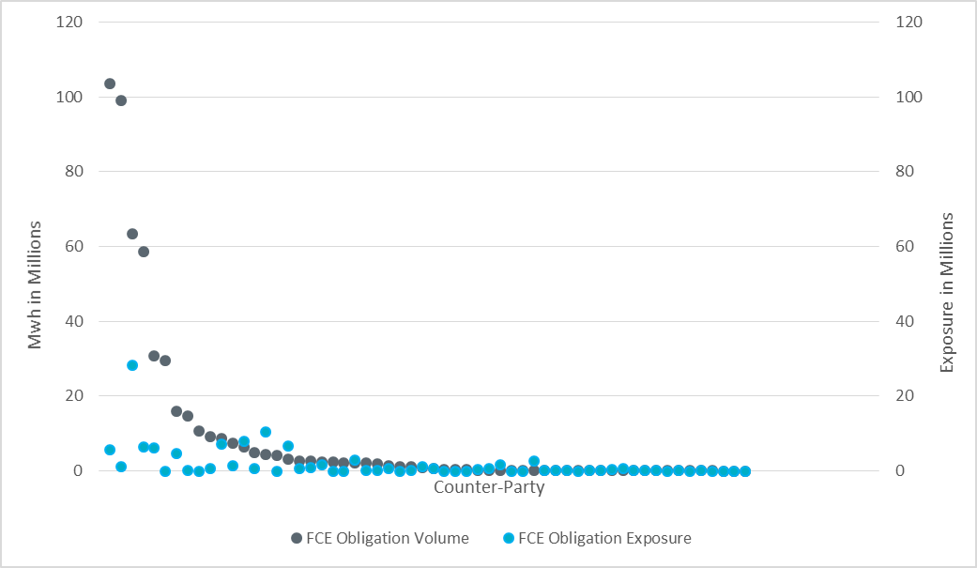
CRR Obligation Volume/Exposure - 5/14/19
Few CRRAHs have very low-risk obligations compared to most CRRAHs

Slide 12
Appendix

Slide 13
Summary of Distribution by Market Segment

Slide 14
Summary of Distribution by Rating Group

Slide 15
Distribution of TPE by Rating and Category

Slide 16
Distribution of Excess Collateral by Rating and Category
Note: Excess collateral doesn’t include Unsecured Credit Limit

Slide 17
Bottom Quintile Distribution of Excess Collateral by Rating and Category

Slide 18
Bottom Quintile Distribution of Average TPE by Rating and Category

Slide 19
Questions

