Slide 1
GMD Impacts on Protection Systems
Qun Qiu
5/16/2019

Slide 2
TPL-007 Requirement Related to P&C
A planning study of GMD Vulnerability Assessment needs to consider “Reactive Power compensation devices and other Transmission Facilities removed as a result of Protection System operation or Misoperation due to harmonics during the GMD event”
  The protection of BES cap banks should be reviewed if it is susceptible to GMD impacts
If GMD Vulnerability Assessment concluded that the system does not meet the performance requirements, responsible entities shall develop a Corrective Action Plan addressing how the performance requirements will be met. The CAP shall:
  Requirement R7.1 … “Installation, modification, or removal of Protection Systems or Remedial Action Schemes” …

Slide 3
IEEE Power System Relaying and Control (PSRC) K17 Working Group
Assignment
  To develop a PSRC WG report to evaluate Geomagnetic Disturbances impacts on protection and control
Bring in experts to help PSRC community learn about GMD to make an informed decision
  GIC Effects on Power Transformers
  GMD Impacts on Generators
  GMD Impacts on Capacitor Banks
Bring together the knowledge and perspective of the PSRC members

Slide 4
Possible Contributions from a PSRC GMD WG
Monitoring
  GIC & Harmonics Monitoring System
Modelling
  Identify vulnerable protective relaying
    What types of relays/protection schemes are vulnerable to harmonics
    What protection system components are vulnerable
  Develop guideline on reviewing susceptible protection of BES cap banks
Mitigating
  Review settings to prevent misoperations
  Modify/harden protection system/scheme
  Relay replacement recommendations

Slide 5
PSRC K17 WG Members and Contributors
WG Members
  Qun Qiu (Chair)
  Luis Polanco (Vice-Chair)
  Abu Bapary
  Brandon Davies
  Dominick Fontana
  Charles Henville
  Hillman Ladner-Garcia
  Van Le
  Yuan Liao
  Vahid Madani
  Tapan Manna
  Adi Mulawarman
  Bruce Pickett
  Sam Sambasivan
  Michael Thompson
Contributors
  Mark Adamiak
  Jim Campbell
  Normann Fischer
  Derrick Haas
  Roger Hedding
  Gary Kobet
  Amir Makki
  Sakis Meliopoulos
  Taylor Raffield
  Charles Sufana
  Rui Sun
  Eric Udren
  Reigh Walling

Slide 6
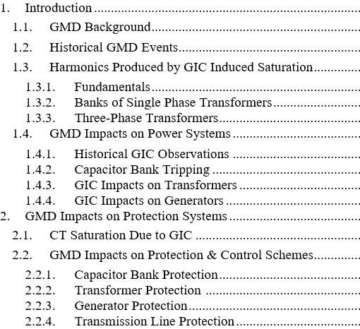
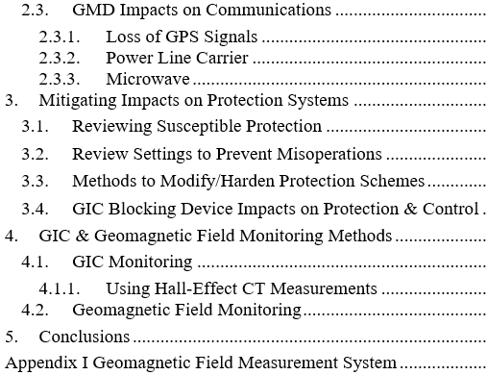
K17 WG Report - Table of Contents

Slide 7
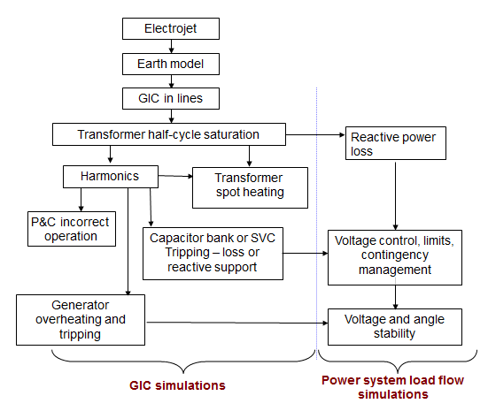
Effects of GIC
Courtesy of Siemens

Slide 8
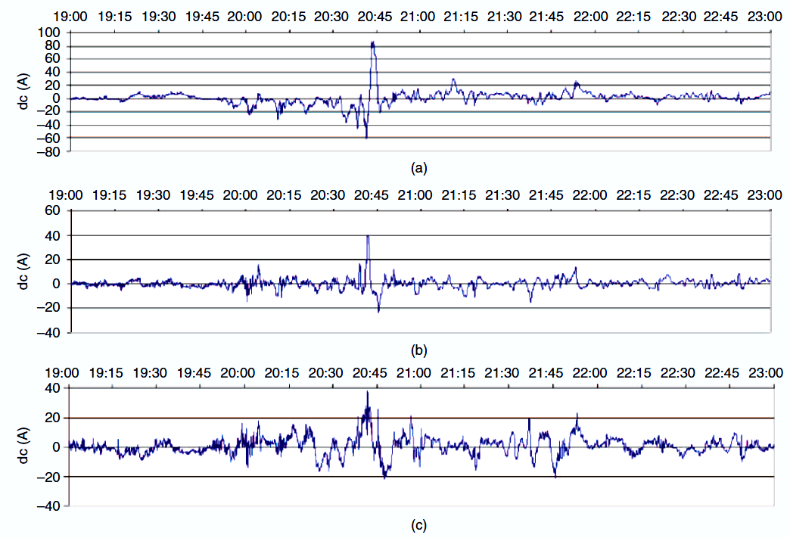
Historical GIC Observations

Slide 9
Capacitor Bank Tripping
During the March 1989 solar storm, 13 capacitor banks within the Dominion Virginia Energy (DVE) service territory tripped within two minutes due to a protection scheme susceptible to harmonic distortion
  Neutral unbalance scheme that measured current at the neutral ground point to determine the failure of capacitor units
  Though the scheme was equipped with a parallel capacitor to provide immunity to 3rd harmonics, the electromechanical relay was unable to distinguish the excessive harmonics of other orders from the fundamental frequency component flowing and, therefore, mis-operated
The capacitor banks and seven SVCs that tripped within 59 seconds of each other in the 1989 Hydro Quebec blackout during the GMD event
  They were equipped with electromechanical relays and current unbalance protection schemes measuring excessive currents at the capacitor bank neutral circuit
  Operations of these type relays protecting capacitor banks and SVC’s were a contributing factor to the Hydro-Quebec 1989 Blackout

Slide 10
GMD Impacts on Protective Relaying
Respond only to the fundamental frequency component by filtering the dc component and harmonics of the signals
    Insensitive to non-fundamental frequency quantities
    However, primary signal distorted by high non-fundamental frequency contents could affect the relay’s phasor calculation
      Could lead to mis-operations in some sensitive applications
      Some grounded capacitor banks use sensitive neutral overcurrent relays to detect capacitor failures, if the settings are very sensitive, the distortion of the fundamental signal could cause mis-operation
Measure the peak voltage/current and/or include the harmonics in the measurement for protective functions.
    Electromechanical relays as well as some static relays are unable to distinguish the excessive harmonics from the fundamental frequency components and, therefore, could mis-operate
    Examples of this type are overcurrent relays for shunt capacitor banks or harmonics filter banks of FACT devices

Slide 11
CT Saturation due to GIC
Expected GIC levels are small compared with CT ratings in typical protection applications
  GIC impact may be minimal by nature of application
  When GIC presents, the error is increased, but the difference is not as dramatic as one might expect
The quasi DC current drives the flux linkage close to the knee-point of the CT excitation curve. However, the AC ratio current is still reproduced reasonably well.
The user may want to consider their specific applications and environment to determine the impact of GIC on the magnetic core of the CT
Reference
  B. Kasztenny, N. Fischer, D. Taylor, T. Prakash, “Do CTs Like DC? Performance of Current Transformers With Geomagnetically Induced Currents” 42nd Annual Western Protective Relay Conference, October 2015

Slide 12
CT Saturation due to GIC
The primary CT acts as a high pass filter, basically filtering out the low frequency component (the GIC component - quasi DC) of the primary signal
Since the primary CT does not reproduce the GIC component contained in the primary current, the data acquisition CTs at the protective relay input are not affected by the GIC
The nominal frequency component is to be correctly scaled down without much loss of signal integrity

Slide 13
CT Saturation Impacts on Line/Transformer Protection
GIC could have very little impact on the CTs used for transmission line and transformer protection
Line distance and overcurrent elements may slightly underreach due to CT errors caused by GICs.
This is not a concern for instantaneous tripping as these elements do underreach under normal system contingencies, such as fault resistance, and are therefore backed up by other protection elements.
Time-coordinated distance or overcurrent elements apply overreaching margins, and with typical margins, they retain dependability, despite the GIC-caused CT errors.
Line differential elements typically incorporate a means to address CT saturation.
Transformer differential elements include percentage restraint to cope with CT errors, and they too remain secure for external faults even under GICs

Slide 14
CT Saturation Impacts on Line/Transformer Protection
Transient CT saturation due to GICs can be very substantial. The saturation is, however, short-lived
  Distance and overcurrent relays would tend to under-reach due to substantial CT saturation in the first half cycle of the fault current. As a result, protection might be slightly delayed for in-zone faults due to transient CT saturation caused by the GICs
  Fast line differential microprocessor relays may be affected by transient CT saturation, but these relays already guard against CT saturation, and when designed properly, do not face any problems
  Slower line differential relays are secure because the errors during transient CT saturation from the GICs are short-lived
  The impact on transformer differential relays is similar as on line differential relays
Summary
  Slightly degraded dependability (under-reaching, slower operation) is no different than for a number of other well-known factors concerning CT saturation
  Existing means to deal with CT saturation due to the well-recognized factors ensure security for CT errors due to GICs.

Slide 15
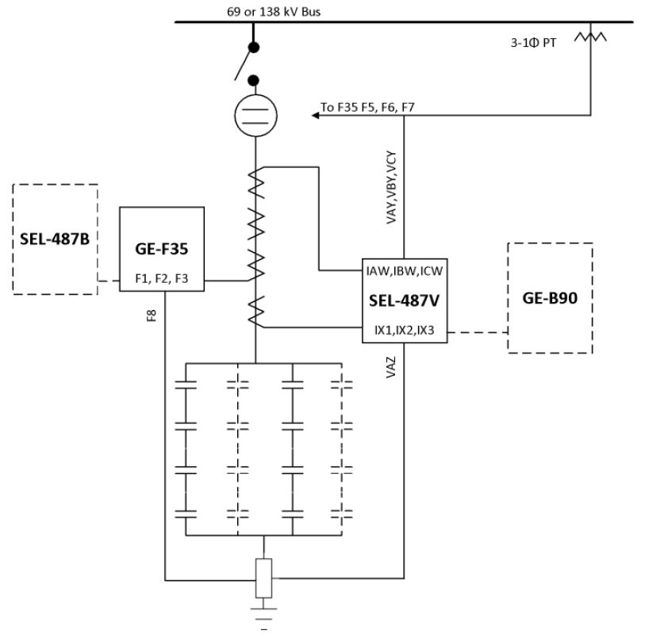
Capacitor Bank Connection - Ungrounded

Slide 16
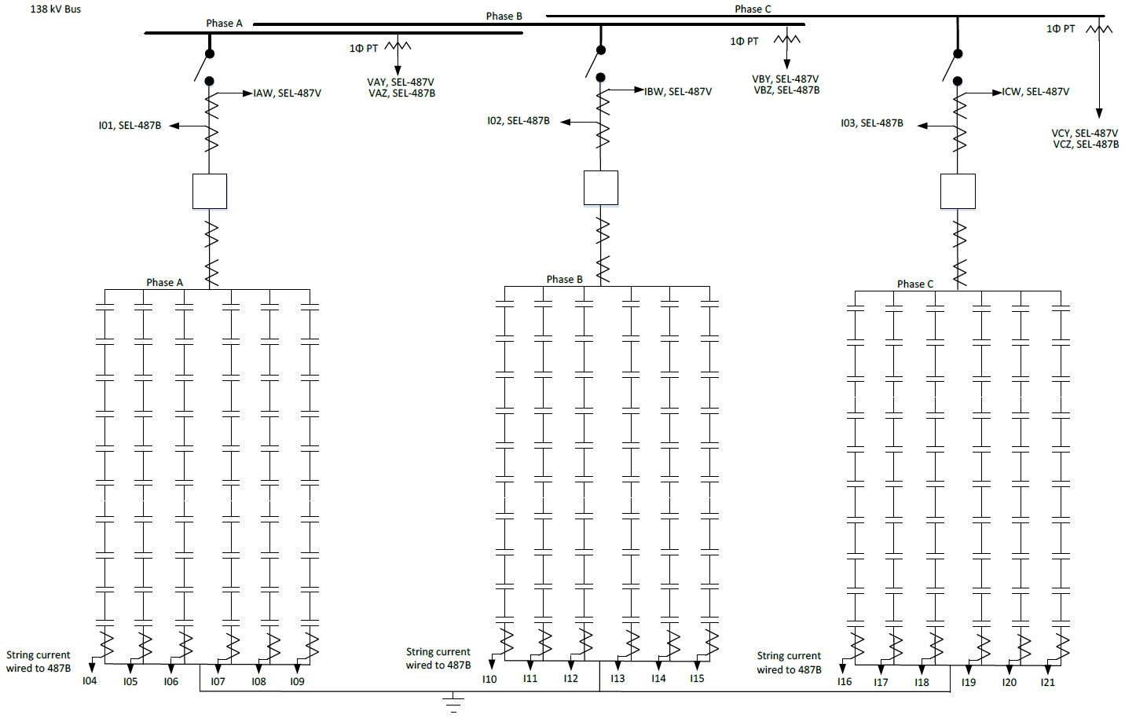
Capacitor Bank Connection – Wye-Grounded

Slide 17
Capacitor Bank Protection – Example
Ungrounded Transmission Capacitor Bank
  System I & II Protection
    50BF Breaker Failure
    50(P) Instantaneous Over Current
    27(P) Under Voltage
    59(P) Over Voltage
    87NU Neutral Shift Over Voltage
      12/5/2018 138kV Cap Bank operated and locked out with neutral shift trip targets, no other faults in the area
      H&H Solid State SNSD relay: ~204 in-service;
Grounded Wye Transmission Capacitor Bank
  System I Protection System II Protection
    50BF Breaker Failure 60(P) Unbalance Protection (String Protection)
    50(P) Instantaneous Over Current 51(P) Time Over Current
    27(P) Under Voltage 27(P) Under Voltage
    59(P) Over Voltage 59(P) Over Voltage

Slide 18
GMD Impacts on Transformer Protection – Normal Operating Conditions
The magnetizing current I_{ET} of a transformer will increase depending upon the magnitude of the GIC
The magnitude of the GIC current also determines the harmonic content of the transformer magnetizing current
As illustrated as the primary/secondary in the two-winding transformer diagram, all transformer terminals connected to a source supply this magnetizing current
The magnetizing current (I_{ET}) appears to be a differential, or operating current (I_{OP})
In general, the GIC current is not large enough to generate sufficient operating current in the differential element to jeopardize the security of the element, i.e., this I_{OP} current is below the pickup current to operate the differential element

Slide 19
GMD Impacts on Transformer Protection – Restricted Earth Fault Element (REF)
GIC could result in the transformer drawing a larger magnetizing current
This magnetizing current will be symmetrical (i.e., it will not contain zero sequence current) and therefore will not jeopardize the security of the REF element.
Should only one of the legs of the transformer saturate due to the GIC current (which is highly unlikely), that phase will draw a larger magnetizing current. This current will flow out of the neutral of the transformer as though it is an external ground fault, and, as a result, the REF element will remain stable even though the magnetizing current contains zero sequence current

Slide 20
GMD Impacts on Transformer Protection – Overcurrent Element
CT secondary current does not contain GIC content, and as such, the GIC current will not influence the overcurrent element
The GIC current could result in the transformer drawing a larger magnetizing current than under normal operating conditions
The vector sum of the transformer nominal load current and magnetizing current, even under GIC conditions, is unlikely to drive the current to be above the operating threshold of the overcurrent element
This is true for operating quantities for the overcurrent element that are rms or fundamental frequency current. However, if the transformer was overloaded during a GIC event, the security margin of the O/C element that exists under normal system conditions with the same overload condition may be decreased due to the higher magnetizing current.

Slide 21
GMD Impacts on Transformer Protection – External Fault Conditions
Under external fault conditions, there may be a concern that a GIC condition (causing CT saturation) could jeopardize the security of transformer protection elements
  If the primary CTs are selected with GIC current in mind (similar to taking account of remanence/residual flux), this is a non-issue and the differential element remains stable for an external fault
GIC current causes the transformer to draw an above average magnetizing current which results in the differential current (I_{OP}) being elevated
The voltage across the power system will decrease due to the fault, resulting in the voltage across the magnetizing branch decreasing as well, hence, reducing the magnetizing current of the transformer and increasing its through current
This will result in the differential element becoming more secure since the percentage of operating current versus restraint current will have decreased

Slide 22
GMD Impacts on Transformer Protection – External Fault Conditions
Restricted Earth Fault Element
  The element operates using filtered quantities and, and the primary CTs secondary current should not contain any GIC current
  If the CTs performance can be guaranteed during an external fault with remanence taken into account, there is no concern for the security of this element during an external ground fault
Overcurrent element
  Similar to the differential element, a fault condition decreases the magnetizing current due to the depression in the voltage
  When the overcurrent device is using fundamental current as the operating quantity, the security margin is not compromised

Slide 23
GMD Impacts on Transformer Protection – Internal Fault Conditions
The concern is that the element will lose dependability and fail to operate during an internal fault condition
Differential Element
  The ratio of the magnetizing current to fault current is a very small number, so the harmonic current content of the total fault current will be well below the typical relay harmonic blocking level (harmonic current content/fundamental current content < 15%)
  An internal fault during a GIC event is therefore not likely going to result in the differential element losing dependability nor will it effectively reduce the operating time of the element
Restricted Earth Fault Element
  The restricted earth fault element uses fundamental current as the operating quantity
  A GIC condition will not negatively impact the dependability or operating time of this element
Overcurrent element
  The magnitude of the fault current would typically be much larger than the GIC current even if the CT does not faithfully reproduce the true fault current

Slide 24
GMD Impacts on Generator/Line Protections
Generator Protection
  Legacy electromechanical and static generator negative sequence overcurrent relays may over or under protect a generator due to inaccurate phase shift to identify negative sequence currents at harmonic frequencies
Line Protection
  Legacy protection using sensitive unbalance (negative and zero sequence) overcurrent protection might misoperate due to the harmonic currents flowing in the lines
Numerical, phasor based, relaying is not particularly susceptible to harmonics, as these protective devices respond primarily to fundamental frequency components
  Modern digital relays are designed to operate exclusively on fundamental-frequency currents, and ignore harmonic currents

Slide 25
Mitigating Impacts on Protection Systems - Reviewing Susceptible Protection
Protection based on harmonics, sequence current and voltage components will have some degree of susceptibility to GMDs
  The degree of susceptibility is driven by the level and magnitude of harmonics, overcurrent and overvoltage components
Capacitor bank protection that uses current at the neutral ground point to determine the failure of capacitor units may be susceptible. However, a voltage differential scheme that uses voltage comparison between readings from two taps of the bank will be immune to harmonic interference
Generator protection that uses electromechanical relays and thermal based sensors will be susceptible
Transformers may go into saturation and induce harmonic currents that may damage the transformers as well as generators connected to them, but transformer protection should overall not be affected
Any protection equipment that is designed to exclusively use the fundamental frequency component to operate will be less susceptible, hence, microprocessor based protection will be less susceptible to GMD/GIC induced problems compared to non-microprocessor (electromechanical/solid state) based protection

Slide 26
Mitigating Impacts on Protection Systems - Review Settings to Prevent Misoperations
Review settings of non-microprocessor relays
  Review any relay that does not filter out harmonics in its operating current or voltage.
  Review transformer differential slope setting to ensure it can handle CT measurement/accuracy error necessary to accommodate a GMD event.
  Review distance and overcurrent elements for line protection. If those elements are intended for overreaching protection, make sure they have enough margin, since these elements can underreach during a GMD/GIC event.
Review settings of microprocessor relays
  Review any highly sensitive negative and zero sequence trip settings
    The primary signal could be distorted by the high harmonics contents, resulting the phasor calculation error that could lead to mis-operations
    Consider using a supervision function to provide additional security
  Make sure operating quantity utilizing fundamental frequency phasor quantity instead of RMS phasors quantity
    Lotebush 138 kV STATCOM tripped for non-fault condition by T60 relay NTOC1 element due to significant DC component when charging up the DC capacitors (4/25/2019)
Notes:
Develop a method to quantify the harmonic, overcurrent and overvoltage levels during a GMD/GIC event in order to provide better guidelines on how much a relay engineer may need to desensitize settings and still have good protection reliability

Slide 27
Mitigating Impacts on Protection Systems - Modify/Harden Protection Schemes
Protective relaying, if not capable of distinguishing THD and DC offset from the fundamental frequency current, may fail in certain protection schemes by mistaking harmonics for a fault or overloading
  These protection schemes include but are not limited to current unbalance, transformer neutral overcurrent, line residual overcurrent and voltage unbalance schemes
Replace existing electromechanical relays with harmonically desensitized models
  Almost all modern digital relay models are equipped with harmonics and DC filters that will allow processing of protective computations without the effects of GMD
  If those legacy relays cannot be replaced, it may be necessary to desensitize the element by providing additional security margin to ride through the increased harmonics
Replace problematic protection schemes with hardened schemes that are unaffected by GICs/harmonics

Slide 28
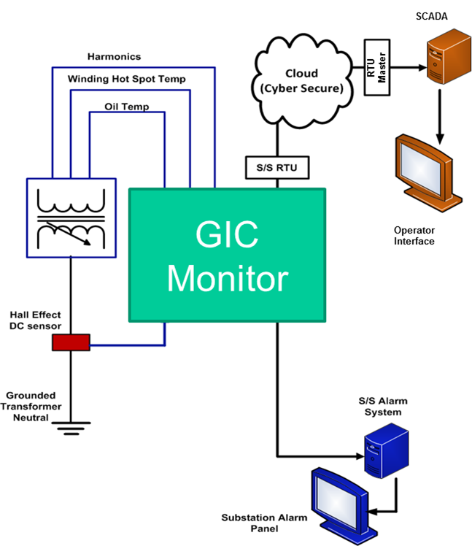
GIC Monitoring System

Slide 29
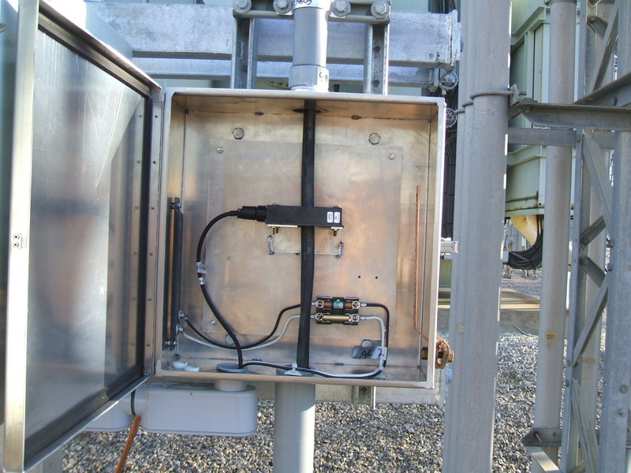
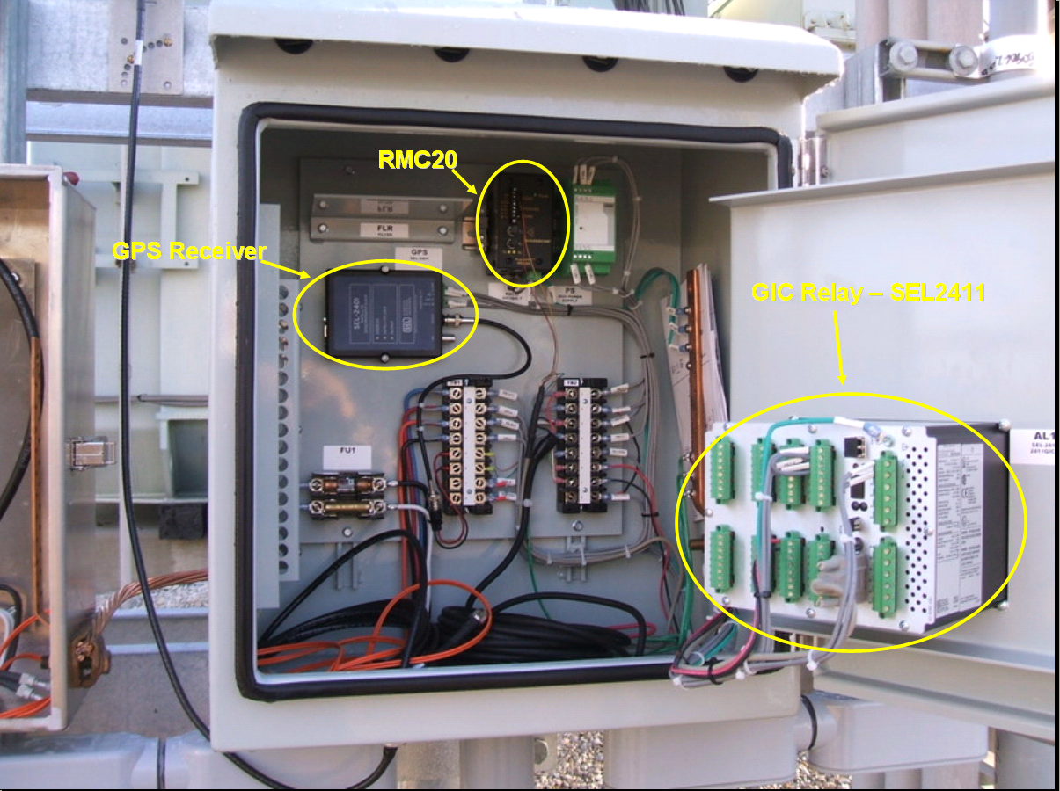
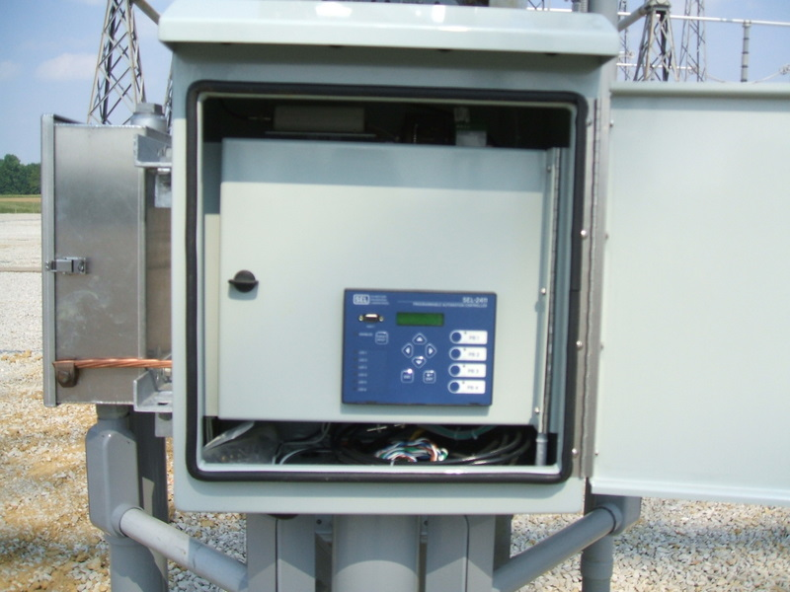
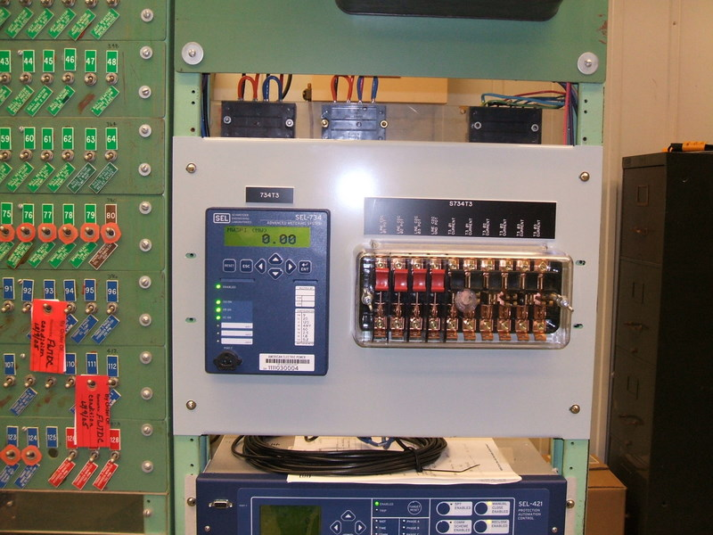
GIC Transducer
Harmonics Monitoring SEL734
GIC Relay – SEL2411

Slide 30

Comments/Questions

Slide 31
Capacitor Bank Protection
Capacitor banks are often wye, double wye or delta connected and grounded or ungrounded
  Externally fused, with individual fuses for each capacitor unit
  Internally fused, with each element fused inside the capacitor unit
  Fuseless, with capacitor units connected in series strings between line and neutral (or between line terminals)
  Unfused, with capacitor units connected in a variety of series and parallel arrangements
Besides the internal or external fuses, unbalance protection is the widely accepted scheme for capacitor bank protection for the following fault conditions:
  Faulted capacitor element
  Fault from capacitor elements to case, bushing failure, faulty connection in capacitor unit
  Fault in capacitor bank other than in unit (arcing fault in bank)
  Continuous overvoltage on capacitor elements or units due to faulted elements or fuse operations within the bank

