Slide 1
ERCOT DELAWARE BASIN STUDY LOAD UPDATE METHOLOGY
Assets Planning
Business and Operations Support
Oncor Electric Delivery Co LLC
Plans are subject to change due to factors including, but not limited to, load, generation, engineering, system protection and system topology.

Slide 2
Request for Information;
West/Far West Weather Zone Electric Service Customer Base
Oncor made requests to high-use O&G customers located in the West/Far West Weather Zones to provide key load forecast information in order to support the ERCOT DBS – the request included supply of electric load information pertaining to forecasted loads size/schedule, type, and location in a “Load Area Modeling” approach with Near-Term and Long-Term conditions.
Essential Data Points
Load Size and Schedule
Near-Term Projections/Forecast: through 2019 and 2020, each;
Long-Term Projections/Forecast: Aggregate through 2024.
Types of Load
“Greenfield” Load: Planned or Projected New Load;
Technology Change: Conversion of Gas Gen to Electric, Other Atypical Industry Schemes or Equipment;
O&G Infrastructure In-Place: Drilled Uncompleted (DUCs), Quick-Turnaround when Takeaway Underway Finishes.
Location for Load
The location for potential load growth is critical to ensuring that:
Electric system Areas of Limitation (existing facilities in place) are strengthened; and,
The siting of new electric infrastructure in areas can be supported where there currently is none.

Slide 3
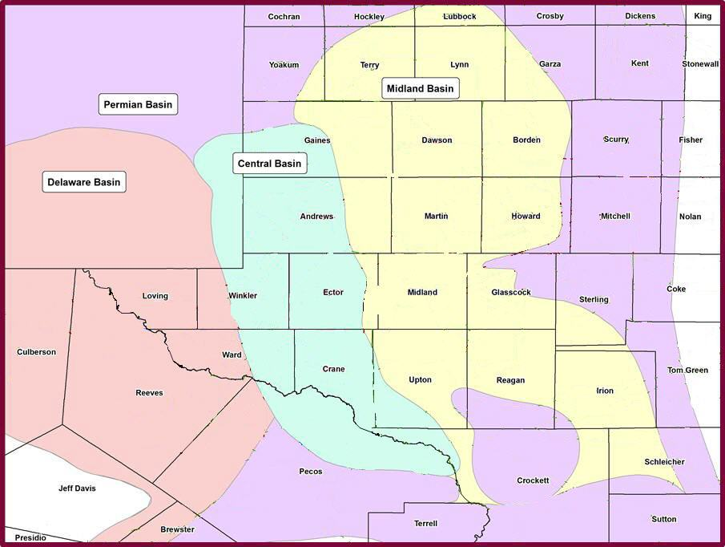
POTENTIAL LOAD AREAS
Potential
Load Area
2
1
3
4
10
5
6
7
8
9

Slide 4
Request for Information;
West/Far West Weather Zone Electric Service Customer Base
“If there were no impediments to access for electric service in the identified Load Zones, either with capacity or schedule, please indicate projections for your Company’s load growth and electric needs for the near-term (2019/2020) and long-term horizons (2024).”
Oncor provided an Excel Spreadsheet in the following general format to collect each Company’s information.
 | 2019 (MW) [Quarterly] |  |  | 2020 (MW) [Quarterly] |  |  | 2024 (MW) [Quarterly]
Load Area | New Load | Conversion | Exist Infra | New Load | Conversion | Exist Infra | New Load | Conversion | Exist Infra
Area 1
---
---
Area 8
Load projections were requested on a Quarterly basis for/through 2019/2020 each, and an aggregate (current through) for 2024, in each of the Essential Data Point categories for load type.
There was additional narrative fields for any additional information or details the customer may have wanted to include.

Slide 5
Request for Information;
West/Far West Weather Zone Electric Service Customer Base
Oncor made data requests and held calls with 10 key customers
Within Oncor’s Culberson Loop:
~ 50% of total projected load (T&D level)
~ 75% of total HV POD load (in-service and in-progress)
These customers represent 29% of total load in the study area counties today (based on kW billing)
No extrapolation made in data submission

Slide 6
RESULTING REQUESTS
Potential
Load Area
AREA | MW
1 | 422
2 | 278
3 | 160
4 | 87
5 | 77
6 | 273
7 | 191
8 | 83
9 | 119
10 | 25
2
1
3
4
10
5
6
7
8
9

Slide 7
QUESTIONS/DISCUSSION

