Slide 1
Credit Exposure Update
Spoorthy Papudesi
Credit Work Group
ERCOT Public
April 18, 2019

Slide 2
Monthly Highlights Feb 2019- Mar 2019
Market-wide average TPE increased from $263.8 million to $298.5 million
The increase in TPE is due to higher prices in early March
Discretionary Collateral is defined as Secured Collateral in excess of TPE,CRR Locked ACL and DAM Exposure.
Average Discretionary Collateral decreased from $ 1,034.8 million to $926.7 million
The decrease in Discretionary Collateral is largely due to decrease in Secured Collateral
Number of active Counter-Parties increased from 233 to 237
No unusual collateral call activity

Slide 3
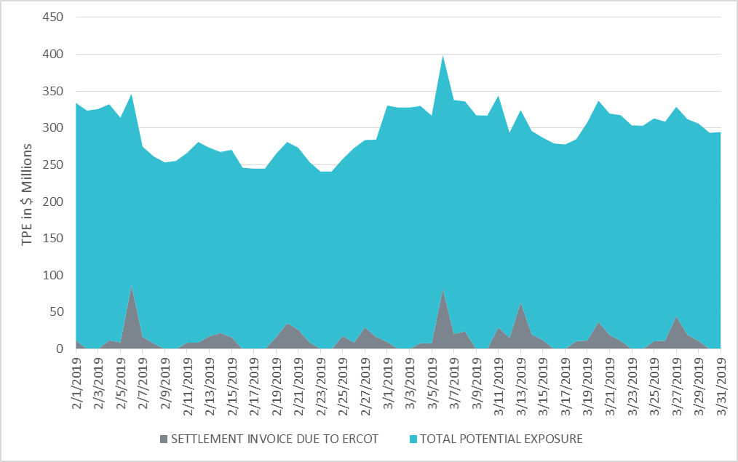
Settlement Invoice Charges/TPE Feb 2019- Mar 2019

Slide 4
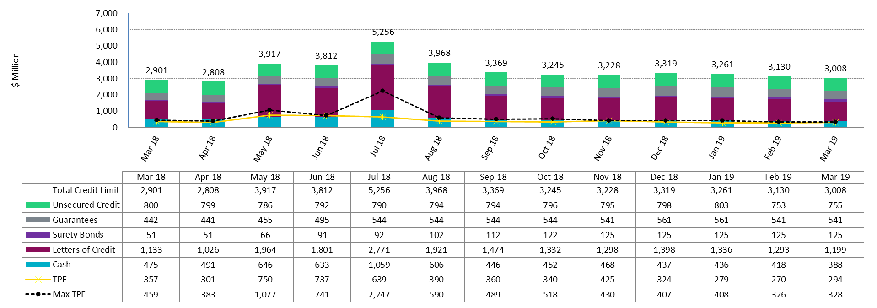
Available Credit by Type Compared to Total Potential Exposure (TPE)
*Numbers are as of month end except for Max TPE

Slide 5
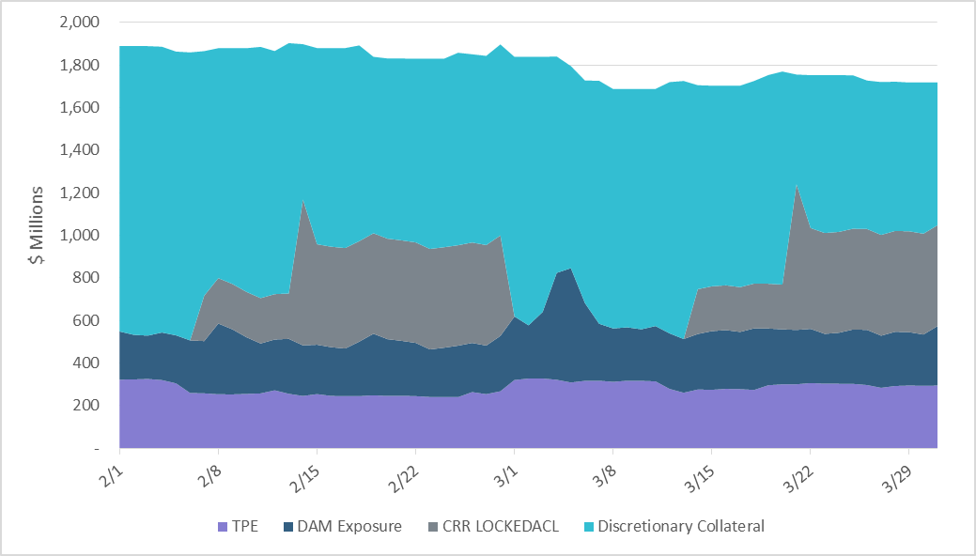
Discretionary Collateral Feb 2019- Mar 2019
Posted collateral covered the DAM Exposure spike caused by higher prices
Note: Discretionary collateral doesn’t include Unsecured Credit Limit or parent guarantees

Slide 6
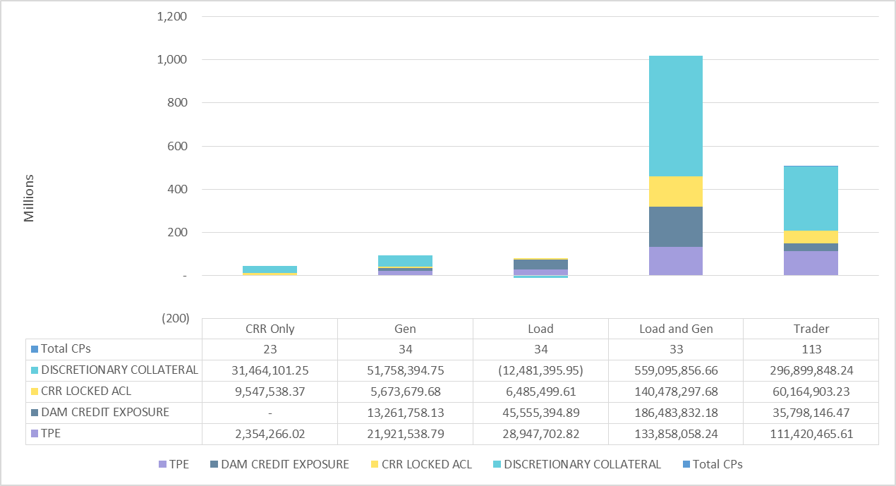
TPE and Discretionary Collateral by Market Segment- Mar 2019
Load and Generation entities accounted for the largest portion of discretionary collateral

Slide 7
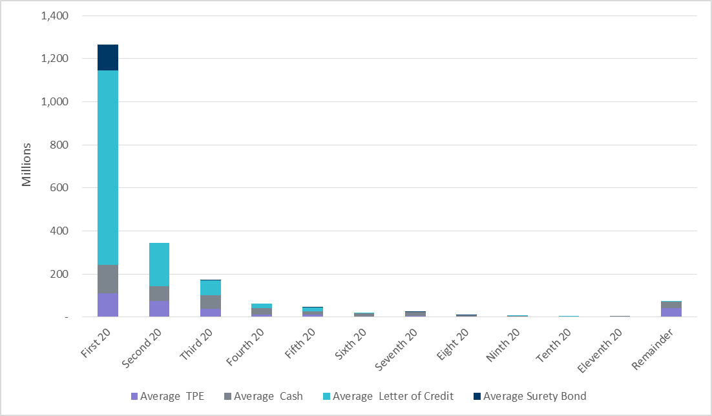
Secured collateral distribution/ TPE- Mar 2019
Posting of discretionary collateral is relatively concentrated.

Slide 8
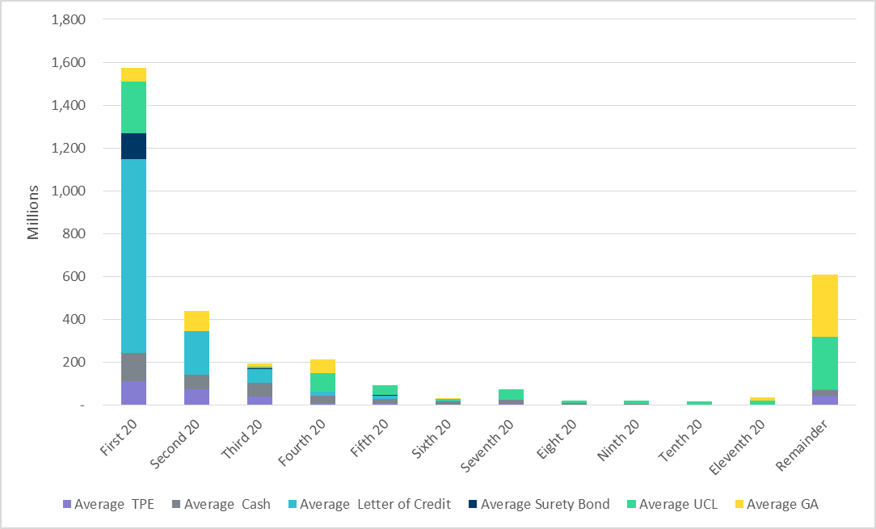
Secured collateral and Unsecured Credit Limit (UCL) distribution/ TPE- Mar 2019
TPE in the last bucket is covered by Guarantees and UCL

Slide 9
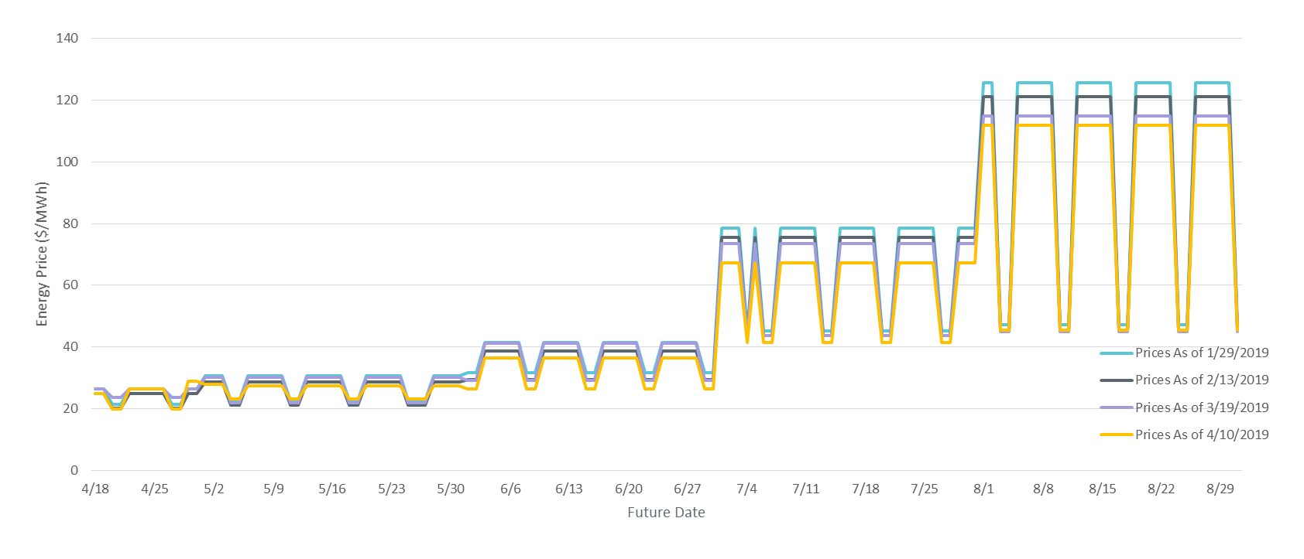
ICE Daily Average Prices April-August 2019
*Daily Average Price = (Peak price*16 +Off-Peak price*8)/24

Slide 10
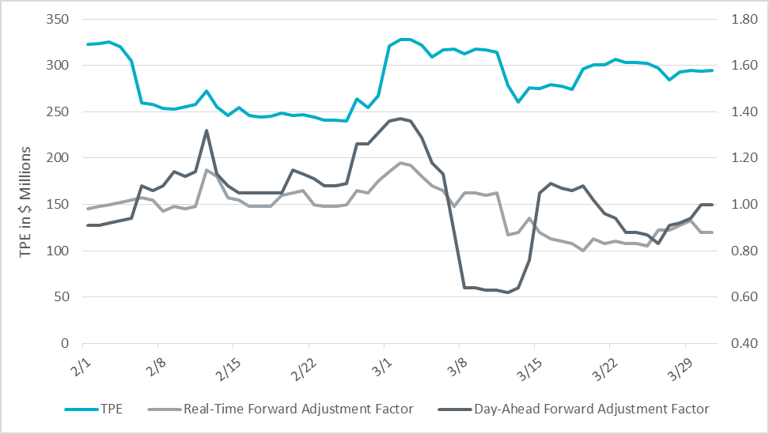
TPE and Forward Adjustment Factors Feb 2019- Mar 2019
TPE moved in conjunction with forward adjustment factors
The Real-Time (RFAF) and Day-Ahead (DFAF) forward adjustment factors capture the ratio of forward ERCOT North prices to actual prices.

Slide 11
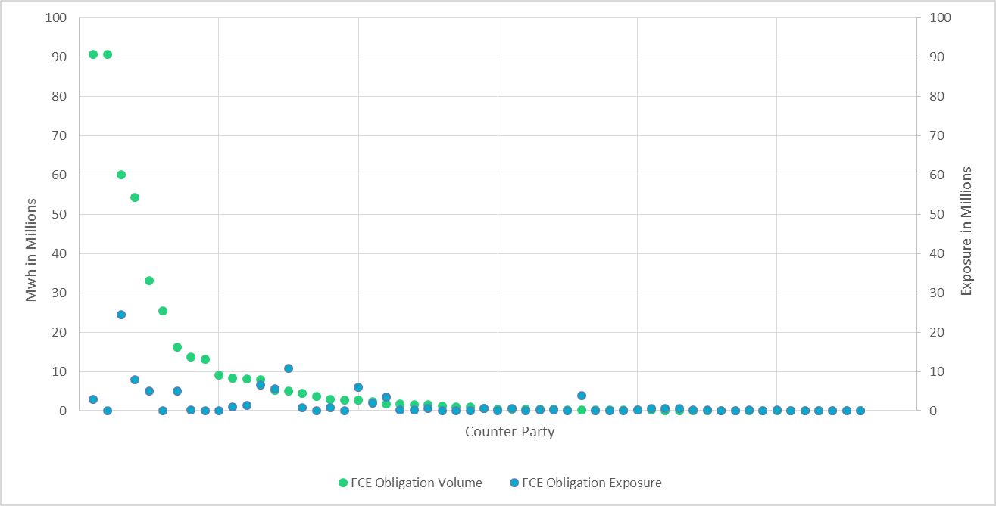
CRR Obligation Volume/Exposure - 4/1/19

Slide 12
Appendix

Slide 13
Distribution of TPE by Rating and Category

Slide 14
Distribution of Excess Collateral by Rating and Category

Slide 15
Bottom Quintile Distribution of Excess Collateral by Rating and Category

Slide 16
Bottom Quintile Distribution of Average TPE by Rating and Category

Slide 17
Questions

