Slide 1
AEP West Texas Project Update
ERCOT RPG Meeting
May 14th 2019

Slide 2
2018 and 2019 Completed Projects
Rebuild Solstice to Yucca Drive 138 kV line – September 2018
Add -100/100 Mvar STATCOM at Lotebush station – April 2018

Slide 3
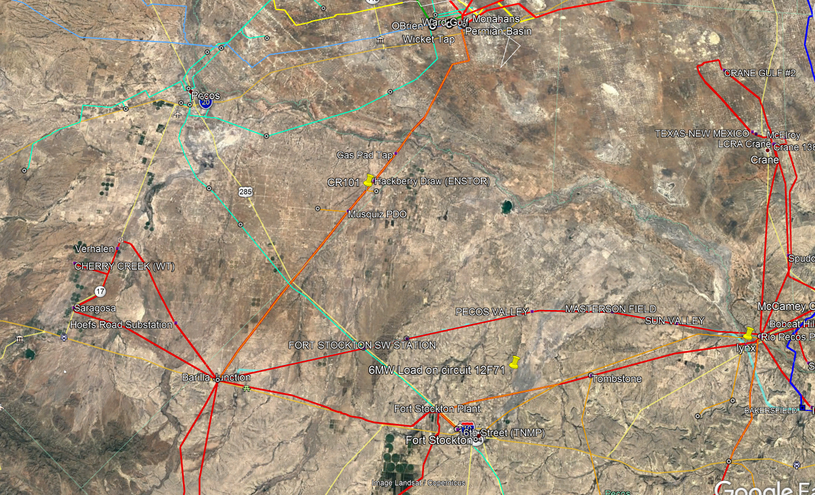
2018 and 2019 Completed Projects

Slide 4
2019 and 2020 Planned Projects
Lynx station and termination of Woodward 1– September 2019
Raise structures on the Ft. Stockton to Solstice 138 kV line – December 2019
Rebuild Solstice to Saragosa 69 kV line, convert to 138 kV and build Cryo substation – January 2020
Rebuild Barrilla Junction to Ft. Stockton SW to Rio Pecos 69 kV line, convert to 138 kV, re-terminate into Solstice, install 138 kV capacitor bank at Solstice, and build new Ft. Stockton Switch 138 kV station – March 2020
Install 138 kV phase shifting transformer at Solstice – March 2020
Termination of TNMP 16th Street – Rio Pecos 138 kV line and Woodward 2 into Lynx station – May 2020
New Solstice 345 kV station, add two 50 Mvar bus reactors and 345 kV double circuit line to LCRA Bakersfield station – December 2020

Slide 5
2019 and 2020 Planned Projects

Slide 6
Questions ?

