Slide 1
2020 Long-term System Assessment Kickoff, Initial Input Assumptions and Capacity Expansion Preliminary Results for Current Trends Scenario
May, 2019
RPG Meeting
Notes:
Welcome to

Slide 2
Outline
LTSA Overview
LTSA Methodology Improvement
Input Assumptions for Current Trends scenario
Load Forecast
Distributed Generation
Electric Vehicle Adoption
Fuel Pricing
New Unit Capital Costs
Emission Costs
Preliminary Results for Current Trends scenario
LTSA Survey
LTSA Schedule

Slide 3
LTSA Overview
The LTSA provides an evaluation of the potential needs of ERCOT’s extra-high voltage (345-kV) system in the 10- to 15-year planning horizon.
The LTSA guides the six-year planning process by providing a longer-term view of system reliability and economic needs.
ERCOT studies different scenarios in its long-term planning process to account for the inherent uncertainty of planning the system beyond six-years.

Slide 4
2020 LTSA Process
Current Trends Preliminary Capacity Expansion
Gather Stakeholder Feedback
Finalize Current Trends Capacity Expansion
Develop Current Trends Transmission Expansion
Develop Load Forecast for Other Scenarios
Develop Capacity Expansion for Other Scenarios
Develop Transmission Expansion for Other Scenarios
Report
Develop ~4 Other Scenarios

Slide 5
LTSA Methodology Improvement
Co-optimize capacity expansion and transmission planning through iterative process
Long-term Capacity Expansion
Yes
New interface limits recommended?
Long-term Transmission Analysis
No
End

Slide 6
Current Trends Initial Data and Study Period
The following slides show preliminary numbers for Current Trends scenario and are subject to change based on survey results (at end of presentation) and any comments from this meeting.
Some of the assumptions could have a significant impact on scenario results. Your feedback is greatly appreciated.
The study period for 2020 LTSA is 2021 through 2035.
The focus is on 2030 to 2035

Slide 7
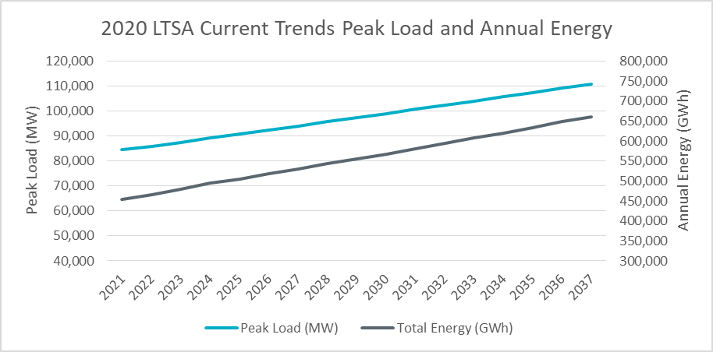
Current Trends Load Forecast
Forecast includes:
Electric vehicle adoption assumption
Distributed PV solar adoption assumption
Existing Private Use Network (PUN) load

Slide 8
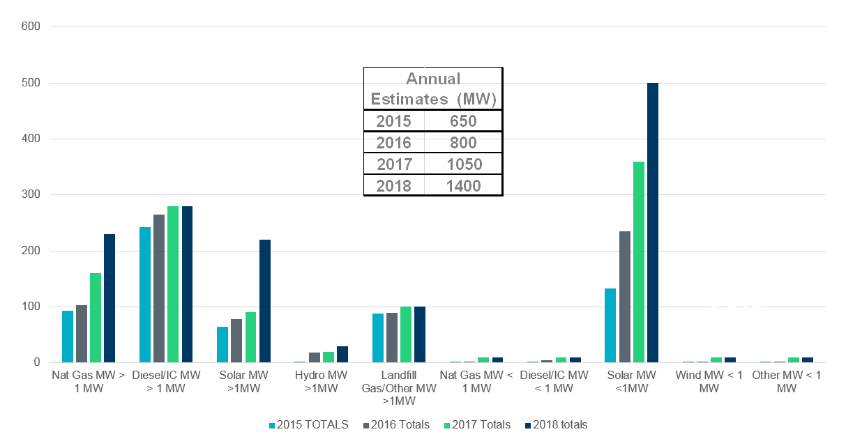
Distributed Generation
Modeled as Generators
Note: This estimate includes informal data reporting by many NOIEs and excludes generation data informally reported by investor-owned utilities for generation that would typically be considered backup or emergency generation.

Slide 9
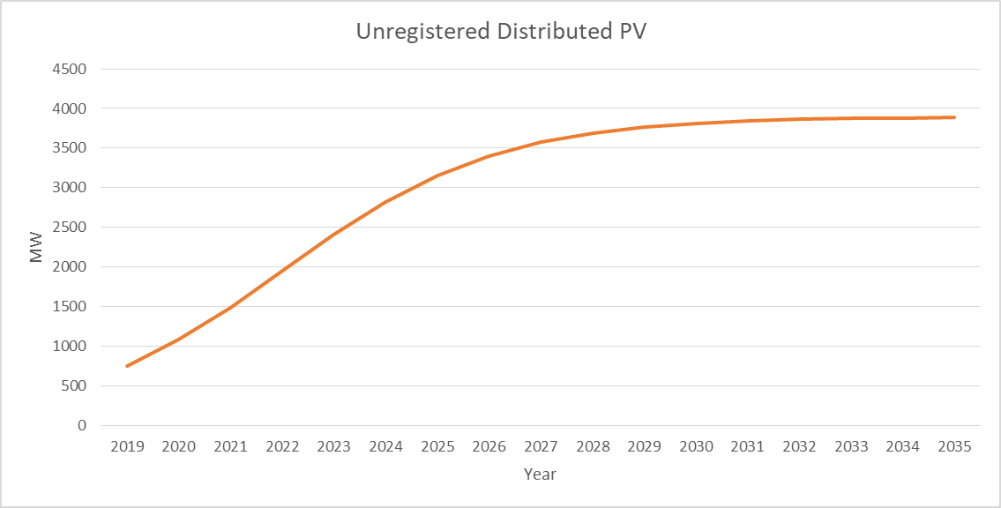
Unregistered Distributed PV
Projection for unregistered distributed PV

Slide 10
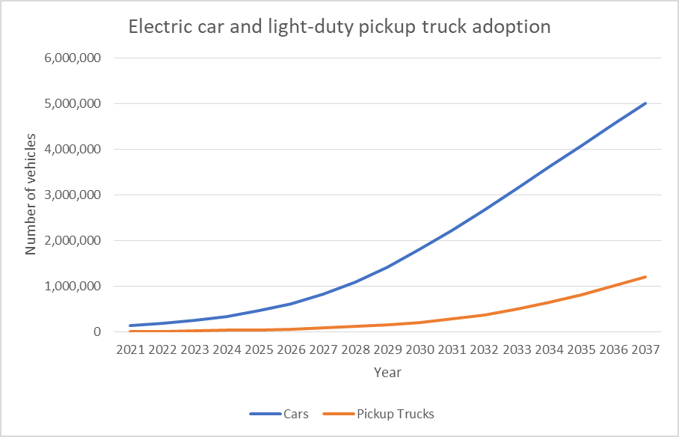
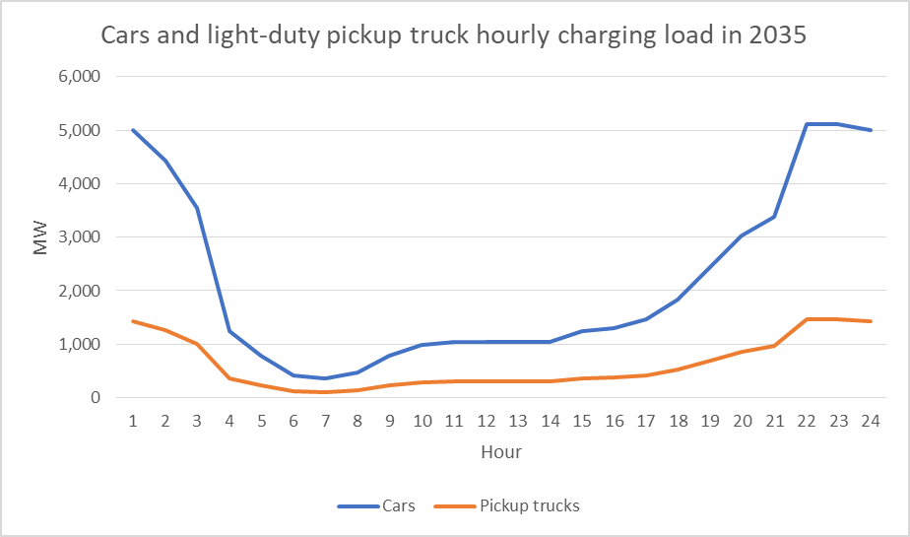
Electric Vehicle Adoption
Electric car and light truck adoption based on Bloomberg New Energy Finance (BNEF) 2017 projection
EV penetration and charging demand estimation for 2035

Slide 11
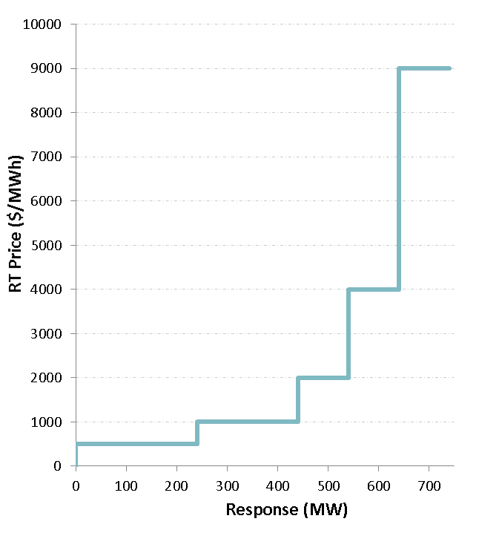
Price Responsive Demand
741 MW PRD in 2017 modeled as resources with striking prices
2% growth rate is assumed for PRD
Load has been grossed up to reflect the load without PRD response.
Source: http://www.ercot.com/calendar/2018/4/20/141901-DSWG

Slide 12
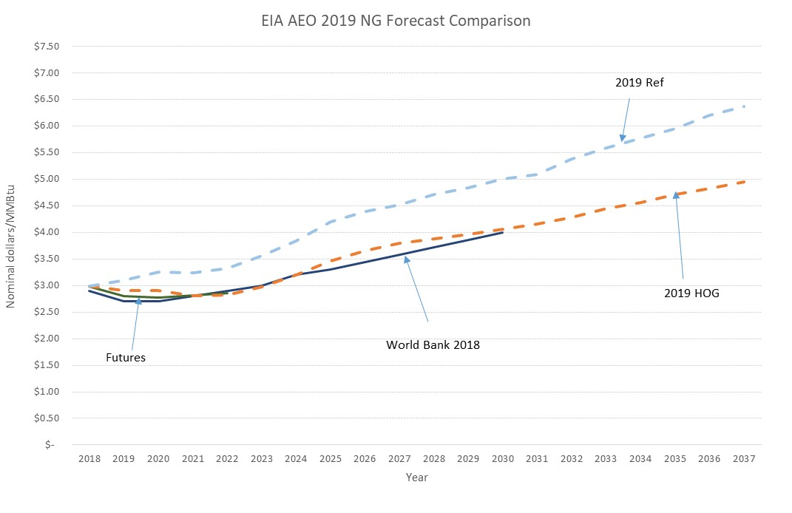
Natural Gas Price Assumptions
Ref is the EIA Annual Energy Outlook (AEO) Reference Case and HOG is the High Oil and Gas Resource and Technology Case
Futures from Nymex and World Bank forecast are from 2018

Slide 13
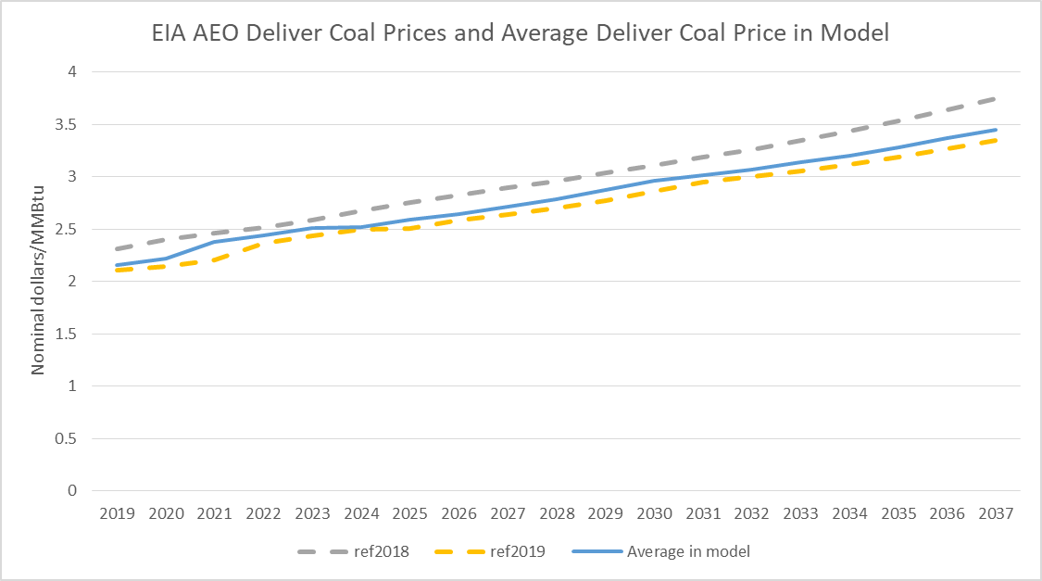
Coal Price
Plant specific deliver coal prices are used in the model. The average of the plant specific prices is shown in the chart.
Ref is the EIA AEO Reference Case
Source: S&P Global Market Intelligence

Slide 14
New Unit Capital Costs
Sources of capital cost assumptions,
Lazard’s Levelized Cost of Energy Analysis, November 2018
EIA AEO 2019
Cost examples from national labs and utility IRP assumptions
Costs are $/kW in nominal dollars

Slide 15
Environmental Issues and Emission Costs
Current Trends Scenario doesn’t include any new environmental regulations.
Emission Prices for Current Trends
Emission | $/ton
NO_{x} (Seasonal) | 150
NO_{x} (Annual) | 2.75
SO₂ | 0.00
CO₂ | 0.00
https://www.rggi.org/Auction/42
https://www.epa.gov/airmarkets/2018-so2-allowance-auction
https://www.spglobal.com/platts/en/market-insights/latest-news/electric-power/012518-seasonal-nox-prices-hold-steady-on-more-small-trades

Slide 16
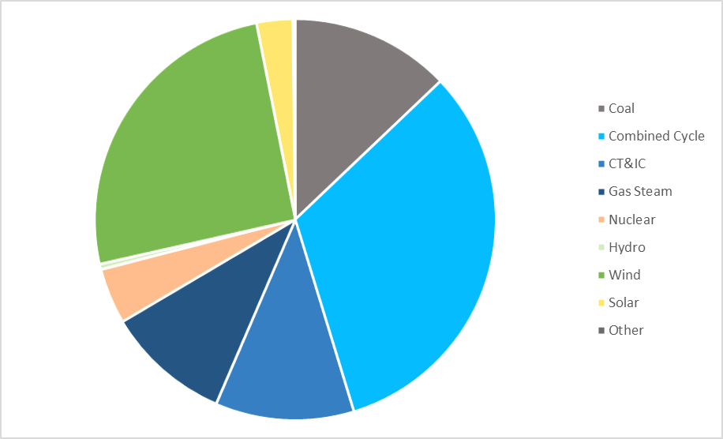
Starting Capacity Mix
Included planned resources which meet Planning Guide 6.9 based on December 2018 CDR and January 2019 GIS released on February 1st 2019.

Slide 17
Preliminary Current Trends Results
Reserve margin in final year: 5%
Built 16,100 MW gas generation
Built 6,400 MW solar
Built 5,500 MW wind
No retirements
Unserved energy in year 2035. Shortages are mainly concentrated in evening hours in summer months with maximum magnitude over 4,000 MW
Notes:
Compared to the Current Trends scenario results of 2018 LTSA, more gas generation capacity are added because of lower projected gas price in the early years of the study horizon; no retirements and more net generation capacity addition are because of higher load forecast and electrical vehicle adoption.

Slide 18
Ancillary Service Prices
Simulated AS prices are generally lower than AS prices in market.
Ancillary service is co-optimized with energy in the model. High AS prices show up during scarcity hours, so the AS prices are much higher in 2035.
Average AS Prices for the past five years vs simulated average AS prices ($/MW per hour)

Slide 19
LTSA Survey
Stakeholders are encouraged to participate in the 2020 LTSA Survey (link below). The survey will remain open until May 28
The survey has questions regarding assumptions in the Current Trends Scenario and drivers that may lead to other scenarios to be studied
Survey link: https://www.surveymonkey.com/r/ERCOT2020LTSA_StakeholderSurvey

Slide 20
2020 LTSA Schedule
Task | Date
Current Trends Preliminary Results | May 2019 RPG Meeting
Stakeholder Feedback | May 2019
Finalize Scenarios | Q3 2019
Finalize Current Trends Capacity Expansion | Q3 2019
Current Trends Transmission Expansion | Q4 2019
Other Scenarios Capacity Expansion | Q1 2020
Other Scenarios Transmission Expansion | Q2 2020

Slide 21
Questions
Julie Jin
Julie.jin@ercot.com
512.248.3982
Jeff Billo
Jeff.Billo@ercot.com
512.248.6334
?

Slide 22
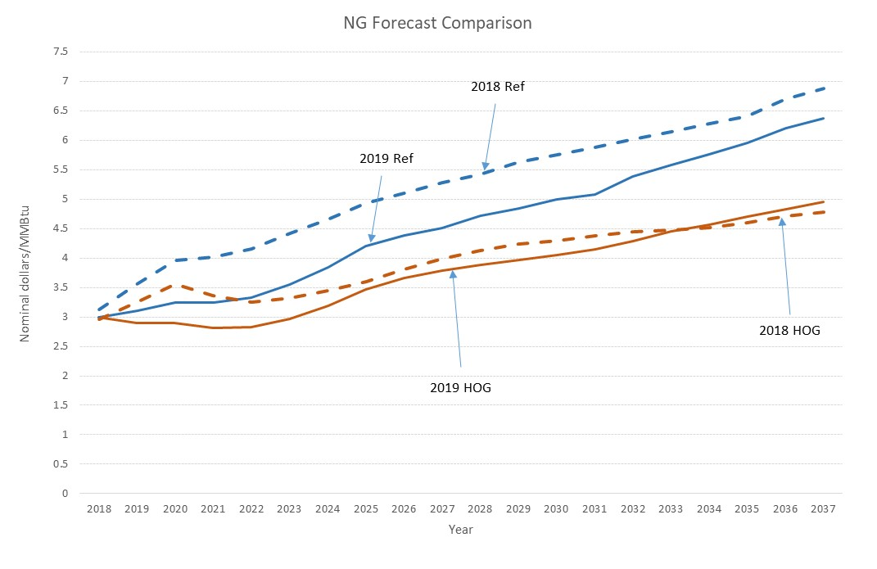
Gas Price comparison, 2019AEO vs 2018AEO

Slide 23
New Unit Capital Costs for 2018 LTSA
Sources of capital cost assumptions,
EIA 2017 Annual Energy Outlook
Lazard’s Levelized Cost of Energy Analysis, December 2016
Solar Energy Industries Association, 4th QTR 2016 Solar Market Insights
Costs are $/kW in nominal dollars

