Slide 1
LOWER RIO GRANDE VALLEY TRANSMISSION EXPANSION PROPOSED PROJECT
ERCOT Regional Planning Group Submittal
May 14, 2019

Slide 2
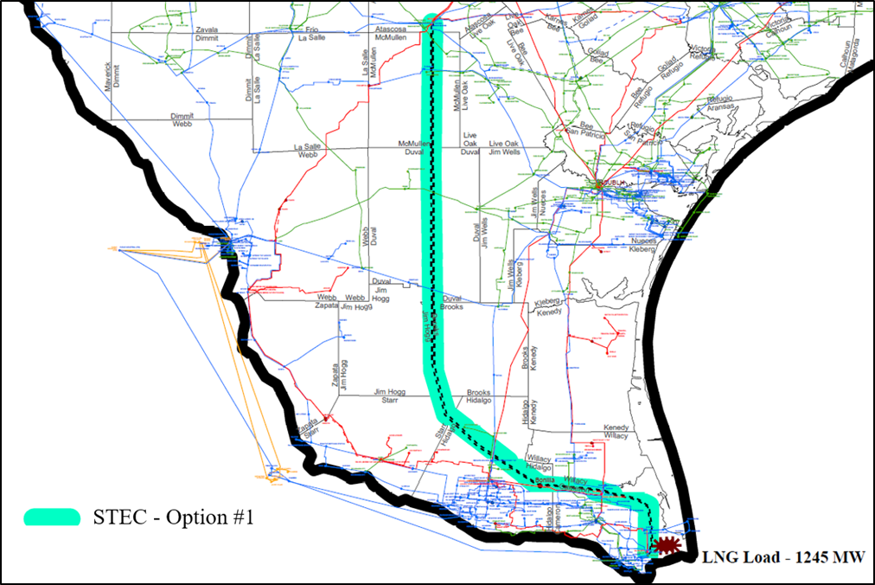
Project Map: STEC Proposal
SAN MIGUEL
LOBO
CORPUS CHRISTI
LAREDO
BONILLA
BROWNSVILLE
UNION CARBIDE
NEW DOUBLE CIRCUIT 345 kV LINE
SAN MIGUEL to BONILLA to UNION CARBIDE
STEC PROJECT PROPOSAL PRESENTATION TO ERCOT RPG 05/14/2019

Slide 3
LRGV History
The Lower Rio Grande Valley (LRGV) has a long history of reliability and resilience issues as a load center on the edge of the ERCOT system away from major resources with limited transmission capability.
Many transmission improvements have been implemented in the LRGV to improve the situation by attempting to keep up with customer requirements and changes.
Each year the annual ERCOT Constraints and Needs Report continues to show significant South Texas/LRGV reliability related transmission constraints and congestion costs.
Due to projected load growth and anticipated LNG load additions in the future, STEC performed reliability studies to assess the impact of the new load in the LRGV.
STEC PROJECT PROPOSAL PRESENTATION TO ERCOT RPG 05/14/2019

Slide 4
Overview: STEC Proposal
STEC submitted a proposed project for transmission expansion into the Lower Rio Grande Valley (LRGV) for RPG review in May 2019.
The project proposes to address expected reliability issues due to load growth in the LRGV and anticipated LNG load additions near Brownsville, TX from 2020 to 2022¹.
The proposed STEC Option 1 project details are the following:
Year | Rio Grande LLC | Texas LNG | Annova LNG (STEC)¹ | Total MW/yr
2020 | 200 | 120 | 135 | 455
2021 | 400 | 240 | 270 | 910
2022 | 600 | 240 | 405 | 1,245
 |  |  | Total Projected Load | 1,245
Project | Cost Estimate ($) | Project Summary
STEC Option 1 | $511,400,000 | Build new 175 mile, double circuit 345 kV transmission line from San Miguel to Bonilla Build new 43 mile, double circuit 345 kV transmission line from Bonilla to Union Carbide Add 2x 37.5 MVAR line reactors at San Miguel, on each circuit Add 2x 37.5 MVAR line reactors at Bonilla, on each circuit
¹The Annova LNG load schedule is slightly outdated since the studies were performed.
Annova now estimates 135 MW total by Q3 2023 and 405 MW total by Q3 2024.
STEC Annova agreement has been provided to ERCOT.
STEC PROJECT PROPOSAL PRESENTATION TO ERCOT RPG 05/14/2019

Slide 5
SubSynchronous Resonance Considerations
In accordance with the ERCOT Nodal Protocols, Section 3.22.1.3(1), STEC conducted a SubSynchronous Resonance (SSR) topology check with the proposed STEC Option 1 project in place to determine if any SSR risk may be introduced by the project.
There are three new 345 kV transmission paths with less than 14 outages to radial the San Miguel generator to the following series capacitors:
Del Sol/Cenizo series capacitors (13 outages)
North Edinburg series capacitors (13 outages)
Rio Hondo series capacitors (13 outages)
A system side frequency scan needed to determine SSR risk for the above conditions.
The wind generator POIs in the study area impacted by the STEC Option 1 project do not have any new or minimal SubSynchronous Control Interaction (SSCI) vulnerability through the new topology introduced by the STEC Option 1 project.
The new paths created from the Option 1 project are not considered the worst case for SSCI vulnerabilities for these wind sites.
All the existing wind generators vulnerable to SSCI in the Lower Rio Grande Valley have SSCI mitigation in place.
STEC PROJECT PROPOSAL PRESENTATION TO ERCOT RPG 05/14/2019

Slide 6
Study Assumptions
STUDY STARTED IN EARLY 2018
BASE CASE | 2017RTP_2022_SUM_SSC_11222017
LRGV LOAD | 2,853 MW prior to LNG load addition 2018 ALDRs for AEP, BPUB, SHARYLAND & STEC Summer Peak Diversified
LNG LOAD | 1,245 MW
TRANSMISSION | Local transmission additions to serve the LNG load AEP Stage 1 Upgrades for 2021 (under review by ERCOT) Lon Hill-Bessel 138kV line rebuild, dynamic reactive support, and shunt capacitor bank addition Tier 4 project ID 6741 (Rate A change for Azteca Sub (8708)-SE Edinburg (8374) 138kV line) with effective date as May 2019 RTP projects: SE Edinburg (8374)-Pharr (5762) and North Edinburg (8380)-McColl Road (8908) 138 kV terminal equipment upgrade North McAllen (8368)-West McAllen (8367)-South McAllen (8371) 138 kV line upgrades North McAllen (8368)-North Edinburg (8380) 138 kV line upgrade
GENERATION | Added all Proposed Generation meeting Planning Guide Section 6.9 as of ERCOT GIS Report April 2018
WIND DISPATCH | 15% of capacity with full reactive support available
STEC PROJECT PROPOSAL PRESENTATION TO ERCOT RPG 05/14/2019

Slide 7
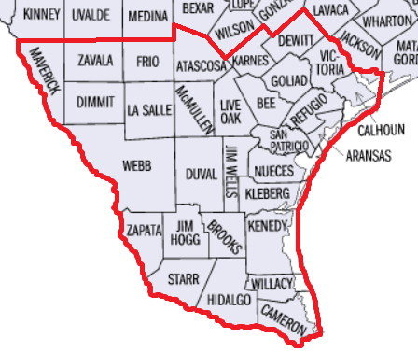
Study Area Assumptions
Study Area
STEC monitored all transmission facilities in, and connected to, the study area.
STEC studied the following contingency categories in, and connected to, the study area:
Normal system condition (P0)
N-1 conditions (P1, P2.1, P7/ERCOT1)
X-1 + N-1 (X-1 is 345:138 kV Auto outages)
G-1 + N-1 (N-1 includes P7/ERCOT1)
N-1-1 (first N-1 for critical 345 kV line outages in the study area)
P4 and P5 contingencies (stability only)
STEC PROJECT PROPOSAL PRESENTATION TO ERCOT RPG 05/14/2019

Slide 8
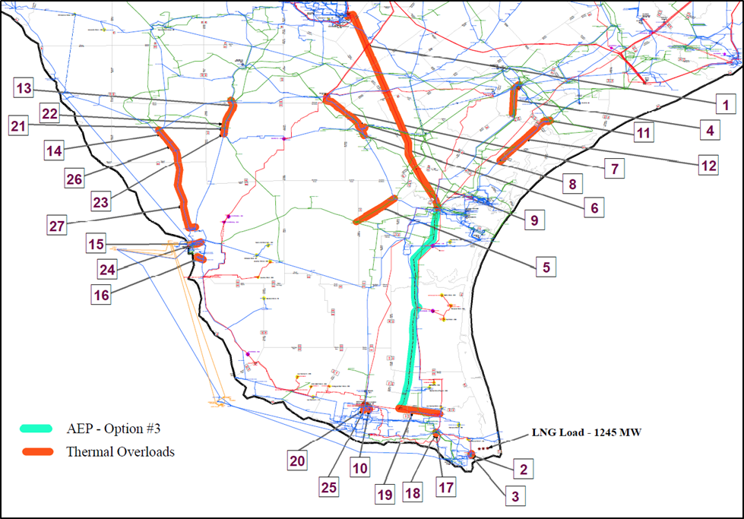
Steady State Study Results: AEP Proposal
Steady State Study tested the AEP Option 3 proposed project from their January 2018 LRGV report.
NSUBLH – Ajo – Bonilla 345 kV BOLD Transmission Line (2 x 1590 ACSR)
Post-contingency thermal overloads remained.
SAN ANTONIO
SAN MIGUEL
LOBO
CORPUS CHRISTI
LAREDO
BONILLA
BROWNSVILLE
UNION CARBIDE
MANY RELIABILITY ISSUES REMAIN
Constrains Transfers
STEC PROJECT PROPOSAL PRESENTATION TO ERCOT RPG 05/14/2019

Slide 9
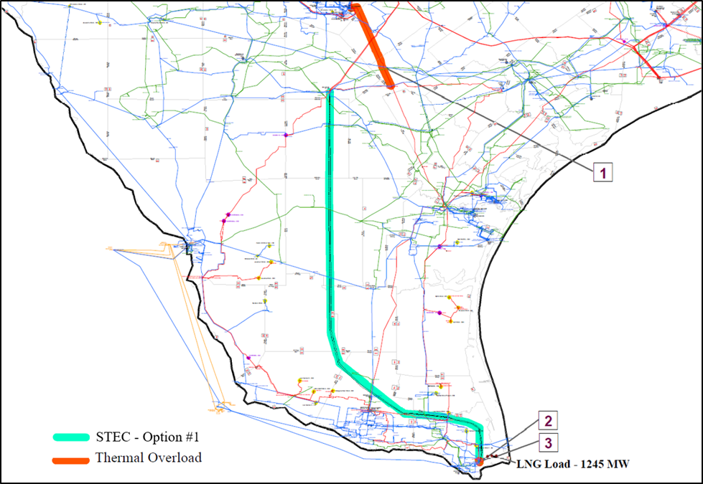
Steady State Study Results: STEC Proposal
Steady State Study found thermal overloads, low voltage violations, and several P1 (N-1) contingencies that did not converge which indicates voltage collapse in the LRGV area.
STEC Option 1 solved all low voltage violations and non-convergence issues.
Overload remained at Spruce - Pawnee.
SAN ANTONIO
Spruce to Pawnee
SAN MIGUEL
LOBO
CORPUS CHRISTI
LAREDO
BONILLA
BROWNSVILLE
UNION CARBIDE
MOST RELIABILITY ISSUES SOLVED
STEC PROJECT PROPOSAL PRESENTATION TO ERCOT RPG 05/14/2019

Slide 10
Stability Study Results
Stability analysis identified transient voltage recovery violations, severe voltage collapse, and loss of synchronism of several conventional generators under P1, P3, P4, P5, and P6 contingency conditions with no additional transmission upgrades implemented to serve the full 1,245 MW of LNG load.
Many stability issues remain with the AEP Option 3 project implemented.
The STEC Option 1 proposed project resolved ALL the stability issues identified.
COMPARISON OF TRANSIENT VOLTAGE RECOVERY VIOLATIONS
Transient Voltage Recovery Violations
No Violations
STEC PROJECT PROPOSAL PRESENTATION TO ERCOT RPG 05/14/2019

Slide 11
Additional STEC Project Advantages
Adds an additional 345 kV transmission path to the LRGV.
Adds resilience by reducing dependence on Laredo and Corpus Christi 345 kV power systems.
About 80% of the project is away from the coast which reduces the risk of outages due to severe coastal weather events.
Increases transfer capability to and from South Texas and LRGV areas.
Adds geographic diversity to the locations for future generation development
STEC PROJECT PROPOSAL PRESENTATION TO ERCOT RPG 05/14/2019

Slide 12
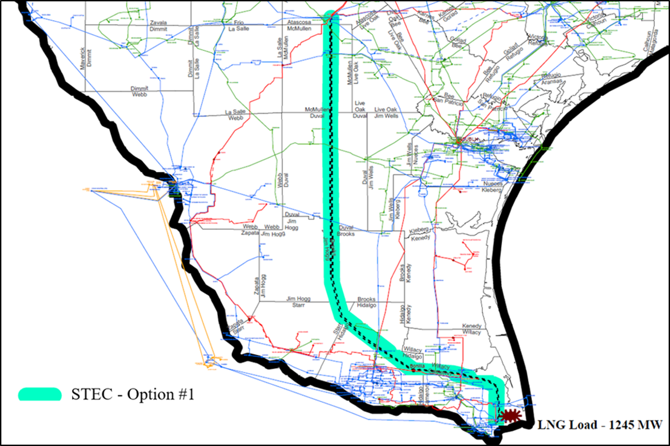
Study Conclusion: STEC Proposal
STEC recommends a fourth 345 kV transmission path into the LRGV in order to serve the expected full LNG load additions of 1,245 MW near Brownsville by 2024.
The STEC Option 1 proposed project successfully resolves the reliability issues.
SAN MIGUEL
LOBO
CORPUS CHRISTI
LAREDO
BONILLA
BROWNSVILLE
UNION CARBIDE
RESOLVES RELIABILITY ISSUES AND INCREASES RESILIENCE
STEC PROJECT PROPOSAL PRESENTATION TO ERCOT RPG 05/14/2019

Slide 13
QUESTIONS & DISCUSSION
Thank You for your time and input.
STEC PROJECT PROPOSAL PRESENTATION TO ERCOT RPG 05/14/2019

