Slide 1


Response of Power System Protective Relays to GIC
Andrew K. Mattei, Baylor University Brazos Electric Cooperative
Dr. W. Mack Grady, Baylor University

Slide 2
Outline
The Waveforms of DC Injection
  Waveform 1: Test Bench Data
  Waveform 2: NERC Example
  Waveform 3: DTRA Field Test Data
Harmonic Distortion and Currents
Time-Overcurrent Relay Testing and Results
Differential Relay Testing and Results
Relay Evaluation Approach
Detection and (Possible) Mitigation of GIC Interference

Slide 3
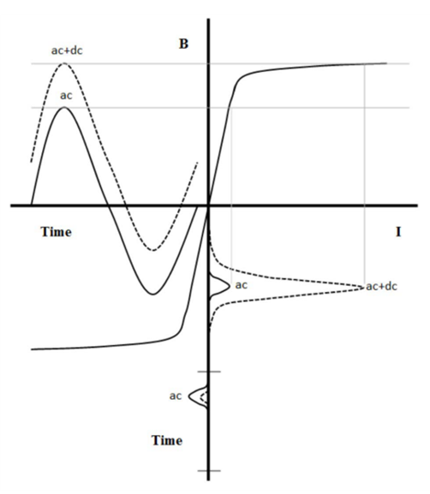
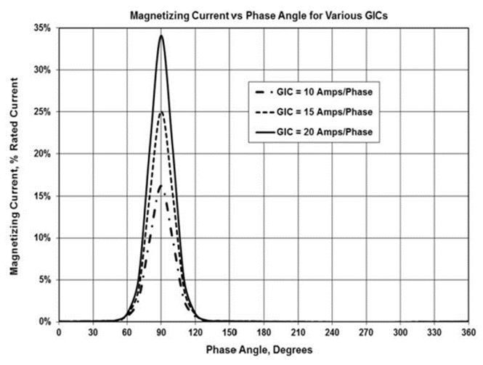
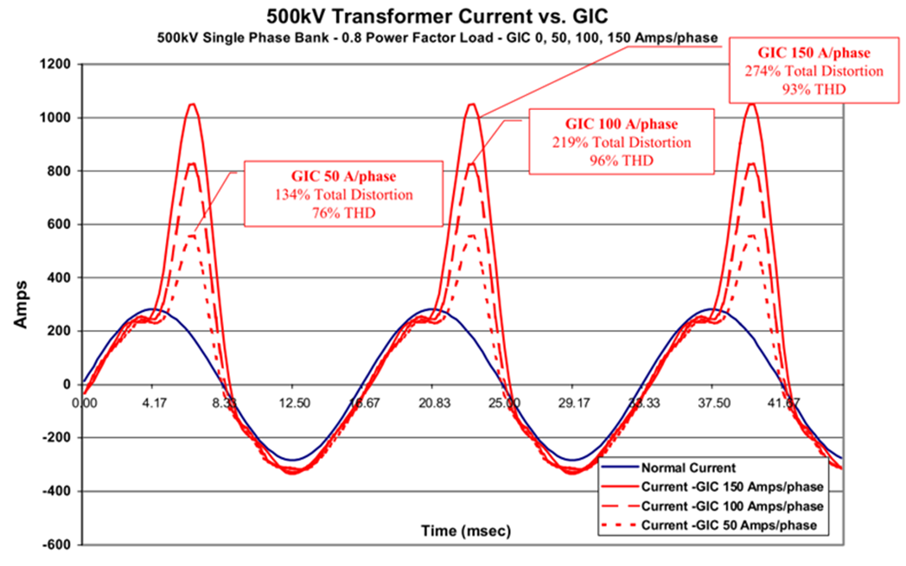
What are we going to see with DC in the system?
IEEE Std C57.163-2015: IEEE Guide for Establishing Power Transformer Capability while under Geomagnetic Disturbances
The Late-Time (E3) High-Altitude Electromagnetic Pulse (HEMP) and Its Impact on the U.S. Power Grid – Metatech, 2010.
Source: IEEE Std C57.163-2015 [6]
Source: IEEE Std C57.163-2015 [6]
Source: Gilbert et.al., [3]

Slide 4
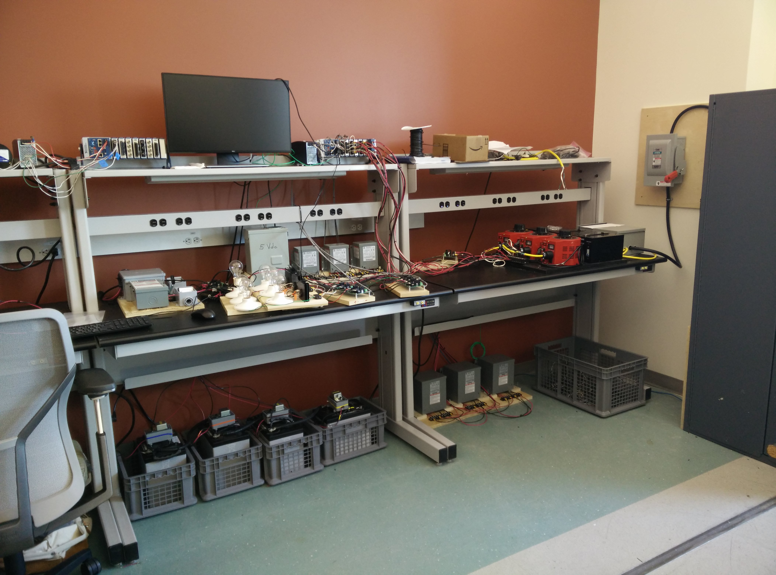
Baylor Test Lab – DC Injection Test Bench
Single-phase and Three-Phase transformers
Data acquisition everywhere (all phases of V & I, including neutrals) with NI / LabView
Capable of 8+ Amps DC injection from batteries

Slide 5
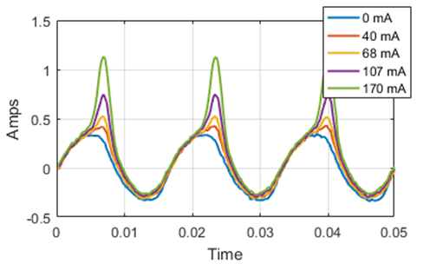
Test Bench Waveform
“Waveform 1” - ~38% Second Harmonic
Matches expectations based on IEEE and Metatech documents
Baylor source has elevated third harmonic
Turn it in to a COMTRADE file for relay testing

Slide 6
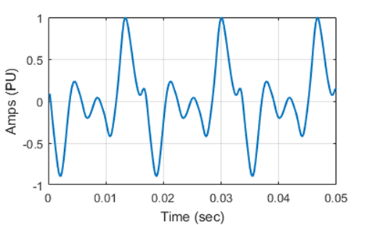
NERC 1989 Event Document (among TPL-007 documents), Figure 15 – “Waveform 2”
Source: NERC [10]

Slide 7
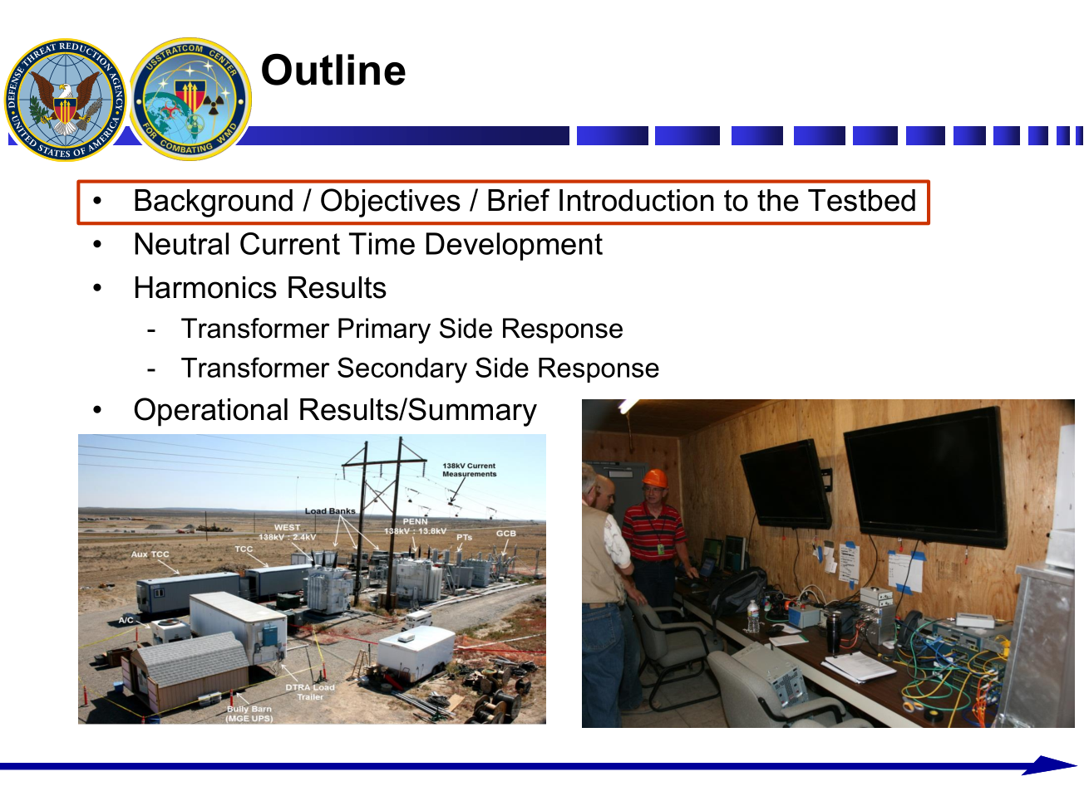
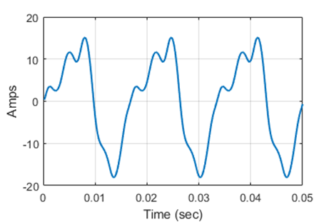
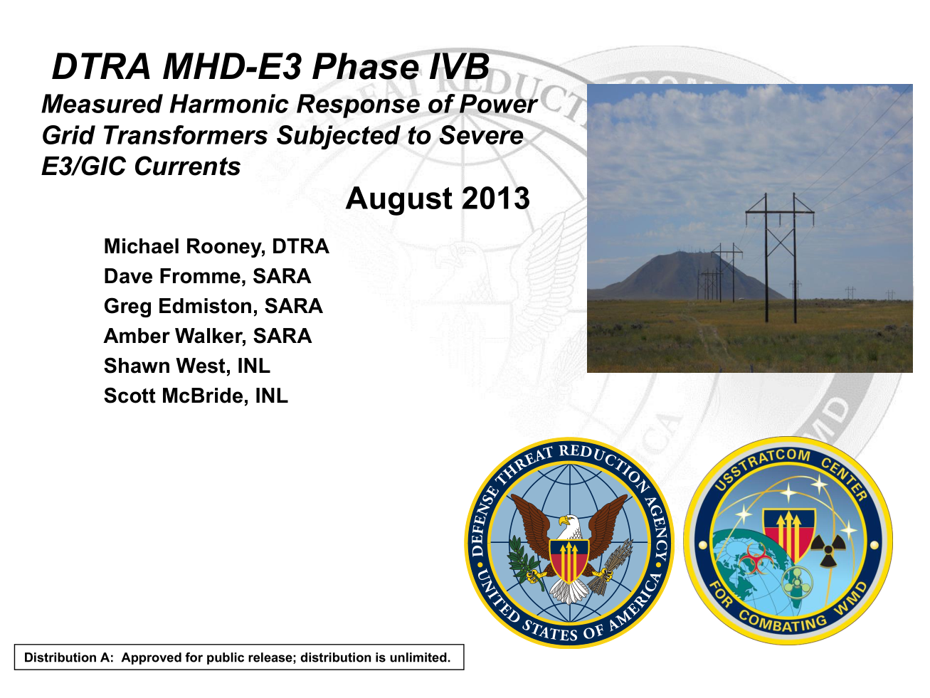
DTRA DC Injection Test Bed @ Idaho National Labs
“Waveform 3”
Source: [11]

Slide 8
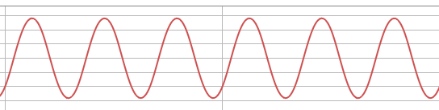

In a Normal World (50 or 60 Hz)
$$I_{RMS}≅I_{FUNDAMENTAL}≅I_{FILTERED}≅\frac{I_{PEAK}}{\sqrt{2}}$$

Slide 9
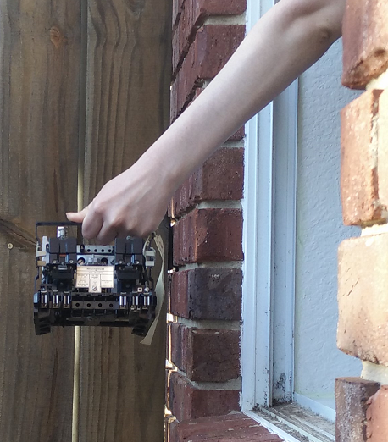

In a Distorted World
$$I_{RMS} ≇I_{FUNDAMENTAL}≇\frac{I_{PEAK}}{\sqrt{2}}$$
Test | I_{RMS} | I_{FILTERED/FUNDAMENTAL} | I_{PEAK}÷√2
Waveform 1 | 10.25 | 9.06 | 17.37
Waveform 2 | 10.25 | 5.03 | 16.79
Waveform 3 | 10.25 | 9.46 | 12.81
DC 0mA | 6.73 | 6.70 | 6.24
DC 40mA | 6.93 | 6.85 | 6.75
DC 68mA | 7.31 | 7.13 | 8.26
DC 107mA | 8.18 | 7.72 | 11.48

Slide 10
3 Time-overcurrent relays tested
Westinghouse CO-9
GE IAC-53B
SEL-421
All set to same pickup / time dial - obviously curves / times will be different between them
The Question: Can we predict EM relay operation based on RMS current?
Waveform 10.25A RMS | THD | CO9 Time (s) | IAC53B Time (s) | SEL421 Time (s)
1 | 53% | 3.08 | 2.445 | 3.587
2 | 177.5% | 4.994 | 2.281 | 480+
3 | 41.8% | 2.738 | 2.425 | 3.2

Slide 11
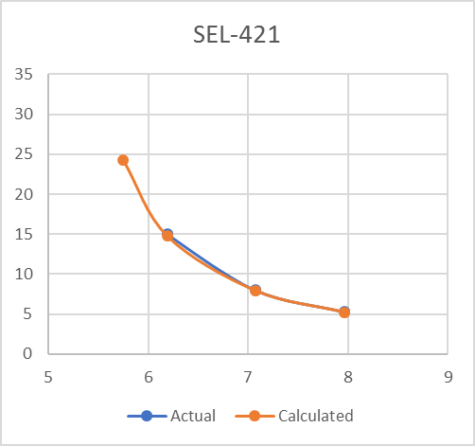
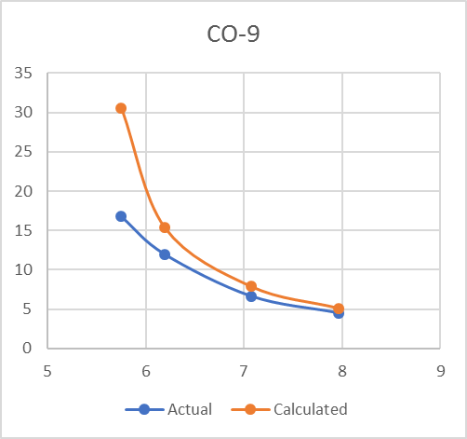
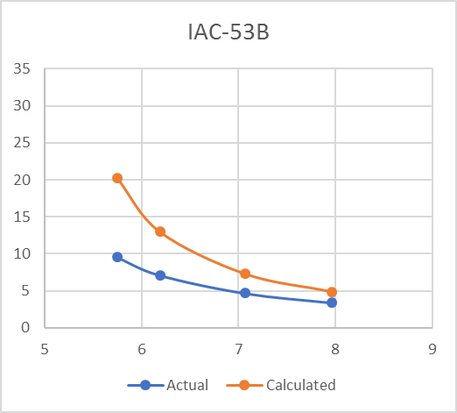
Waveform 1 – Varying RMS Magnitude
Concern becomes unpredictable behavior near pick-up point when compared to fundamental component

Slide 12
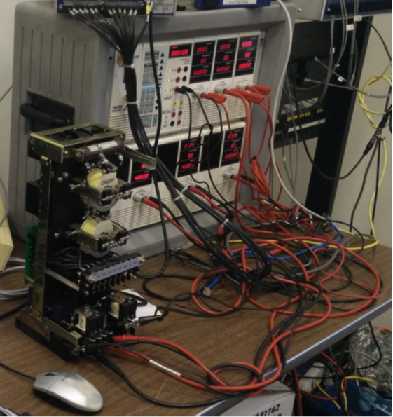
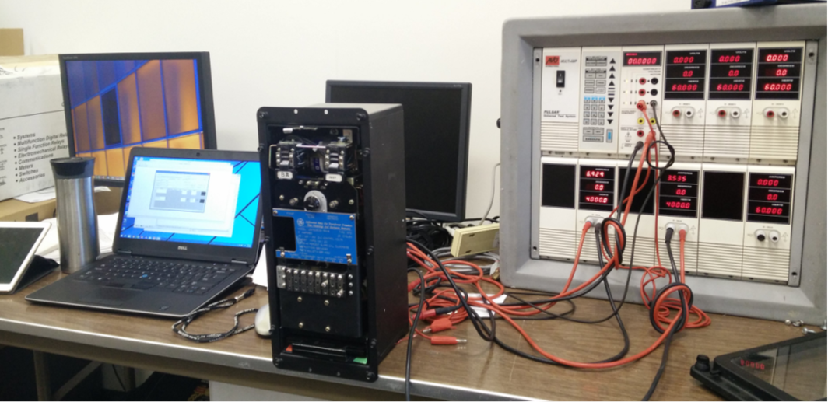
Differential Relay Testing (Simplified)
Westinghouse HU, GE STD, GE BDD, SEL-487E

Slide 13
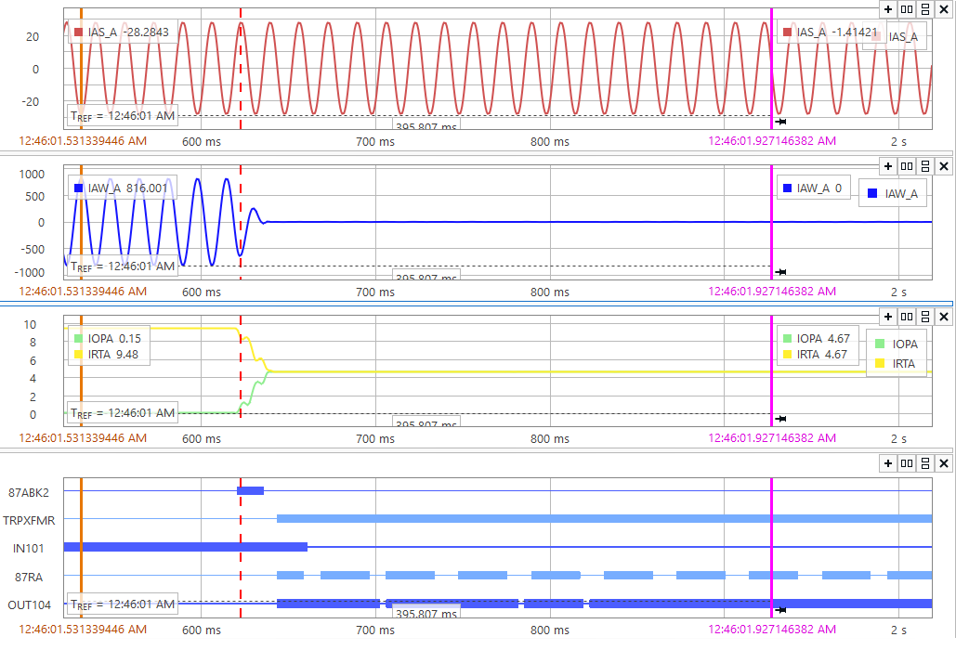
Test 1 (baseline): Does relay trip for loss of secondary side current?
All current flowing into primary side winding when secondary current drops out
Of course it trips, as it should. All relays tested - tripped.

Slide 14
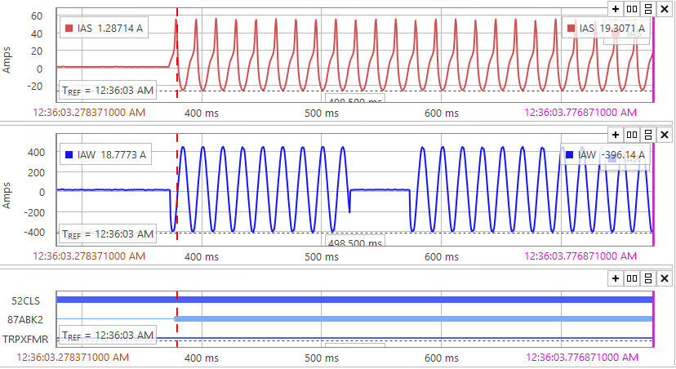
Test 2: Does relay trip during Waveform 1 on Primary winding?
Drop secondary current again, just like Test 1
None of the tested relays tripped. Second harmonic blocking / restraint inhibits tripping.
Unrestrained tripping (instantaneous) is not affected. Relay will still trip on high current levels.

Slide 15
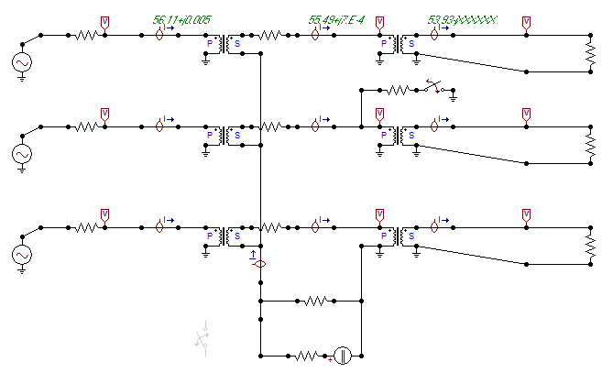
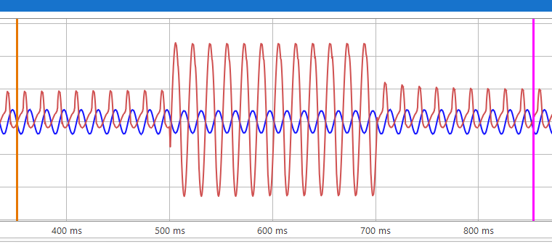
Internal Fault with Harmonics – ATP Simulation
Credit to Derrick Haas for the conversation / idea
Simulation of B-phase internal fault using ATP based on Transformer Test Bench
Second harmonic ‘disappears’ during faulted period
Still evaluating tests; second harmonic content below block level

Slide 16
Observations
Time-overcurrent protection can become a bit unpredictable with harmonics. Even though relays may feature similar construction (induction-disc), the way they handle harmonics may be different.
With a microprocessor-based relay, severe harmonics (Waveform 2) may not result in protection activating even though peak current is well above pickup (operating only on fundamental).
Some believe that differential relays may not operate for an actual fault during GIC events until the instantaneous pickup is reached. This may slow tripping and result in more damage than a ‘fast trip’. Simulation indicates this may or may not occur – it depends on the relay and how it’s set.

Slide 17
Selection - So what relays do we focus on?
Overheard within ERCOT: How do we know what relays to look at? Where can we start?
Start with the TPL-007-2 GIC model for the Benchmark Event.
  Evaluate the higher-magnitude GIC flows within your area of responsibility.
  Determine transformers, capacitor banks, and SVC’s near the elevated-GIC area.
  Examine the protection on those devices. Run some harmonic-laced COMTRADE files if necessary.*
  *(Endgame Spoiler: probably not.)

Slide 18
How much is enough DC for concern?
NERC requires transformer thermal assessment impact at 75A DC in GIC model. No specification for relaying.
IEEE PSRC Working Group K-11, April 1996, The Effects of GIC on Protective Relaying: “GIC levels below 30A have no noticeable effect on the power system.”
K-11 did not specifically indicate total neutral or per phase, implication is total neutral, so (for me) consideration begins at 10A per phase while looking at voltage level (higher = more impact).

Slide 19
Brazos Checklist (my own):
Does the NERC benchmark event model indicate greater than 10A per phase?
Is the voltage 138kV or higher?
What type of relays are installed at this location and at nearby facilities (electromechanical or microprocessor)? (Consider cap banks, etc. that aren’t modeled but are nearby.)
Are relay pickup settings designed for tight or loose tolerance for lower levels?
Do differential relays have harmonic blocking/restraint enabled?
Are there odd relays like electromechanical negative sequence relays?

Slide 20
Detection & Mitigation – what can relays do?
Harmonic detection can send alarms to System Operators so that mitigating actions can be taken.
  Use a timer on second harmonic blocking pick-up. If duration is greater than 600 cycles (or ?), assert an alarm to SCADA.
  Use calculations based on fundamental and RMS voltages to monitor for increase in THD at transmission (138kV+) levels
Plan ahead with alternate settings groups for high-impact areas. Consider allowing for margin to keep equipment – especially reactive equipment – in service. Transformers in deep saturation absorb VARs and cap banks / SVCs become very important for stability.

Slide 21
Conclusion
EM relays may be unpredictable. Examine the GIC model and determine impacted areas. In these areas, strongly consider replacing EM relays with uP.
Be considerate with uP relays and harmonic distortion. Will distortion be greater than the fundamental (like Waveform 2)?
Consider alarming for extended periods of harmonics and/or THD. This will alert System Operator that differential protection may be disabled or a time-overcurrent element may not have enough fundamental to assert.

Slide 22
Concern Areas that Need Testing
Electromechanical Negative-Sequence Protection
Voltage waveforms are different than current waveforms – EM cap bank protection
Looking for relays…

Slide 23

Questions
amattei@brazoselectric.com
Paper available on A&M Web Site – 2019 Conference for Protective Relay Engineers
https://prorelay.tamu.edu/archive/2019-papers-and-presentations-2/
https://en.wikipedia.org/wiki/File:SunBurst10.jpg – modified version of
https://commons.wikimedia.org/wiki/File:Robot_Arm_Over_Earth_with_Sunburst_-_GPN-2000-001097.jpg

