Slide 1
AS Offers Structure Under RTC
Hailong Hui
May 13, 2019

Slide 2
Takeaways from 4/30/2019 RTCTF Meeting
NPRR 863 Changes to AS Offers
Add ECRS in the “Online Reserves” category: link ECRS with REGUP, RRS and Online Non-Spin.
Change the name of current “Non-Spin Offline” category to “Offline Reserves” category, add “OFFQS ECRS” in this category and link it with Offline Non-Spin.
Only QSGR can submit OFFQS ECRS AS Offer.
AS Offers changes under RTC
Recommend AS Offers are always inclusive with Energy Offer Curve in RTC.
Recommend default AS Offer linking.
Recommend AS Offer submission window same as EOC.
Only QSGR with OFFQS Resource status can provide OFFQS ECRS in RTC. The OFFQS unit will be treated as online in RTC and can get both Base Points and OFFQS ECRS awards.

Slide 3
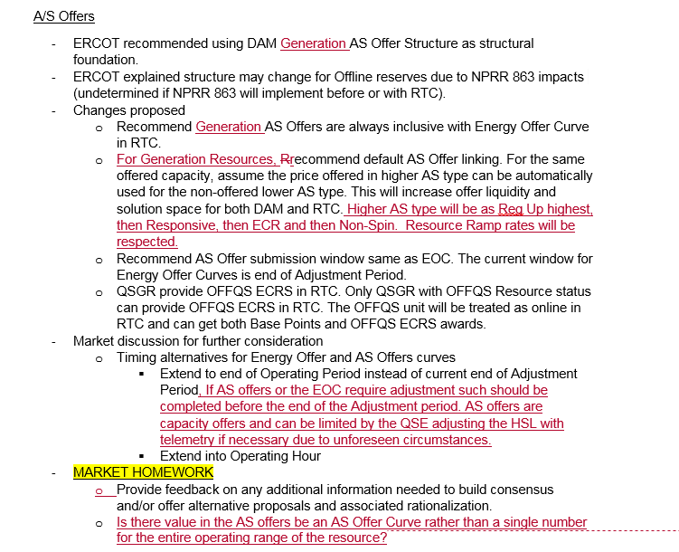
Comments from Market Participants
Comments from Floyd Trefny

Slide 4
ERCOT Responses to Market Participant Comments
The AS Offer Structure applies to both Generation Resources and Load Resources. Load Resource can also submit linked online reserve AS Offers, e.g., linked RRS and ECRS.
ERCOT agrees the AS type ordering for default AS Offer linking:
Higher AS type will be as Reg Up highest, then Responsive, then ECRS and then Non-Spin. Resource Ramp rates will be respected.
The AS Offer submission window does not necessarily need to be extended to the end of Operating Period instead of current end of Adjustment Period. The Real-Time telemetry can indicate the change in AS capability due to unforeseen circumstances.
Today and in RTC, each Resource can submit up to 5 capacity amounts (in MW) for an AS category for each hour. It should already meet the QSE requirements for different AS Offer combinations. It will create significant system impacts to change segment AS Offers to AS offer curves.

Slide 5
Questions

