Slide 1
2019 RTP Update
May 2019
RPG Meeting

Slide 2
Agenda
2019 RTP case information/assumption update
Status update
Next steps
Appendix
2019 RTP Final Load Levels

Slide 3
2019 RTP Status Update
Initial reliability start cases were posted on MIS Secure on March 15, 2019.
Load forecast values for economic analysis were posted on MIS Secure on April 8, 2019.
Currently in progress:
Single-event (N-1) reliability analysis
Economic analysis

Slide 4
2019 RTP Assumptions Update (1/2)
Resources that have been publicly announced to shut down will be taken offline
Decker Units 1 and 2 (announced April 17, 2019¹)
Oklaunion (announced September 20, 2018²)
ERCOT will submit a PGRR to codify this assumption
Horse Hollow switching considerations?
1 https://www.austintexas.gov/edims/document.cfm?id=317748
2 https://aep.com/Assets/docs/investors/AnnualReportsProxies/docs/18annrep/2018AnnualReportAppendixAtoProxy.pdf

Slide 5
2019 RTP Assumptions Update (2/2)
DC tie curtailment will be utilized before proposing transmission upgrades for P0, P1, P2.1, and P7 contingencies
There is a new stability interface limit that will be modeled for the Lobo-North Edinburg 345 kV line

Slide 6
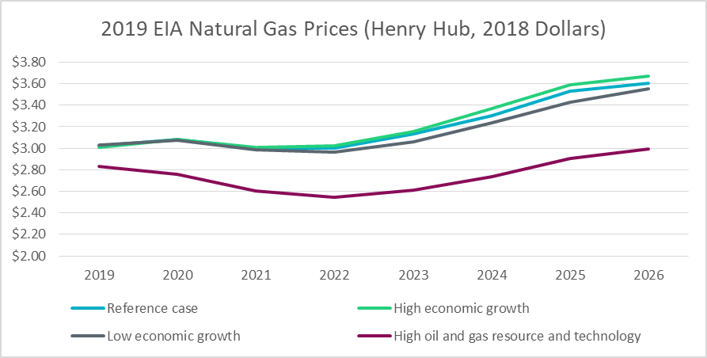
2019 RTP Gas Price Assumption
EIA AEO scenario (2018 $) | 2019 | 2020 | 2021 | 2022 | 2023 | 2024 | 2025 | 2026
Reference case | $3.03 | $3.08 | $3.00 | $3.00 | $3.13 | $3.31 | $3.53 | $3.60
High economic growth | $3.01 | $3.08 | $3.01 | $3.02 | $3.16 | $3.37 | $3.59 | $3.67
Low economic growth | $3.03 | $3.07 | $2.99 | $2.96 | $3.06 | $3.24 | $3.43 | $3.55
High oil and gas resource and technology | $2.83 | $2.76 | $2.60 | $2.55 | $2.61 | $2.74 | $2.90 | $2.99

Slide 7
Next Steps
Other Reliability Studies
Case conditioning
Sensitivity analysis
Short circuit study
Long-lead time equipment study
Initial start cases, and contingency list ready
Multiple element outage and cascading analyses
2018 RTP Report
Set 1 (P1, P7),
Set 2 (P2, P4, P5) contingency analysis for the base cases
Economic analysis
P3, P6.2 contingency analysis for the base cases
Blue box: complete
Yellow box: in progress

Slide 8
Send comments to:
Ping.Yan@ercot.com

Slide 9
2019 RTP Load Level – less self-served and losses (final)
Year | Coast | East | Far West | North | North Central | South Central | Southern | West
2021 | 23,828 | 2,884 | 5,690 | 2,221 | 26,723 | 13,658 | 6,349 | 2,318
2022 | 24,343 | 2,903 | 5,865 | 2,229 | 27,026 | 13,906 | 6,583 | 2,381
2024 | 24,907 | 2,966 | 6,151 | 2,246 | 27,636 | 14,399 | 7,332 | 2,507
2025 | 25,087 | 3,002 | 6,256 | 2,254 | 27,939 | 14,639 | 7,707 | 2,568
All load levels in MW
 | Bounded (based on 5% threshold)
 | 90th percentile
 | SSWG Forecast
 | Adjusted based on ERCOT review of TSP information

Slide 10
SSWG load v/s ERCOT 90/10 (less losses and self served)

Slide 11
SSWG load v/s ERCOT 90/10 (less losses and self served)

