Slide 1
2018 LTSA: Emerging Technology Scenario Transmission Analysis Update
May 2019
RPG Meeting

Slide 2
Background
2018 LTSA was completed in December: http://www.ercot.com/content/wcm/lists/144927/2018_LTSA_Report.pdf
Analysis included
  Load forecast and generation expansion analysis for 5 scenarios
  Transmission expansion analysis for 1 scenario (Current Trends)
ERCOT subsequently performed transmission analysis for the Emerging Technology Scenario

Slide 3
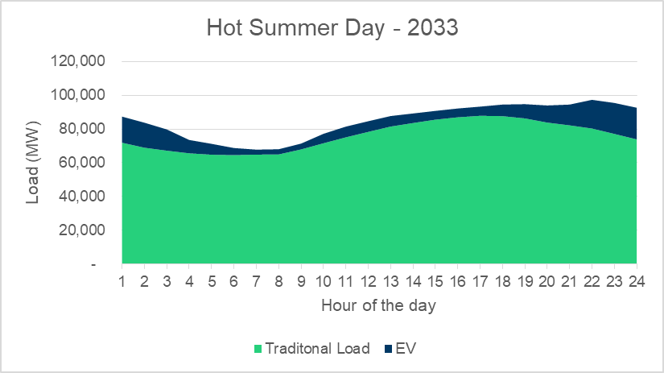
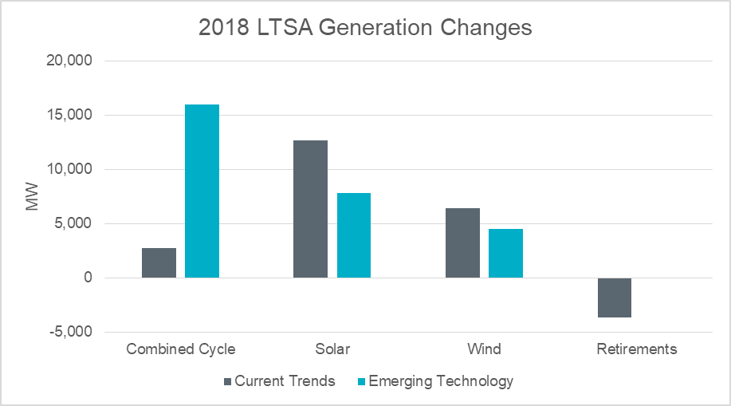
Emerging Technology Scenario Review
 | Demand Assumptions |  |  |  | Generation Assumptions
 | Annual System Growth | Energy (GWH) | Peak (MW) | Distributed PV (GW) | NG price forecast ($/mmBtu) in 2033 nominal $ | Renewable incentives
Current Trends Scenario | 1.40% | 535,600 | 91,174 | 1 | 4.48 | PTC/ITC phase out as currently expected
Emerging Technology Scenario * | 1.40% | 611,824 | 102,941 | 1 | 4.48 | Same as CT
* 3 million cars, 80 thousand short haul trucks/buses and 0.2 million long haul trucks

Slide 4
Emerging Technology Scenario Transmission Analysis Results
Index | Description | In-service Year | Current Trends Production Cost Savings ($M) | Emerging Technology Production Cost Savings ($M)
1 | Build Oklaunion - West Krum, a new double-circuit 345-kV line | 2028 | 77 | N/A
2 | Build Odessa - Bearkat, a new 345-kV line | 2028 | 35 | N/A
3 | Lubbock Loop: Build North - Oliver, a 345-kV line on new ROW Upgrade the Long Draw - Grassland 345-kV line | 2028 | 108 | 62
4 | Northwest Austin Metro new 345-kV line and 345/138-kV transformer | 2028 | 20 | N/A
5 | Northwest Dallas-Fort Worth new 345-kV line | 2028 | 32 | N/A
6, 7 | Lamesa Area Improvements | 2028 | 161 | 117
8 | West Texas to San Antonio new 345-kV line | 2028 | 182 | 100
9 | Upgrade the 345/138 kV autotransformer at Bergheim | 2028 | 10 | N/A
10 | Odessa to North McCamey new 345-kV line | 2028 | 41 | N/A

Slide 5
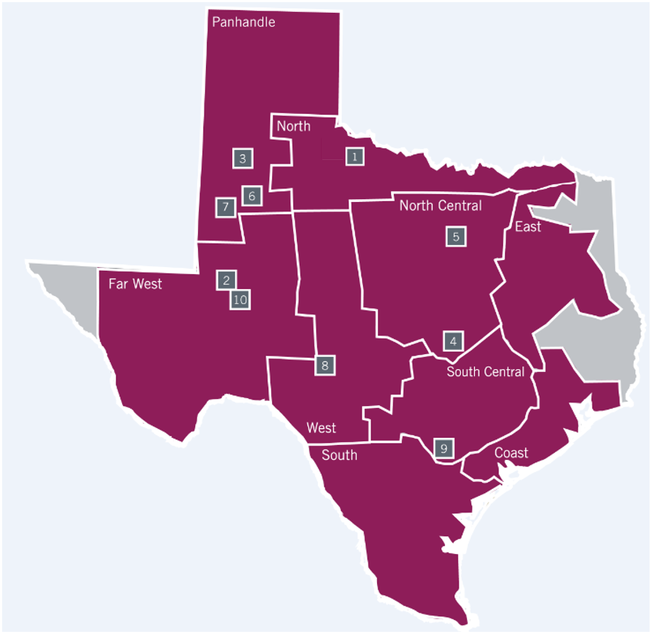
2018 LTSA Transmission Project Locations

Slide 6
Key Findings
The Emerging Technology Scenario had more gas generation in eastern part of system and less solar/wind in west compared to Current Trends
Results in less West-export transmission needs
However, several large West-export transmission projects were still needed

Slide 7
Questions?

