Slide 1
Real-Time Ancillary Service Shortages
Operations Analysis
Wholesale Markets Subcommittee
May 1, 2019
Reliability and Operations Subcommittee
May 2, 2019

Slide 2
Introduction
ERCOT and the Independent Market Monitor (IMM) have noticed a consistent pattern of Ancillary Service (AS) shortages in Real-Time
ERCOT has improved its internal process to better track these Real-Time AS shortages for post hoc analysis
ERCOT can address AS shortages prior to the end of adjustment period with the Supplemental Ancillary Service Market (SASM) mechanism
During the Operating Hour in Real-Time, Control Room Operators address AS shortages by manually contacting QSEs to resolve issues

Slide 3
Protocol Language
6.5.7.5 Ancillary Services Capacity Monitor
Each QSE shall operate Resources providing Ancillary Service capacity to meet its obligations. If a QSE experiences temporary conditions where its total obligation for providing Ancillary Service cannot be met on the QSE’s Resources, then the QSE may add additional capability from other Resources that it represents. It adds that capability by changing the Resource Status and updating the Ancillary Service Schedules and Ancillary Services Resource Responsibility of the affected Resources and notifying ERCOT under Section 6.4.9.1, Evaluation and Maintenance of Ancillary Service Capacity Sufficiency. If the QSE is unable to meet its total obligations to provide committed Ancillary Services capacity, the QSE shall notify ERCOT immediately of the expected duration of the QSE’s inability to meet its obligations. ERCOT shall determine whether replacement Ancillary Services will be procured to account for the QSE’s shortfall according to Section 6.4.9.1.

Slide 4
Protocol Language
8.1.1.3 Ancillary Service Capacity Compliance Criteria
ERCOT shall provide each QSE representing Resources a capacity summary containing as a minimum the same general information required in Section 6.5.7.5, Ancillary Services Capacity Monitor, except specific to only the QSE. The summary shall be updated with calculations every ten seconds by ERCOT and then provided to the QSE every five minutes using the MIS Certified Area.
The QSE, within ten minutes of receiving the insufficient capacity notification from ERCOT, the QSE must:
If due to a telemetry issue, correct the telemetered Ancillary Services Resource Responsibility to provide sufficient capacity; or
Must provide both appropriate justification for not satisfying their Ancillary Service Obligation and a plan to correct the shortfall that is acceptable with the ERCOT operator. ERCOT shall report non-compliance of Ancillary Service capacity requirements to the Reliability Monitor for review.
Note that, ERCOT has identified a report timing issue with the QSE AS Capacity Monitor for the first interval of the hour when responsibilities are compared to the previous hour’s end of adjustment period responsibilities
The report timing will change from 10 seconds prior to each 5-minute clock interval to run at the top of each 5-minute clock interval

Slide 5
Real-Time AS Shortage Statistics
Real-Time AS Shortages are calculated by averaging SCED telemetered responsibility with correct resource status codes compared to end of adjustment period AS Responsibility (which includes SASMs, AS Trades, etc.)
Between April 1, 2018 and March 31, 2019:
Average of 8 MW of total AS shortage each hour (0.15% of total AS requirement)
Total QSE-AS-hours short as a percentage of total QSE-AS-hours:
If 2 QSEs have 2 MW of REGUP and REGDN short for 2 hours, that is 8 QSE-AS-hours (total of ~964,000 QSE-AS-hours)
29,372 QSE-AS-hours short by 0.1 MW or more (3%)
10,175 QSE-AS-hours short by 1 MW or more (1%)
1,192 QSE-AS-hours short by 10 MW or more (0.1%)
1,243 reported Operator Log entries related to Ancillary Service shortages by the Resource, Real-Time, and Reliability Risk Desks
Notes:
Only 231 QSE-AS-hours where COP was short at the end of adjustment period; this is most often due to SASM timeline and inability to procure for closest hours.

Slide 6
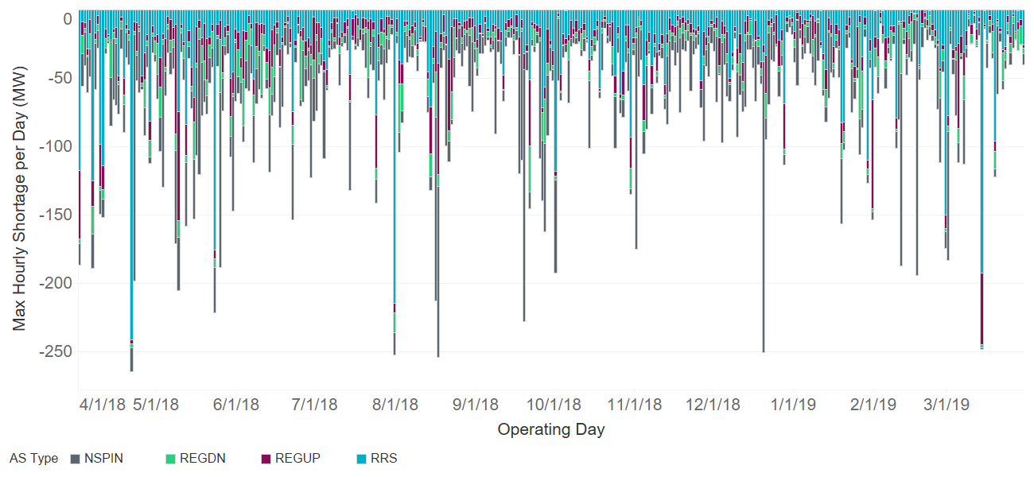
Real-Time Max Hourly AS Shortage
How to read graph:
Each bar is a single day, where the max shortage per AS type is stacked
Each AS type max shortage could come from a different hour in the day
Surpluses within the same AS hour are not included

Slide 7
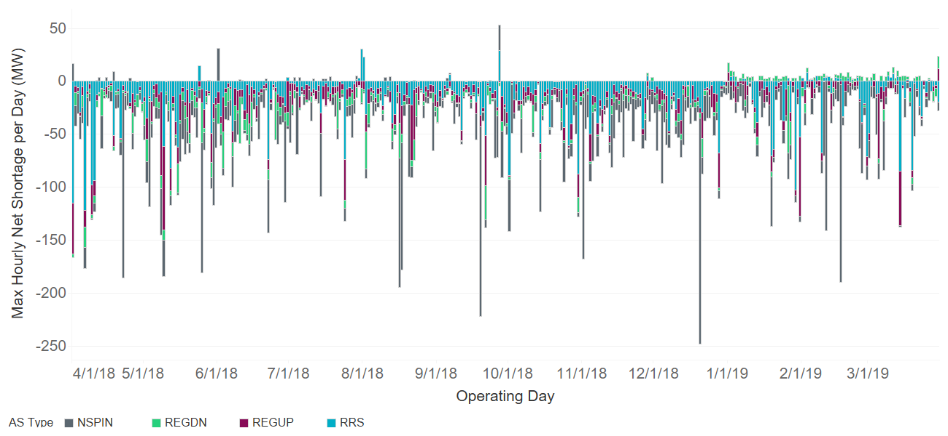
Real-Time Max Hourly Net AS Shortage
How to read graph:
Each bar is a single day, where the max shortage per AS type is stacked
Each AS type max shortage could come from a different hour in the day
Surpluses within the same AS hour are included

Slide 8
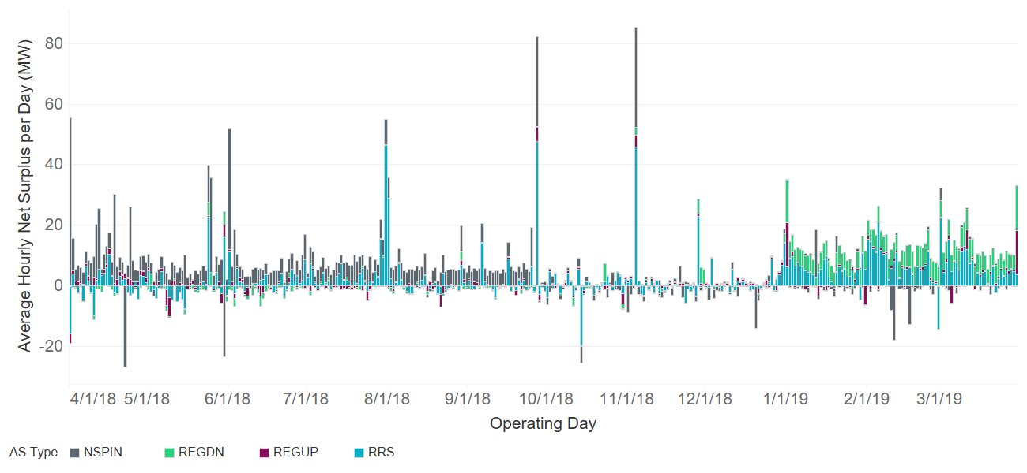
Real-Time Average Hourly AS Shortage
How to read graph:
Each bar is a single day, where the average shortage/surplus per AS type is stacked
Surpluses within the same AS hour are included

Slide 9
Common Reasons for Real-Time AS Shortages
Some common reasons for the AS Shortages we noticed were
QSE to QSE AS trade not submitted
Telemetry errors such as incorrect responsibilities
Incorrectly moving AS over the top of the hour or intra-hour
Outage in which QSE is unable to move AS in time
SASM executed but AS can’t be procured for first couple of hours
Incorrect resource status codes
As a follow up ERCOT has sent 20+ Request For Information (RFIs) on April 4th to QSEs with Real-Time AS shortages greater than 10 MW for 3 consecutive SCED intervals

Slide 10
Summary
QSEs should ensure Resource Real-Time AS Responsibility and correct Resource Status Codes are telemetered according to Nodal Protocols Section 6.3.2 Activities for Real-Time Operations
Communicate to ERCOT Resource changes to Ancillary Service Resource Responsibility via telemetry in the time window beginning 30 seconds prior to the five-minute clock interval and ending ten seconds prior to that five minute clock interval
QSEs should ensure AS trades are properly submitted, even when moving AS between two QSEs related to the same Counterparty
ERCOT will continue monitor Real-Time AS Shortages and will send out RFIs each month on an as needed basis

Slide 11
Appendix

Slide 12
Resource Status Codes for Providing AS
ERCOT EMS and SCED require both correct telemetered responsibilities and resource status code to properly deploy AS in Real-Time
Resource status codes per AS type:
Regulation Up: ONREG, ONOSREG, ONDSRREG, ONOPTOUT, ONRGL, FRRSUP
Regulation Down: ONREG, ONOSREG, ONDSRREG, ONOPTOUT, ONRGL, FRRSDN
Responsive Reserve Service: ONRUC, ONREG, ON, ONDSR, ONOSREG, ONDSRREG, ONEMR, ONRR, ONOPTOUT, ONRGL, ONCLR, ONRL
Non-Spin Reserve Service: ONRUC, ONREG, ON, ONDSR, ONOS, ONOSREG, ONDSRREG, ONEMR, OFFNS, OFFQS, ONOPTOUT, ONRGL, ONCLR
Note: Non-Spin can be in STARTUP or SHUTDOWN when being deployed
Notes:
Resource status codes are specified in implementation for providing AS in order to mitigate gross telemetry issues when the telemetered AS responsibility may not be correct.

