Slide 1
Resource Integration & On-going Operations Project Workshop
29 April 2019

Slide 2
Recap of Aug 30, 2017 Workshop
ERCOT presented possible changes that are being considered but not being proposed at this time
  Little or no debate during workshop
  Asked that comments be sent to jteixeira@ercot.com
Planning Guide changes PGRR52, PGRR54, NPRR809
Demo of GINR application under development
Discussion of RARF Replacement project

Slide 3




RIOO – Resource Services
RIOO - Resource Services (RS) project update
RARF Hub data analysis almost complete;
39 of 48 data tables analyzed.
New Oracle database being designed.
Effort to repair data for new database
starting in May.
Wireframe development effort trending
well.

Slide 4
RARF process
RE submits RARF
Manual checks performed by ERCOT
If acceptable processed through the ETL tool
RARF placed in RARF stage
Delta report run to identify differences between previous RARF
Audit report created to check for errors
Approved RARF replaces previous RARF in HUB
Data checked prior to loading to NMMS
If needed corrections made.
Data loaded to NMMS

Slide 5
Data Issues Identified
Special characters – can address via validation
Connectivity data
Why?
  Corrections made prior to next step
Recent RRGRs approved (016, 018, & 019)

Slide 6
Data Repair Plan Options
Issue requests for information (RFIs)
Request RARF resubmissions
Use NMMS data to repair incorrect data
  Complicated but doable
  Not all RARF data is in NMMS
ERCOT repairs data, notifies RE, and RE validates during market trials

Slide 7
RIOO – Resource Services Project
Wireframes in Progress

Slide 8
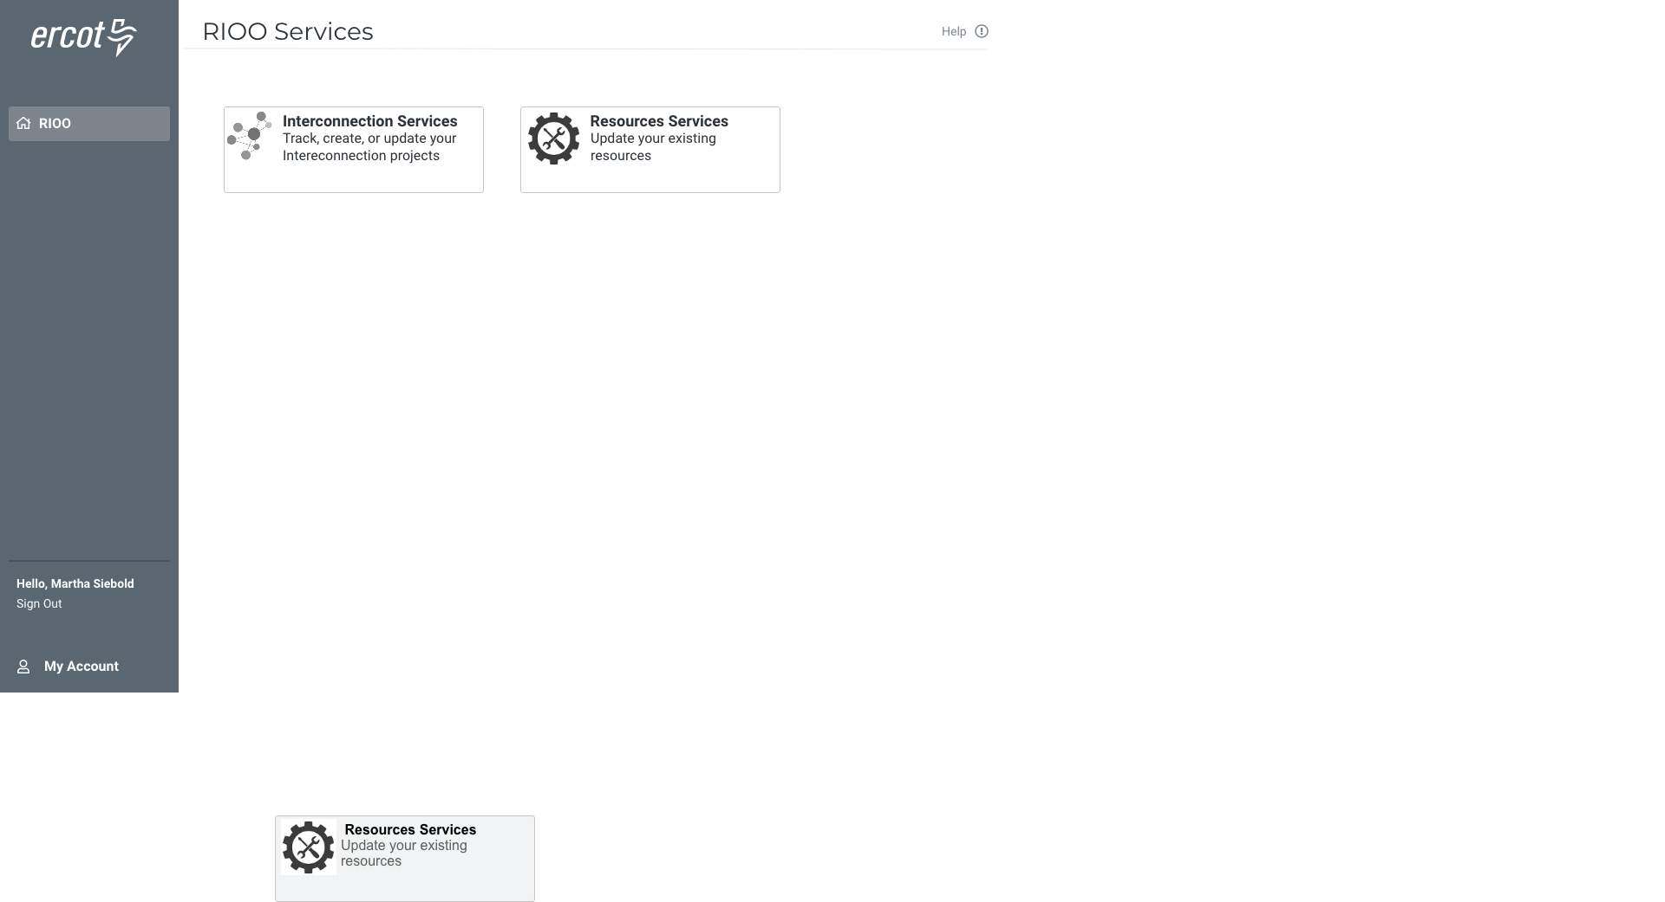

Slide 9
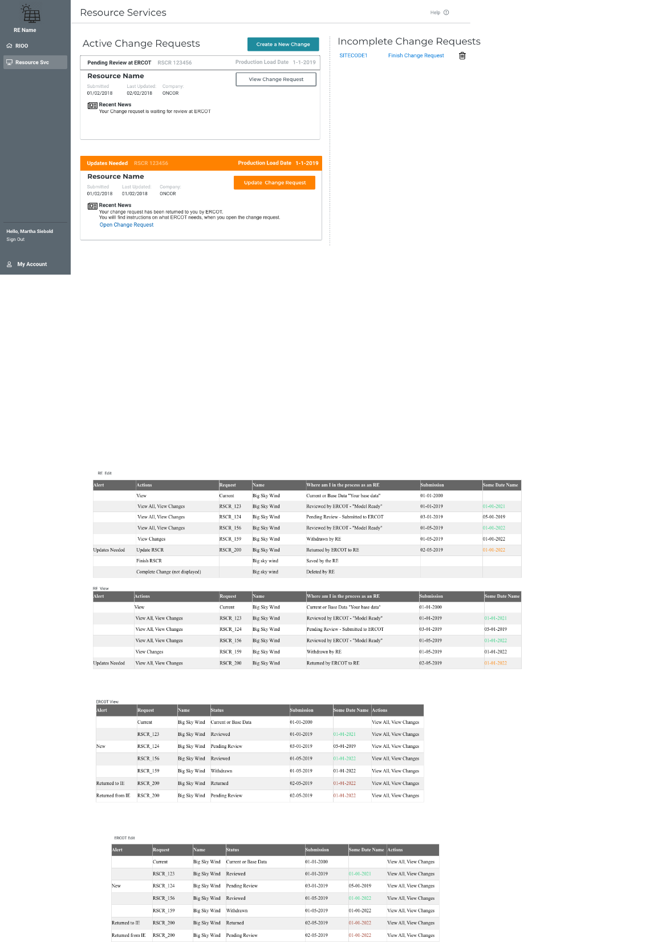

Slide 10
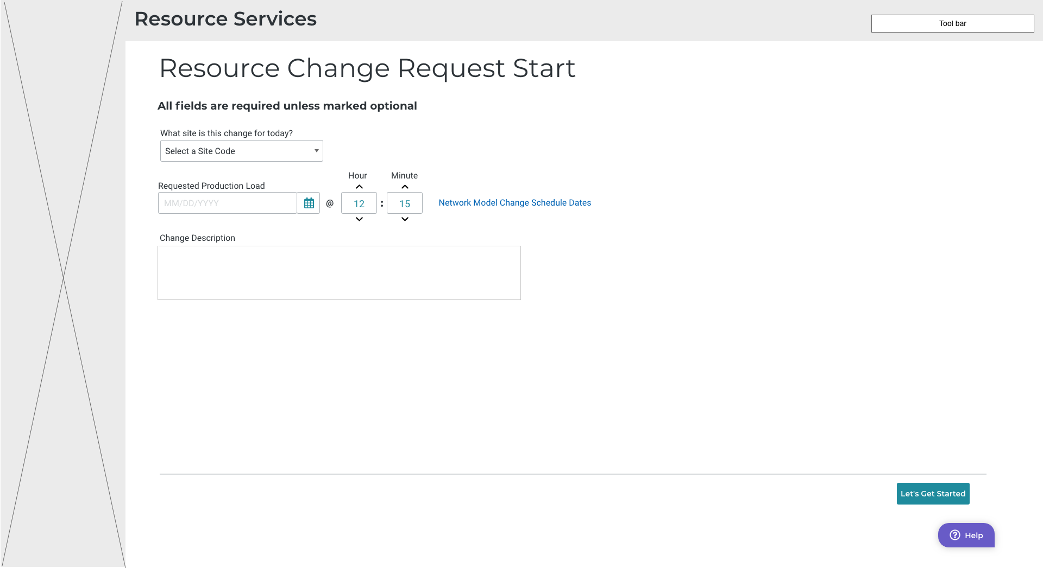

Slide 11
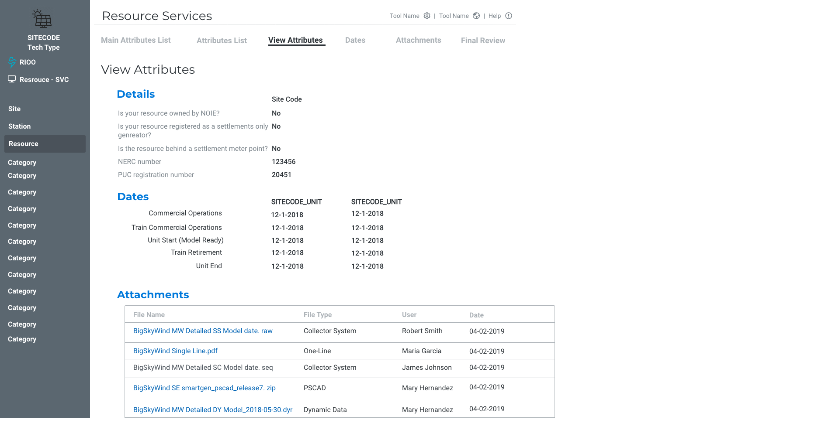

Slide 12
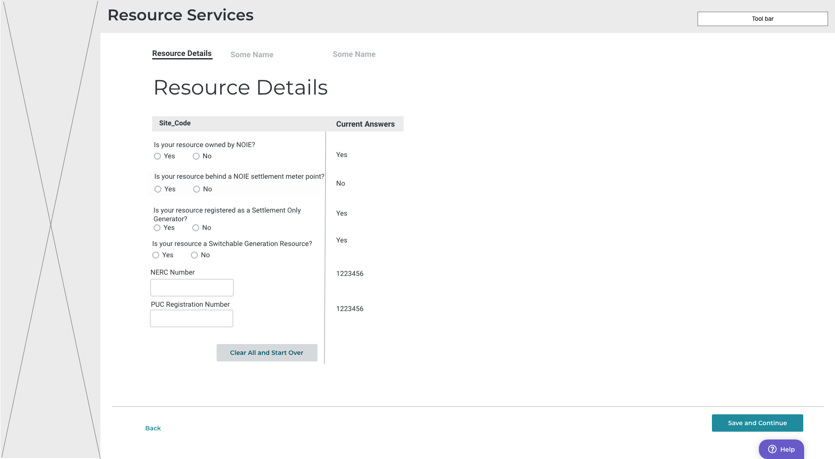

Slide 13
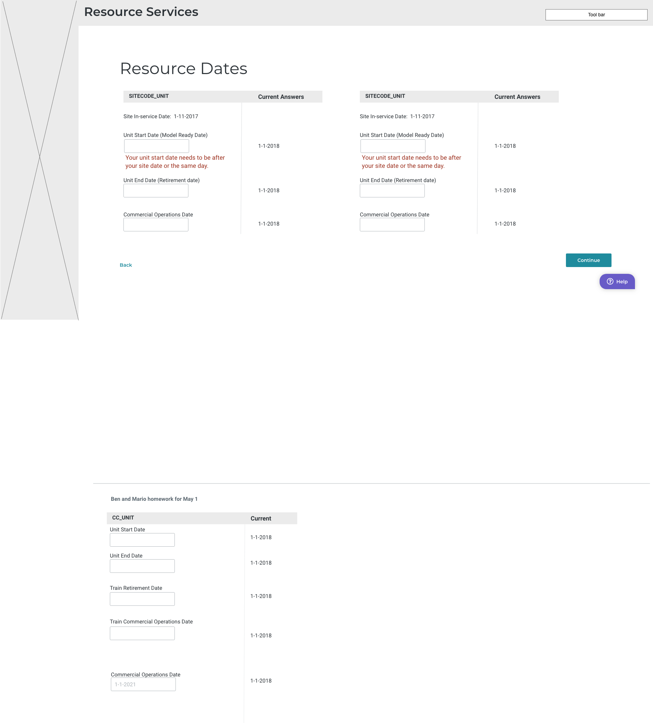

Slide 14
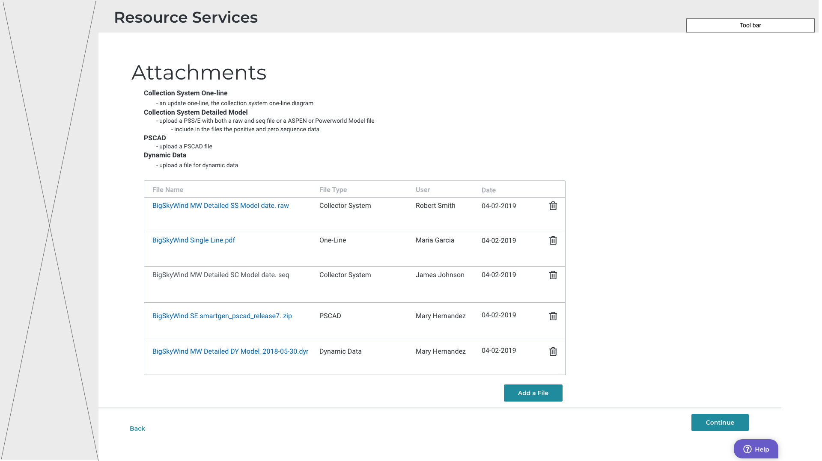

Slide 15
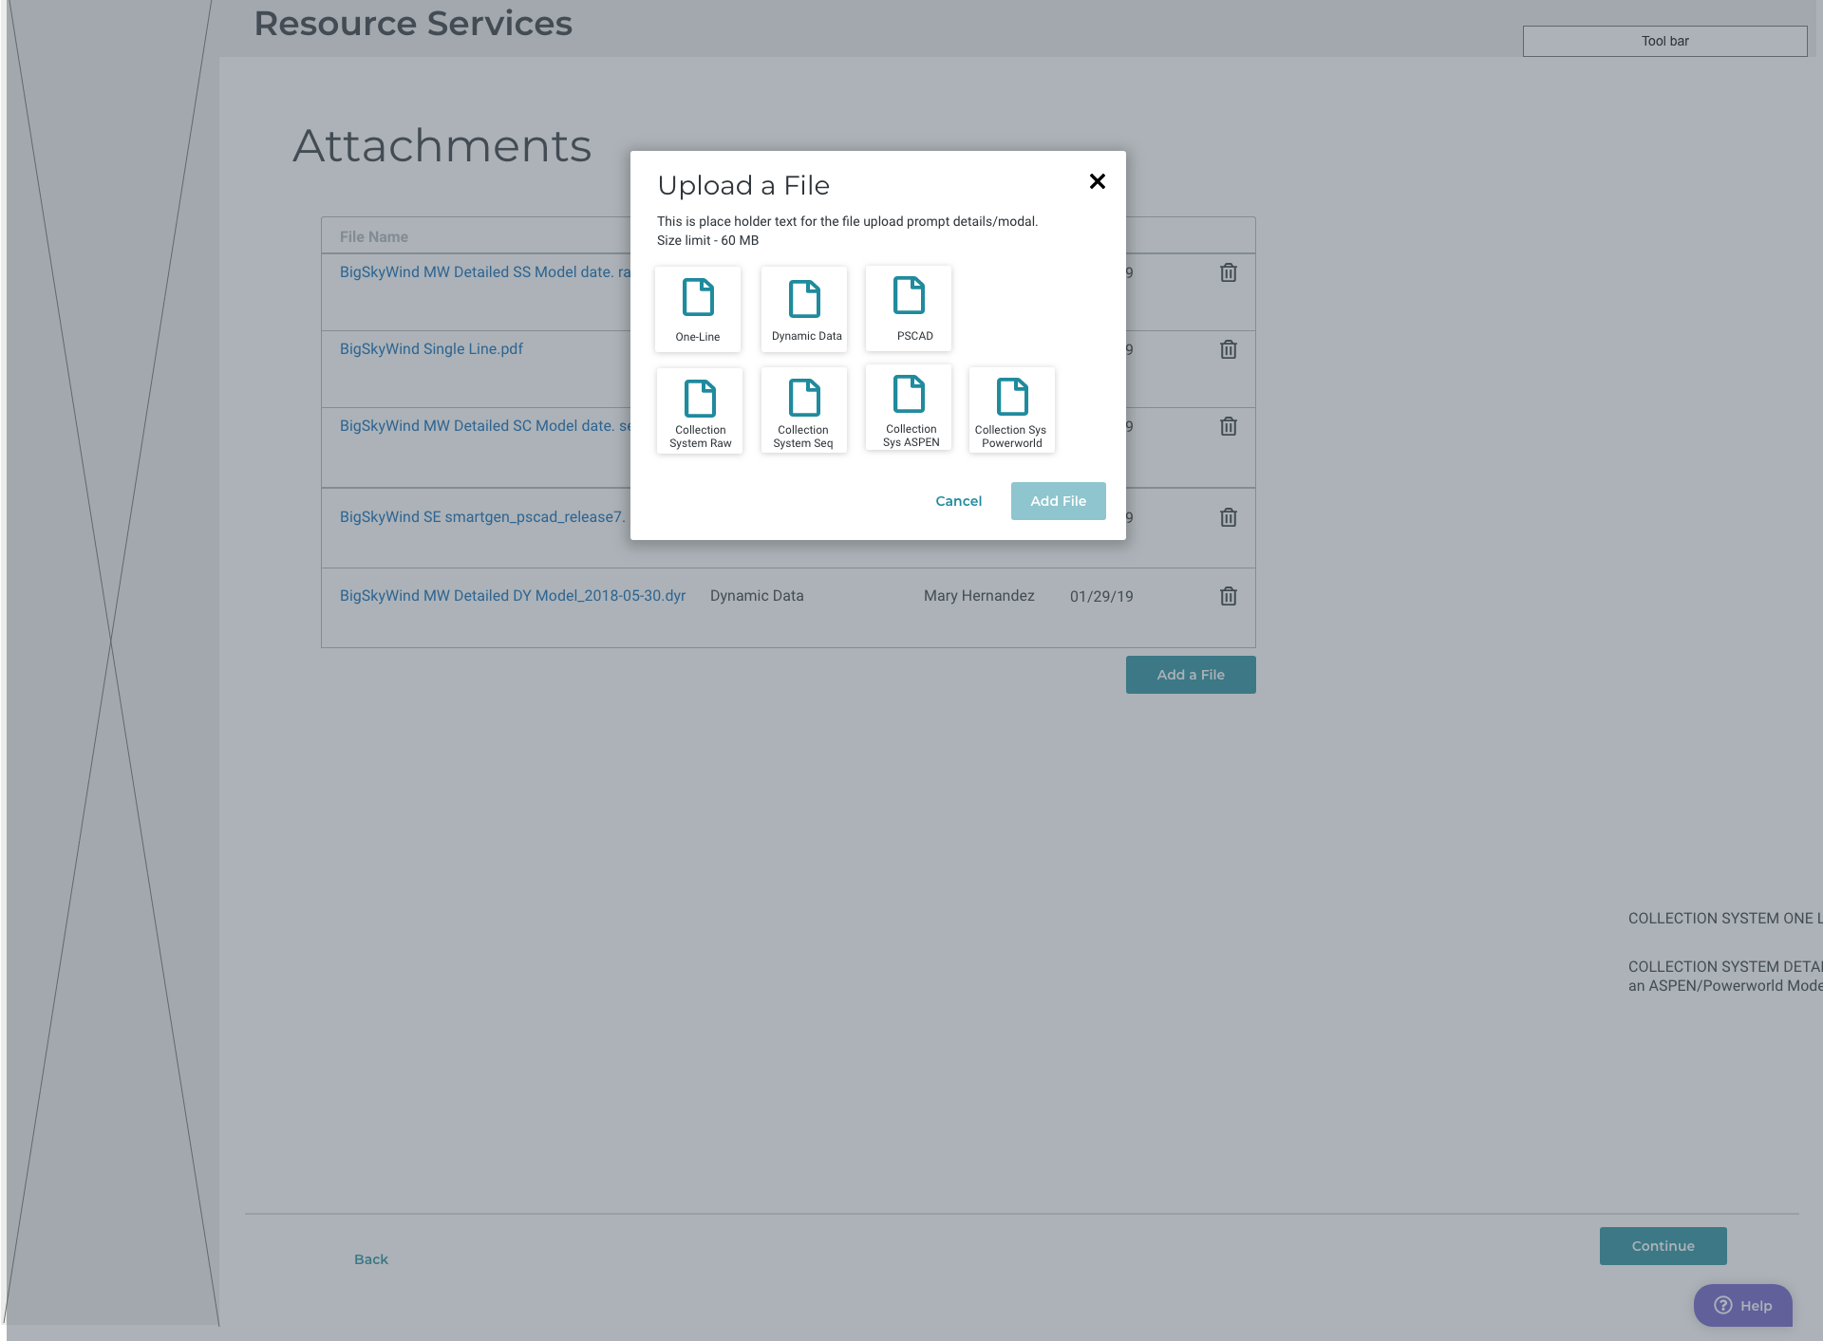

Slide 16
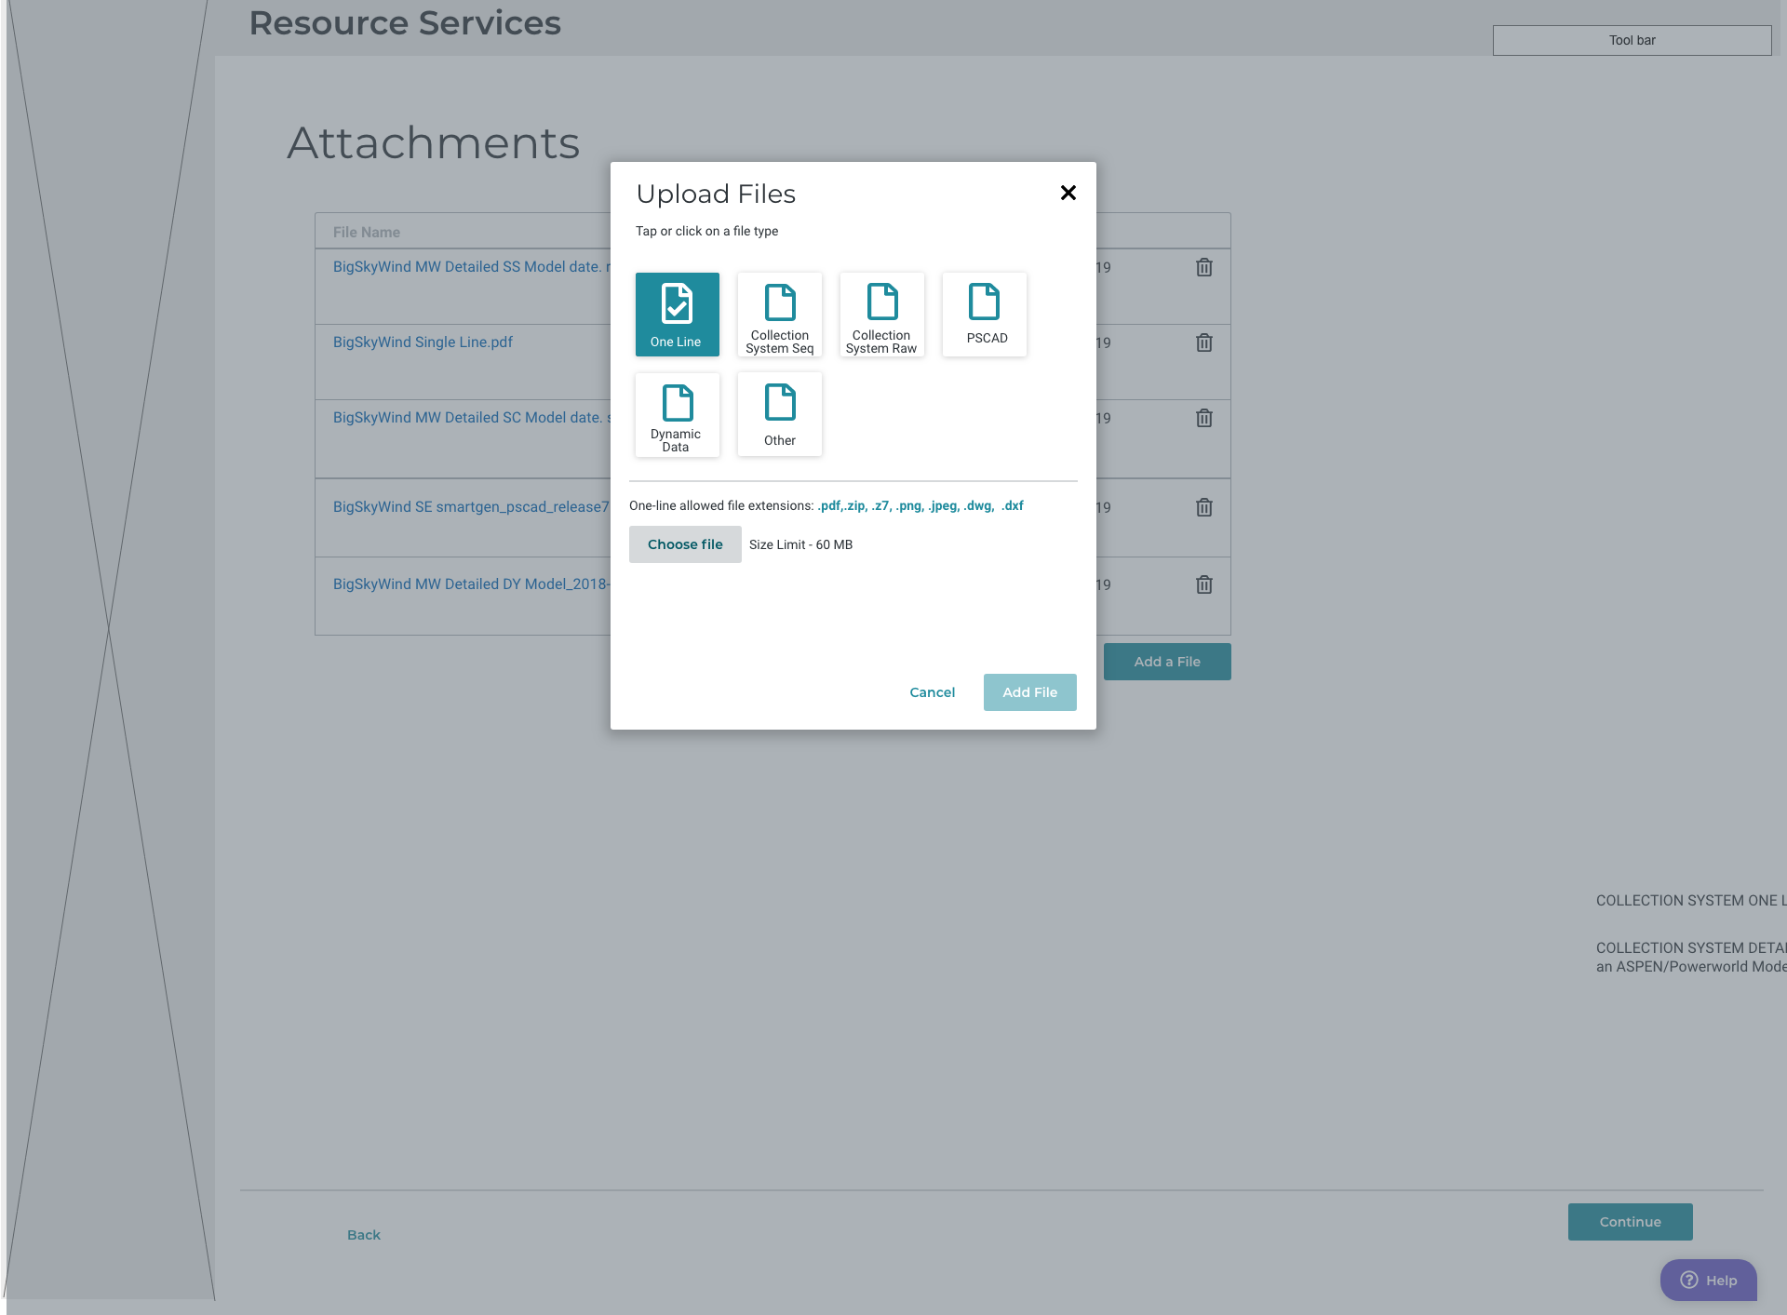

Slide 17
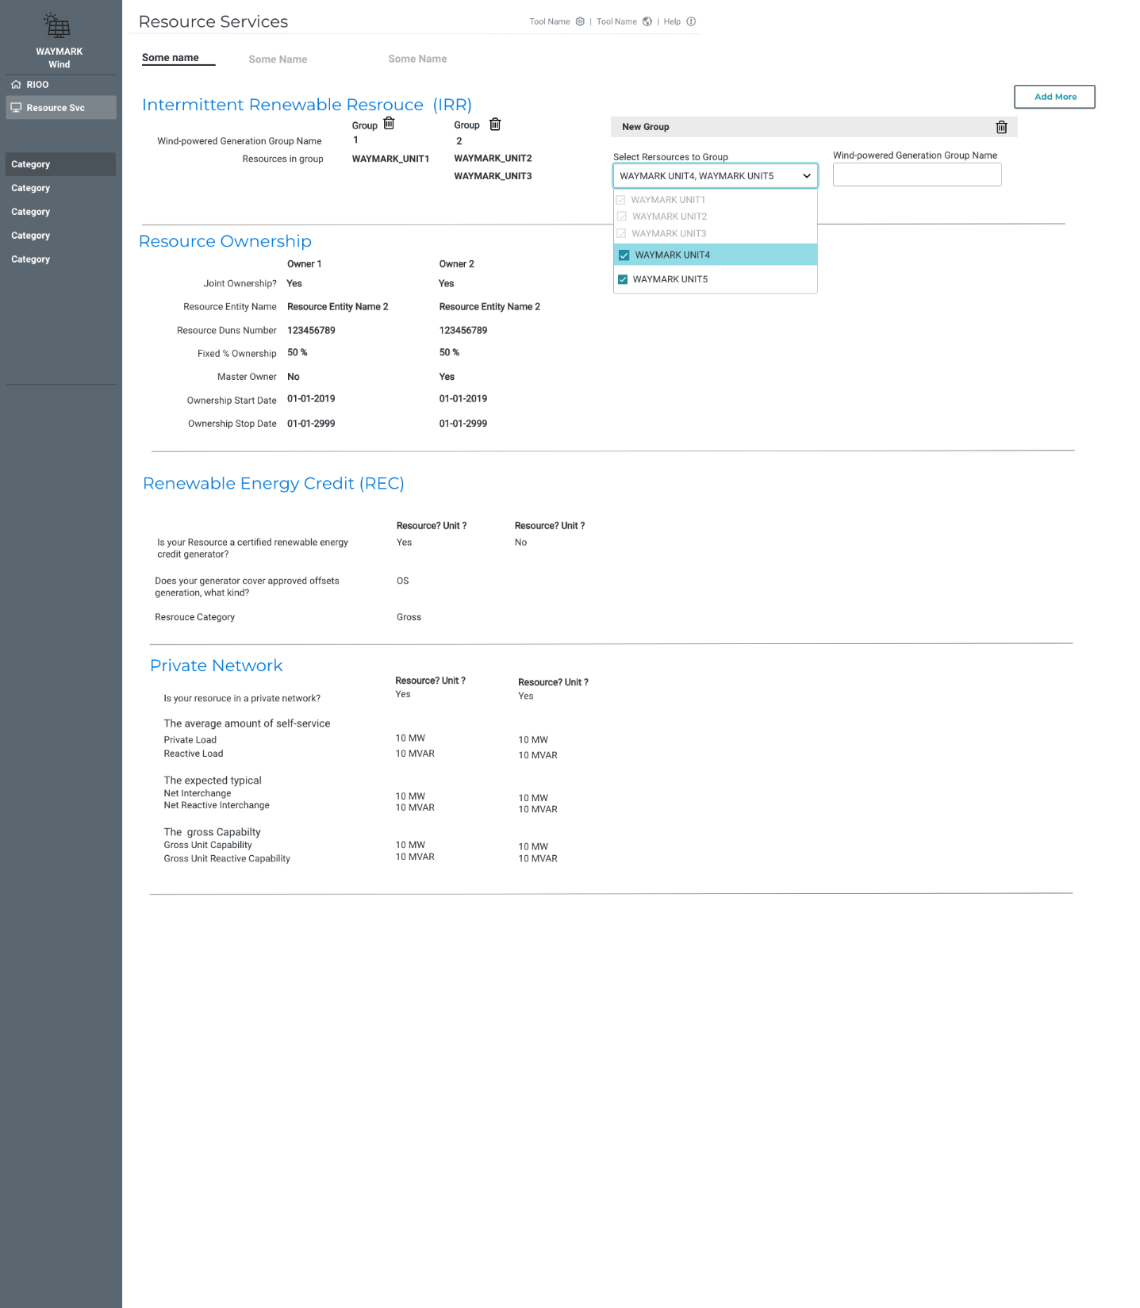

Slide 18
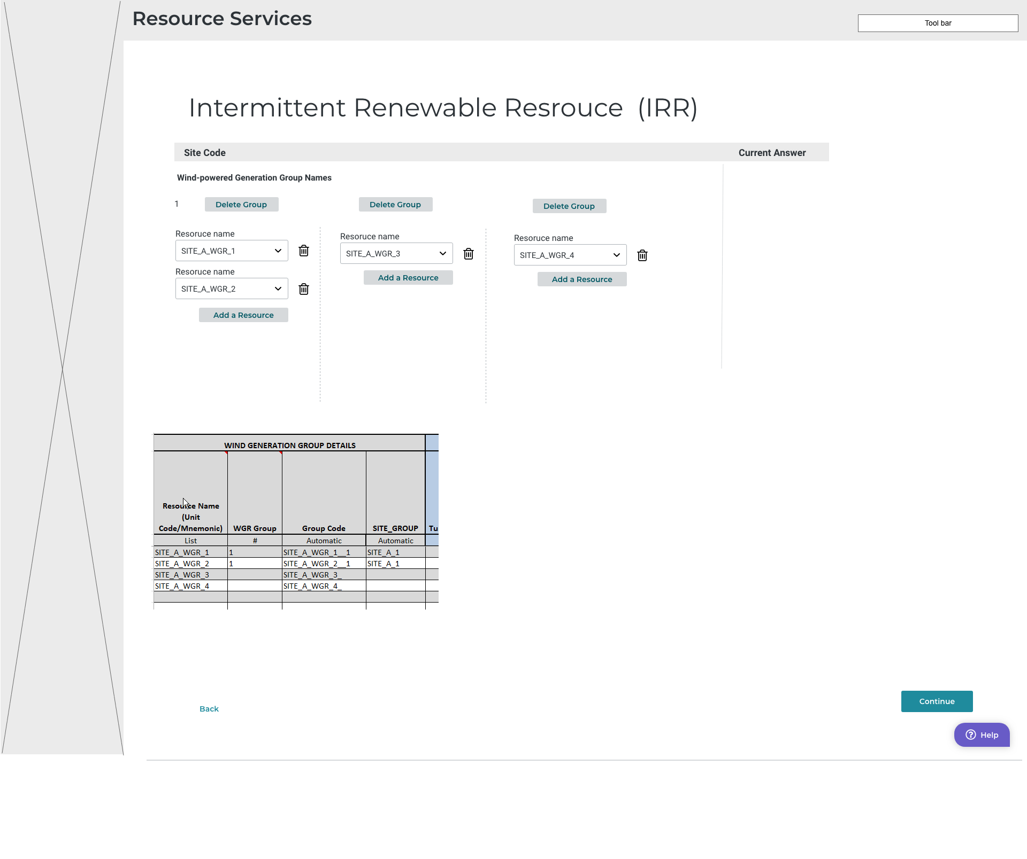

Slide 19
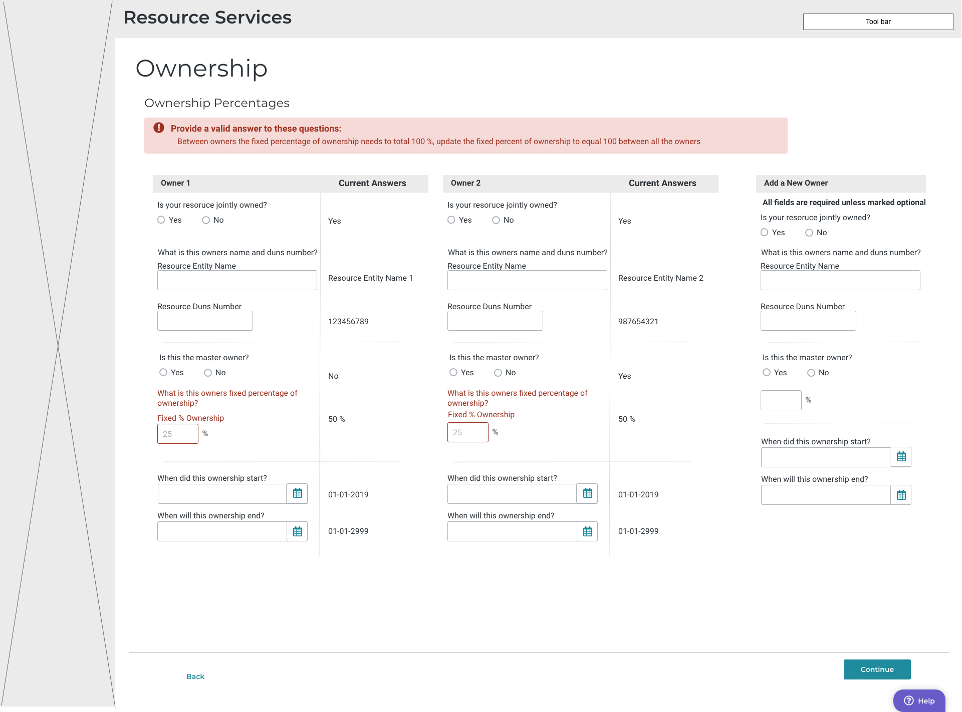

Slide 20
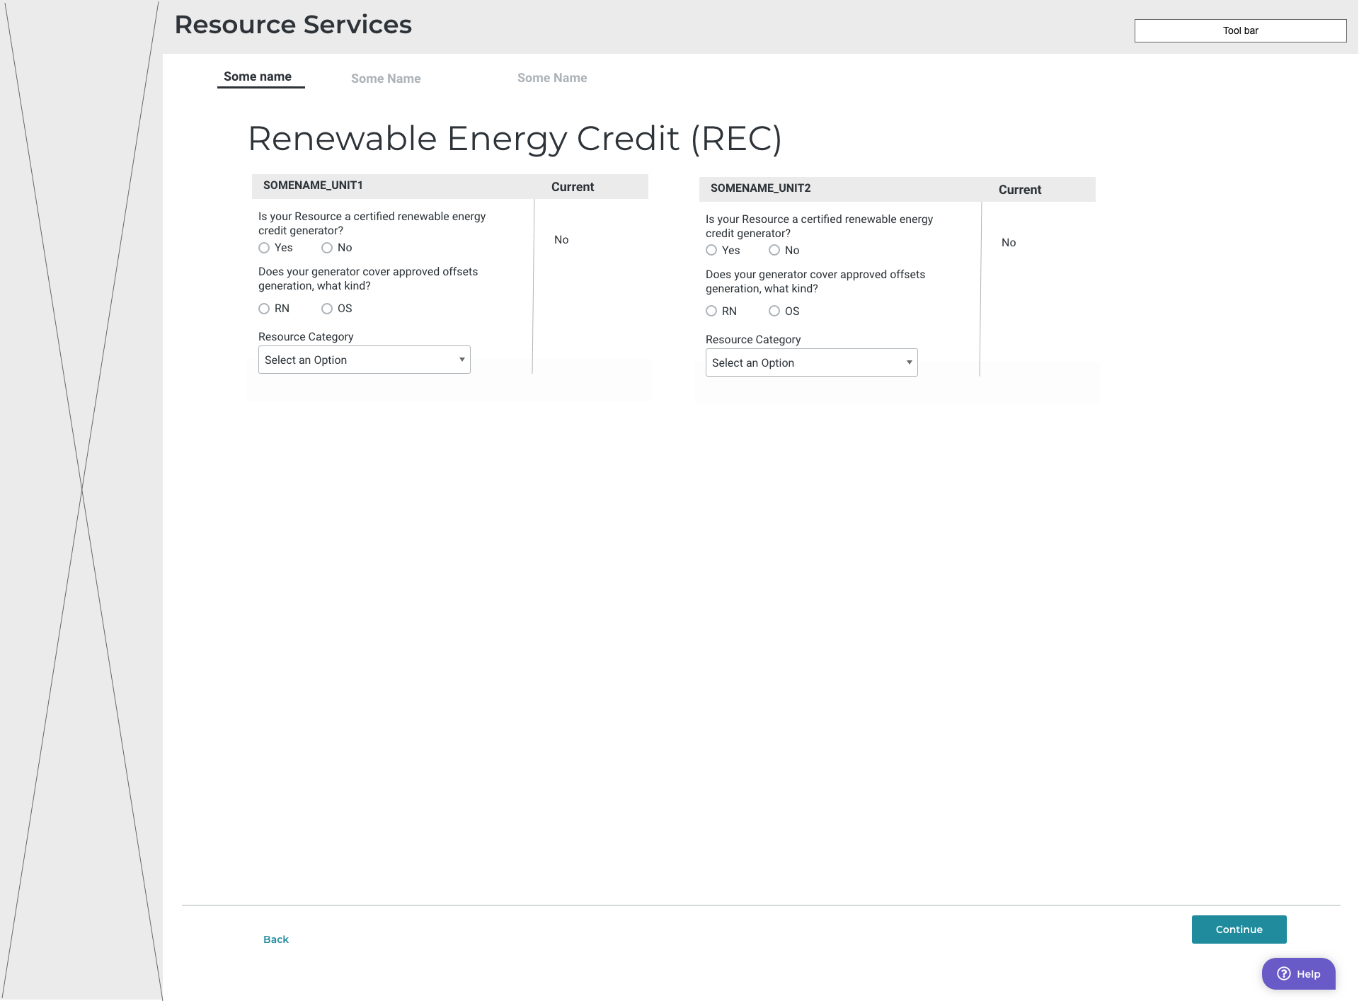

Slide 21
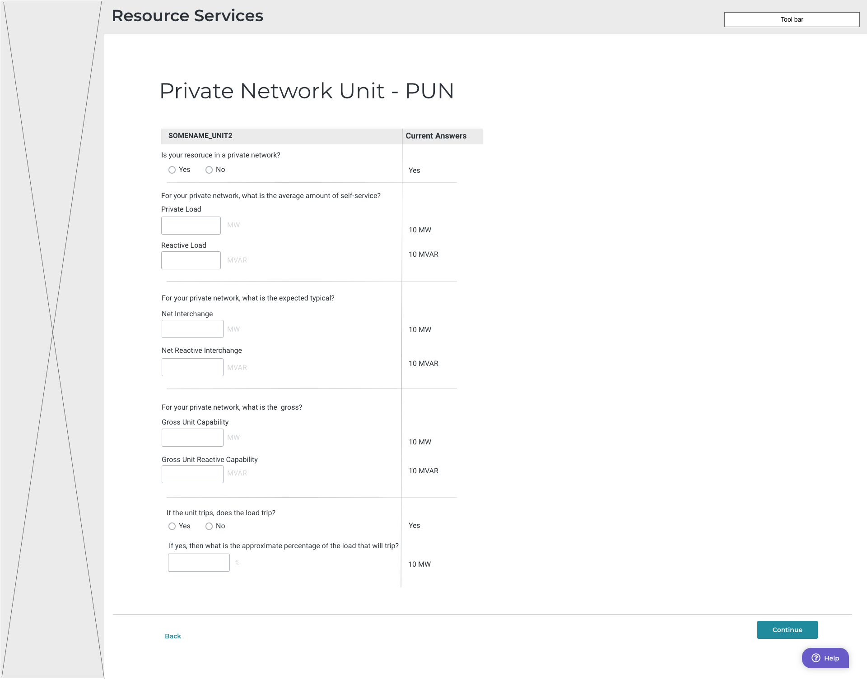

Slide 22
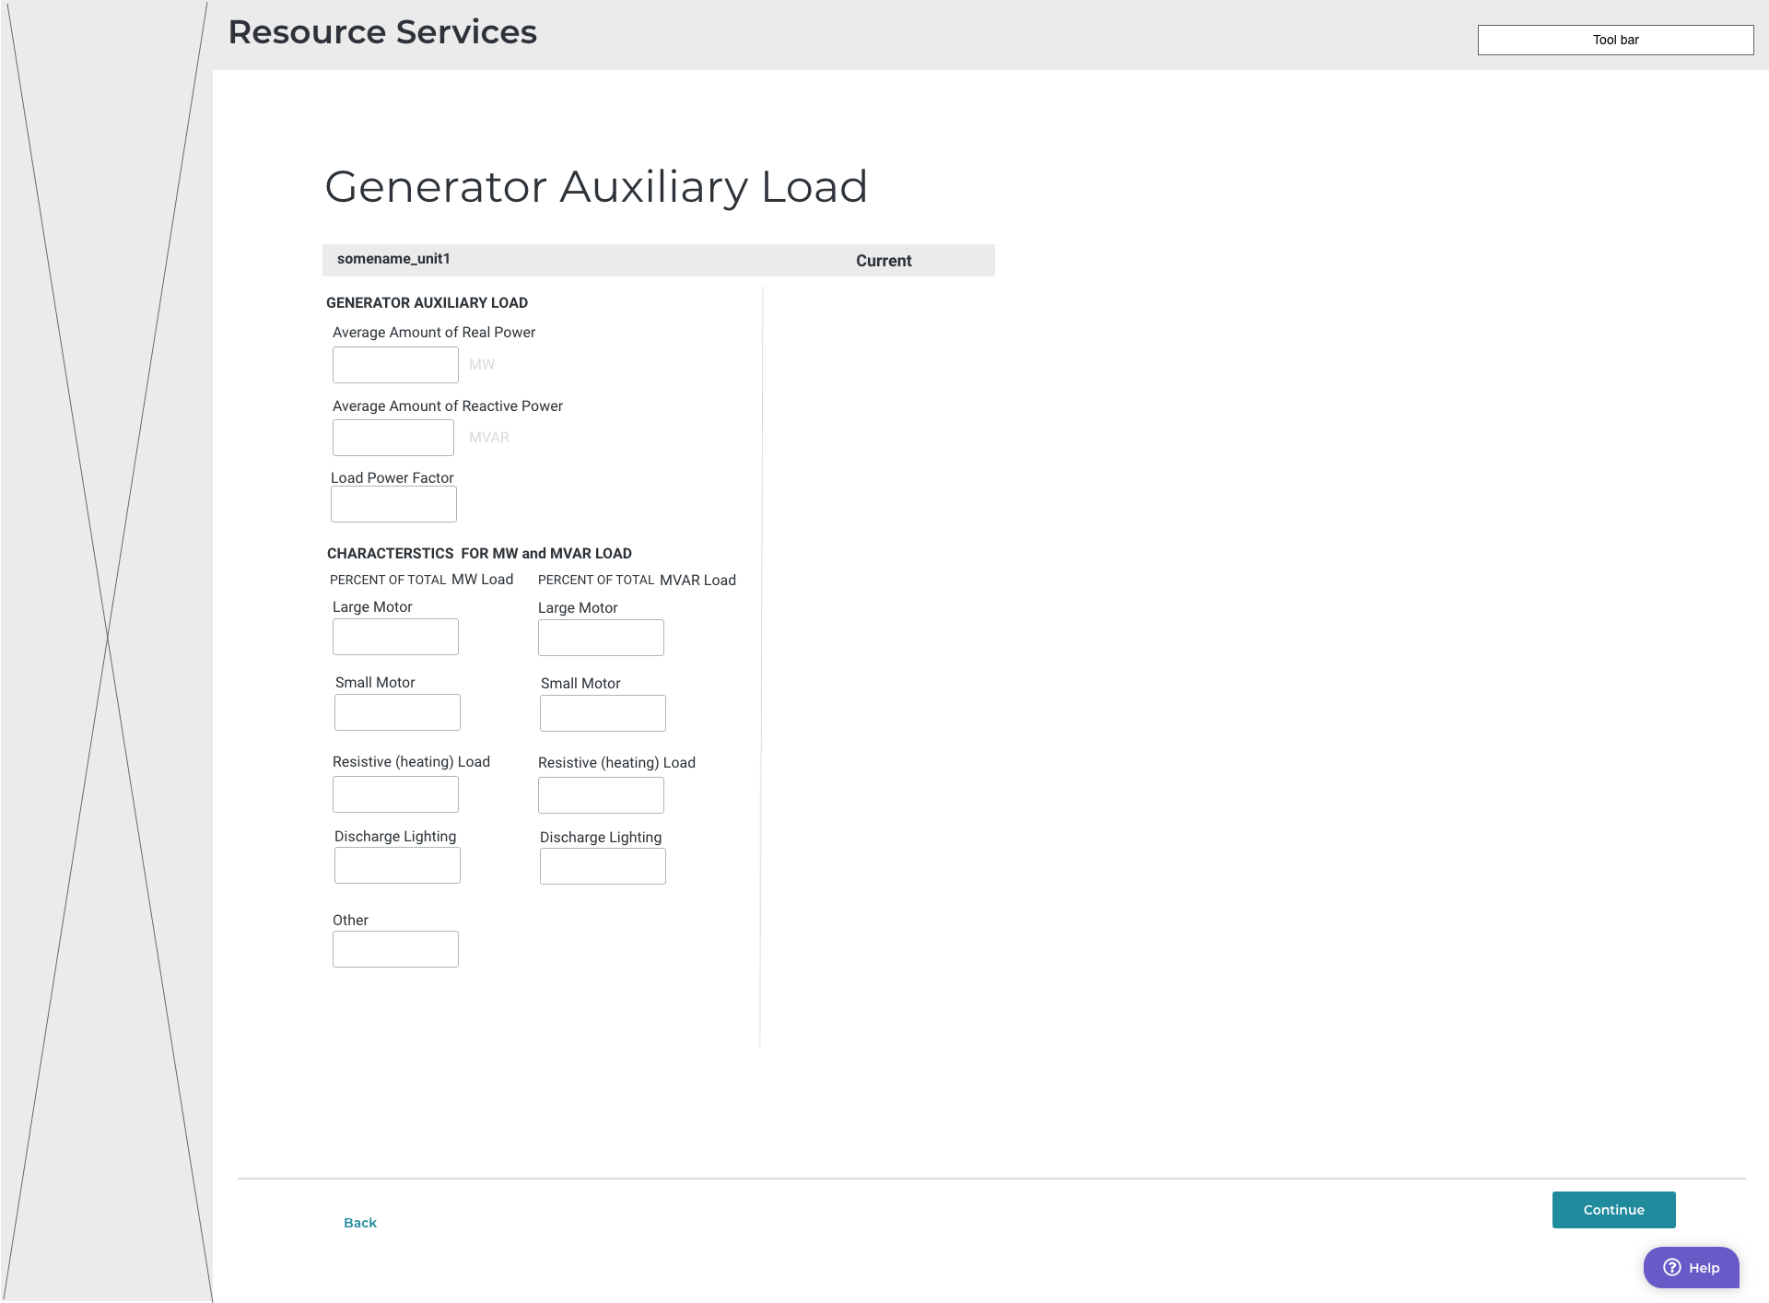

Slide 23
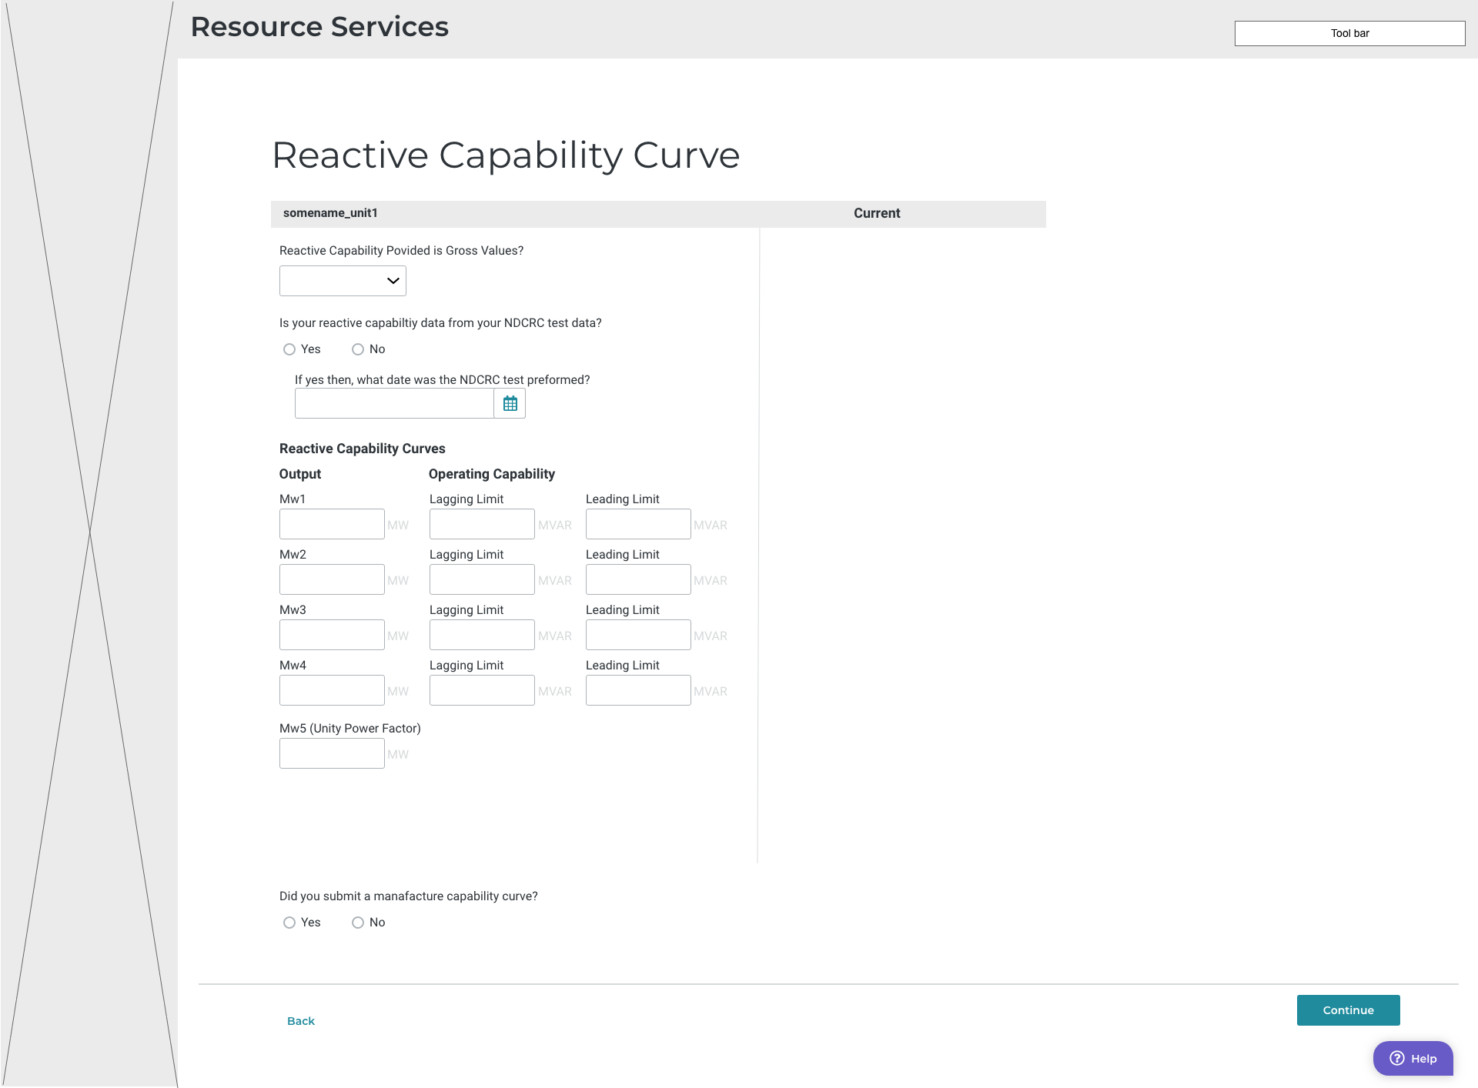

Slide 24

Q&A

