Slide 1
Resource Limit Calculator Under RTC
Nitika Mago
ERCOT Operations
April 30, 2019

Slide 2
Problem Statement
Identify changes, if any, required to Resource Limit Calculator (RLC) under RTC.
Discussion Outline
RLC functional overview
Summary of changes identified and rationale
Discussion and next steps

Slide 3
RLC Overview
Resource Limit Calculator
SCED BP/LMP Data To QSE via SCADA/ICCP
Telemetry from QSE via SCADA/ICCP
Ancillary Service Calcs.
ex. HASL, LASL
Calculated and telemetered Data To MMS/SCED
Dispatch Data from MMS
Resource Limit Calcs.
ex. SURAMP, SDRAMP, HDL, LDL
GTBD Calculation
Includes PLDRR, PWRR
Data For Settlements
Operator Initiated Data
Other Calcs./Stuff
Ex. SCED Trigger following RRS release
Data For Reports and Compliance
Nodal Protocol Section 6.5.7.2 drives the calculations and monitoring built into RLC today.
RLC uses telemetry from QSEs to compute limits such as HDL, LDL, HASL and LASL. These limits are then sent to MMS/SCED.
RLC receives dispatch data from MMS and sends the same to QSEs.
RLC also hosts calculations related to Generation To Be Dispatched (GTBD), including Predicted Load Ramp Rate (PLDRR) and Predicted Wind Ramp Rate (PWRR).

Slide 4
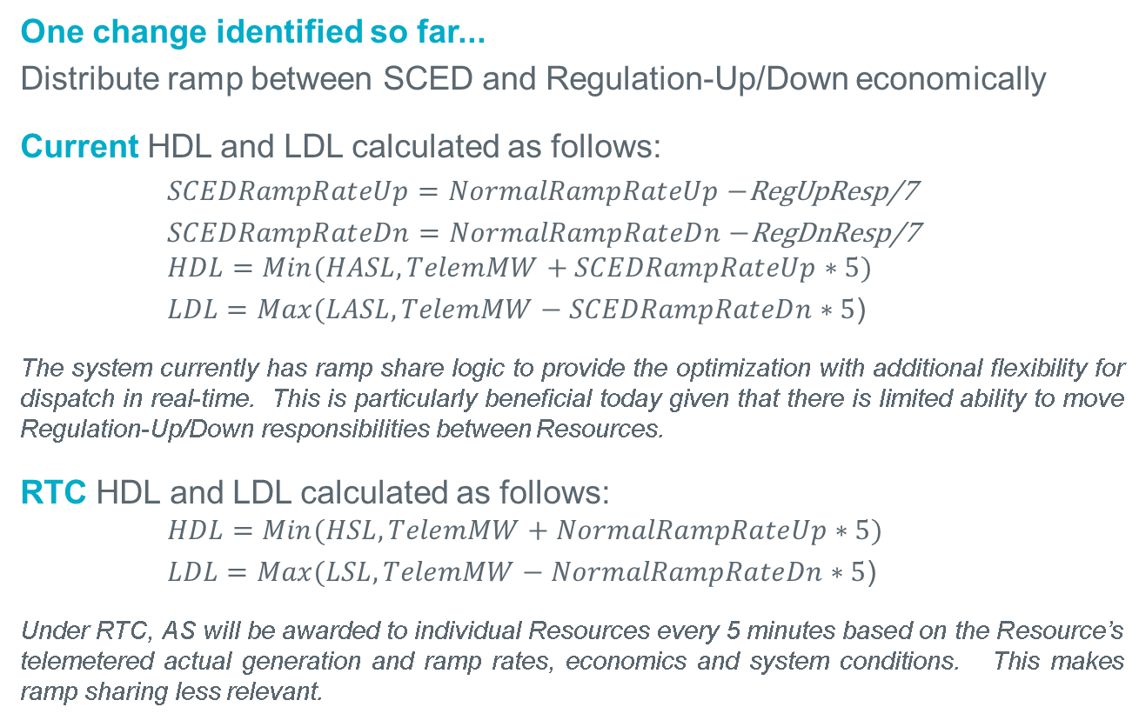
Ramp Share Logic Changes
One change identified so far...
Distribute ramp between SCED and Regulation-Up/Down economically
Current HDL and LDL calculated as follows:
$SCEDRampRateUp=NormalRampRateUp−$RegUpResp/7
$SCEDRampRateDn=NormalRampRateDn−$RegDnResp/7
$$HDL=Min(HASL,TelemMW+SCEDRampRateUp∗5)$$
$LDL=Max(LASL,TelemMW−SCEDRampRateDn∗5$)
The system currently has ramp share logic to provide the optimization with additional flexibility for dispatch in real-time. This is particularly beneficial today given that there is limited ability to move Regulation-Up/Down responsibilities between Resources.
RTC HDL and LDL calculated as follows:
$$HDL=Min(HSL,TelemMW+NormalRampRateUp∗5)$$
$LDL=Max(LSL,TelemMW−NormalRampRateDn∗5$)
Under RTC, AS will be awarded to individual Resources every 5 minutes based on the Resource’s telemetered actual generation and ramp rates, economics and system conditions. This makes ramp sharing less relevant.

Slide 5
Questions

