Slide 1
Market Credit Working Group update to the Wholesale Market Subcommittee
Bill Barnes NRG, Chair
Josephine Wan Austin Energy, Vice Chair
05/01/2019

Slide 2
MCWG update to WMS
General Update
April 18th Joint MCWG/CWG Meeting
3 NPRRS reviewed for their credit impacts
917NPRR Nodal Pricing for Settlement Only Distribution Generators (SODGs) and Settlement Only Transmission Generators (SOTGs)
926NPRR Removal of 90-Day Period Between SSR Study Approval and Synchronization
929NPRR PTP Obligations with Links to an Option DAM Award Eligibility
All operational and without any credit impact. Discussion on settlement changes and impact to credit.

Slide 3
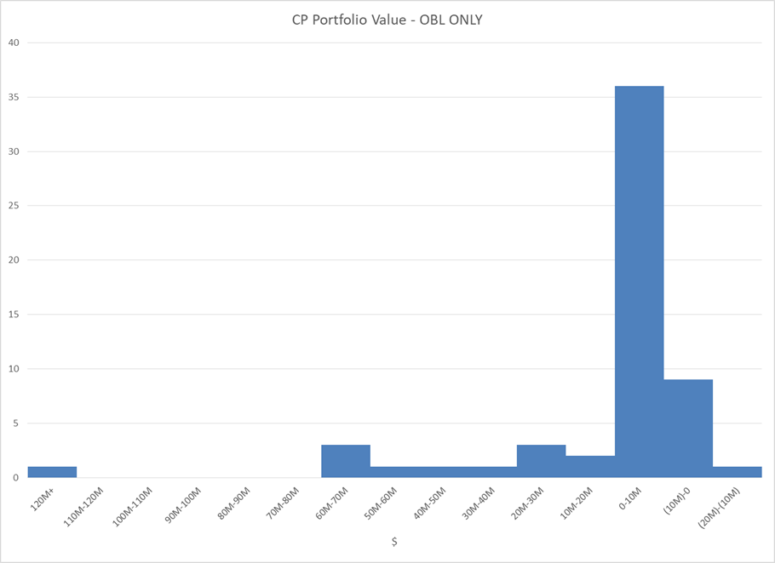
MCWG update to WMS
Review of ERCOT CRR Portfolio Valuation
Assess the risk of a large CRR portfolio default
Dollars

Slide 4
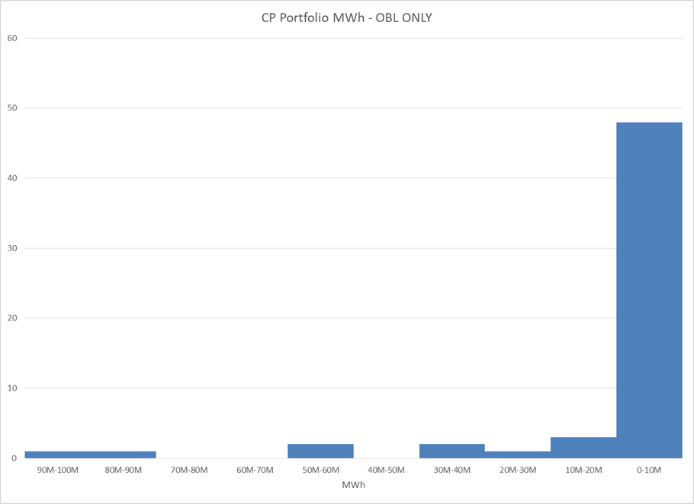
MCWG update to WMS
Review of ERCOT CRR Portfolio Valuation
Assess the risk of a large CRR portfolio default
MWh

Slide 5
MCWG update to WMS
CRR Portfolio Disposal Discussion
Modify existing one-time auction
Allow negative bidding
Allow “percentage slices” to be purchased
Liquidate in next Long Term Auction or Monthly Auction Sequence
Allows for more competitive solution
Could distort outcomes if portfolio is large
No auction, liquidate all rights in DAM
Most competitive result
Drags out default over very long time (up to 3 yrs)

Slide 6
MCWG update to WMS
Market Entry Qualifications Rules & Process
ERCOT legal informed the group that they do not see issues with reviewing current market entry qualifications.

Slide 7
MCWG update to WMS
ERCOT Credit Exposure Updates
Market-wide average TPE increased from $263.8 million to $298.5 million
The increase in TPE is due to higher prices in early March
Discretionary Collateral is defined as Secured Collateral in excess of TPE,CRR Locked ACL and DAM Exposure.
Average Discretionary Collateral decreased from $ 1,034.8 million to $926.7 million
The decrease in Discretionary Collateral is largely due to decrease in Secured Collateral
Number of active Counter-Parties increased from 233 to 237
No unusual collateral call activity

Slide 8
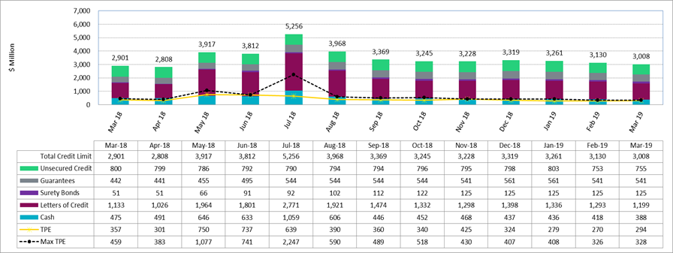
MCWG update to WMS

Slide 9
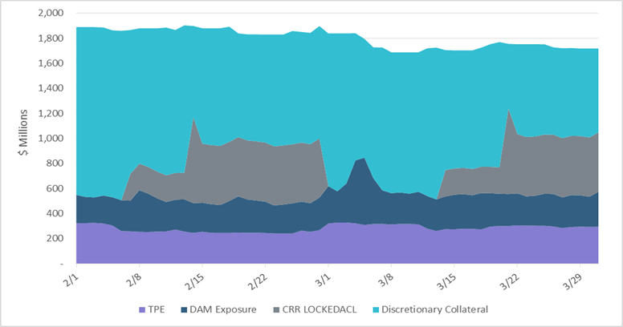
MCWG update to WMS

Slide 10
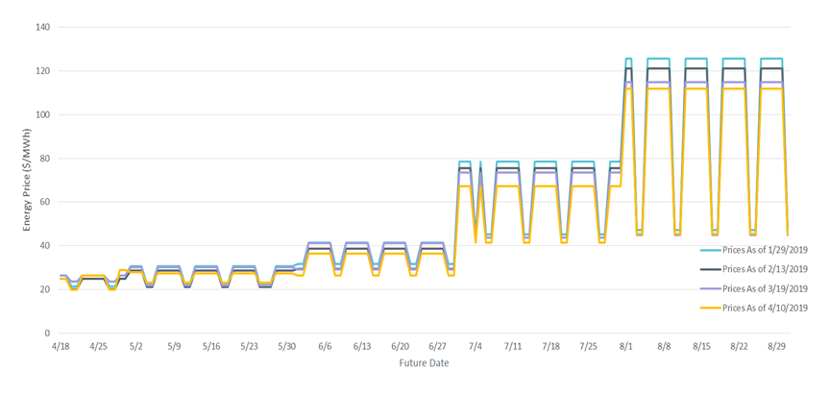
MCWG update to WMS

