Slide 1
PUC Project 46304 Directive 8 - Voltage Support Service
Freddy Garcia
Operations Planning

Slide 2
PUC Project 46304 Order, Directive 8
“ERCOT shall (a) study and determine whether Southern Cross Transmission or any other entity scheduling flows across the Southern Cross DC tie should be required to provide or procure voltage support service or primary frequency response, or their technical equivalents, (b) implement any necessary revisions to its standards, guides, systems, and protocols, as appropriate, and (c) certify to the Commission when it has completed these actions.”
PFR component resolved by ERCOT Board in August 2018.
VSS component of directive essentially requires determination as to whether Southern Cross Transmission LLC (SCT) should be required to provide reactive power capability to facilitate imports and exports over that DC Tie, or whether those voltage support needs should instead be satisfied by TSPs, by default.
This question should be considered in context of policy for other potential new DC Ties.
Because question involves equity and market design considerations, ERCOT will be seeking stakeholder guidance on the determination.

Slide 3
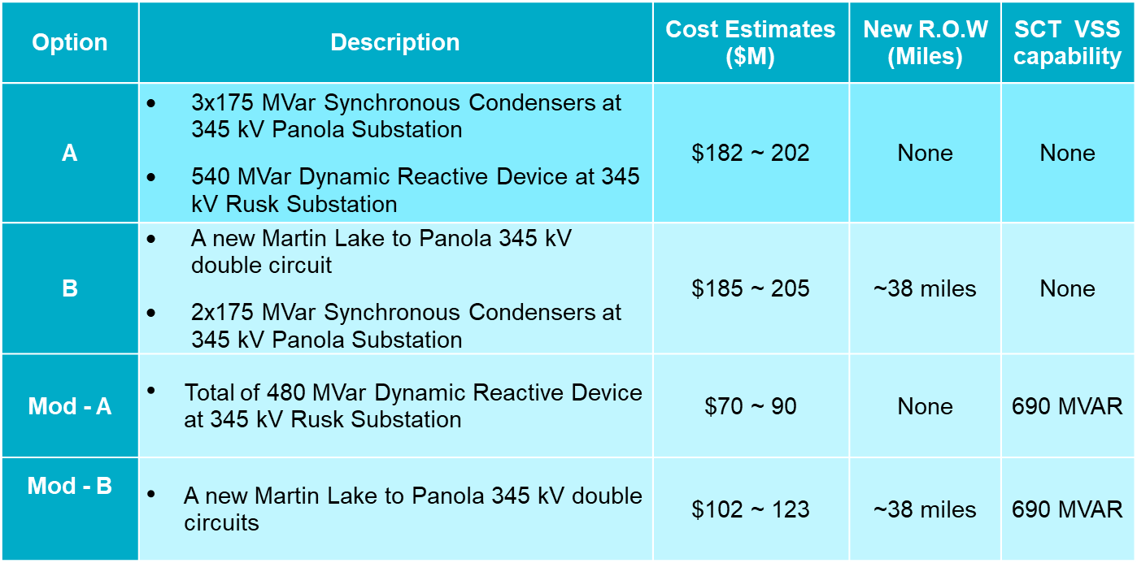
Southern Cross Transmission – Planning Study Results
ERCOT Directive 6 studies identified reactive needs associated with SCT DC Tie; identified two upgrade options and two modified options with SCT providing ~0.95 power factor reactive capability (see March 2019 RPG meeting materials: http://www.ercot.com/calendar/2019/3/12/165277-RPG)
Notes:
Summer Peak 350 MW Import
HWLL 2100 MW Export

Slide 4
SCT Transfer Limits Without Upgrades
SCT Transfer Limits⁽³⁾ |  | Assessment | Violation
Direction | Flow MW |  | Type | Contingency
Import to ERCOT | 547 | Steady State/Dynamics | Thermal Overload ⁽¹⁾ | NERC P7
Export from ERCOT | 1289 | Steady State/Dynamics | Voltage Collapse ⁽²⁾ | NERC P7
Based on 2% Power Transfer Distribution Factor (PTDF) and Outage Transfer Distribution Factor (OTDF) cutoffs
Voltage Collapse is assumed at 0.80 p.u. voltage
For this transfer limit analysis, generation re-dispatch was not attempted to solve the identified thermal overload.

Slide 5
Quantity of VSS Required
If DC Tie owners must provide voltage support, then the quantity of VSS to be provided would also need to be defined.
Possible options:
Static obligation, regardless of voltage need: e.g., 0.95 power factor requirement currently applicable to Generation Resources (this was assumption in Directive #6 planning studies)
Need-based obligation: might vary by facility and/or over time based on need. Needs could be reduced or eliminated in some circumstances if MW flow is restricted below some established level.

Slide 6
Path Forward
ERCOT will look to ROS to provide input or proposed resolution of the issue to TAC for decision that ERCOT staff would present to ERCOT Board for endorsement.
Would working group consideration be helpful?

