Slide 1
DSWG Meeting
2019 Goals #3 and #5
Potential ERS Modifications to Accommodate
Battery Energy Storage System Participation
In ERS and other DER
April 26, 2019
David W Goza
Universal Energy LLC

Slide 2
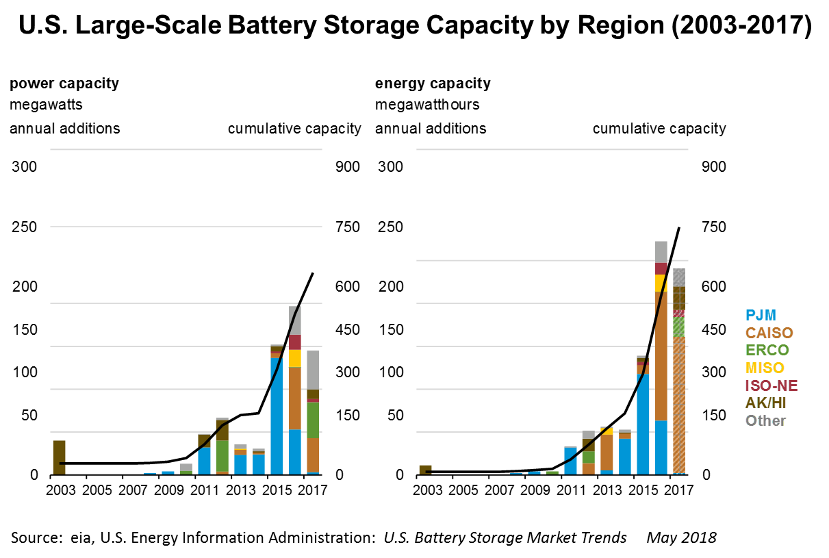
Battery Presentation - Introduction
The Batteries will be here soon

Slide 3
Battery Presentation – BESS Opportunities
Commercial and Residential Customers
  Demand Charge Reduction
  Power cost arbitrage
  Non-monetary benefits
  Resilience
  Reliability
  Renewable energy ride-through
Utility Customers
  Avoid/delay Transmission and Distribution (T&D) upgrades
  Frequency Response
  Voltage Support
  Renewable energy ride through

Slide 4
Battery Presentation – BESS Operation
Charge At Night
  Low price kWh
  Off-peak demand
  Typically charge at 25% of discharge rate
Discharge At Peak
  Instant response
  No ramp time, no minimum dispatch time
  Typical discharge is 100% to 50% of capacity
  1 MWh BESS discharge
    500 kW for 2 hours
    1000 kW for 1 hour
    Higher discharge rates
    125 kW for 8 hours

Slide 5
Battery Presentation – ERS TRSOW
Charge At Night
  Low price kWh
  Off-peak demand
  Typically charge at 25% of discharge rate
Discharge At Peak
  Instant response
  No ramp time, no minimum dispatch time
  Typical discharge is 100% to 50% of capacity
  1 MWh BESS discharge
    500 kW for 2 hours
    1000 kW for 1 hour
    Higher discharge rates
    125 kW for 8 hours

Slide 6
Battery Presentation – ERS Deployment History

Slide 7
Battery Presentation – ERS Deployment Req 1
TSROW – Section 15.6
For purposes of this section, deployment obligation time is the cumulative time during the Sustained Response Period of an event during which an ERS Resource has an obligation. Deployment obligation time does not include the ramp time. An ERS Resource shall be subject to a maximum of eight hours of cumulative deployment obligation time per ERS Contract Period, except that for ERS Resources that did not exhaust their obligations in a previous ERS Contract Period within the same ERS Standard Contract Term, the maximum deployment obligation time shall be the remaining deployment obligation time from the previous ERS Contract Period consistent with the Protocols, Section 3.14.3.3, Emergency Response Service Provision and Technical Requirements.

Slide 8
Battery Presentation – ERS Time Req 2
  TSROW – Section 15.7
  Notwithstanding the paragraph above, the following shall apply;
    For a Non-Weather-Sensitive ERS Resource, if an ERS deployment is still in effect when the ERS Resource’s cumulative deployment obligation time equals or exceeds eight hours, the ERS Resource must continue to meet its event performance requirements for the next four hours or until ERCOT releases the ERS Resource, whichever comes first.
    For a Weather-Sensitive ERS Resource, the following shall apply:
      The maximum number of deployment events during an ERS Standard Contract Term shall be equal to two times the number of months of Weather-Sensitive obligation in the ERS Standard Contract Term.
      The duration of a Weather-Sensitive ERS Load’s deployment obligation time for a single event shall be a maximum of three hours.
      If an ERS deployment is still in effect when the Weather-Sensitive ERS Resource’s cumulative deployment obligation time equals or exceeds eight hours, the ERS Resource must continue to meet its event performance requirements until the three hour maximum deployment obligation time for that event is met or ERCOT releases the ERS Load, whichever comes first.

Slide 9
Battery Presentation – ERS Time Conflict
  BESS in ERS would be required to operate 8 hours as Non-Weather Sensitive
    1 MWh Battery = 125 kW for 8 hours
  This discourages BESS participation in ERS

Slide 10
Battery Presentation – Deployment Options
  Option 1:
    Treat BESS in ERS the same as Weather Sensitive
    1 MWh Battery = 333 kW for 3 hours
  Option 2:
    Reset ERS time limit in Section 15.7 to less than 8 hours for all
  Option 3:
    Set ERS time limit for BESS to 1 hour
  Option 4:
    Limit BESS deployment to duration equal to Time Period in which it is offered

Slide 11
Battery Presentation – Conclusion
  Next Steps
    BESS needs to be defined in ERCOT
    Protocol revision required for ERS timing issue
    RARF Workbook for BESS?
  Other?
  END

