Slide 1
AS Offers Structure Under RTC
Hailong Hui
April 30, 2019

Slide 2
Why Change AS Offers for RTC?
Follow today’s linked AS Offer structure to minimize system changes
NPRR 863 AS Offer change will flow into RTC
Other AS Offer changes related to RTC

Slide 3
Today’s AS Offers
Resource specific and submitted by QSE
Must be qualified for specific AS type to submit specific AS Offer
Price floor is $0 per MW
Price cap is SWCAP
MW floor is 0.1 MW
MW cap for fixed quantity block offered by Non-Controllable Load Resources (NCLRs) is150 MW
Submission window starting at 14 days before the Operating Day
Submission window ending at the end of Adjustment Period
Linked AS offers among different AS type
Inclusive or exclusive of Energy Offer Curves (indicated in Energy Offer Curves submission)

Slide 4
Today’s AS Offer Structure
A set of data applicable to the entire submission:
QSE short name
­Resource ID (includes mode/configuration)
­Combined cycle plant name (required for combined cycle Resources only)
­Non-Controllable Load flag (true/false indicating UFR or CLR, required for Load Resources only)
­Expiration date/time
One or more sets of data applicable to separate periods of time in the day:
Start date/hour
End date/hour
Up to 5 capacity amounts (in MW) for an AS category (“Online Reserves” - includes RRS, Reg-Up, Online Non-spin; “Regulation-Down”; and “Non-Spin Offline” – Resources must be qualified to provide the AS type, and Load Resources qualified for Non-Spin cannot submit Non-Spin Offline)
A price associated with each AS type for each capacity amount, if offered for that capacity
Fixed/variable quantity block indicator, for each capacity amount (only Load Resources can indicate fixed)
Multi-hour indicator
Source: Market Submission Validation Rules V1.0 (ERCOT MIS Secure Area)

Slide 5
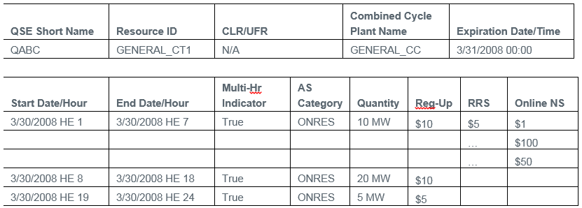
An Example of Today’s AS Offer
AS Category must be ONRES, REGDN or OFFNS
Source: Market Submission Validation Rules V1.0 (ERCOT MIS Secure Area)

Slide 6
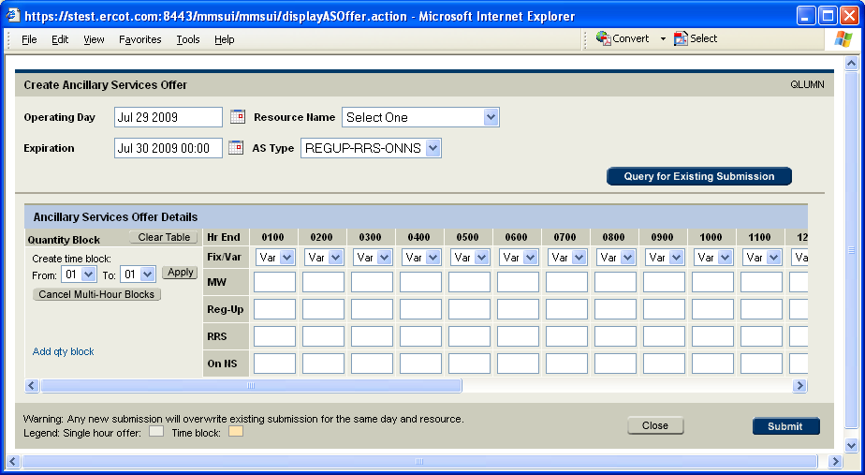
Market Manager - Create Ancillary Services Offer
Source: Market Manager User Guide V0.08 (ercot.com)

Slide 7
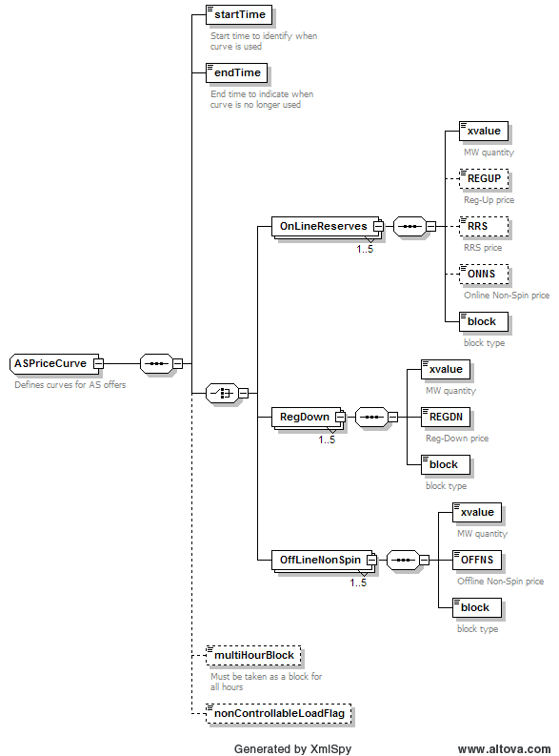
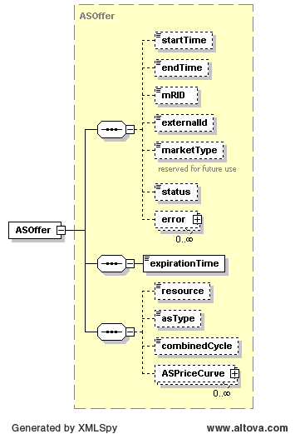
Today’s AS Offer Structure (XML)
Source: EIP External Interfaces Specification v1.20L(ercot.com)

Slide 8
NPRR 863 Changes to AS Offers
ECRS can be provided from online and offline generators and Load Resources.
Only QSGR with OFFQS Resource status can provide ECRS when physically offline.
NPRR 863 changes to today’s AS Offers:
Add ECRS in the “Online Reserves” category: link ECRS with REGUP, RRS and Online Non-Spin.
Change the name of current “Non-Spin Offline” category to “Offline Reserves” category, add “OFFQS ECRS” in this category and link it with offline Non-Spin.
Only QSGR can submit OFFQS ECRS AS Offer.
QSGR can submit OFFQS ECRS and/or offline Non-Spin AS Offer in DAM and get awarded without being committed by DAM; this is similar to today’s offline Non-Spin offers.

Slide 9
AS Offers Changes Under RTC
Recommend AS Offers are always inclusive with Energy Offer Curve in RTC.
Recommend default AS Offer linking.
For the same offered capacity MW, assume the price offered in higher AS type can be automatically used for the non-offered lower AS type.
This will increase offer liquidity and solution space for both DAM and RTC.
Recommend AS Offer submission window same as EOC.
The AS Offer submission window does not necessarily need to be extended to the end of Operating Period instead of current end of Adjustment Period.
The current window for Energy Offer Curves is end of Adjustment Period.
QSGR provide OFFQS ECRS in RTC.
Only QSGR with OFFQS Resource status can provide OFFQS ECRS in RTC.
The OFFQS unit will be treated as online in RTC and can get both Base Points and OFFQS ECRS awards.

Slide 10
Questions

