Slide 1
Load Frequency Control (LFC) Changes Under RTC
Sai Moorty
Principal, Market Design and Analysis
April 30, 2019

Slide 2
Overview
Problem Statement:
“Identify changes, if any, required for LFC under RTC.”
Identify scenario(s) where LFC changes are appropriate
Real-Time Market timeline
Regulation related calculations in RTC
Explanation of Updated Desired Base Point (UDBP) and Regulation Deployment
Two extreme scenarios and potential solutions
Scenario 1: Reg-Up responsibility change to zero
Scenario 2: Reg-Up responsibility change >0
Summary and next steps

Slide 3
Load Frequency Control (LFC) Under RTC
So far, ERCOT has identified a couple of scenarios under RTC where changes to LFC may be appropriate.
Under RTC, based on economics and system conditions, Regulation Up/Down Awards to a Resource can be different for each RTC run (which normally runs every 5 minutes).
The change of Regulation responsibility across the hour boundary that occurs in today’s Real-Time Market (RTM) is similar to what would occur under RTC.
Two extreme scenarios are presented and proposals for changes to LFC presented.
f₆₀
Telemetry Snapshot
Base Points
Raw ACE
QSE 1
+
Filt. ACE
f_{actual}
Allocate
Reg
_
-10*Bias
Filter
Regulation
Required
UDBP Calc
QSE 2
QSE n
LFC block diagram

Slide 4
Real-Time Market Timeline – Today
Less impacted by renewable Resource variability
Less impacted by forecast errors (load, wind, solar)
Ability to economically dispatch RRS and still meet reliability timelines
Uniquely different than other ISOs where Base Points and LMPs are binding starting at least 5 minutes into the future
SCED Inputs@11:00:05
Telemetry Snapshot
Offers
GTBD
SCED Base Points, LMP Binding till next SCED Run
SCED Run
SCED Run
LFC Inputs@11:00:20
Telemetry Snapshot
Frequency
Base Points
LFC
4s
11:00:20
11:00:24
11:00:05
11:05:05
Time

Slide 5
Real-Time Market Timeline – No Change Under RTC
Takeaway: Retain benefits of current timeline. RTC does not change the timeline (i.e., LMP, Base Point, AS Awards, MCPCs are binding immediately after RTC is finished).
RTC Inputs@11:00:05
Telemetry Snapshot
Offers
GTBD
RTC Base Points, LMP, AS Awards, AS MCPCs
Binding till next RTC Run
RTC Run
RTC Run
LFC Inputs@11:00:20
Telemetry Snapshot
Frequency
Base Points
LFC
4s
11:00:20
11:00:24
11:00:05
11:05:05
Time

Slide 6
Real-Time Market Timeline (Cont.)
QSE systems receiving Reg. Awards and Reg. instructions
Takeaway: QSEs control systems can get Regulation Awards and Regulation instructions simultaneously. In extreme cases, they may get Regulation instructions before receiving Regulation Awards (orders of milli-seconds to seconds latency between receiving Reg. Awards and Reg. instructions).
QSE 1
SCED
LFC/RLC
ICCP
QSE 2
Interface
Market DB
EMS AppDB
SCADA DB
QSE n
QSE 1
Interface
XML I/F
QSE 2
MIS DB
QSE n
6

Slide 7
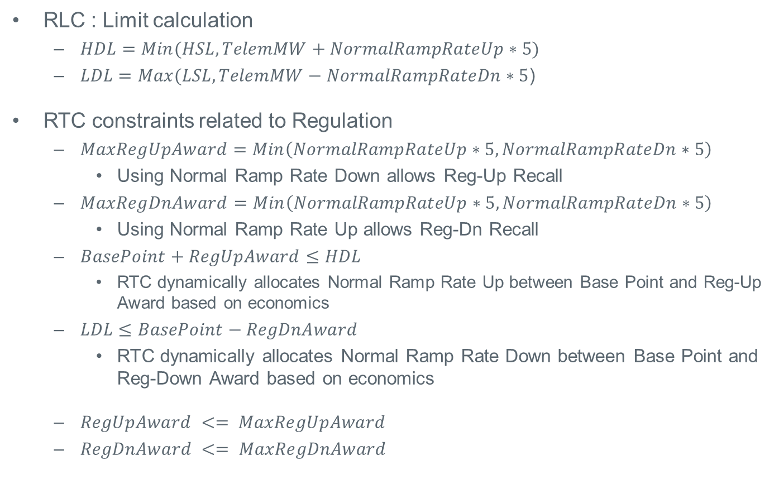
Regulation Related Calculations Under RTC
RLC : Limit calculation
$HDL=Min(HSL,TelemMW+NormalRampRateUp∗5)$
$LDL=Max(LSL,TelemMW−NormalRampRateDn∗5$)
RTC constraints related to Regulation
$MaxRegUpAward=Min\left(NormalRampRateUp∗5,NormalRampRateDn∗5\right)$
Using Normal Ramp Rate Down allows Reg-Up Recall
$MaxRegDnAward=Min\left(NormalRampRateUp∗5,NormalRampRateDn∗5\right)$
Using Normal Ramp Rate Up allows Reg-Dn Recall
$BasePoint+RegUpAward≤HDL$
RTC dynamically allocates Normal Ramp Rate Up between Base Point and Reg-Up Award based on economics
$LDL≤BasePoint−RegDnAward$
RTC dynamically allocates Normal Ramp Rate Down between Base Point and Reg-Down Award based on economics
$RegUpAward <= MaxRegUpAward$
$RegDnAward <= MaxRegDnAward$

Slide 8
Updated Desired Base Point (UDBP) and Regulation Deployment
UDBP is a Resource-specific tracking signal for Resources to ramp to new Base Points
It is a 4-minute ramp starting from previous Base Point and ending at the next Base Point
The UDBP ramp is calculated whenever new results of SCED are input to LFC (normally every 5 minutes)
Every LFC cycle (4 seconds), ERCOT sends QSEs the Resource-specific UDBP and QSE portfolio level Regulation instruction
QSE system distributes its QSE portfolio level Regulation instruction among its Resources providing Regulation (Resource Regulation instruction)
The Resource control system MW Set-Point for any instant of time (t) is :
Resource Set-Point(t) = UDBP(t)+ Resource Regulation Instruction(t)
BP@SCED 11:00
UDBP
BP@SCED 10:55
SCED@11:00
Time
11:00
11:05
ERCOT LFC tracks the expected response of a Resource using its UDBP(t) and Resource allocation of QSE Regulation Instruction(t) based on Resource Participation Factors telemetered by QSE

Slide 9
Scenario 1: RegUp Responsibility Change to Zero
RegUp Instruction
HSL, HASL
RegUp Instruction
HSL, HASL
RegUp Instruction
RegUp Instruction
RegUp Instruction
HSL, HASL
HSL, HASL
HSL, HASL
HSL, HASL
HSL, HASL
HSL
HSL, HASL
HSL
HSL
HSL
HSL
HSL
HSL
HSL
After SCED@11:00, MW output ramps down and then increases as the Resource control system tracks UDBP
Unnecessary MW movement
Potential loss of revenue
MW output (tracking UDBP + Reg Instruction)
BP@SCED 11:00
MW output (tracking UDBP + Reg Instruction)
BP@SCED 11:00
RegUp
Resp.
BP@SCED 11:00
RegUp
Resp.
RegUp
Resp.
RegUp
Resp.
RegUp
Resp.
RegUp
Resp.
RegUp
Resp.
RegUp
Resp.
MW output (tracking UDBP + Reg Instruction)
UDBP
UDBP
HASL
BP@SCED 10:55
BP@SCED 10:55
BP@SCED 10:55
BP@SCED 10:55
BP@SCED 10:55
BP@SCED 10:55
HASL
BP@SCED 10:55
HASL
HASL
HASL
HASL
HASL
HASL
UDBP
UDBP
UDBP
UDBP
SCED@11:00
SCED@11:00
SCED@11:00
Time
Time
Time
Time
Time
Time
Time
Time
11:00
11:05
11:05
11:05
11:05
11:05
11:05
11:05
11:00
11:05
11:00
11:00
11:00
11:00
11:00
11:00
Issue is that the starting point of UDBP ramp is previous Base Point and does not consider the fact that with Regulation instruction, the Resource’s expected MW could be far away from previous Base Point

Slide 10
Potential Changes Under Consideration For RTC
Replace Resource-specific tracking signal UDBP with “Updated Desired Gen (UDG)”
UDG for a Resource from ERCOT LFC (@time t):
UDG(t) = Base Ramp(t) + Resource Specific Regulation Instruction(t)
UDBP(t) and UDG(t) are same for Resource with no Regulation responsibility
HSL
RegUp Instruction
UDG
BP@ 11:00
RegUp
Resp.
UDBP
BP@ 10:55
Time
11:00
11:05
What is Base Ramp?
Like UDBP:
Is a 4-minute ramp to a new Base Point
Ending MW point of Base Ramp is the next RTC Base Point
Differs from UDBP only in the starting MW point for the ramp
Starting MW point of Base Ramp is the expected MW output from Resource at the time new Base Points are received. It is the sum of:
Previous RTC Base Point
Last LFC (t-1) Regulation-Up/Down instruction
A new Base Ramp is computed whenever new Base Points from RTC are input to LFC

Slide 11
Scenario 2: RegUp Responsibility Change > Zero
After SCED@11:00, LFC Regulation instruction not feasible because, when added to current MW output, it exceeds the HSL limit of Resource
Eventually, Resource able to provide requested Regulation instruction as MW output ramps down to next Base Point
Issue is that in determining the QSE level Regulation instruction, does not consider available room (HSL-expected MW output) for Reg-Up and (expected MW – LSL) for Reg-Dn
RegUp Instruction
RegUp Instruction
MW output (tracking UDBP + Reg Instruction)
MW output (tracking UDBP + Reg Instruction)
MW output (tracking UDBP + Reg Instruction)
MW output (tracking UDBP + Reg Instruction)
HSL
HSL
HSL
HSL
HSL
HSL
HSL
HSL,HASL
HSL
HSL,HASL
HSL,HASL
HSL,HASL
HSL,HASL
HSL,HASL
HSL,HASL
HSL,HASL
UDBP
UDBP
UDBP
UDBP
UDBP
UDBP
RegUp
Resp.
RegUp
Resp.
RegUp
Resp.
RegUp
Resp.
RegUp
Resp.
RegUp
Resp.
RegUp
Resp.
RegUp
Resp.
BP@SCED 10:55
BP@SCED 10:55
BP@SCED 10:55
BP@SCED 10:55
BP@SCED 10:55
BP@SCED 10:55
BP@SCED 10:55
HASL
HASL
HASL
HASL
HASL
HASL
HASL
HASL
BP@SCED 11:00
BP@SCED 11:00
BP@SCED 11:00
SCED@11:00
BP@SCED 11:00
SCED@11:00
SCED@11:00
SCED@11:00
11:05
Time
Time
11:05
Time
11:05
11:05
11:05
Time
11:00
Time
11:00
11:00
11:00
11:00
11:00
11:00
11:00
11:05
11:05
11:05
Time
Time
Time

Slide 12
Potential Changes Under Consideration For RTC (Cont.)
Some combination of:
Modify process in LFC that allocates system wide Regulation instruction to Resources by:
Accounting for available room on Resources (HSL(t) - Base Ramp(t)) for Reg-Up and (Base Ramp (t) – LSL) for Reg-Dn
After above step, reallocate any remaining Regulation Instructions on Resources still having available room
Adjust Regulation instruction considering UDG, or reset Regulation instruction to zero when LFC gets new outputs from RTC (Base Points, AS Awards)
HSL
UDG
Base Ramp
RegUp Instruction
RegUp
Resp..
BP 10:55
BP@ 11:00
11:00
11:05
Time

Slide 13
Reg-Up Award Change and its Deployment Under RTC
Scenario 1: Reg-Up Responsibility Change to Zero
RegUp Instruction
HSL, HASL
RegUp Instruction
UDG
HSL
HSL
BP@SCED 11:00
MW output (tracking UDG)
BP@RTC 11:00
RegUp
Resp.
MW output (tracking UDBP + Reg Instruction)
RegUp
Award
UDBP
BP@SCED 10:55
BP@RTC 10:55
HASL
Base Ramp
SCED@11:00
RTC@11:00
Time
Time
11:00
11:05
11:00
11:05
Scenario 2: RegUp Responsibility Change > Zero
RegUp Instruction
MW output
(tracking UDG)
MW output (tracking UDBP + Reg Instruction)
UDG
HSL,HASL
HSL
HSL
UDBP
RegUp
Resp.
Base Ramp
RegUp Instruction
RegUp
Award.
BP@SCED 10:55
BP@RTC 10:55
HASL
BP@RTC 11:00
HASL
SCED@11:00
BP@SCED 11:00
RTC@11:00
11:00
11:00
11:05
11:05
Time
Time

Slide 14
Summary and Next Steps
Summary
Presented proposal on changes to LFC
Change ERCOT LFC Regulation instruction from QSE portfolio level to Resource-specific
Next steps
ERCOT will continue examining additional scenarios and refine proposal to change LFC
Feedback requested on additional scenarios to examine
Feedback requested on proposed changes to LFC or other alternative proposals

Slide 15
Discussion

