Slide 1
Fuel Index Price Data Comparisons
Ino González
Principal, Market Accounting and Settlements
WMWG
April 22, 2019

Slide 2
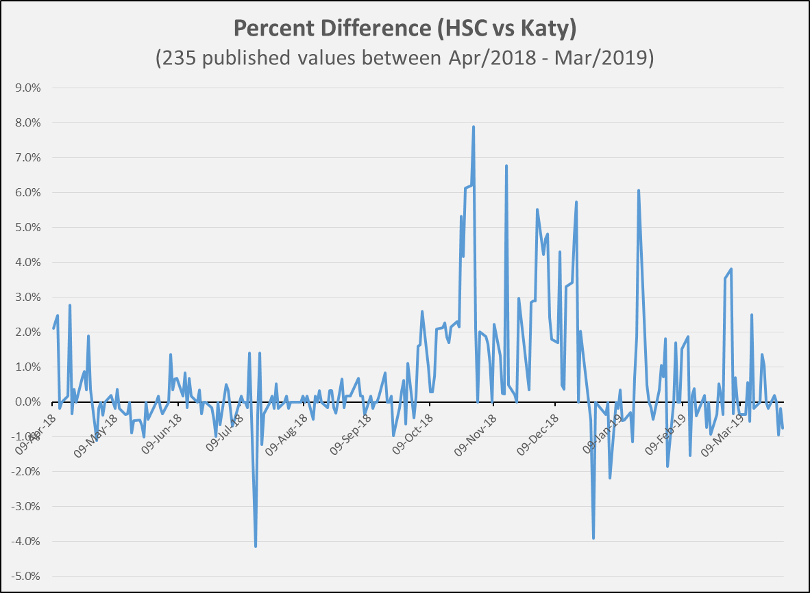
HSC vs Katy Price Differences

Slide 3
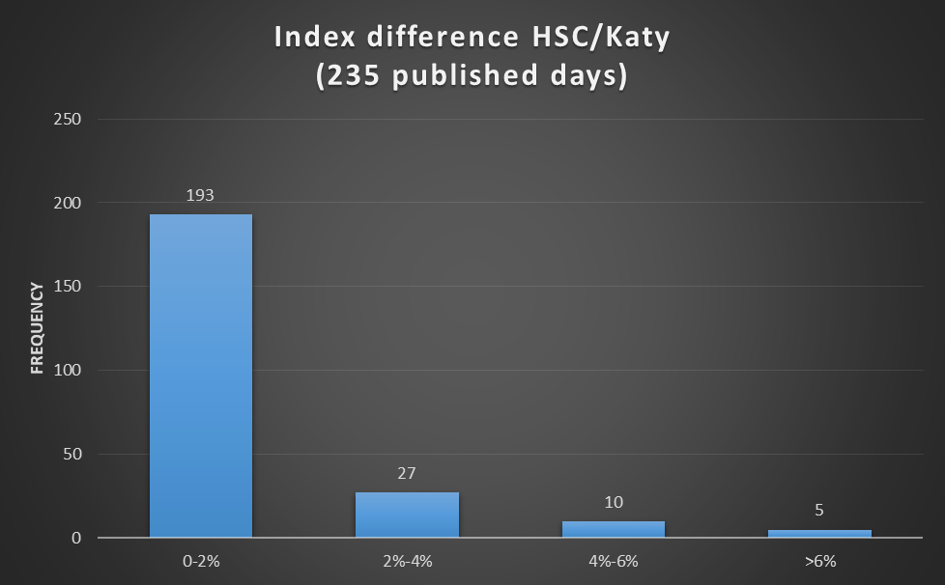
HSC vs Katy Price Difference Frequency Distribution

Slide 4
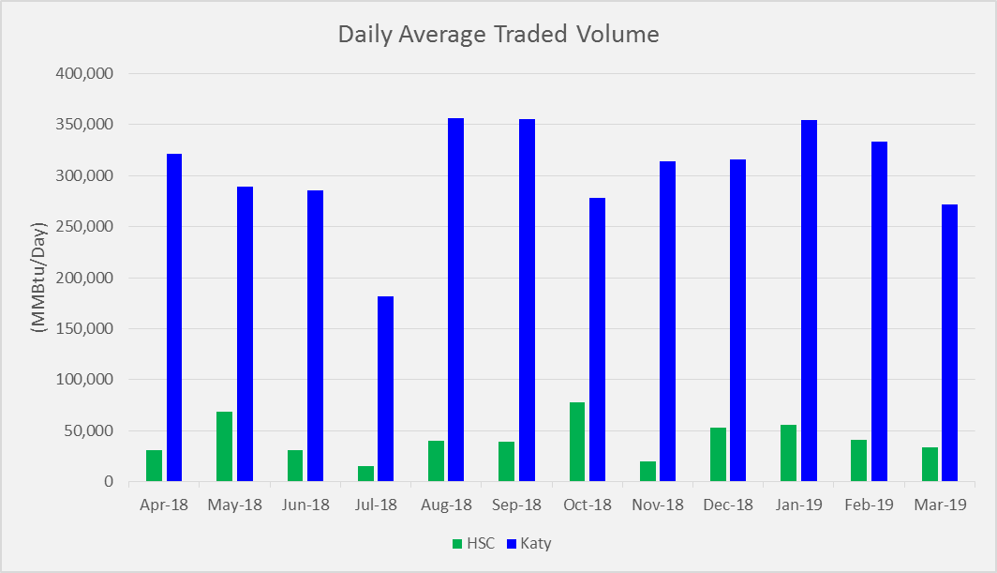
HSC vs Katy Volume Comparison

Slide 5

HSC Total Days Without Published Price

Slide 6

Alternative Options for Natural Gas Index Prices
Another Price Index reflecting Central Texas Natural Gas prices
NGPL, TexOk zone (daily and bid week)
Includes deliveries into Natural Gas Pipe Line from the Texas-Louisiana border in Jefferson County, Texas, to Montgomery County, Texas. The zone also includes the line segment to Cass County, Texas, and to Carter County, Oklahoma. NGPL’s Gulf Coast pooling point is included.

Slide 7
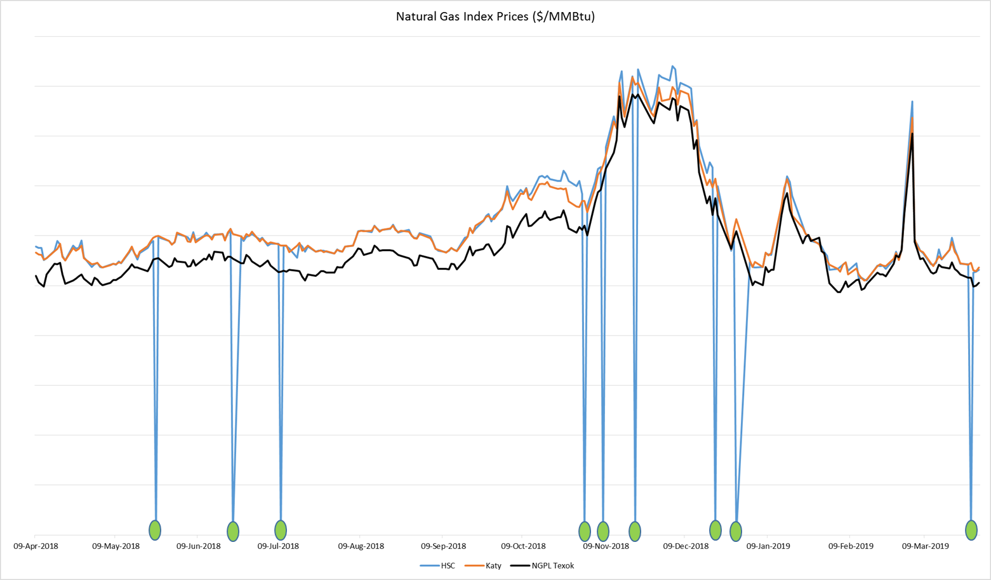

HSC vs Katy vs NGPL TexOk Price Distribution

Slide 8
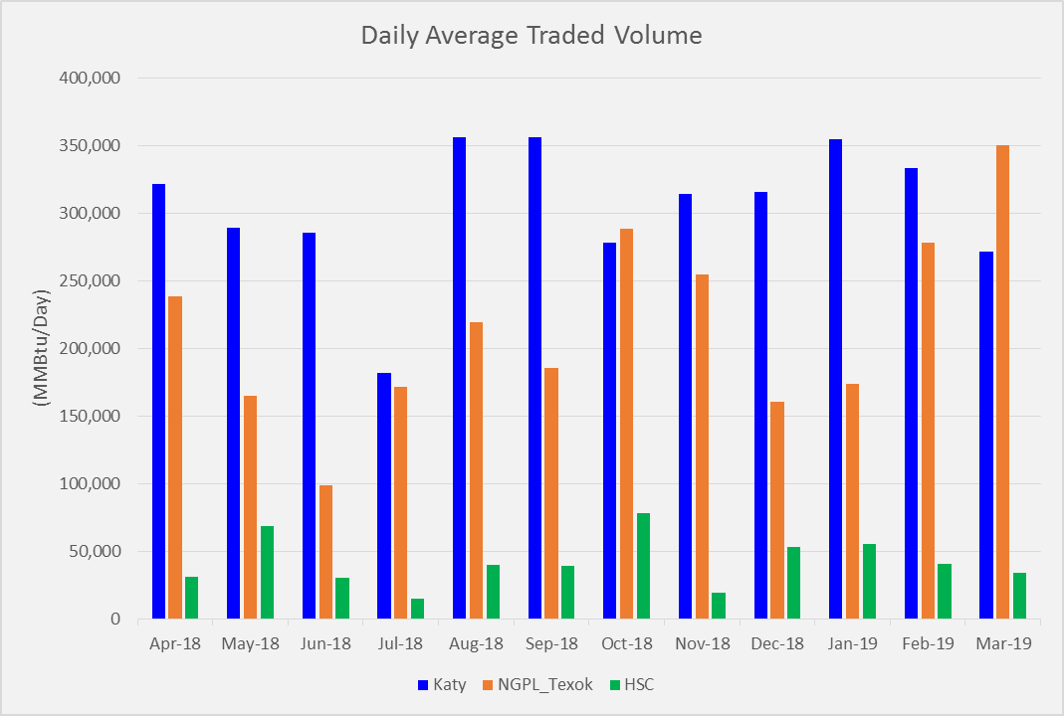
HSC vs Katy vs TexOk Volume Comparison

Slide 9
Questions?
Notes:
https://castaylor.ercot.com/owa/redir.aspx?C=oPhl4_Wz9UCI7oVqJkGdaM-P4-MvhtMIRAMJFZ7-K5eOg6lo6esBMUiebAbXd4c8z8FTPzV8g8A.&URL=https%3a%2f%2ftheconversation.com%2fwhen-will-rooftop-solar-be-cheaper-than-the-grid-heres-a-map-54789%3futm_source%3dtwitter%26utm_medium%3dreferral%26utm_campaign%3dUTAustinNews
http://www.vox.com/2015/6/19/8808545/wind-solar-grid-integration
http://greeningthegrid.org/quick-reads
https://ec.europa.eu/energy/intelligent/projects/en/projects/pv-grid
http://energy.gov/eere/sunshot/systems-integration

