Slide 1
Visualizing Energy Storage Resources
Joel Koepke
Manager, Grid Coordination – Applications and Development

Slide 2
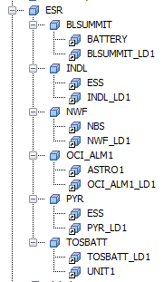
Current Energy Storage Resource: Generator + Load
Energy Storage Resources do not currently exist in the Energy Management System (EMS).
  Basic functionality is accomplished using a:
    Generator (discharging) and a
    Controllable Load Resource (charging)
ERCOT will effectively combine these two instances to create an ESR
New telemetry points and existing points from the Generator and Load will be available for calculation and display purposes
To facilitate initial display creation, ERCOT will combine telemetry from Load and Generator instances

Slide 3
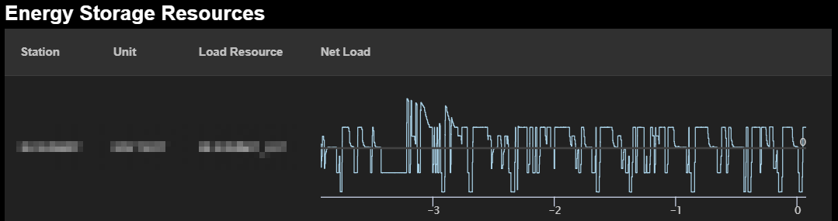
Current Visibility – Charging/Discharging Over Time
With current Load and Generator telemetry, ERCOT can determine if the ESR is charging or discharging.

Slide 4
Near Term Displays – State of Charge (at POI) Over Time
With minimum, maximum, and current state of charge telemetry points, Operators can visualize the ESRs current charge with respect to the charging range.

Slide 5
Near Term Displays – Charge/Discharge Duration
MXDP – Maximum Operating Discharge Power Limit
MXCP – Maximum Operating Charge Power Limit
The Charge/Discharge chart gives ERCOT visibility of the potential charging or discharging rates over time.

Slide 6
Near Term Displays – Charge/Discharge Duration
Min. Discharge Time
Min. Charge Time
With the current state of charge and the maximum discharge/charge rates, ERCOT can calculate the minimum times to reach MXOS and MNOS.

Slide 7
Near Term Displays – Charge/Discharge Duration
Max Discharge Rate for 15 min.
Max Charge Rate for 15 min.
With the current state of charge, ERCOT can calculate maximum charging and discharge rates for any duration.

